Slide 1
THE EMERGENCY FOOD
ASSISTANCE PROGRAM TRAINING
Presented by the Food Distribution Unit:
Vincent Schenck
May 15, 2019
California Department of Social Services

Slide 2
What is TEFAP?
Sacramento
Washington DC
Flow of food throughout the United States
Notes:
The Emergency Food Assistance Program
Federal program provided by the USDA
Commodities
Purchased by the USDA in Washington D.C
Transported to CALIFORNIA

Slide 3




HISTORY AND FACTS
When were food programs first introduced in the United States?
Which President Enacted the EFAP program?
What was the first commonly known “government commodity”?
Notes:
When were food programs first introduced in the United States?
1930’s
USDA Foods program began in the early 1930’s
Designed to shore up farm prices
Help American farmers suffering from the economic upheaval of the Great Depression
Which President Enacted the EFAP program,
President Reagan, est. 1981
Supplement the diets of low-income Americans,
including elderly people
3. What was the first commonly known “government commodity”?
Government Cheese

Slide 4
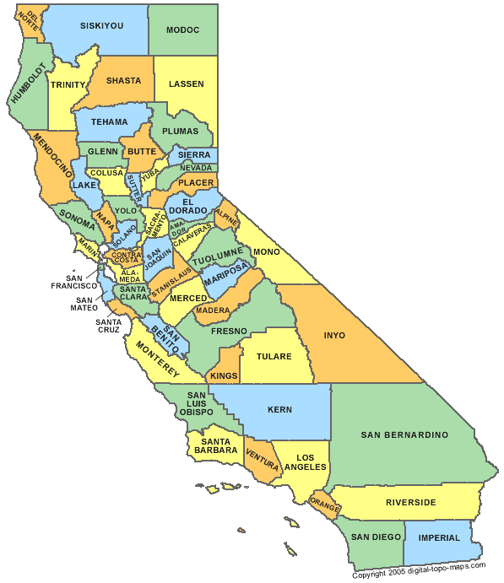
California Department of Social Services (CDSS)
Oversees at State level
48 Food Banks/58 Counties
1.1 million plus people served monthly in CA
Supplement nutrition
Notes:
CDSS oversees the program within California
48 food banks that provide the EFAP program to 58 counties
Approximately 1.1 million people served MONTHLY by EFAP
REMINDER EFAP is a supplemental food program

Slide 5

EFAP Requirements
TEFAP POLICY AND PROCEDURE MANUAL
http://www.cdss.ca.gov/inforesources/EFAP/Regulations-and-Policy-Guidance
Notes:
The EFAP program follows USDA regulations
The State of California also has an EFAP procedure manual (updated 2018)
This presentation explains the necessary guidelines to comply with the regulations

Slide 6

AGREEMENTS –LOCAL FOOD BANKS
Notes:
California partners with Food Banks
Distribute throughout California
Food Banks have agreements with the State
Those food Banks then in turn have agreements with their sub sites like pantries
Sub sites must have a Current EFAP site agreement on file with THE FOOD BANK
A site agreement may not be necessary
If does not store food
manage the distribution (managed by the Food Bank itself)

Slide 7

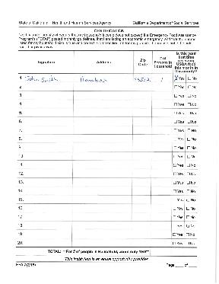
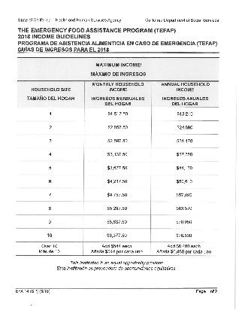
Required Signage and Forms (§ 7.5)
EFA-7
Income Guidelines
Notes:
Required Signage and Forms at EFAP distributions
Clearly Posted at sign in table
EFA-7 Sign in sheet
The And Justice for All Poster
The income guidelines

Slide 8
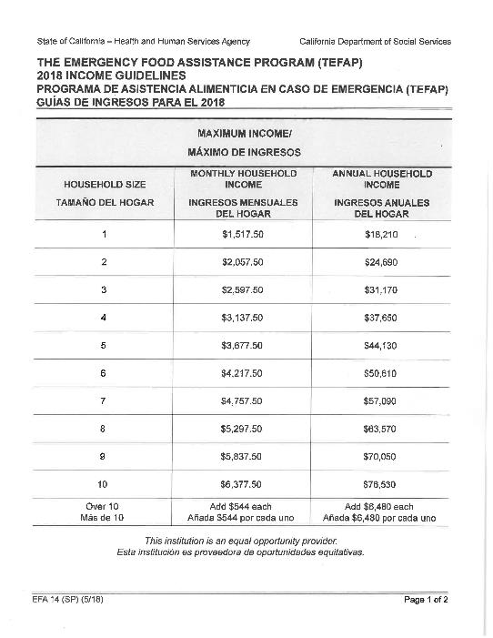
Program Eligibility/Income Guidelines (section 6.3)
Income within the guidelines 2017 INCOME GUIDELINES
Monthly or Annual Income
Only required to self-certify - May not be asked for proof of income, no SS# and etc.
2018 Form update Spanish and English **
Notes:
To qualify for EFAP program :
Recipients meet income guidelines
Based on monthly or annual income
MAY NOT BE ASKED FOR PROOF OF INCOME OR SSN
**Beginning for 2018 (coming out in about April 2018) the Spanish and English versions will be available on one form.
Only “self certify” by signing the EFA-7 form,

Slide 9

Picking up Commodities for Others/Alternate Person Picking up
(section 6.5)
Notes:
Recipients may allow alternates to pick up

Slide 10
1
2
Must bring “Alternate Pick- up form” or signed note from recipient each distribution
Alternate can pick up for recipient
3
The site must attach form to EFA-7
Notes:
Alternate may to pick up for an eligible recipient.
One alternate can pick up for five persons only
An original alternate pick up form is required for every pick up
The alternate must bring either an “ALTERNATE PICK UP” form or a SIGNED NOTE from the recipient
The pick up form must be attached to the EFA-7

Slide 11
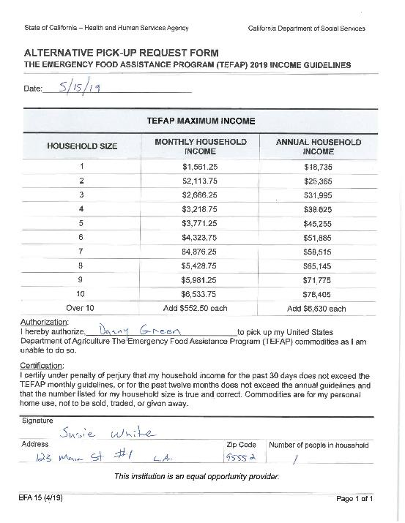
Alternate Pick up Form
Notes:
The recipient should fill in this form-
Include the date. An original form is required for every pick up (eff 2018)
Write Person’s name authorized to pick up
The eligible recipient must
sign the form,
Include address,
Include number in the household
THIS FORM IS ALSO AVAILABLE IN SPANISH

Slide 12
Alternate Signed Note
Date
Statement by recipient
Alternate’s name
Income eligible
Recipient’s signature
Notes:
The note needs to include:
Date
Statement from recipient authorizing alternate person to pick up
Alternate’s name
Statement that the recipient is income eligible
Recipient’s signature, address and number in the household

Slide 13
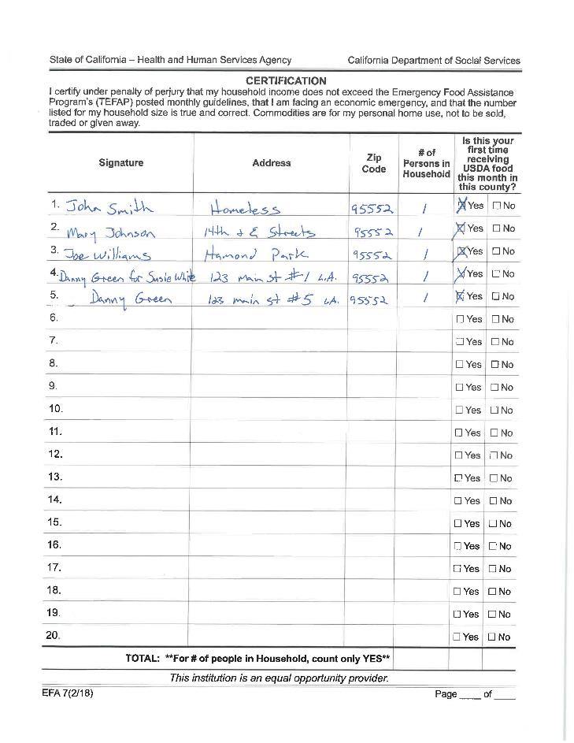
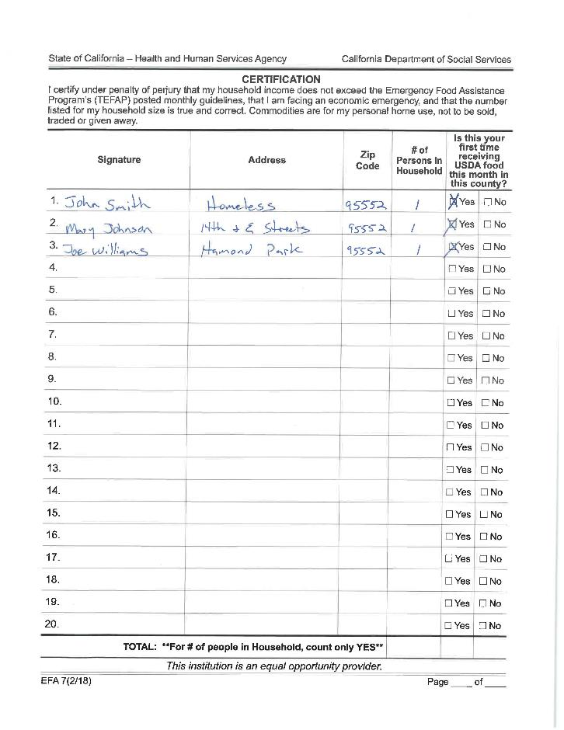
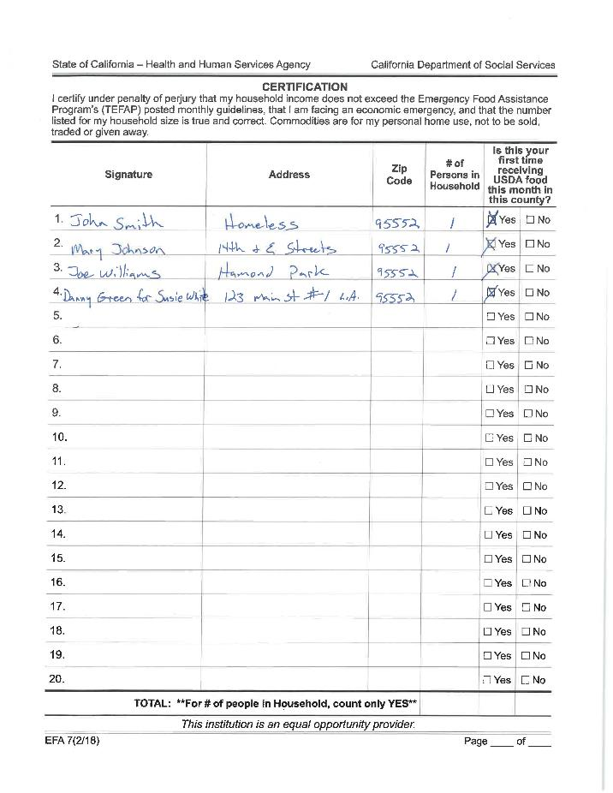
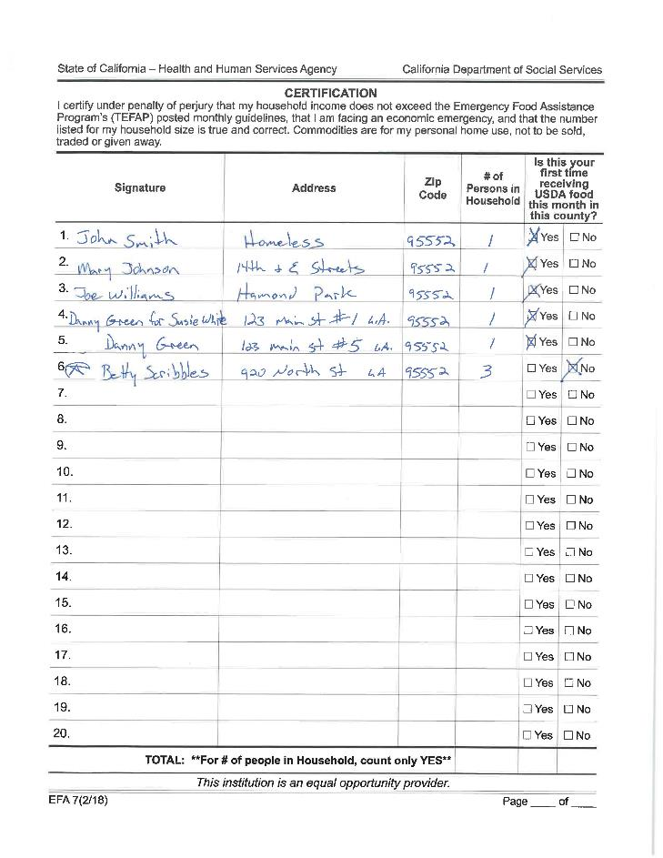
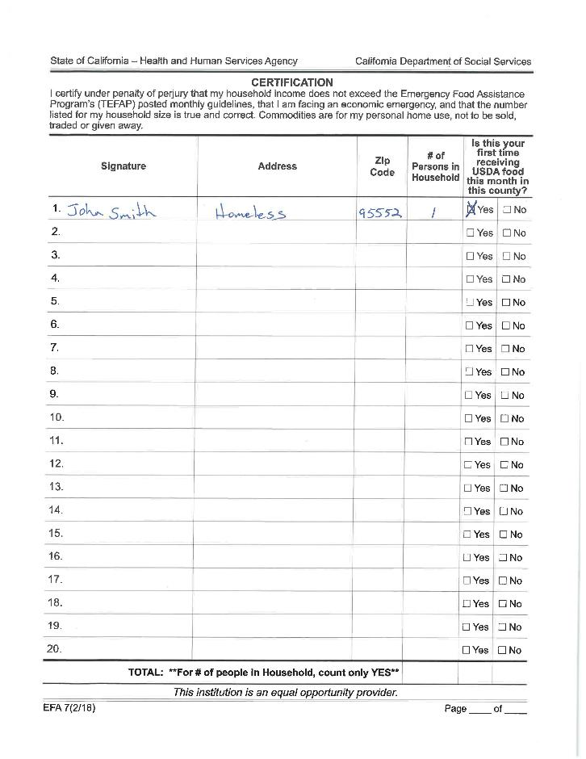
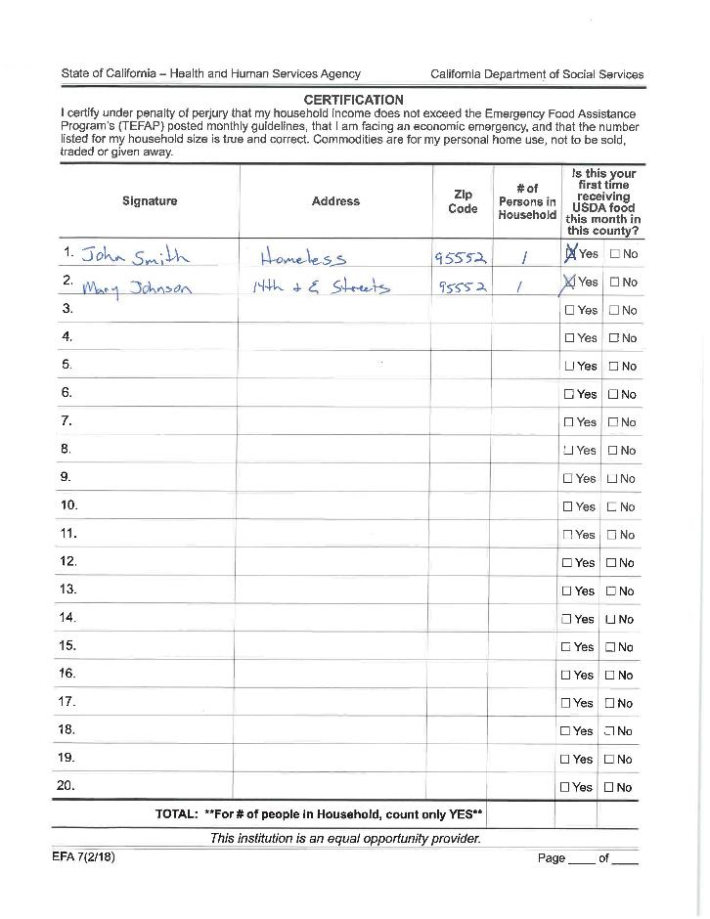
EFA – 7 Form
Notes:
Alternate should sign “John for Jane Doe”
Attach the Alternate Pick up form to the EFA-7 when completing

Slide 14
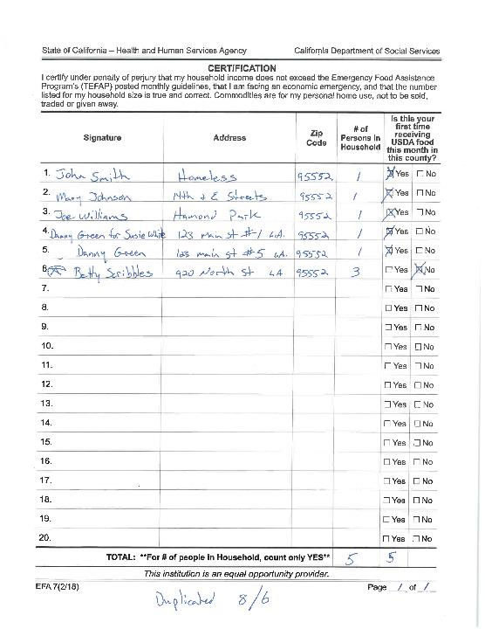
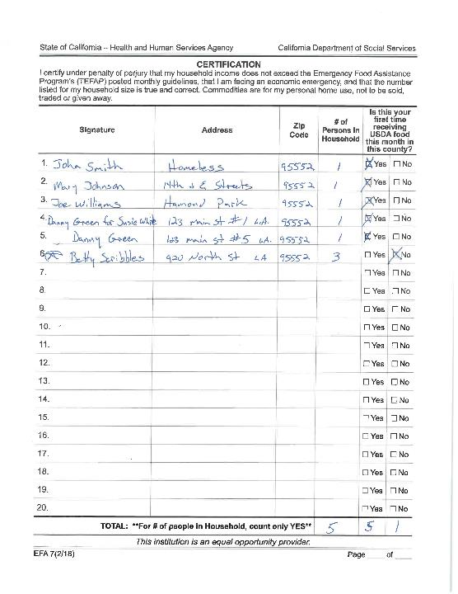

Slide 15

Residency (§6.4)
Should reside in area
If no proof, food may not be denied if they are willing to sign EFA-7
If out of the service area, serve and advise of their site in their area
Notes:
Persons should reside in the area.
May ask for proof of residence HOWEVER, should still serve them if willing to sign the EFA-7.
Can re-direct them to contact Food Bank for closer sites

Slide 16

Open to the Public (§ 7.2)
Must be open to the public
Prior permission for closed site
Notes:
The site must be open to everyone from the public unless the Food Bank has previously received permission from the State to operate as a closed site.

Slide 17

(10.2) Receipt and Distribution Procedure
Local food donations may be distributed with USDA commodities or in conjunction with other programs
Notes:
If the site requires an application for the donated foods, EFAP MUST be offered first by only self certification
The donated food may then be offered after

Slide 18


End of Distributions/Donations (§ 7.3)
Must distribute during advertised dates and times
A person must stay to inform recipients of other options if run out of food
  No type of payment
  MONETARY Donations CANNOT be solicited
Notes:
Must distributed during advertised dates and time and if run out must stay, no type of payment or donation requested.

Slide 19



Unrelated Activities religious, political, social (§ 7.7)
NOT during a distribution
Information not placed in TEFAP containers
NOT a condition to receive commodities
No disruption or delay
Notes:
Crosses, Bibles, signs, symbols are perfectly fine
Cannot require prayer or listening to political speeches to receive food
May pray before or after distribution or away from the line
May not disrupt or delay distribution

Slide 20

REQUIRED SIGNAGE AT FAITH BASED SITES
Notes:
Faith Bases Sites must have this additional signage posted

Slide 21
Written Notice of Beneficiary Rights
Notes:
Religious Sites must display
THE WRITTEN NOTICE OF BENEFICIARY RIGHTS
Near sign in form
Provides information about an alternate site for those not wanting to receive food at a religious site.
May just provide Food Bank info on the notice

Slide 22
Beneficiary Referral Request
Notes:
Religious Sites must have copies available of:
THE BENEFICIARY referral request
Contact information for Food Bank at top
Instruct the person to send the form to the contact
The food Bank can then provide an alternate location for pick up

Slide 23
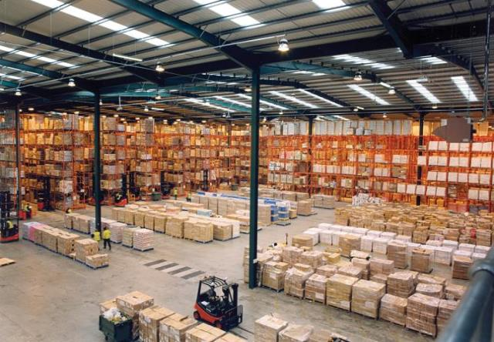
Storage
Notes:
IF A SITE STORES FOOD

Slide 24





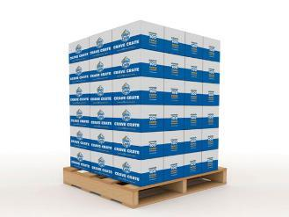
Storage
TEMP LOG &
Notes:
IF A SITE STORES FOOD
Storage must:
Be cleaned regularly
Use pro-active pest control measures
Stored at appropriate temps
Separate and Identified as USDA
Kept ideally 4-6’’ off the floor and 3’ from the wall
Storage of food should be locked
Repackaging of product not allowed

Slide 25

Inventory (§ 12)
No excessive inventory
No more than 2-3 months
FIFO method
Check the best if used by date
Notes:
Use FIFO - first in and first out method but regularly check the Best If Used By Date.

Slide 26

Reporting & Recordkeeping (§ 15)
Household numbers reported
EFA-7 kept for 3 years plus current year at the each site
or must be sent to LARFB
Notes:
Household participation numbers must be
Reported to Food Bank
Within ???? Days (depending on the FB’s requirement)
If maintaining original EFA-7
Must keep for three years plus the current year

Slide 27
Reporting & Recordkeeping (§ 15)
Inventory Report - report in CDMS due by the last day of the month following the month being reported.
Household Participation (HHP) and Congregate Feeding Participation (CFP) Report - report figures due by the last day of the month following the month being reported.
Notes:
For the FOOD BANKS ONLY
Food Banks must report the receipt and distribution of USDA commodities on a monthly basis into CDMS due by the last day of the month following the month being reported.
EX: December numbers are due by Jan 31
Food Banks must report participation figures on a monthly-basis due by the last day of the month following the month being reported.
Ex: December numbers are due by Jan 31

Slide 28


Civil Rights Training
Annually
Webinar
Checklist
In person
Tools
Effective January 2018
Notes:
Civil Rights training must be offered annually
Front line staff must take this annually
Non frontline every three years
The options are
Webinar
In person training
Checklists

Slide 29
Civil Rights Training
Records maintained
Certificates
Complaint logs
3 years
LARFB is keeping Civil Rights Training Checklist and Certificates. Complaint logs are kept at site with copy sent to LARFB. Complaints must be reported to LARFB within 24 hours.

Slide 30

Questions?

Slide 31
Contact Information
Vincent Schenck, FDU Consultant
Vincent.Schenck@dss.ca.gov
Don Williams, FDU Manager
Don.Williams@dss.ca.gov
Resources
To access the FDU website, please visit:
http://www.cdss.ca.gov/inforesources/EFAP

