Slide 1
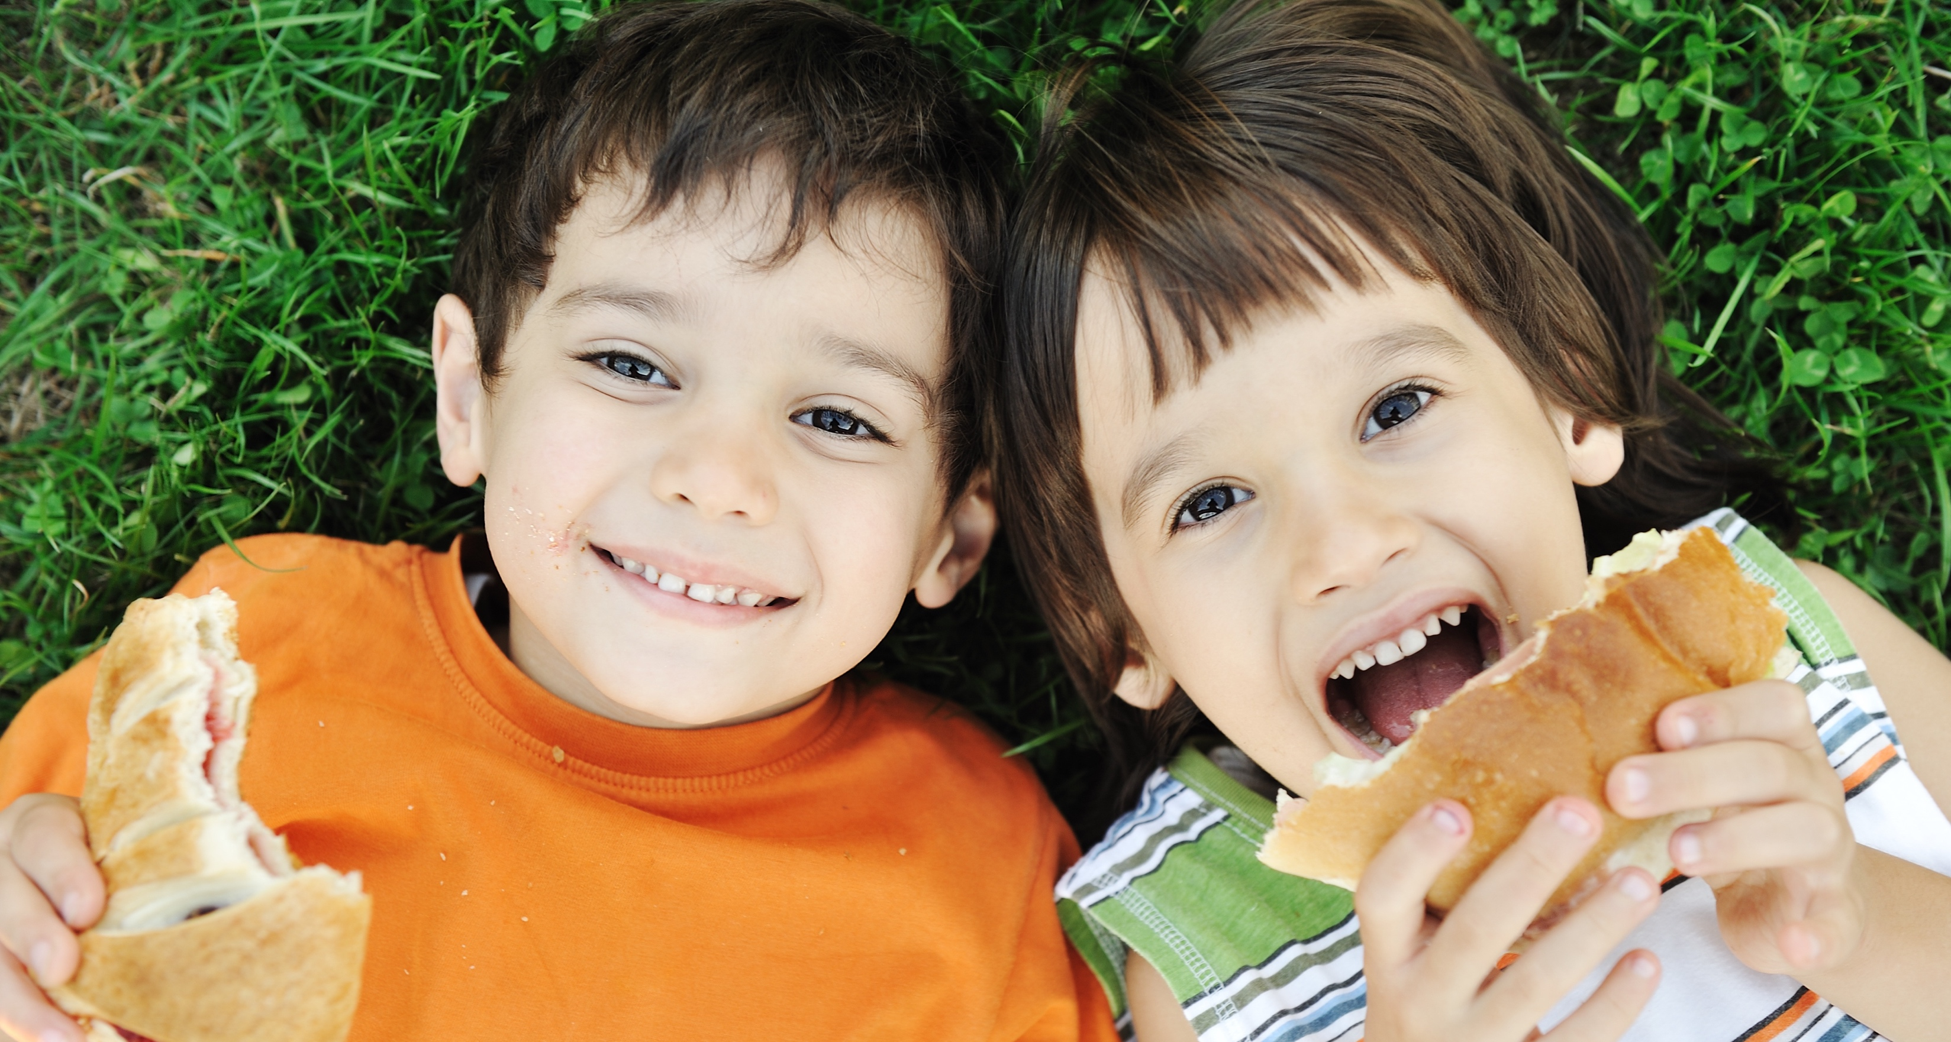
Utilizing Social Media for Agency Sustainability

Slide 2
Introductions
David May
Director of Marketing and Communications
Los Angeles Regional Food Bank
dmay@lafoodbank.org
@yamdivad
@yamdivad
/yamdivad
/in/yamdivad
Courtney Morra
Marketing and Communications Manager
Los Angeles Regional Food Bank
cmorra@lafoodbank.org
@courtney_morra
/in/courtney-morra/

Slide 3
Overview
Today, we will cover:
Getting started (and becoming an expert) on social media.
What, where and why post on social media.
The role of social media in modern marketing.
Questions and answers.

Slide 4
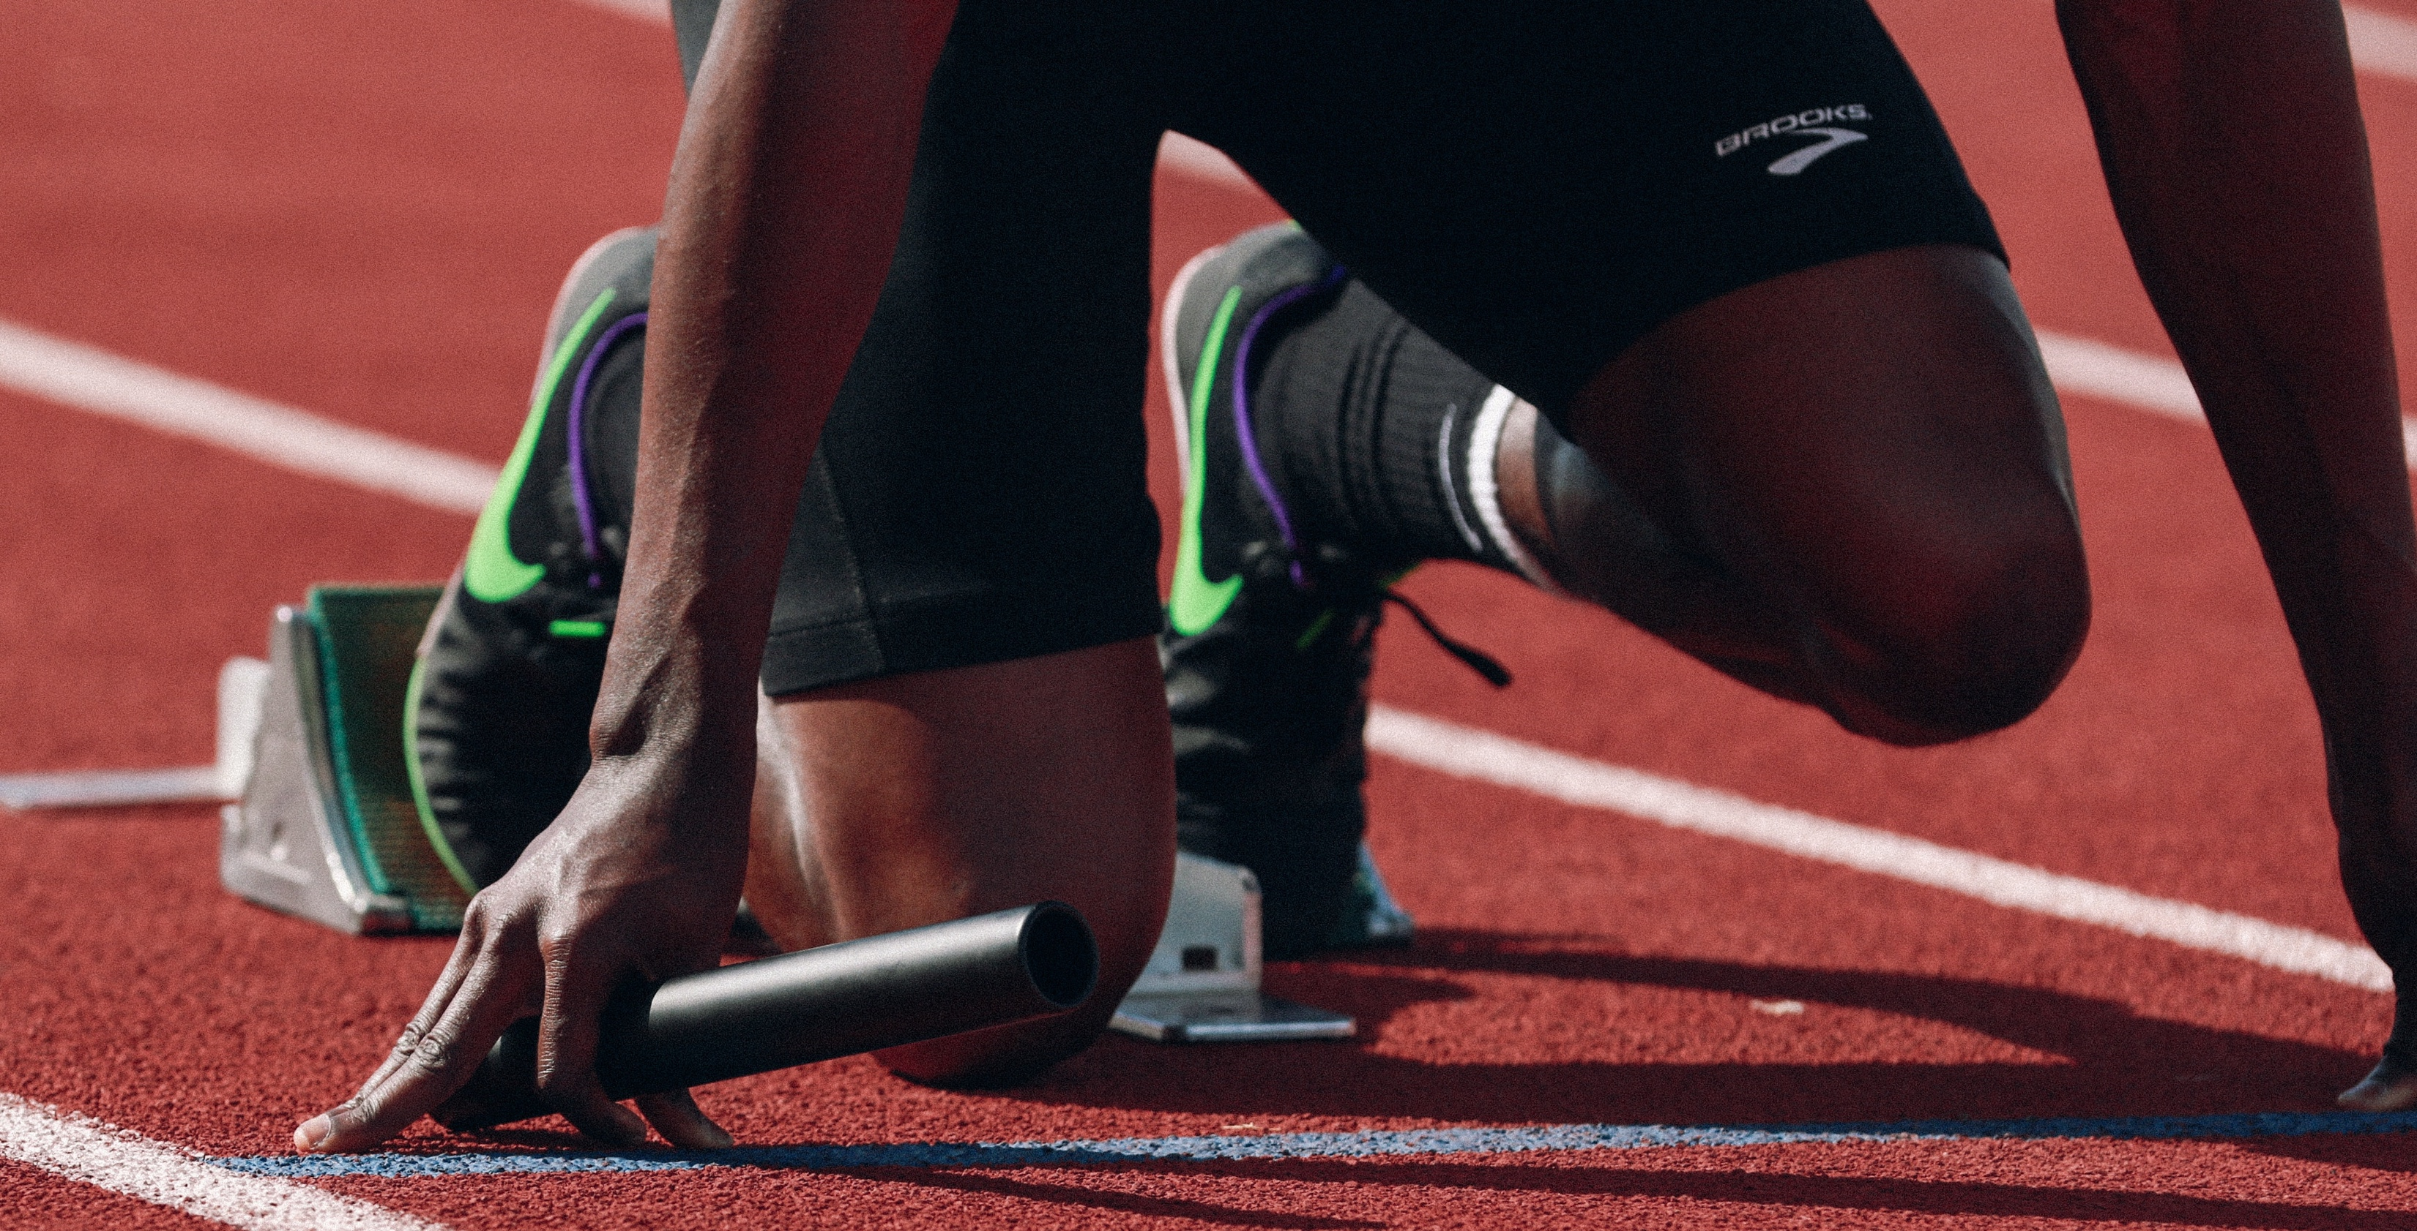
Getting started with social media

Slide 5
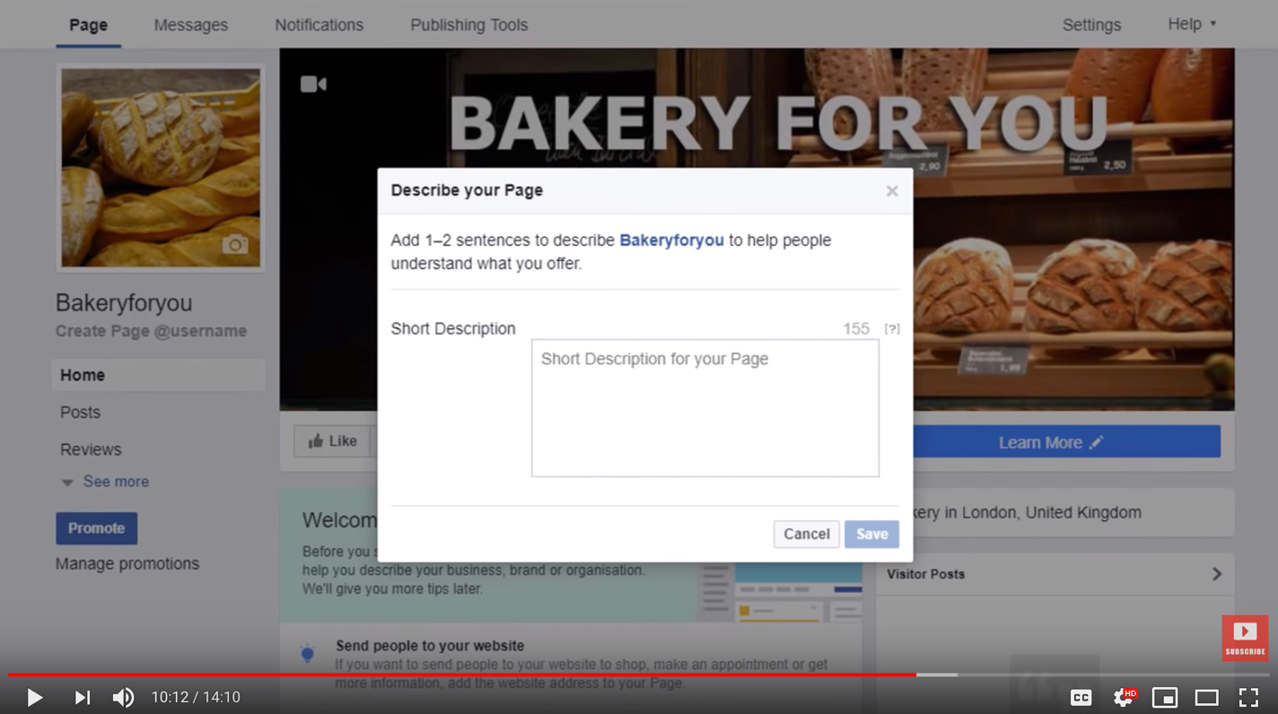
Create Your Accounts
How to start a Facebook Business Page
https://youtu.be/lAKEddOEd00
How to make sure you Google Business Profile is Ready
https://youtu.be/1D9faRLZN8s
How to start an Instagram Brand Account
https://youtu.be/_r6QpQQythE
How to start a Twitter Account
https://youtu.be/w_QfszTktso
How to start a YouTube Channel
https://youtu.be/b38ef8n1p4U

Slide 6
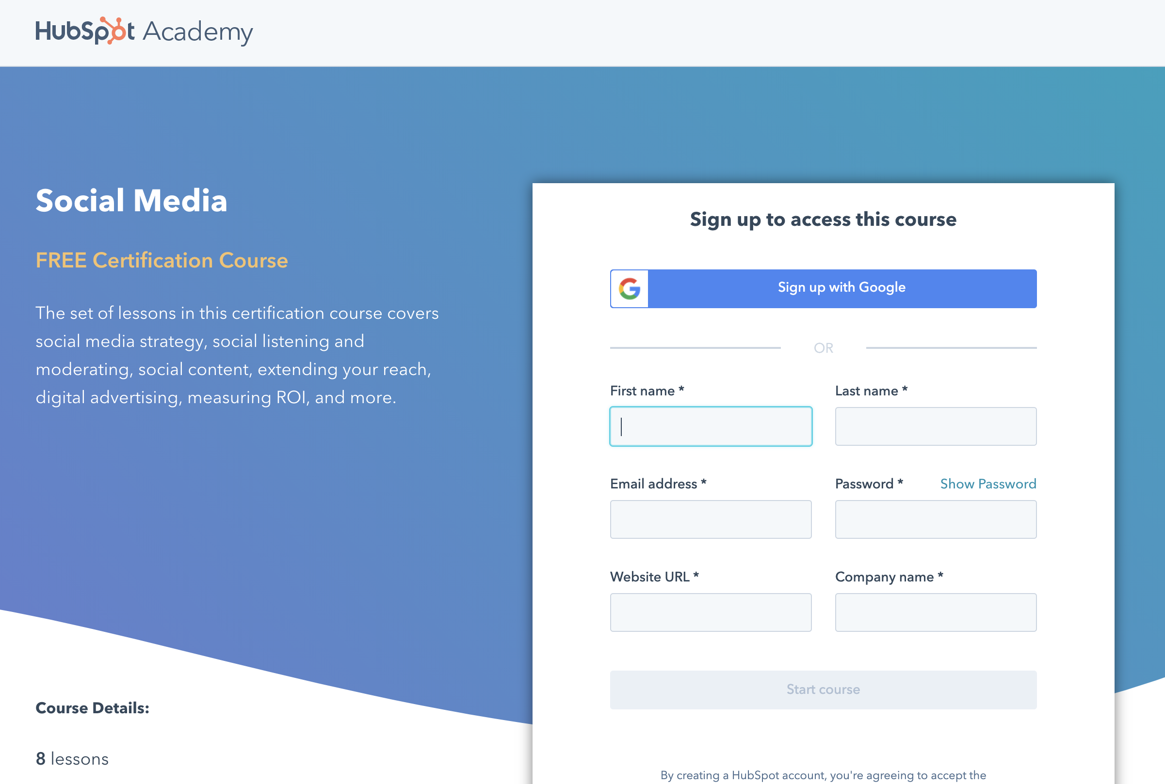
Become a Social Media Expert
Notes:
https://academy.hubspot.com/courses/social-media

Slide 7
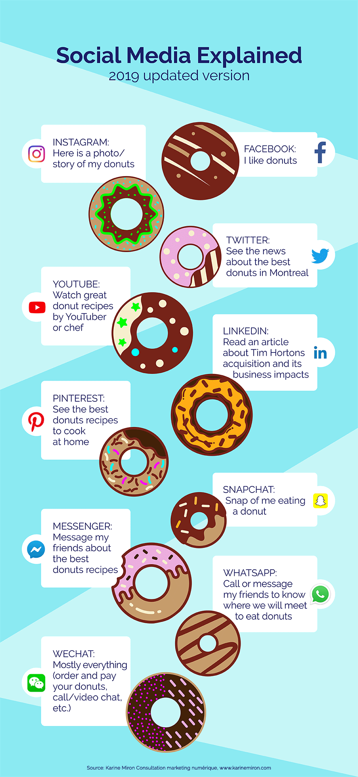
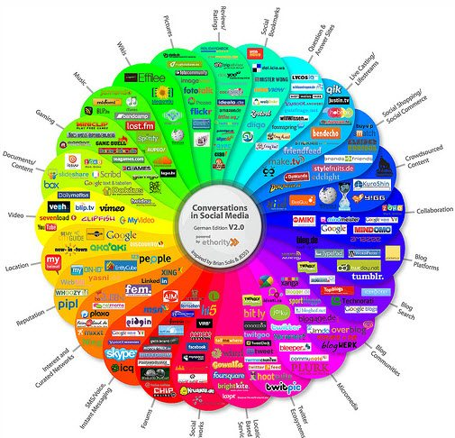
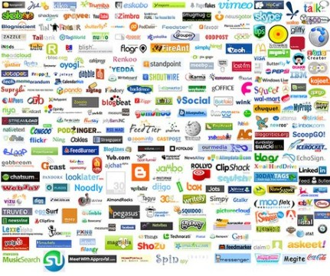
What Platforms are Right For You?
Notes:
David

Slide 8
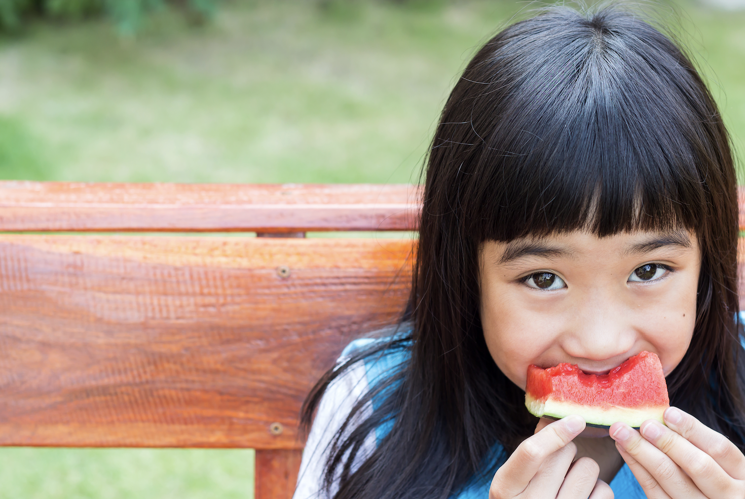
The What, where and why Of Social Media Posts
Notes:
Courtney

Slide 9
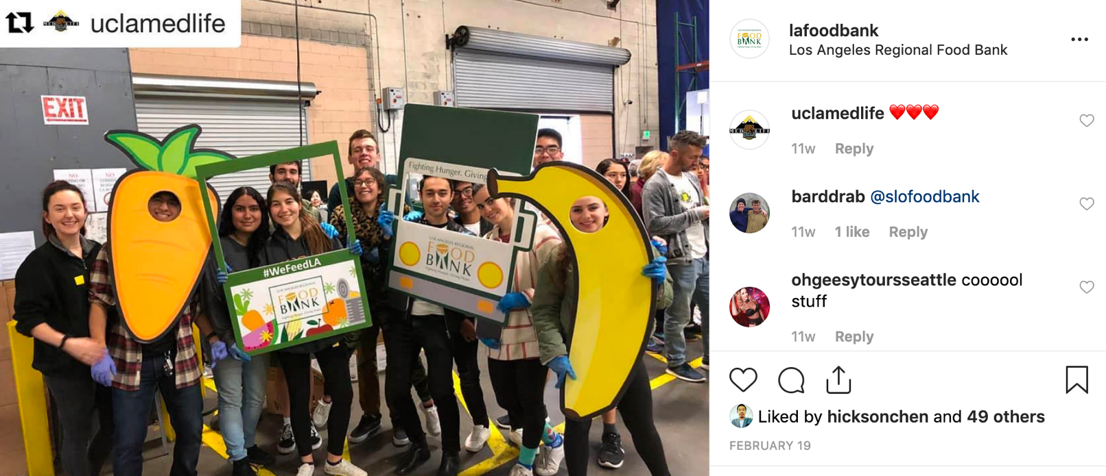
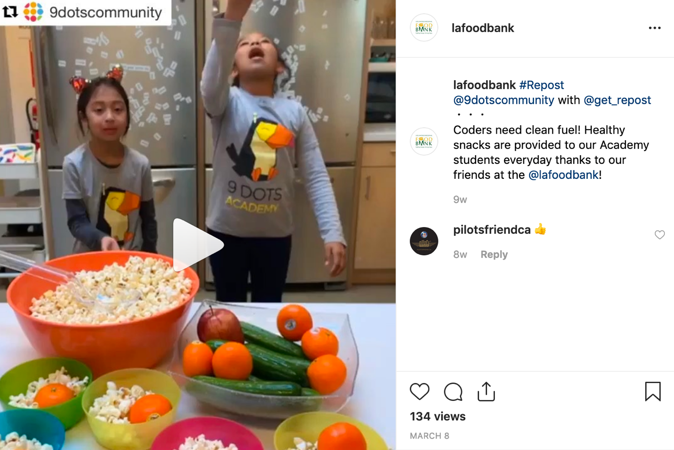
What
Social Media should be just that; social.
Posts should demonstrate that you know and care about your audience
POST TYPES
User Generated Content (UGC)
This is any content—text, videos, images, reviews, etc.—created by people, rather than brands. We will often share UGC on our own social media accounts, mainly Instagram.
These are opportunities to show appreciation and build credibility.

Slide 10
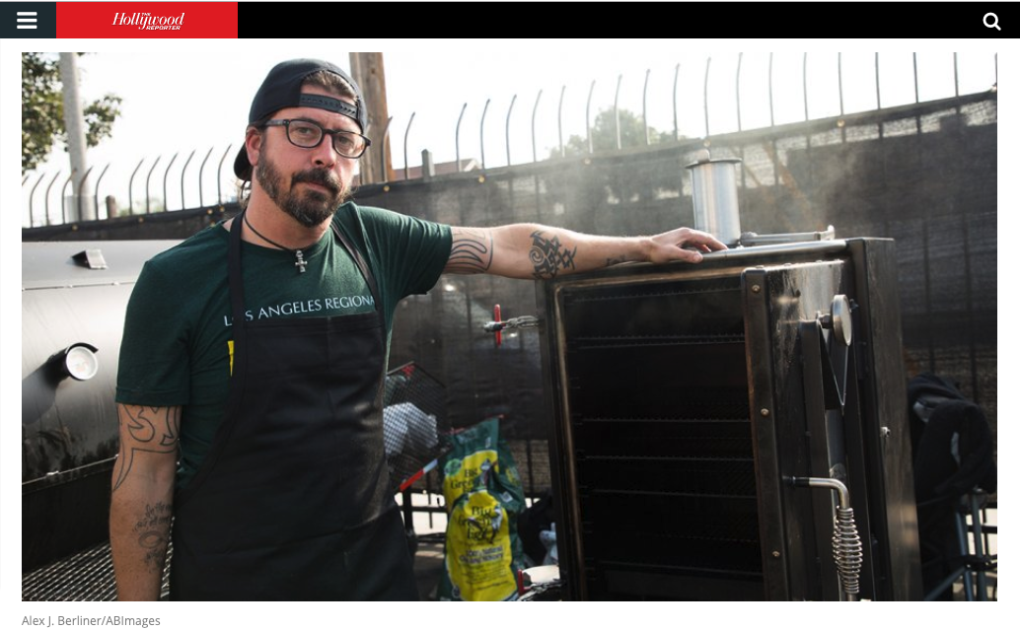
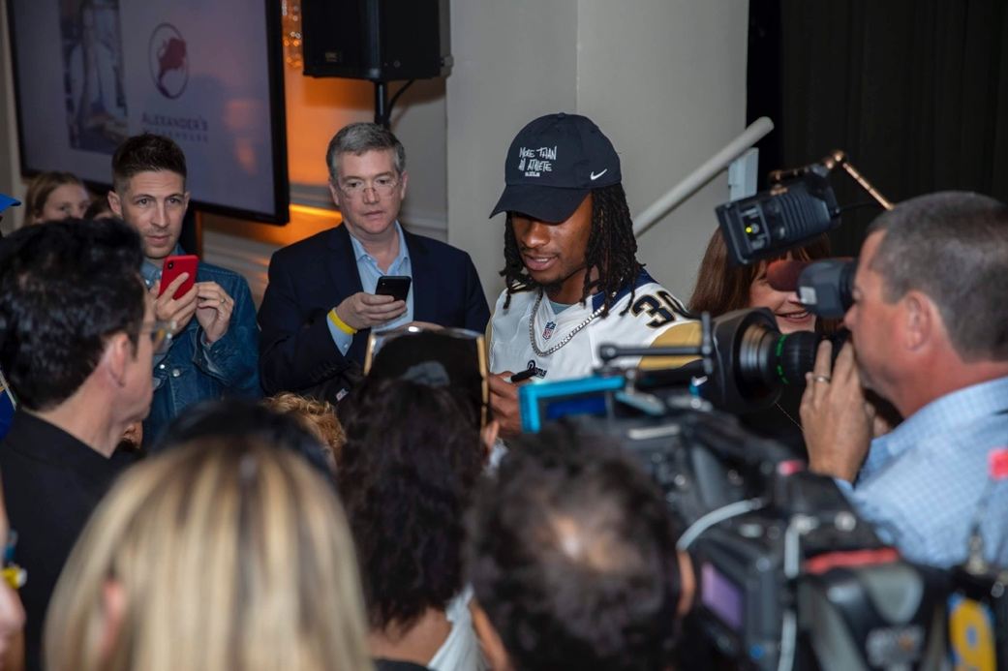
Another way for UGC
Our mission is something pretty much no one can argue with; when people learn about the urgent need and our efficient work to alleviate hunger and prevent food waste, many of them can’t help but want to get involved. We should treat our audience as active participants in our mission, not passive recipients of our message.
By cultivating and maintaining relationships with influential members of our community, we improve our opportunities to increase awareness, credibility, audience size and, ultimately, conversions.
Create social media toolkits and messaging points for:
VIPs and Influencers for events.
Campaigns such as #GivingTuesday.
For volunteers and staff.
Let’s face it! If your story isn’t interesting to you, it won’t be interesting to anyone else. Employee and volunteer advocacy will help you build your brand and credibility.

Slide 11
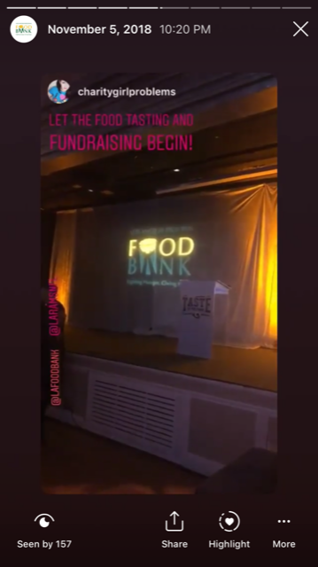
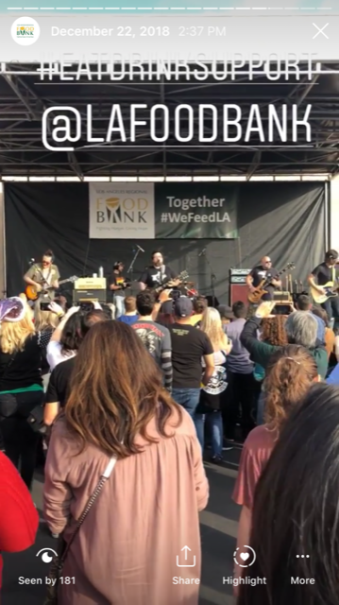
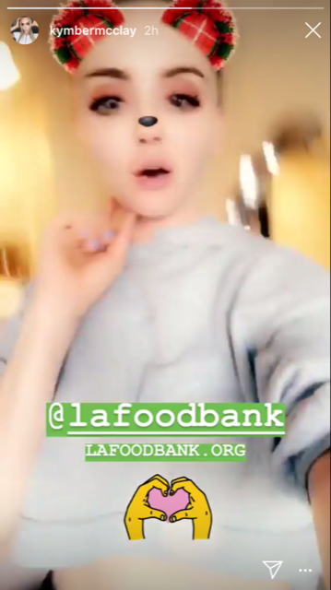
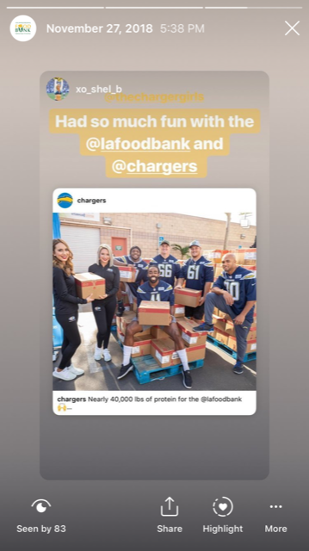
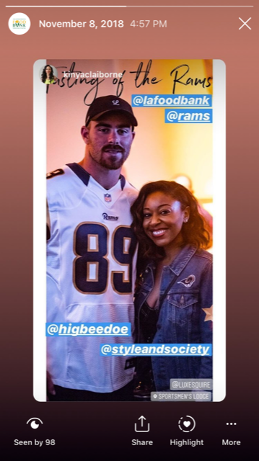
UGC Examples

Slide 12
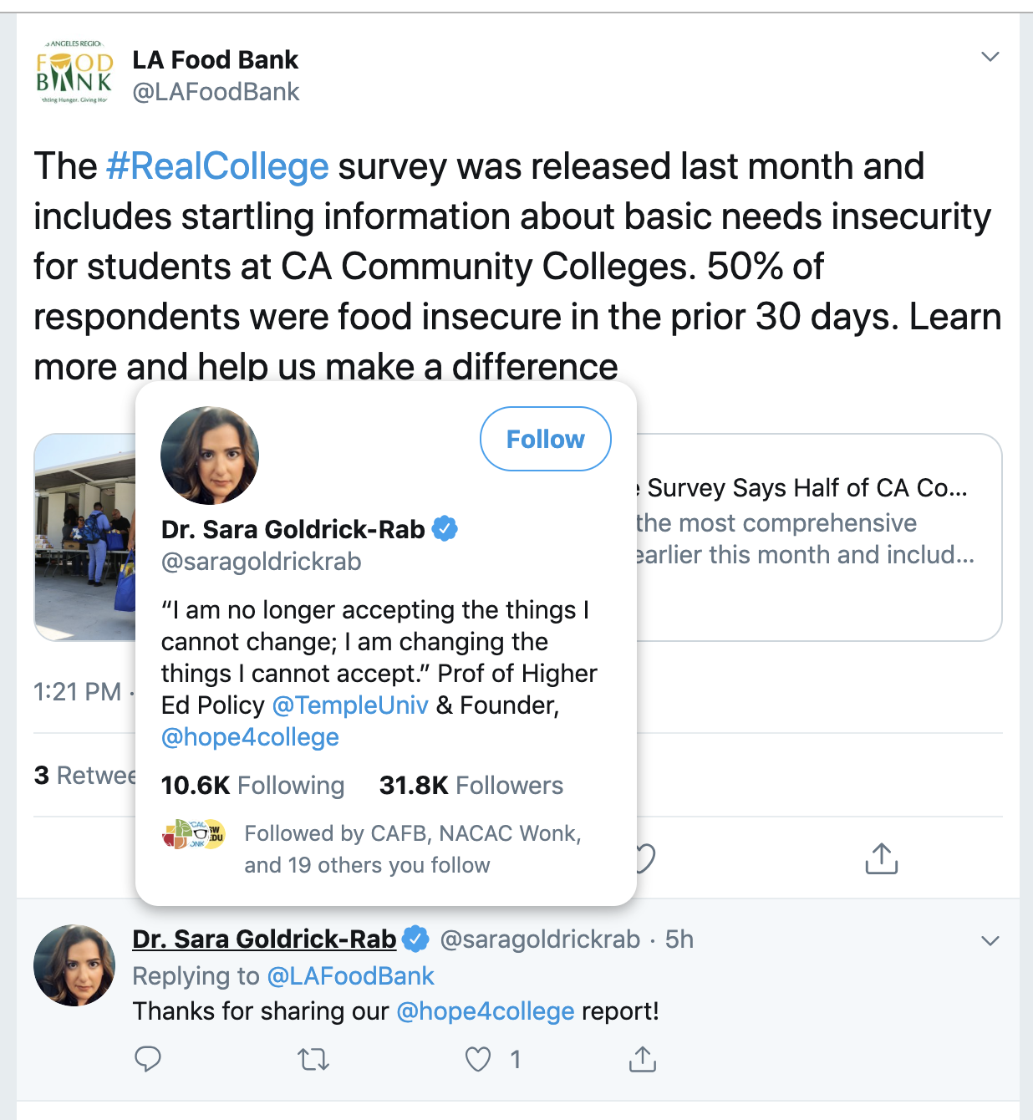
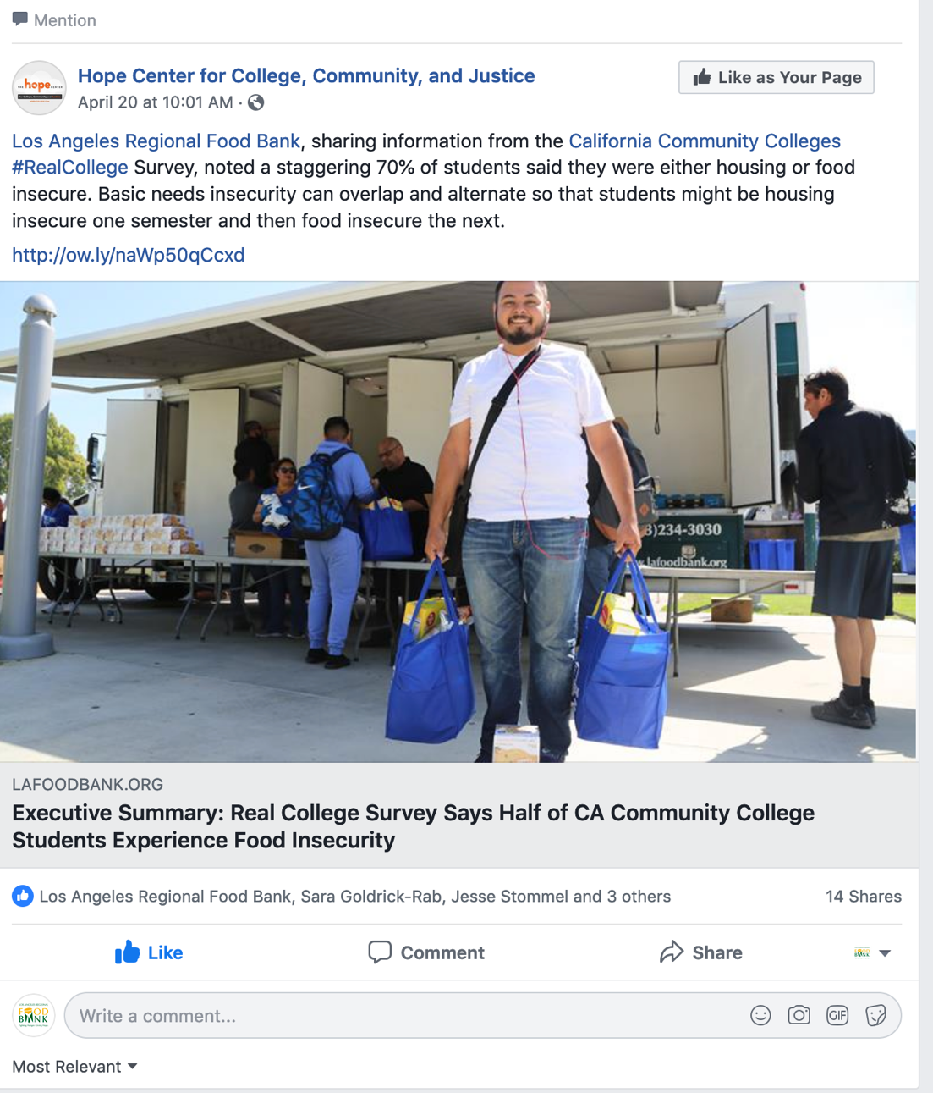
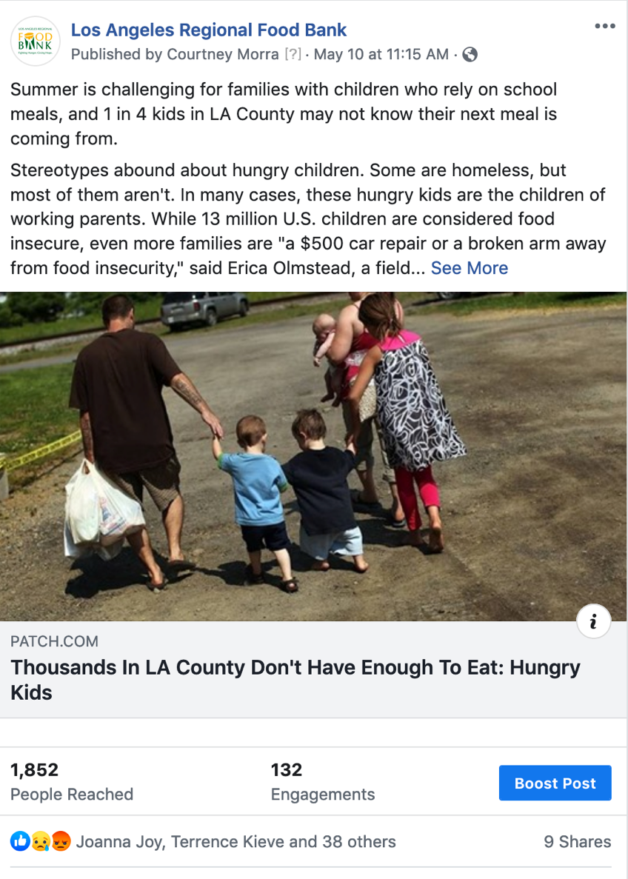
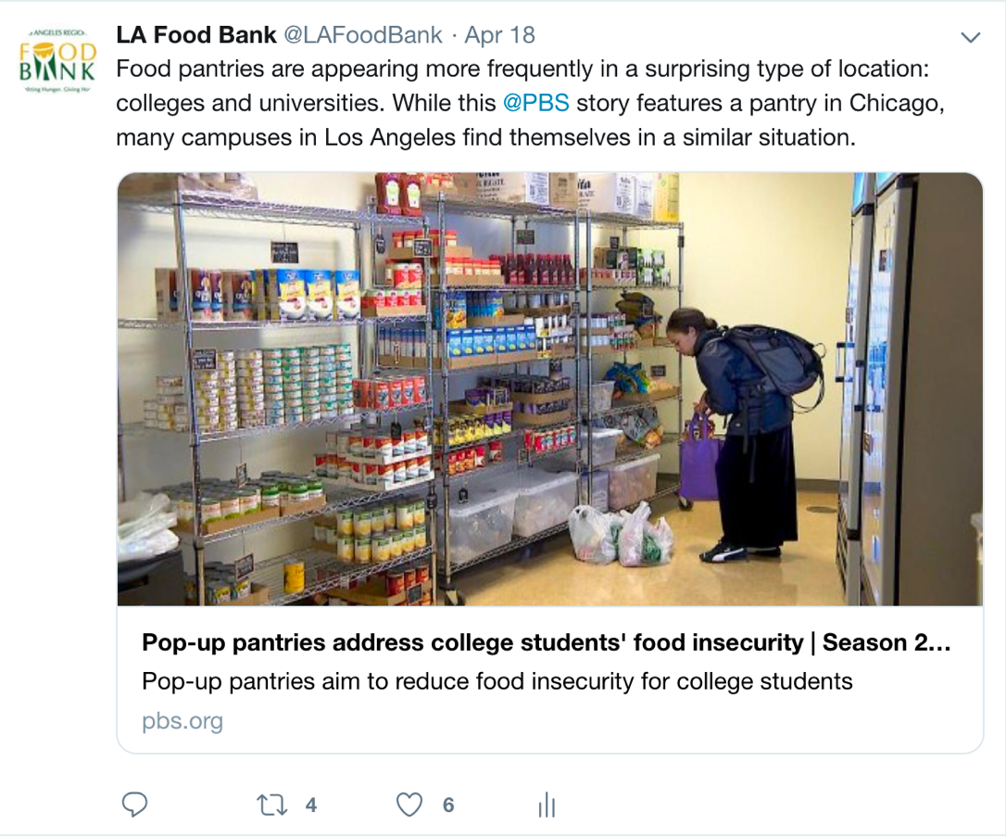
What
Curated Content: These are opportunities to show our expertise and that we are paying attention to topics that are of interest to our audience; these include articles and other content we share from reliable third parties.

Slide 13
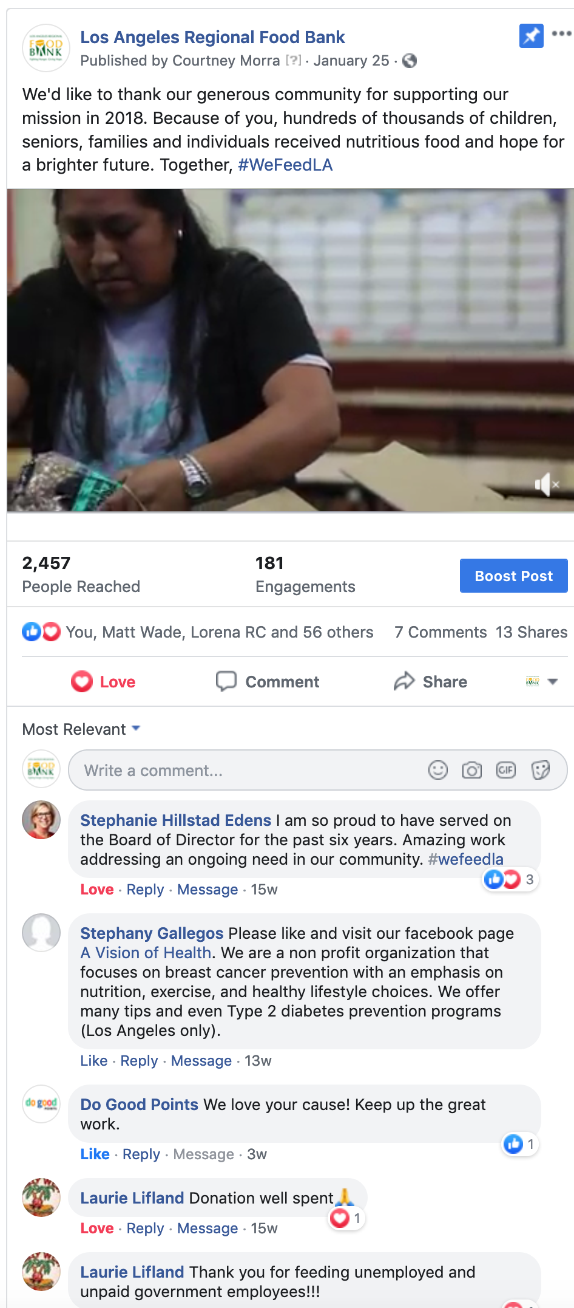
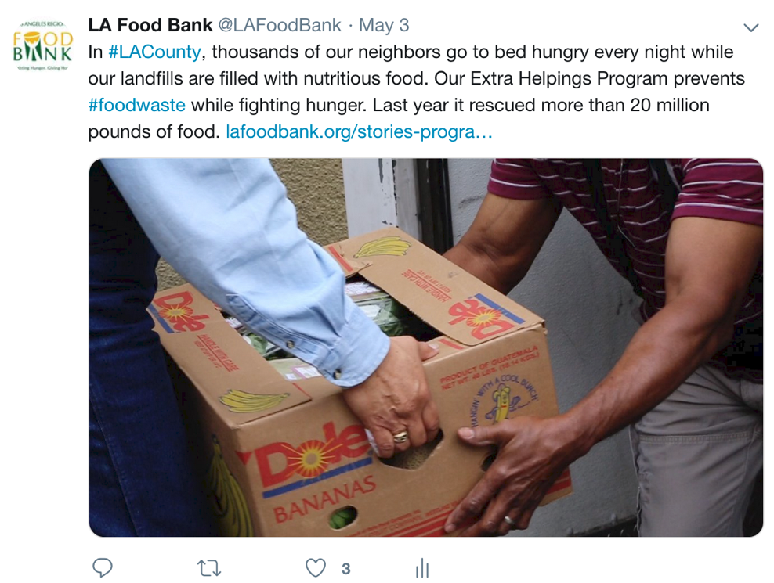
What
Original Content: Just like it sounds, this is content we’ve created and which we own.
Video: It’s best to upload video natively to social rather than sharing a link to YouTube.
Blog: Post a teaser, photo and link that make the reader want to learn more. This will drive traffic back to your site and improve chances of a conversion.
Photos: Grab attention and cut down on wordiness with photos!
When in doubt, keep your posts as brief as possible.
Remember: there’s a good chance you’re dealing with scrollers and mobile users.
Treating your posts like novels creates more opportunities for readers to lose interest and likewise miss your CTA. So, using photos and videos is a good way to engage a distracted audience.

Slide 14
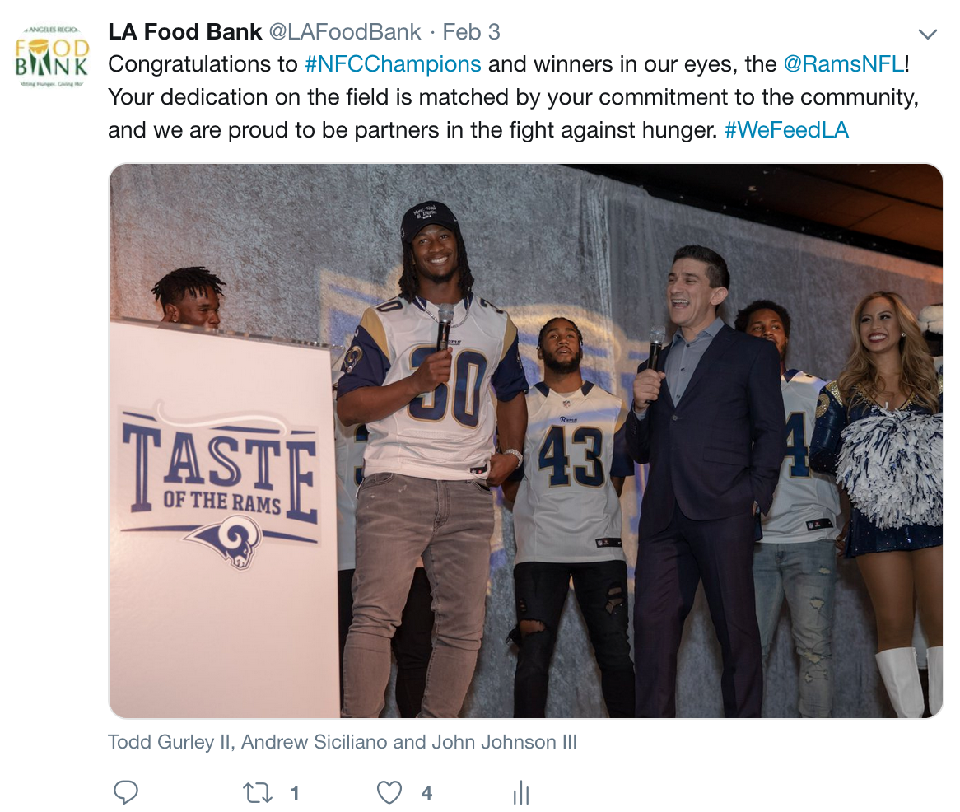
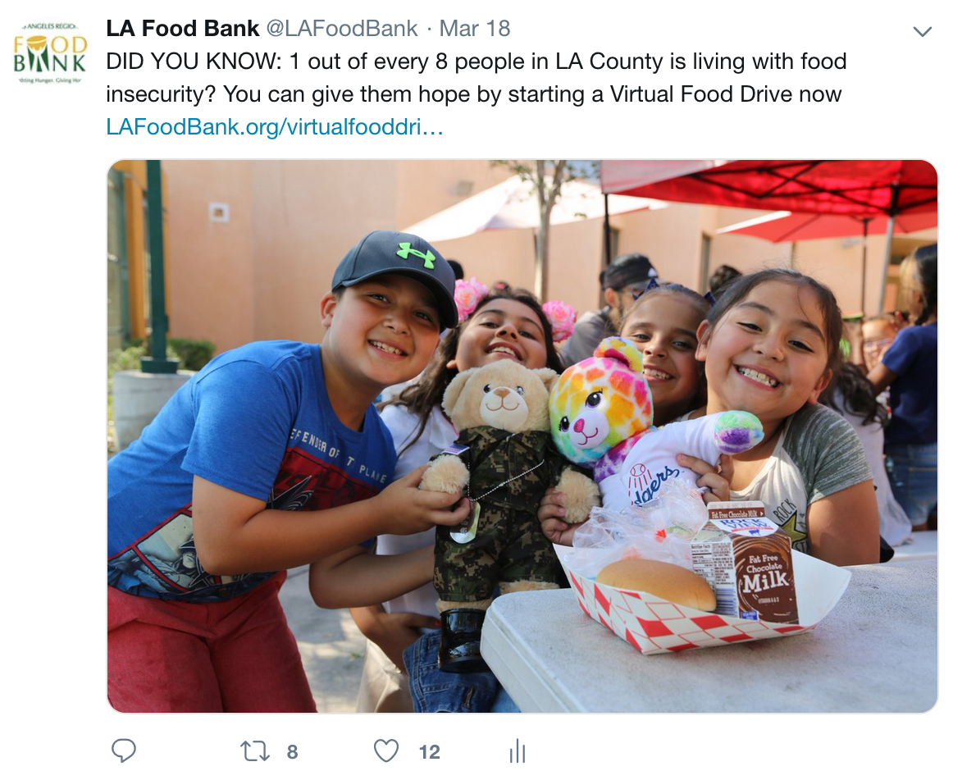
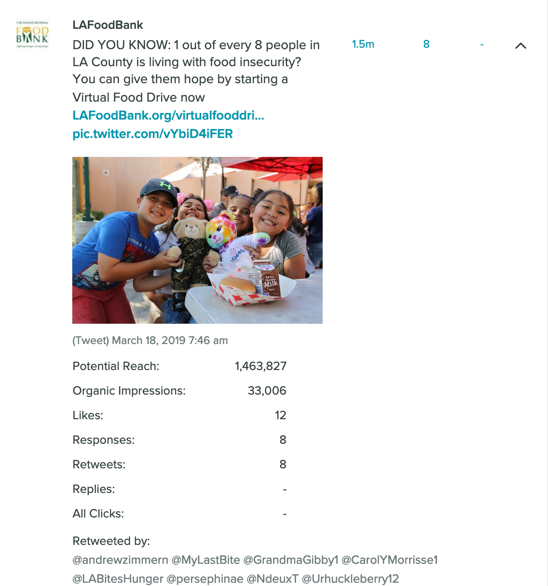
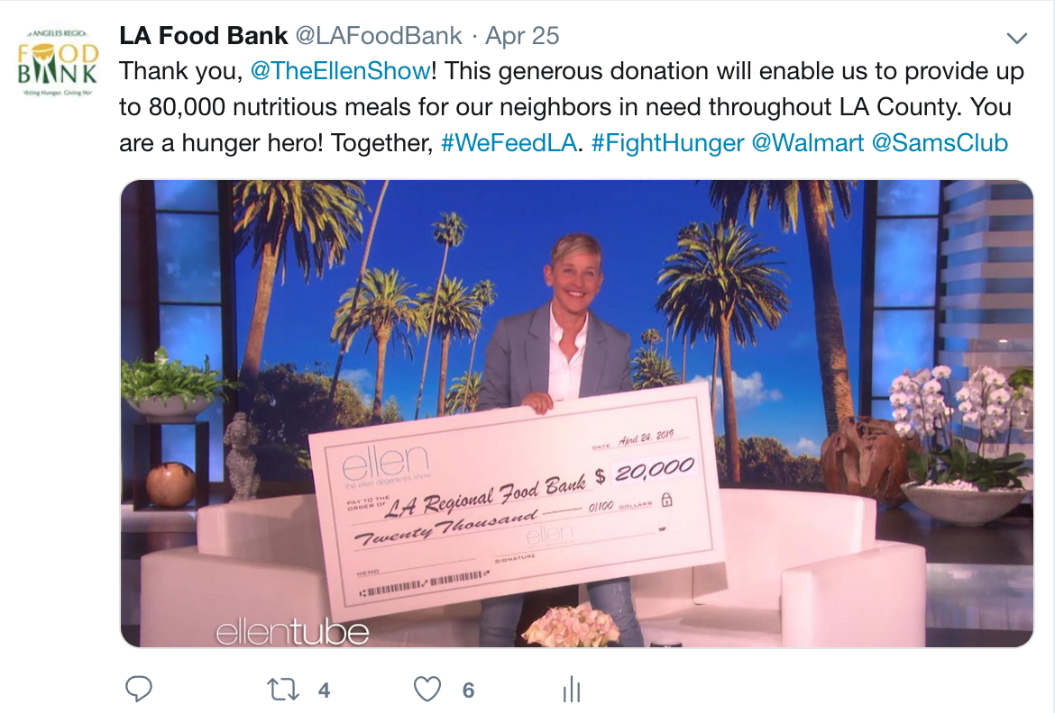
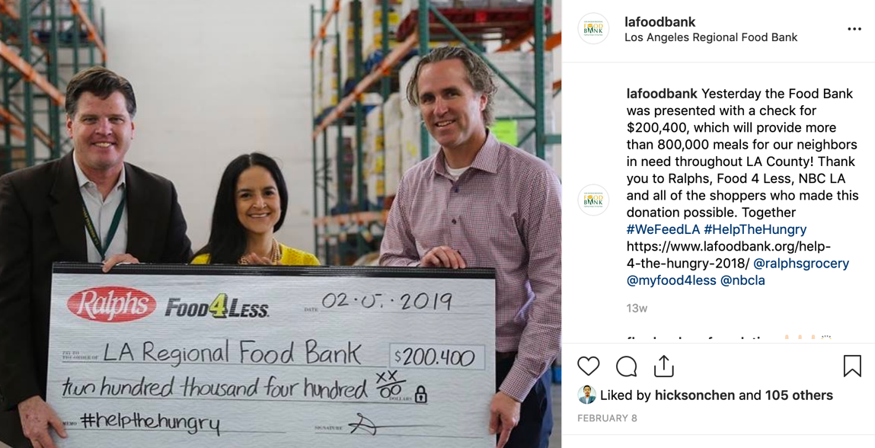
What
Micro Content: These are shorter posts which might include a stat and a CTA or a even just quick “thank you.” These help to keep audiences primed and engaged.
Notes:
Courtney

Slide 15
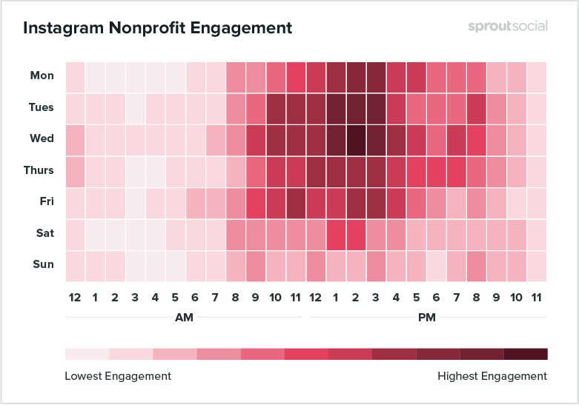
Instagram Post Timing
Notes:
The best time for nonprofits to post to Instagram is Wednesday at 2 p.m.
Other high engagement times include Monday from 2–3 p.m., Tuesday from 1–3 p.m. and a relatively strong block of time on Saturday from 1–2 p.m.
The safest times to post are Monday through Friday, 10 a.m.–4 p.m.
Sunday gets the least engagement, as well as every day from 11 p.m.–5 a.m.
---

Slide 16
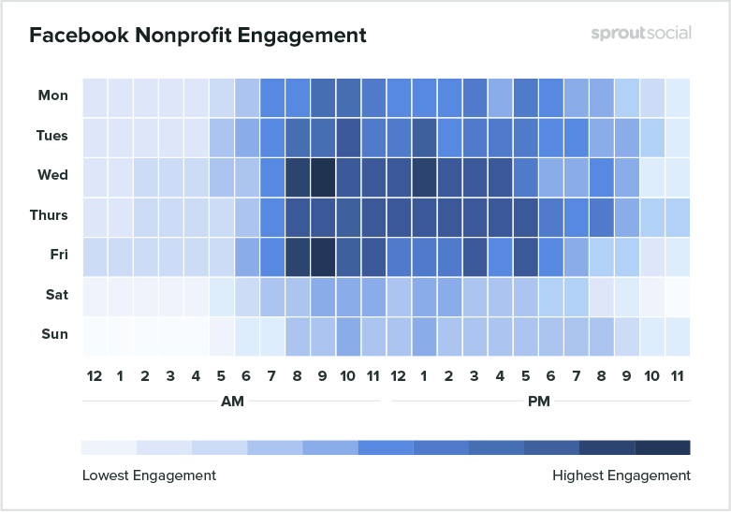
Facebook Post Timing
Notes:
The best time for nonprofits to post on Facebook is Wednesday at 8–9 a.m.
Other high engagement times include Thursday at 10 a.m. and Friday 8-10 a.m.
The safest times to post are Monday through Friday, 8 a.m. to 5 p.m.
Saturday and Sunday show the least engagement per day, and the lowest engagement times are 10 p.m.–5 a.m. every day.

Slide 17
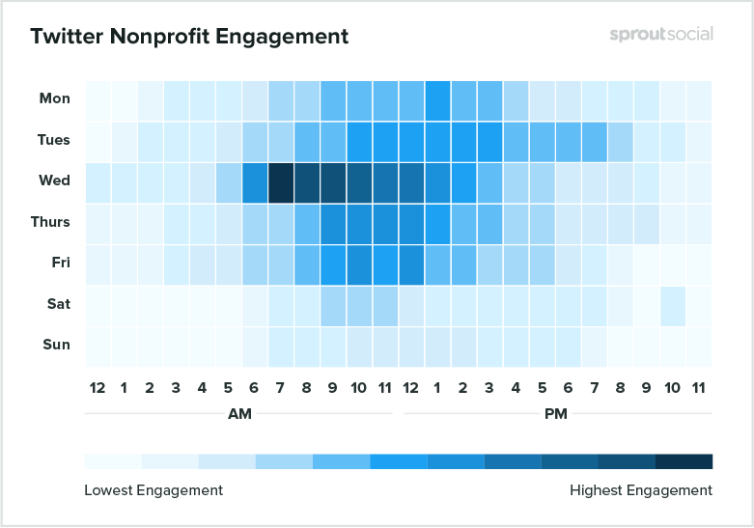
Twitter Post Timing
Notes:
The best time for nonprofits to post on Twitter is Wednesday at 7 a.m.
Other high engagement times include Wednesday from 6 a.m.–4 p.m.
The safest times to post are Tuesday through Friday from 8 a.m.–3 p.m.
Saturday and Sunday get the least engagement, as well as every day between 10 p.m. and 4 a.m.

Slide 18
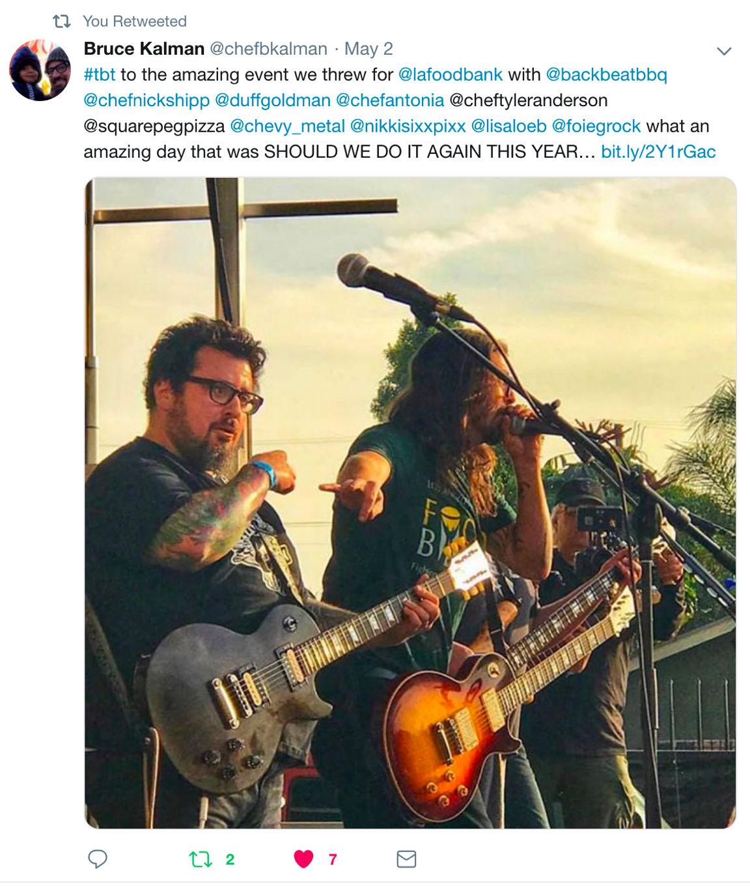
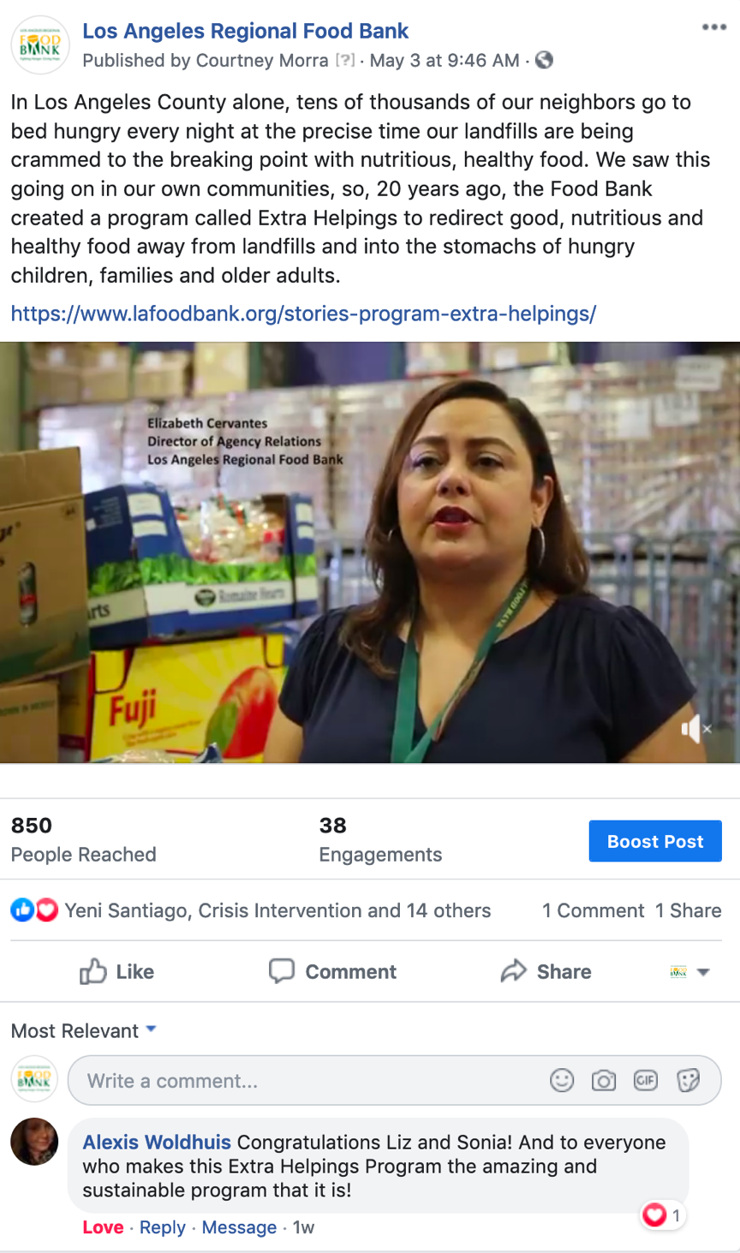
Why post this?
Before posting, ask yourself:
Who am I trying to reach?
What do I want them to do or learn?
Am I demonstrating value?
How will I know if I have been successful?
Would I share this if I didn’t work at this organization, or in this space?
Successful posts:
Are Relevant
Spark Emotion
Are Trustworthy
Demonstrate Empathy
Authoritative/Educational
Authentic
Share worthy/Interesting

Slide 19
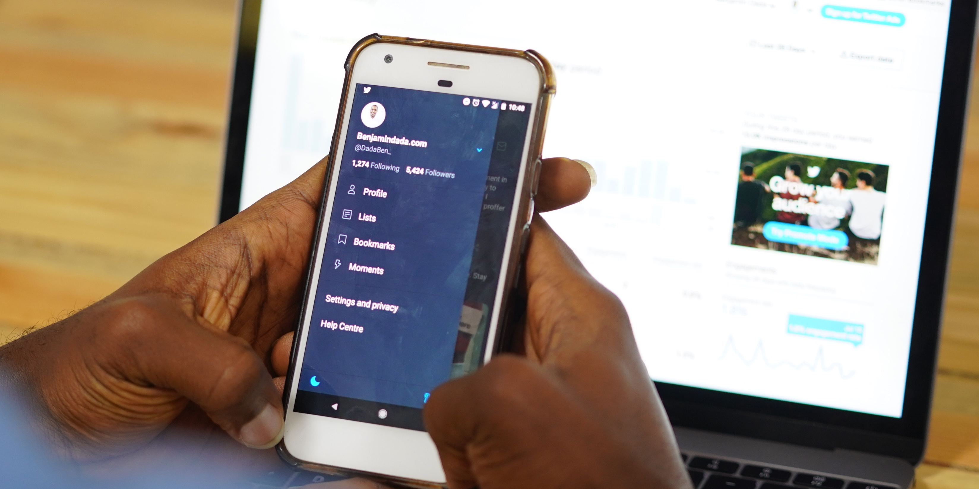
Social media’s role In marketing strategy
Notes:
David

Slide 20
Use SM to attract new people to our community by empowering brand ambassadorship.
Use SM engage visitors and cold leads. Cultivate them to hot leads.
Engage and retarget hot leads using CTAs. Convert and continue to engage.
Delight our supporters and empower them as brand ambassadors.
Notes:
David

Slide 21
Inbound Marketing
Notes:
David

Slide 22
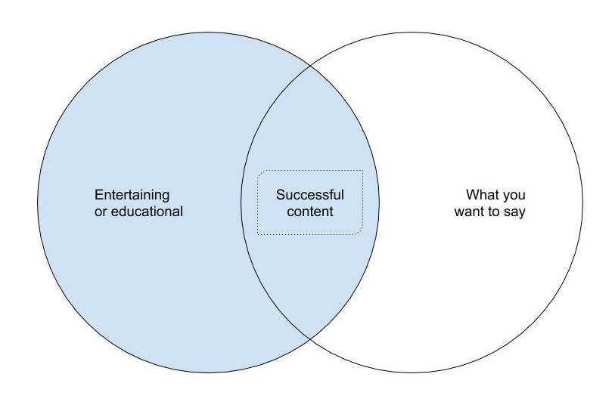
Content Marketing
Notes:
David

Slide 23
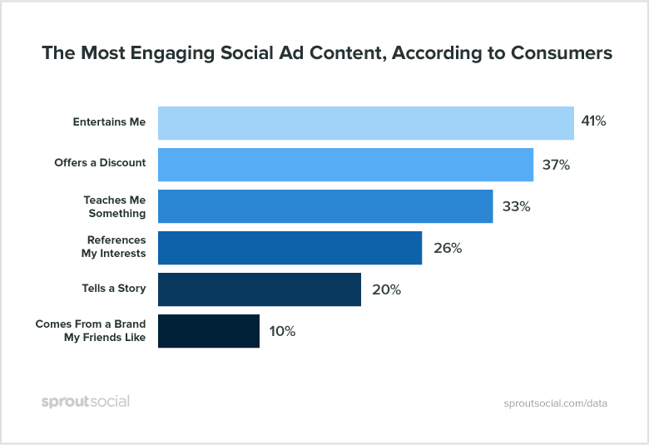
Content Marketing
Notes:
David

Slide 24
Social Media Marketing
Social media can be used to syndicate content.
Organic Social Media Marketing.
Video
Photos
Blog posts
Paid Social Media Marketing.
Boosted posts.
Social media advertising.
Influencer Marketing.
Much of this content can also help you with e-newsletters.

Slide 25
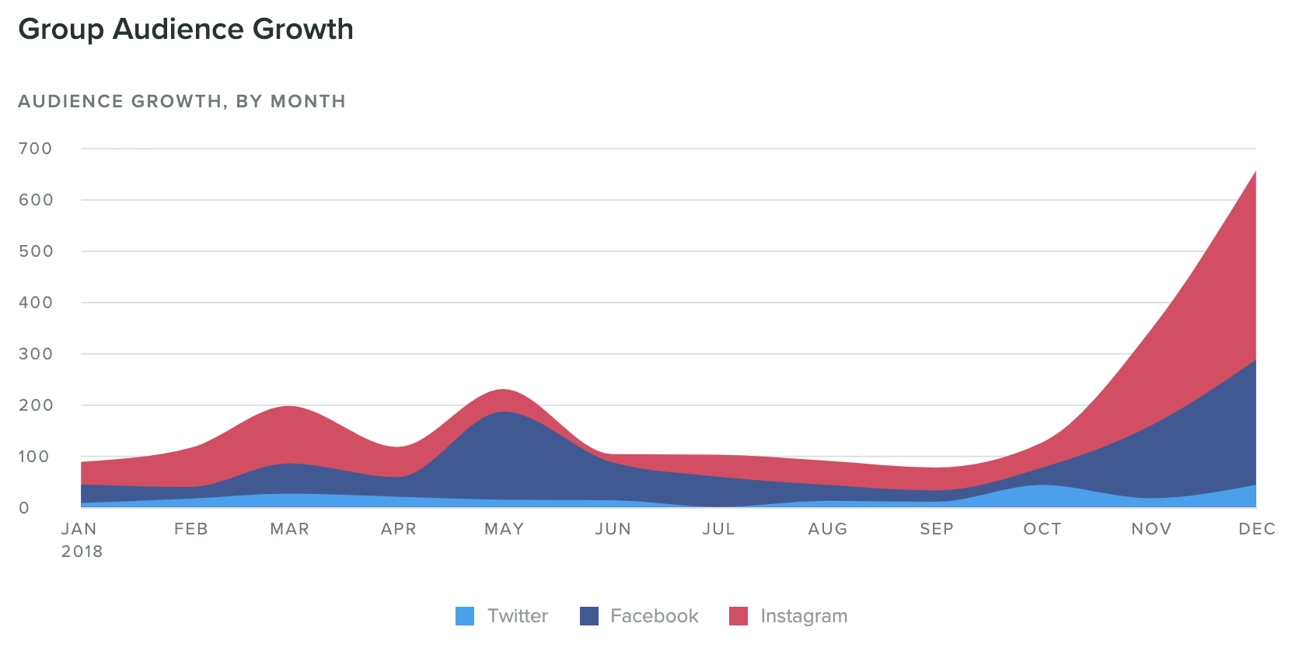
Social Media Growth: 2018
Total Fans | 19,474
New Twitter Followers | 123 | +2.10%
New Facebook Fans | 932 | +10%
New Instagram Followers | 1,090 | +36.20%
Total Fans Gained | 2,145 | +11.80%
9,364
6,077
4,163

Slide 26
We Are Here To Help
We have the Shelf Life Guide for you!
Visit us to get your free guide
We want to come visit!
Professional photography
Video footage
Transcripts of interviews
Stories
Mentions/retweets
David May
Director of Marketing and Communications
Los Angeles Regional Food Bank
dmay@lafoodbank.org
@yamdivad
@yamdivad
/yamdivad
/in/yamdivad

Slide 27
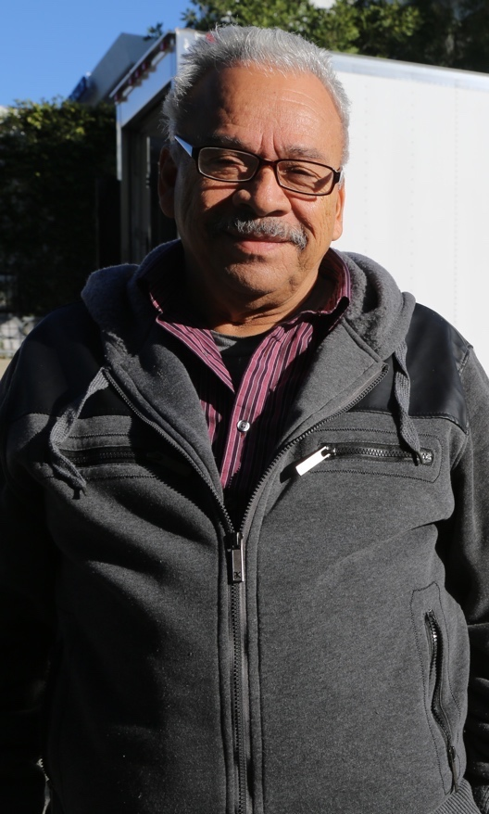
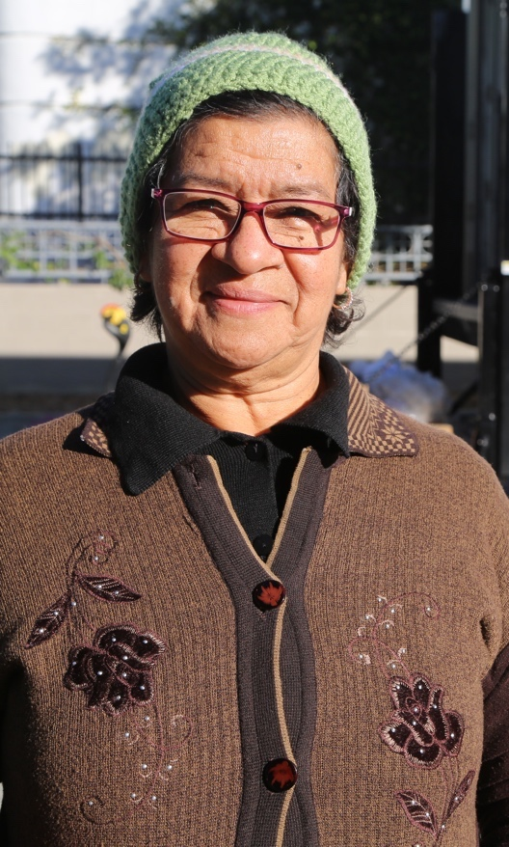
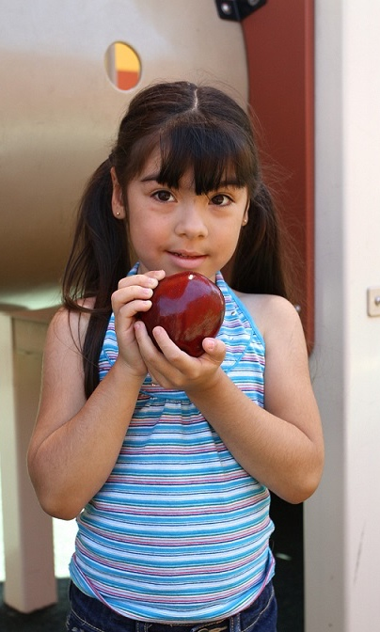
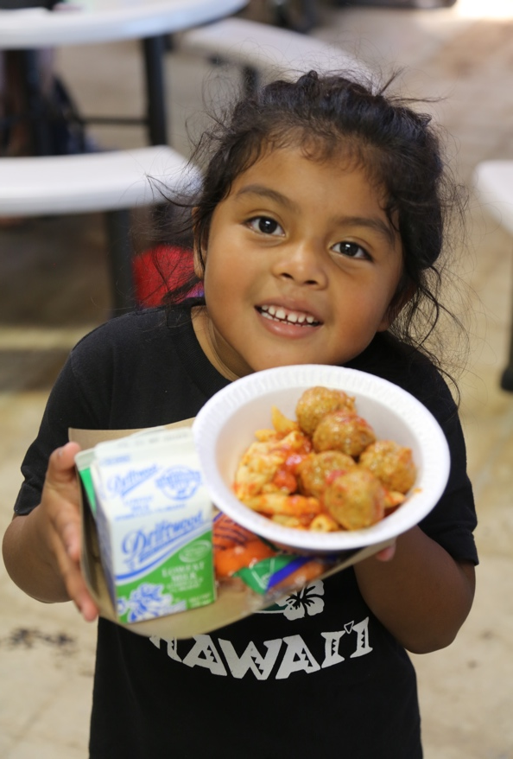
Questions?

