Slide 1
Starting the Policy Conversation: : How Agencies & Clients Can Play a Critical Role
in Advising Elected Officials
Nancy Volpert
Director of Public Policy & Strategic Initiatives
Jewish Family Service of Los Angeles
nvolpert@jfsla.org

Slide 2
Agenda
Policy Update
Moving Advocacy Forward
Making Your Voice Matter
Q & A

Slide 3
Ab
Jewish Family Service of Los Angeles (JFS) has a longstanding commitment to fighting hunger and poverty in seniors, families and individuals of all ages.
JFS { SOVA Community Food and Resource Centers provide groceries, counseling and case management, as well as onsite CalFresh enrollment.
The JFS { Senior Nutrition Program is a vital component of the agency's continuum of resources available to older adults, and provides approximately 1,000 seniors with meals in neighborhood dining centers and at their homes each day.

Slide 4
JFS Public Policy Efforts
Legislative Advocacy
Active participation in the legislative process on the local, state and national level
Elected Official Relationship Management
Build and maintain positive relationships with Elected Officials and their staff
Community Engagement
Engage our larger JFS family and partner with likeminded organizations to enhance advocacy

Slide 5
Policy Updates

Slide 6
H.R. 2 – Farm Bill
The bill, which passed out of committee without bipartisan support, contains deep cuts to the Supplemental Nutrition Assistance Program (SNAP).
If enacted, the bill would worsen hunger and food hardship for thousands of low-income households statewide.
As drafted, the bill would cut $20 billion in benefits and eligibility resulting in approximately 2 million people losing access to the program nationwide
The bill eliminates a state option known as categorical eligibility – that is estimated to impact as many as 126,0356 California households below 200% of the poverty level.
The bill establishes mandatory Employment and Training Requirements that impose administrative burdens on California’s state government and low-income residents, dictating that all adults on SNAP, must be working or participating in a qualified training program for at least 20 hours a week, unless they qualify for an exemption, within one month of enrolling in SNAP

Slide 7
AB 3200 (Kalra): SSI/SSP
SSI/SSP is a federal and state safety net program that provides a very basic income to low income seniors and people with disabilities who have little-to-no other income or resources to help them pay for basic living expenses such as food, clothing, and shelter.
This bill has become known as the $100 for 100% bill and would increase State Supplementary Payment (SSP) grants by $100 a month to reach to nearly 100% of the Federal Poverty Level and restore the annual Cost Of Living Adjustment (COLA) in the program.
This helps every Californian move out of poverty and live with dignity, particularly the 1.3 million Californians who rely on the combined federal/state Supplemental Security Income/State Supplementary Payment (SSI/SSP) program and have experienced cuts with devastating costs to themselves and to our state.
The state has made historic progress in reversing the Great Recession deficits, but this has come at the expense of maintaining rock-bottom SSI/SSP grants that force hunger, homelessness and inhumane hardship on 1.3 million of our neighbors.
There is also an effort to find an equitable end to cash-out.

Slide 8
SB 982 (Mitchell): CalWORKs Ending Deep Childhood Poverty
The California Work Opportunity and Responsibility to Kids (CalWORKs) program provides basic needs cash aid and services to low-income families with children to alleviate the impact of poverty on children and help parents overcome barriers to employment.
The CalWORKs program serves 1.1 million individuals in California, 80 percent of whom are children. Yet, the level of support provided to CalWORKs families is insufficient to meet basic needs and lift all of these children out of deep poverty.
This bill will endeavor to eliminate deep poverty in the CalWORKs program by placing a minimum grant level to ensure no CalWORKs grant falls below 50 percent of the federal poverty line.
By doing so, this bill will protect children from the worst harms of chronically unmet basic needs and better enable the CalWORKs program to achieve its goals.

Slide 9
Moving Advocacy Forward

Slide 10
Policy advocacy is essential for protecting and strengthening
the public safety net
Strong advocacy efforts by anti-hunger advocates in California have been integral to protecting and expanding the supply of emergency food
Food access networks have specialized knowledge about hunger in their communities, and that knowledge can be very powerful when turned into action through advocacy
Anti-hunger advocacy efforts play a key role in:
protecting funding for vital programs (CalFresh, EFSP)
Removing unnecessary and burdensome requirements

Slide 11
Influencing Public Policy
Stay Informed about Policy
Build Relationships with Law Makers
Advocate for Specific Policies

Slide 12
Stay Informed
Use Social Media to know what thought leaders and activists are talking about
Pay attention to Action Alerts
Participate in coalitions
Western Center on Law & Poverty @Western_Center
Take advantage of anti-hunger specific resources
California Association of Food Banks @CAFoodBanks
California Budget Project @CABudgetProject
Feeding America
California Food Policy Advocates
LA Food Policy Council
Hunger Action LA
CA Hunger Action Coalition
LA Regional Food Bank
Feeding America
Mazon
Food Research and Action Center

Slide 13
Distinction Between District vs. Capitol Issues
District
Local
Field
Intervention at the constituent level
Field Staff/ Caseworkers/ District Director
Capitol/ City Hall
Intervention at the policy development level
Legislative staff, Chief of Staff
Important to spend time with Elected Officials AND staff

Slide 14
Relationship Building with Policymakers
Be Proactive – Not Reactive
If you have not interacted with your elected official’s office before, arrange a personal meeting
Add your local, state and federal elected officials and their staff to your organization’s mailing list
Give periodic updates on community needs and your services to your neighborhood, city and county council meetings
Invite local elected officials to visit your program and tour your site(s)
Engage Board members and Volunteers as they may already have relationships

Slide 15
Relationship Building with Policymakers
YOU are an Invaluable Resource
Constituent Needs
Policy Expertise
Connections to Community Leaders
Educate Legislative Staff

Slide 16
Advocate for Specific Policy Outcomes
Respond to LA Regional Food Bank, CAFB and other likeminded organizations to send letters of support
Write a letter, call or visit your elected official(s) to show your support for a specific legislation
Underline the connection of your organization to the lawmaker’s district
Leave informational handouts and contact information behind

Slide 17
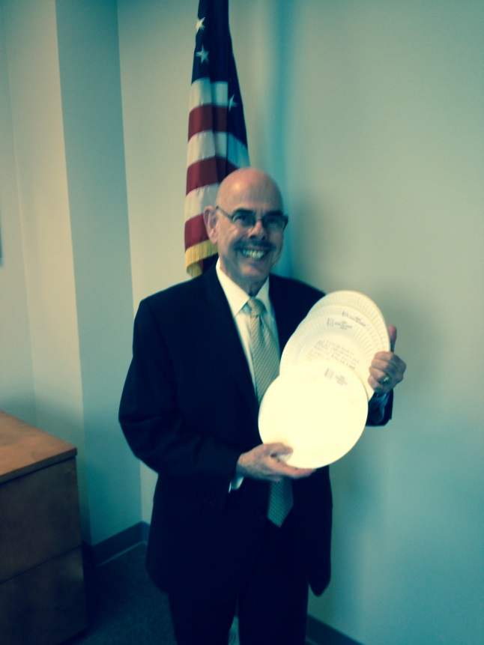
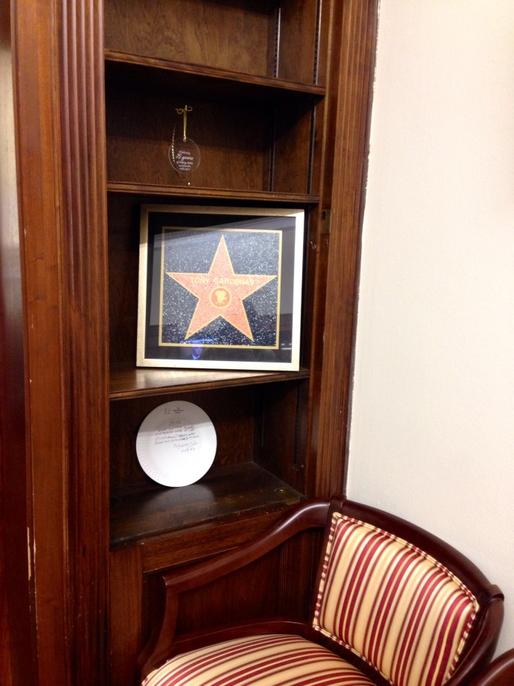
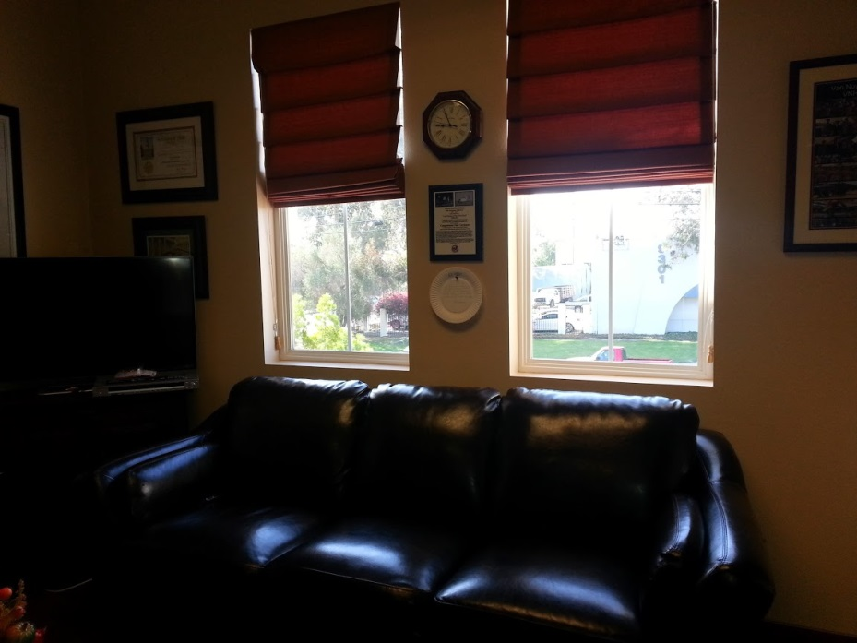
JFS Paper Plate Campaign

Slide 18
Anti-Hunger Advocacy Resources
Ab
LA Regional Food Bank
www.lafoodbank.org
California Association of Food Banks
www.cafoodbanks.org
California Food Policy Advocates
www.cfpa.net
Food Research & Action Center (FRAC)
www.frac.org
Feeding America
www.feedingamerica.org

Slide 19
Make Your Voice Matter

Slide 20
Voting Matters in EVERY Election
The best way to ensure that our laws reflect our priorities is to ensure that lawmakers who care about our issues are elected
Nonprofits can engage in voter registration, voter education and get out the vote campaigns without risk to their 501(c)(3) status
Nonprofits cannot take a position or advocate for/against a candidate
Information for nonprofits who want to help people vote:
California Association of Nonprofits
Calnonprofits.org
Nonprofit Vote
Nonprofitvote.org

Slide 21
Are You Ready to Participate in 2018?
1
Make sure you are registered to vote
voterstatus.sos.ca.gov
2
Know your deadlines
Primary Voter Registration: May 21
Primary Election date: June 5
3
Encourage Staff, Volunteers & Clients
to Vote if Eligible
4
Spread the word
Remind your friends & colleagues to confirm their voter status and to VOTE!

Slide 22
Nonpartisan Information
Ab
Cal Matters
www.elections.calmatters.org/2018
League of Women Voters
www.vote411.org
Los Angeles County Registrar-Recorder/County Clerk
www.lavote.net
Voter’s Edge California
www.votersedge.org/ca
Nonprofit VOTE
www.nonprofitvote.org

Slide 23
THANK YOU

