Slide 1
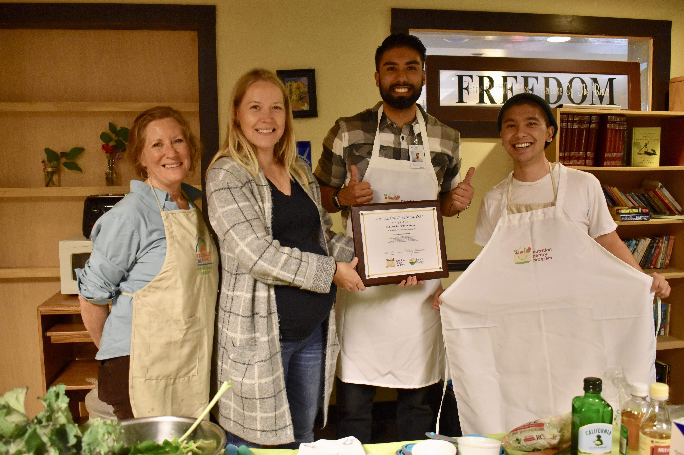
Introduction and Invitation to the Nutrition Pantry Program
Adrienne Markworth
Leah’s Pantry
May 15th, 2019

Slide 2
Overview
Intro to Leah’s Pantry
Making our work client centered: using a trauma-informed lens
Introduction to the Nutrition Pantry Program
NPP for All (Pantries) – an invitation to join the network!

Slide 3
WE ENVISION nourished communities and a healthy, equitable food system.
OUR MISSION is to improve the health, wellness, and resilience of communities through trauma-informed nutrition security.

Slide 4
… because everyone deserves nourishing meals every day.

Slide 5
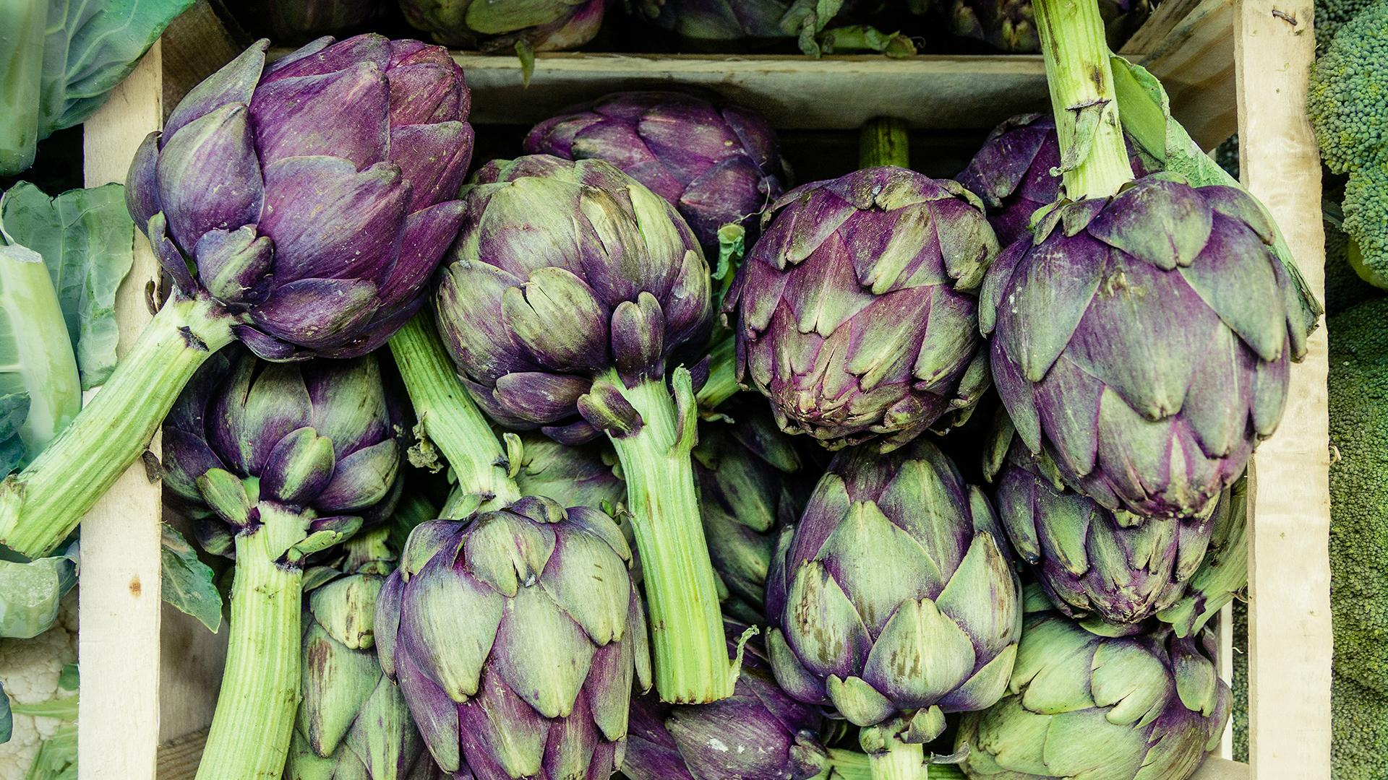
STRATEGIES
Implement innovative programs that explore our relationship with food, support health, and build resilience.
Build capacity of partner organizations to best serve their communities.
Start conversations to expand the frame
and include impacts of trauma on our nutritional health.

Slide 6
Products and Programs

Slide 7
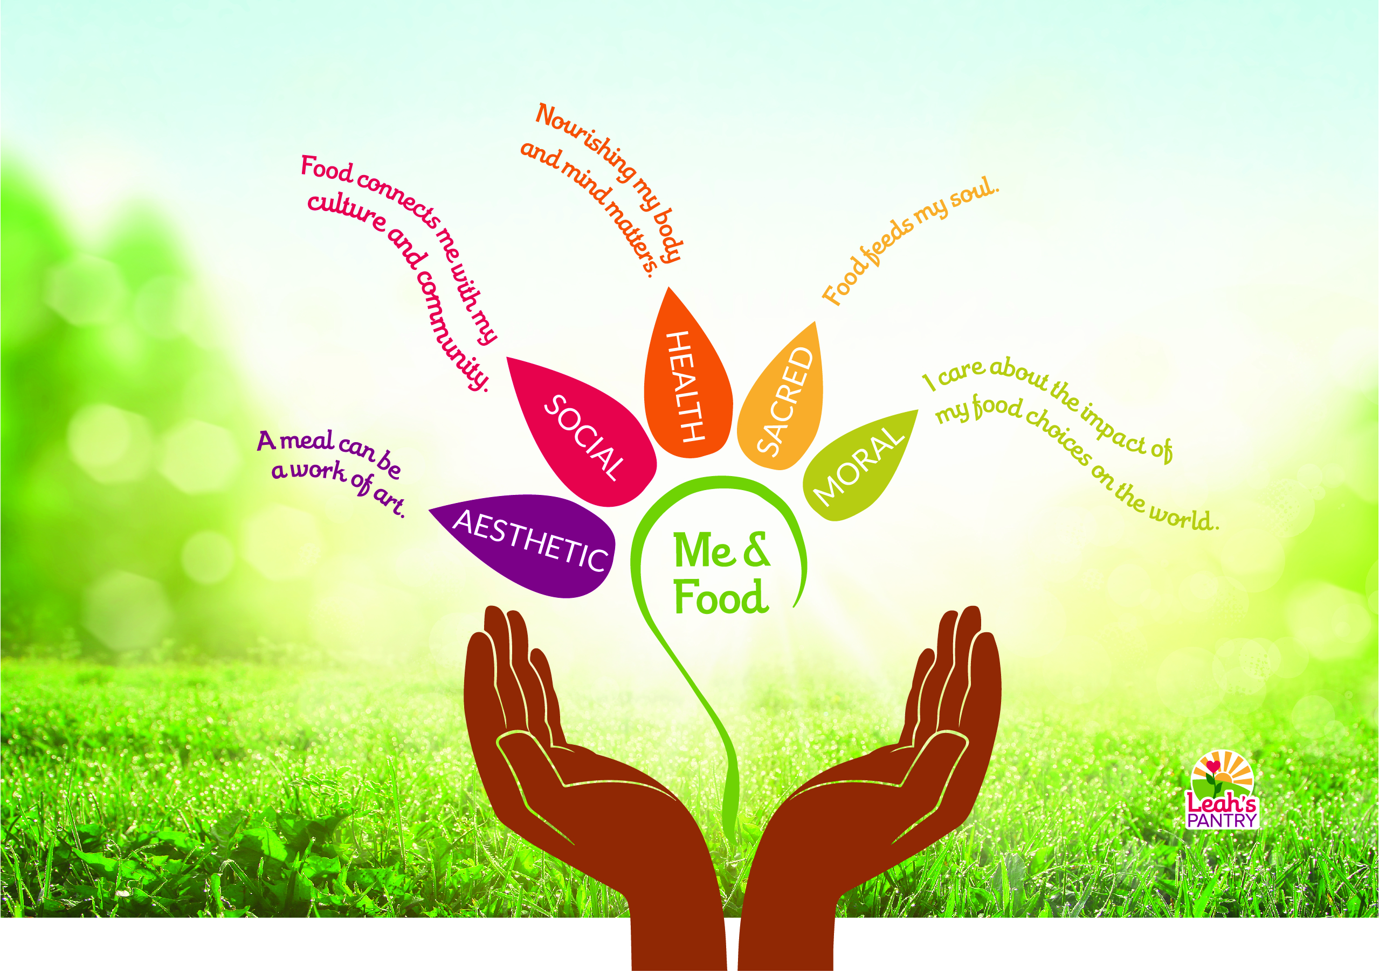

Slide 8
Pillars Of Food Nutrition Security
Food Resources Sufficient quantities of nutritious food available on consistent basis.
Food Access Sufficient resources to obtain appropriate foods for a culturally appropriate and nourishing diet.
Food Use A healthy environment and adequate knowledge to prepare foods that meet nutritional needs.
Stability and Self-Sufficiency
Stability of resources, access, and use over time.

Slide 9
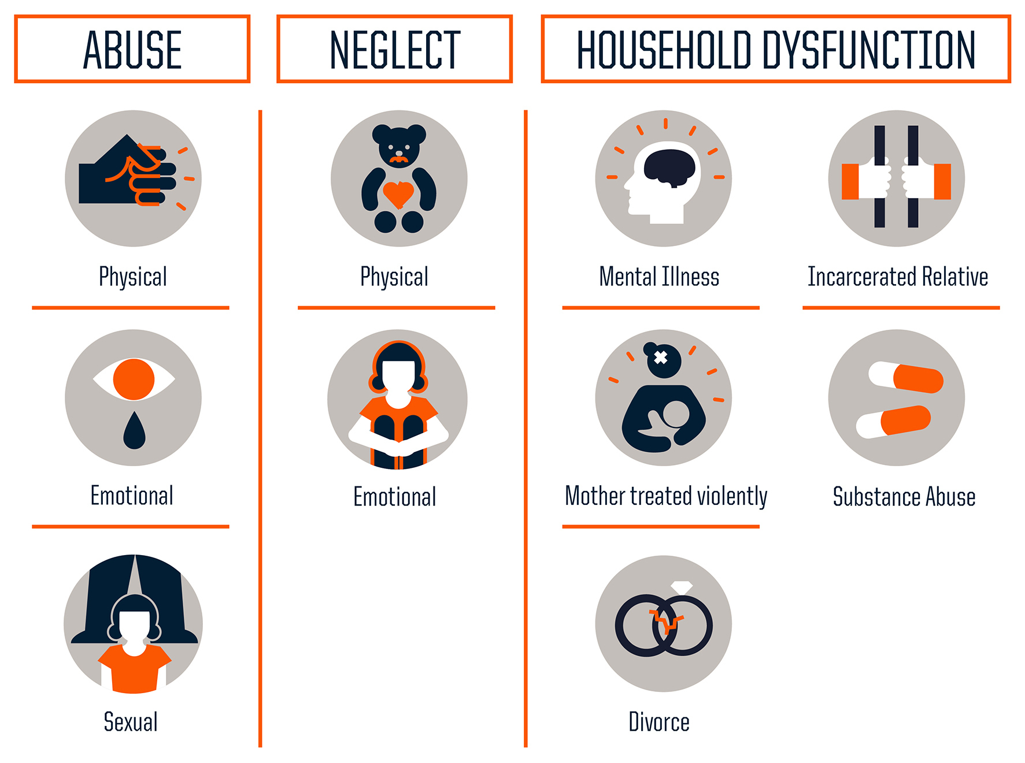
The Original ACEs study

Slide 10
Philadelphia ACE Survey (2012-3)
Witness Violence
Felt Discrimination
Adverse Neighborhood experience
Bullied
Lived in foster care

Slide 11
ACES: Adverse Childhood Experiences
Early Death
People with six or more ACEs died nearly 20 years earlier on average than those without ACEs.
Disease, Disability, and Social Problems
Adoption of Health-risk Behaviors
Death
Social, Emotional, and Cognitive Impairment
Birth
Disrupted Neurodevelopment
Adverse Childhood Experiences
MECHANISMS BY WHICH ADVERSE CHILDHOOD EXPERIENCES INFLUENCE HEALTH AND WELL-BEING THROUGHOUT THE LIFESPAN
Notes:
health and medicine only looks at the top 3

Slide 12
Implications for Nutritional Health
People with six or more ACEs died nearly 20 years earlier on average than those without ACEs.
Early Death
Disease, Disability, and Social Problems
Obesity Heart disease
Diabetes Kidney disease
Adoption of Health-risk Behaviors
Emotional eating Eating calorie-dense foods
Lack of sleep Sedentary lifestyle
Social, Emotional, and Cognitive Impairment
High fat/high sugar cravings Feast or famine mindset
Decreased self-regulation
Damaged metabolism Inflammation
Increased body fat Gut-brain circuitry
Disrupted Neurobiology
Adverse Childhood Experiences
MECHANISMS BY WHICH ADVERSE CHILDHOOD EXPERIENCES INFLUENCE HEALTH AND WELL-BEING THROUGHOUT THE LIFESPAN
Notes:
a whole discussion warranted, no time

Slide 13
Reframing
Caregiving/Giving Love
Feeling Loved
Seeking protection and safety
Predictability and security
Asserting Autonomy
Dysregulated hunger and satiety signals
Altered neurochemical and metabolic pathways
overfeeding
overeating
hoarding
food addiction
poor “will power”
eating disorders
weight gain
high salt, fat, sugar intake
Notes:
Feeling Loved
Protection
Safety seeking
Control
Result of neurochemical and metabolic pathways affected by trauma
binging
craving
hoarding
what are possible interpretations?

Slide 14
How might we reframe client behaviors using this perspective?

Slide 15
Food/Feeding Specific Trauma
Unreliability and unpredictability of meals
Loss of autonomy around food choices
Shame, bias, stigma of food assistance
Restriction and Control
Fat shaming
Manipulation, punishment or rewarding with food
Loss of food culture
Food as a tool of oppression
Notes:
Food itself can be a source of trauma or dysregulation

Slide 16
Two Perspectives
Trauma of any kind can cause disruption in a healthy relationship with food
Food itself can be a source of trauma, which begins or exacerbates an unhealthy relationship with food
Therefore, the relationship between food, individuals, families, and communities must be treated with care and a holistic perspective
Notes:
Feeling Loved
Protection
Safety seeking
Control
Result of neurochemical and metabolic pathways affected by trauma
binging
craving
hoarding
what are possible interpretations?

Slide 17
Well Intentioned Tensions

Slide 18
Well Intentioned Tensions
Give clients voice and choice, treat them with respect and dignity, and encourage a healthy relationship with all foods...
...but enact a policy that eliminates the distribution of any sweets. How do I reconcile health with choice? They could celebrate special occasions with healthy options?

Slide 19
Well Intentioned Tensions
There are so many great ways for pantries to improve, and many of the options don’t take too much time or effort...
....but staff are already burned out and resources are thin. How to avoid overwhelm?

Slide 20
What are tensions you feel in your work?

Slide 21
Implications to Programs
Does the program or initiative:
reduce shame, anxiety, confusion and tension?
promote safety, dignity, joy?
inspire healing and a healthy relationship to food?
Notes:
joy—motivator; program/initiative based

Slide 22
Barriers to Trauma-Informed Food Security
Rules, restriction, deprivation or scarcity mindset
Disregard of client readiness
Lack of cultural humility
Bureaucratic and non-transparent processes
“Donation dumping”; poor quality resources
Notes:
uncovered these

Slide 23
Prioritize
Client dignity, voice and needs
Stress reduction
Choice and autonomy
Food in support of mental and physical health
Culturally-relevant and accessible resources
Leveling of power dynamics in interactions
(adapted from SAMHSA’s Principles of Trauma Informed Care)

Slide 24
NPP Philosophy and Process

Slide 25
Building, supporting, and certifying a network of client-centered, health-focused food distributions.
Notes:
NPP provides a process for implementing practical, client-centered strategies for a health-focused environment in all types of food distribution sites.

Slide 26
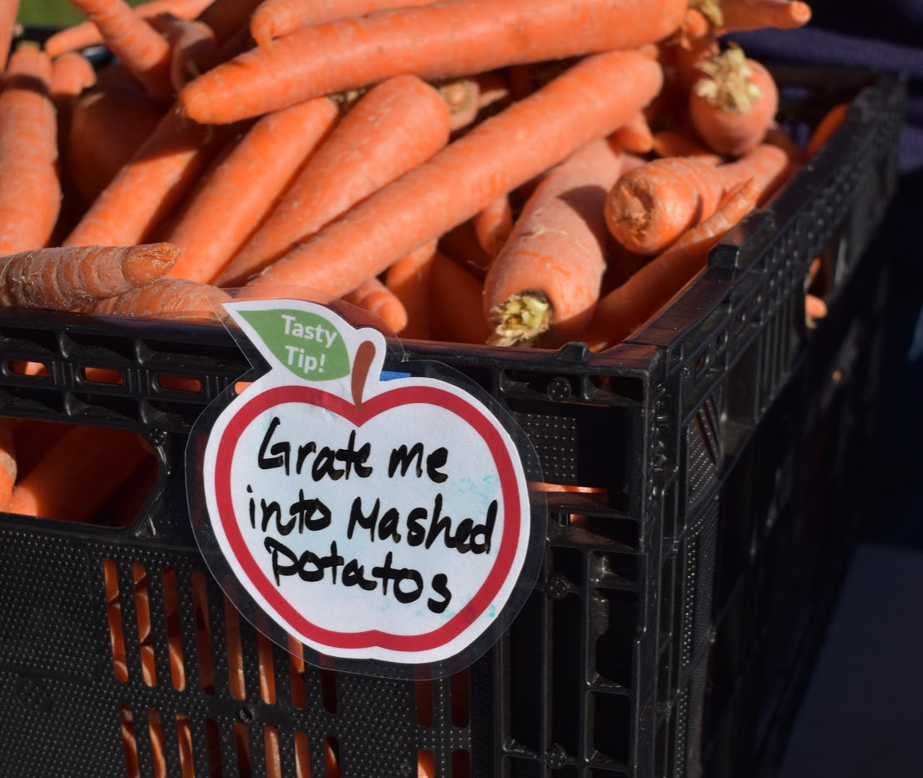
Nutrition Pantry Program Vision
Wherever free food is provided to communities experiencing nutrition insecurity:
the environment is welcoming and responsive to client needs,
the food is nourishing and appropriate,
clients feel confident preparing and consuming these healthier foods.

Slide 27
I’m nourished. I’m seen. I’m heard. I matter.
Notes:
The other thing I want to talk about when it comes to creating a food distribution center that supports the whole-person is to talk about how to incorporate trauma-informed principles in to our work with pantries.

Slide 28
^{Environment}
^{Clients are warmly welcomed} ^{and healthy options} ^{are easy to access.}
^{Nutrition Goals & Pantry Plans}
Policies and procedures are documented and align with a commitment to dignified, healthy distribution.
^{Inventory &} ^{Purchasing}
Healthy foods are prioritized for distribution. Pantries support a variety of waste reduction efforts.
^{Nutrition} ^{Education}
Clients, volunteers, and staff have access to nutrition and culinary education.
^{Cultural & Dietary} ^{Accommodations}
People of different backgrounds have access to food and information that fits their preferences and health needs.
^{Community} ^{Connections}
Pantries connect and collaborate with the community.
Notes:
The program addresses 6 focus areas at pantry sites.

Slide 29
Process
1
2
Preparation
Complete the Healthy Food Pantry Assessment
Collect client input
Work Plan Creation
Document existing work in each focus area
Assign initial growth stage for each focus area
Select appropriate interventions
Receive training and resources & implement
Seed—has not yet begun to work in the area, but would like to
Sprout—has started work, and may even have significant work; can provide examples, but still wants to do more
Bloom—has evidence of activities in this area; currently satisfied with efforts
Notes:
Average program completion is 6 months and comprises of 3 phases.
Pantries begin by completing the Healthy Food Pantry Assessment and collecting client input.
Then, a Work Plan is created documenting work in each focus area.

Slide 30
Process
3
4
Certification
Implement work plan and document additions or improvements
Complete Healthy Food Pantry Assessment
Leah’s Pantry will work with pantry to determine whether Silver or Gold Certification is appropriate based on focus area stages
Maintenance
Review work plan annually for improvement opportunities
Share your Nutrition Pantry work in the community

Slide 31
Benefits of Certification
Part of a network of certified pantries
Recognition in the community
Leadership opportunities through presentations, trainings, conferences, and mentorship of other pantries
Motivation and alignment opportunity for staff, volunteers, Board members
Cutting edge thinking around trauma & nourishment
Access to funding opportunities

Slide 32
NPP Results Snapshot

Slide 33
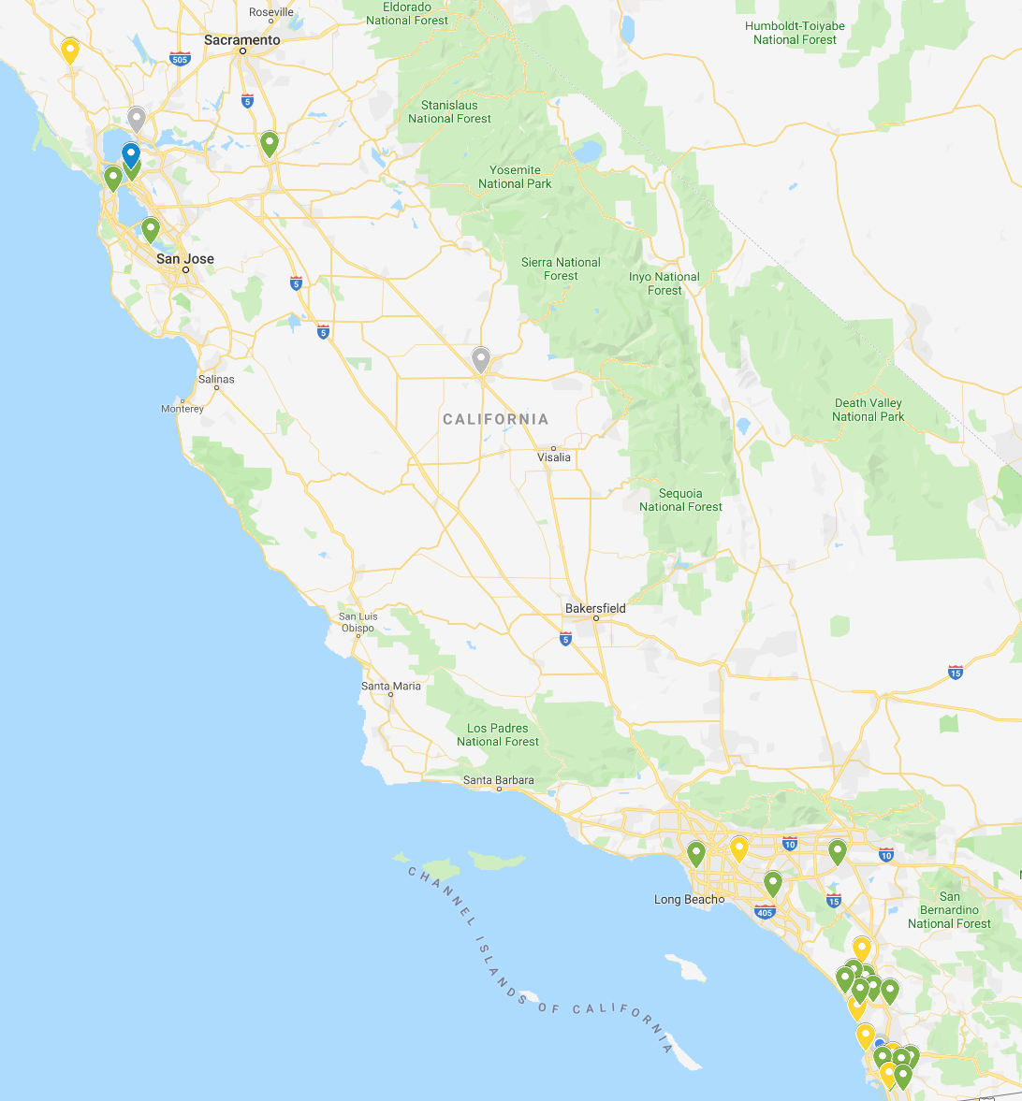
Statewide Snapshot
12 Graduated Pantries
7
Certified Gold
1
Certified Silver
18 (+5)
Pantries in Process
13
Counties with NPP in their 3 –year IWP

Slide 34
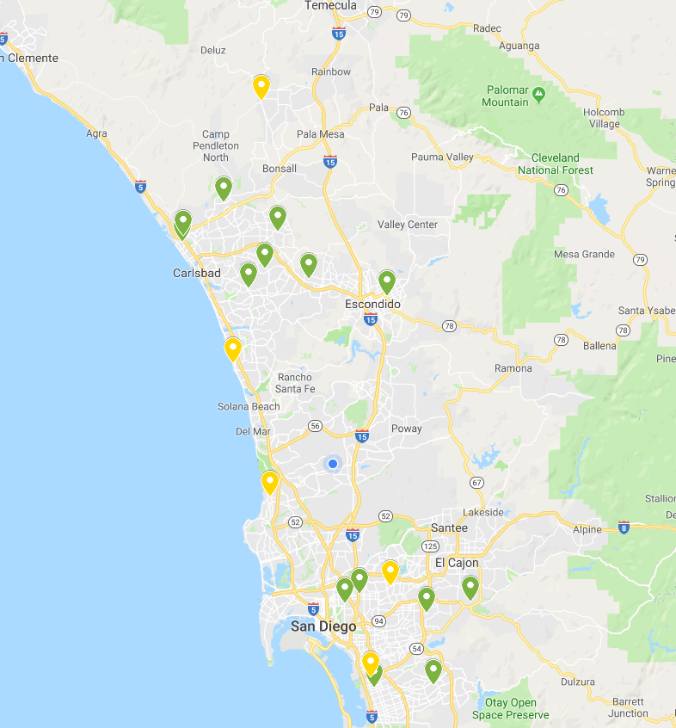
San Diego Focus
7 Graduated Pantries
5
Certified Gold
10 (+5)
Pantries in Process
11
Trainings/Conferences
4
Major Partners

Slide 35
What is happening?

Slide 36
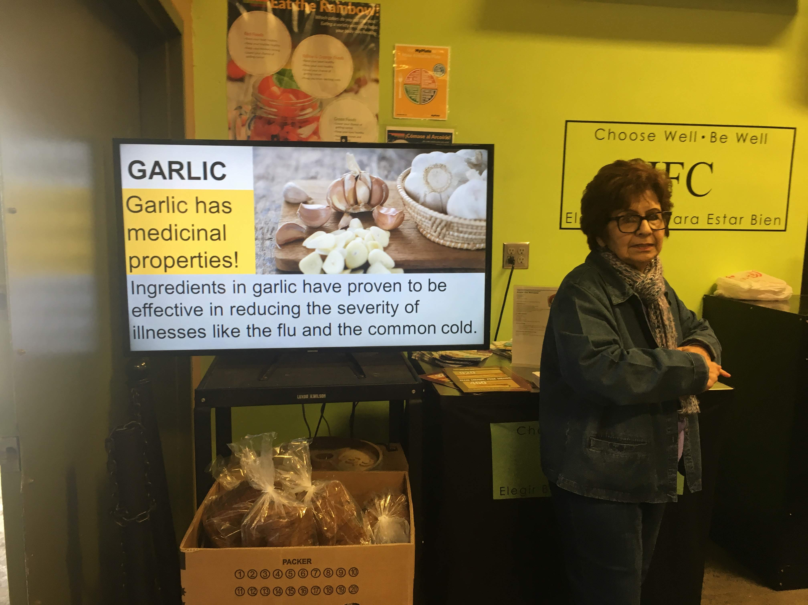
Nutrition Education
Nutrition Corner (IFC)
Microwave Workshops (MiraCosta)
TV playing EatFresh.org videos in waiting area
EatFresh.org Mini Course during staff and volunteer meetings
Individual RD or Nutrition Ed Consults for clients
InterFaith Food Center, Santa Fe Springs

Slide 37
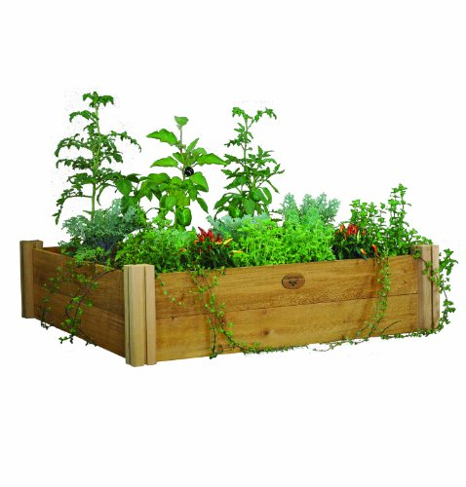
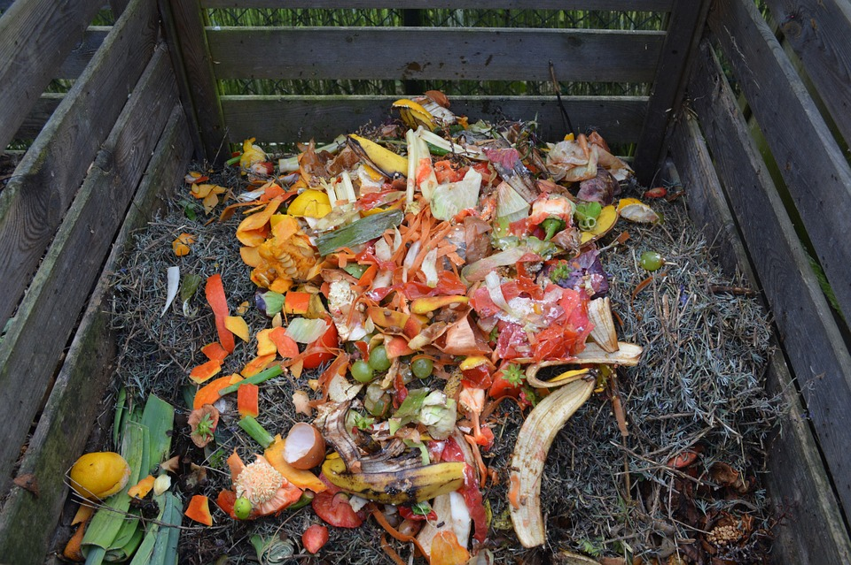
Reducing Waste
Composting and gardening (St. Margaret’s Center)
Agricultural feed
Working with donors

Slide 38
Community Connections
Smart collaboration of complementary programs
Use client needs assessment to seek out new partnerships
Focus on high quality referrals
Considering neighborhood food security – micro planning
Being proactive about creating space for dialogue

Slide 39
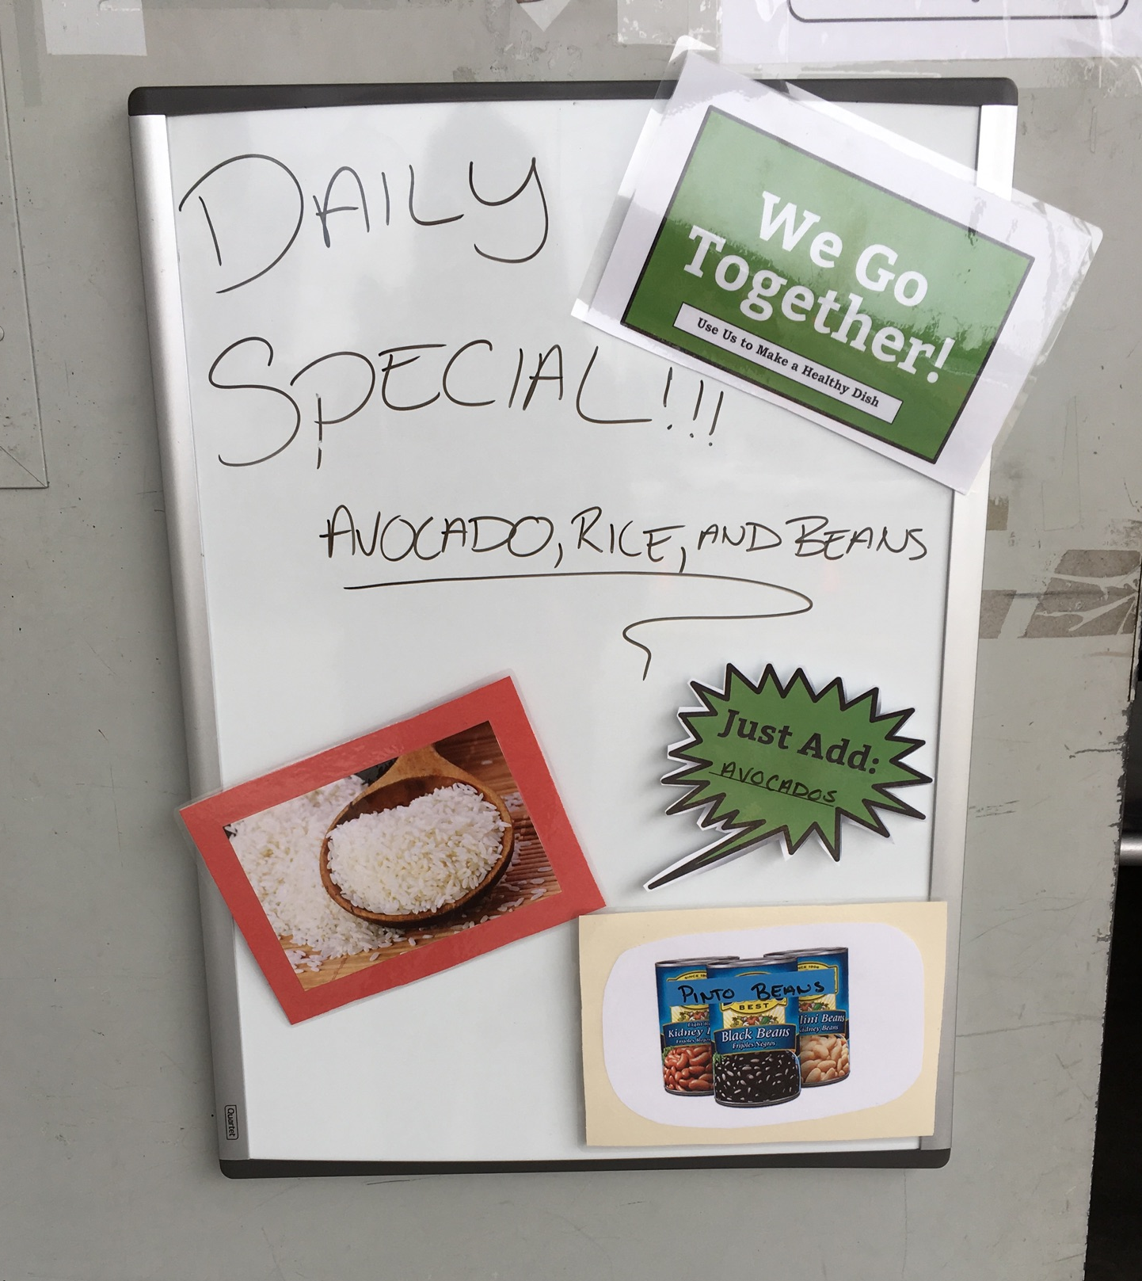
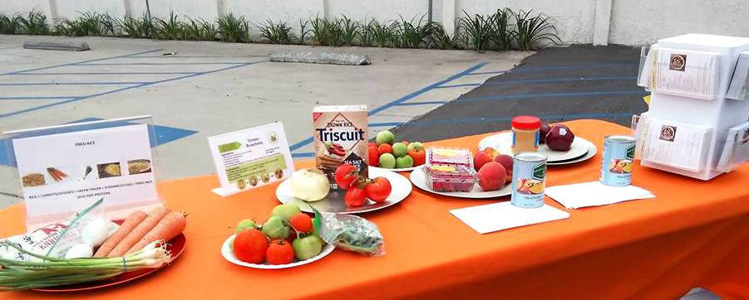
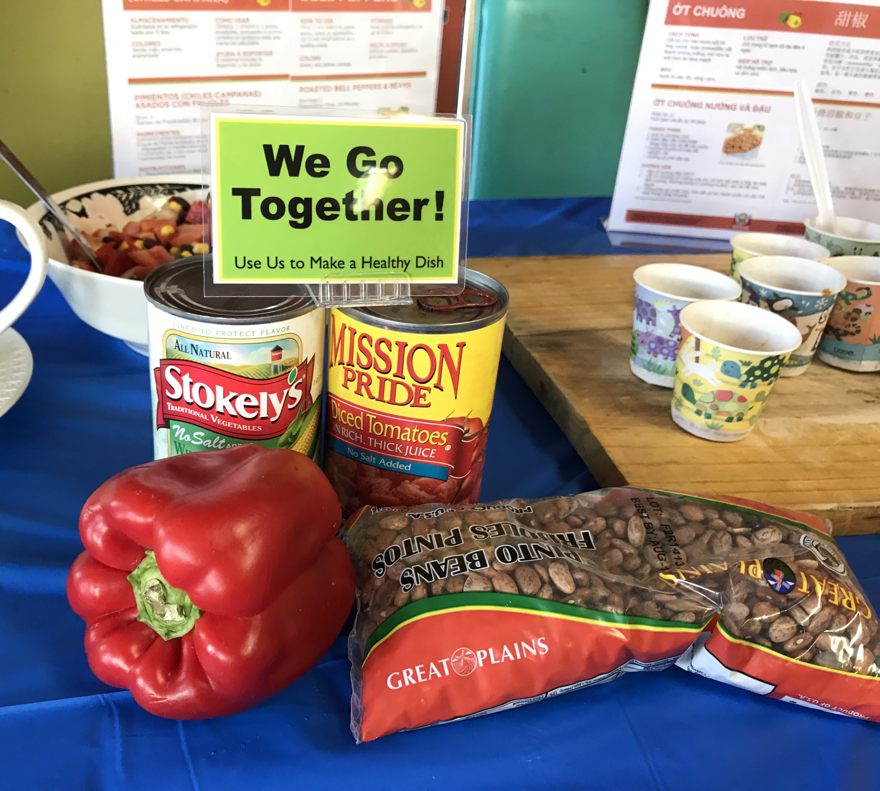
Normalize – How Do I Use this Food?
Bundling Provide snack & meal ideas by
displaying pantry ingredients
CC Fresno
Harbor House
Oakland
Turning the Hearts, Chula Vista

Slide 40
NPP For All (pantries)

Slide 41
NPP as a Network
Food Waste Reduction Partners
Support
Support
Trauma Informed Partners
Nutrition Education Partners
Silver Certified Pantries
Focus Area Super Stars & Graduated Pantries
Food Pantry and Food Bank Community
Gold Certified Pantries
CalFresh and other government agencies
Food Access Partners
Support and Innovation
NPP Ambassadors
Food as Medicine Partners

Slide 42
Which areas are you excelling in?
Which areas are a struggle?
^{Inventory &} ^{Purchasing}
^{Environment}
^{Nutrition Goals & Pantry Plans}
.
^{Cultural & Dietary} ^{Accommodations}
^{Community} ^{Connections}
^{Nutrition} ^{Education}
Notes:
The program addresses 6 focus areas at pantry sites.

Slide 43
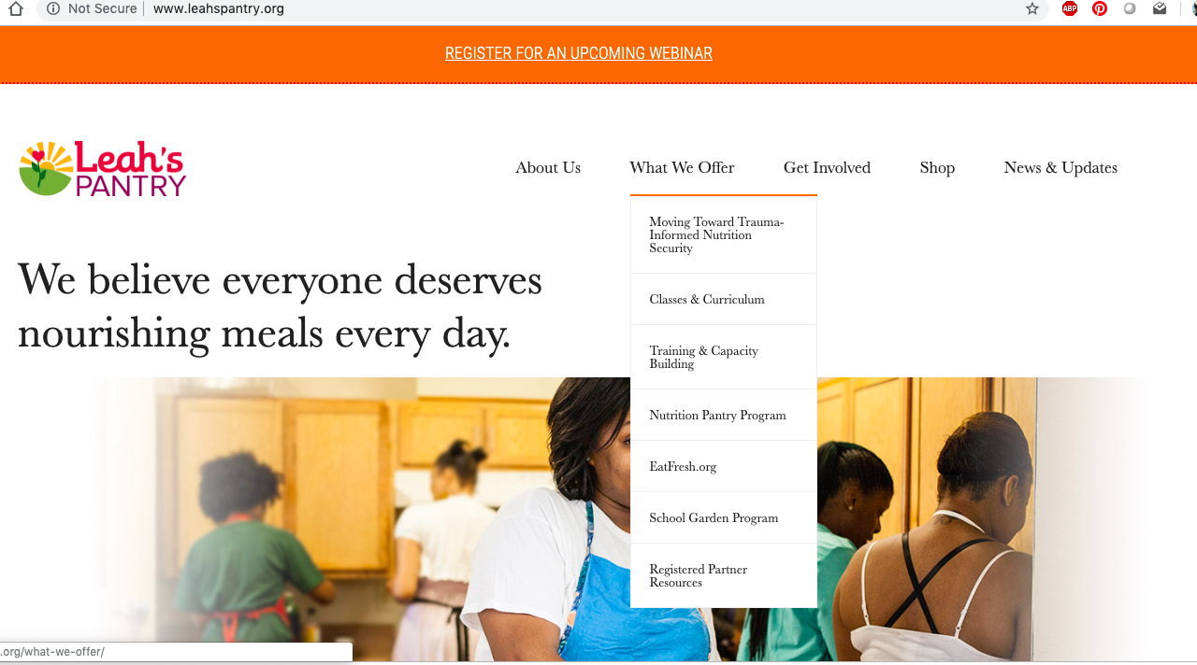
NPP Partner Resources
Past & future webinars,
Training registration
Access to NPP, EatFresh.org, & Food Smarts resources

Slide 44
NPP Partner Resources (selected examples)
Getting Started
Healthy Food Pantry Assessment
Implementation
Cultural & Dietary Tip Sheets
EatFresh.org toolkit
Signage
Nudges & Recipe Bundling Resources
Other Signage, Posters & Tips
Surveys & Client Feedback
Examples of Strategies
Donor Communications
Nutrition Ed Handouts

Slide 45
Training Opportunities
Webinar: Using EatFresh.org to Reduce Household Food Waste
Thursday May 16th, 10:00-10:45am
Signup: www.leahspantry.org
Food Smarts for Food Pantries Training
L.A. Dates TBD
Open to all levels of participation

Slide 46
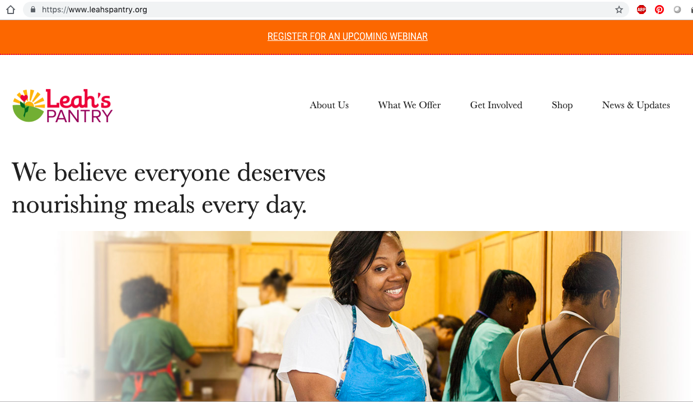
Register Here

Slide 47
What are the client-centered& health-focused things you see happening at food distribution sites?

Slide 48
What are barriers to providing a client-centered, health-focused distribution?

Slide 49
Q&A
Questions?

Slide 50
Contact Us
Adrienne Markworth
adrienne@leahspantry.org
415-710-2729
Notes:
*********************************************

