Slide 1

Food Bank 101
2021
Notes:
Welcome + Housekeeping

Slide 2
Housekeeping
Please remained muted

Slide 3
Introductions
Please enter in the chat box:
Name
Agency Name
How long have you been at the organization?
Other Information you would like to share
Notes:
Order: Liz, Agencies, (LaRonda, ask Michael), Team
Housekeeping: Chatbox options (Alexis will be reviewing the chatbox) / Questions at the end.

Slide 4
Agenda
Available Programs
Pick up V.S. Delivery
Warehouse location
LARFB Policies (COVID)
Pantry Locator
Agency Express
Reporting
Communication
Q & A
Notes:
Programs - EH, TEFAP, Diapers, CAFB kits
Logistic Constraints
AE - Log In and how to Use
Reporting
Communication - Email, Text, Cell

Slide 5
Available Programs
Type of Program | Details
Extra Helpings | Perishable food rescue program that routes food from retail grocery stores directly to an agency. The items that are available through program are frozen, refrigerated, baked goods, produce, eggs, and many dairy products. Agencies that participate in this program are required to distribute at least once per week.
CAFB Kits | Pre boxed kits of non perishable shelf stable items available for pick up at one of our locations

Slide 6
Delivery
Agencies have the option of receiving delivery or picking up their order
Deliveries hours are 8:00 am – 12:00 noon
The Los Angeles Regional Food Bank received a grant to cover delivery fees during the pandemic. Fees will be waived until further notice.
Fees range from $14-$22 per 1000 lbs depending on the distance from LARFB to your site
When calculating fees, pounds will be rounded up to nearest thousand
We offer door to door deliveries in all other areas of L.A. County
Minimum weight requirement is 2,000 lbs

Slide 7
Pickup Procedures
To make your trip to the Food Bank easier, please abide by the following procedures when picking up your order.
Agencies may arrive at the Food Bank no more than five minutes before your scheduled appointment
The parking lot attendant will guide you to a vacant space.
You are limited to one commercial vehicle or two regular sized vehicles in a vacant parking space.
Agencies with more than one site will not be allowed to separate their order on Food Bank property

Slide 8
Warehouse Locations
Main Warehouse and Front Dock Shopping
1734 East 41st Street, Los Angeles, CA 90058
Commerce Warehouse
6055 Randolph, Commerce, CA 90040

Slide 9
LARFB Policies
To abide by all applicable federal, state and local laws, rules and regulations regarding the safe and proper handling of donated goods
To ensure that the donated food and other product conforms to any applicable provisions of the Federal Food, Drug and Cosmetic Act (as amended) and any \regulations that follow.
Not to discriminate in the provision of service, against any person because of race, color, citizenship, religion, national origin, ancestry, age, marital status, disability, sex, sexual orientation including Gender identity, unfavorable discharge from the military or status as a protected veteran.
To ensure that the agency and its representatives treat all clients, volunteers, staff, and Food Bank representatives in a professional manner in demeanor, language, and actions
To give (at no charge) food and other items obtained from the Food Bank directly to agency’s clients regardless if agency paid shared maintenance fees or purchased items from the Shop, Smart and Save program. Agency cannot request or require donations from clients. Agency cannot request or require clients to exchange service time for food or other items received from the Food Bank.

Slide 10
LARFB Policies
To ensure that agency staff and/or volunteers only receive food and other items obtained from the Food Bank if they are considered low-income. Staff and/or volunteers receive the same food items and number of food items as all other clients. Staff and/or volunteers will not receive preferential treatment and are not allowed to select their own items.
Not to directly or indirectly sell, exchange, barter, transfer or charge a fee of any kind for food or other items received from the Food Bank. Not to share food or other items received from the Food Bank with any other non-profit or religious organization without prior written approval from the Food Bank.
Not to violate food safety or distribution policies. If notified by the Food Bank, of any violation(s) the agency will need to submit a corrective action plan in writing and will need to correct the violation(s) before it is allowed to receive food and/or other items from the Food Bank.
Not to distribute food and other product received from the Food Bank outside of Los Angeles County.
To provide and utilize cold and dry storage space to ensure the integrity of the food until it is used and/or distributed.

Slide 11
Covid Procedures
While on LARFB premises, all persons must wear a mask unless they are inside their vehicle.
While on LARFB premises, all persons must follow social distancing and remain at least six feet apart.
Once you advise IOC personnel that you have arrived, please return to vehicle. Stay in your vehicle or right next to your vehicle.
Avoid gathering in groups while in the parking lot. There are multiple forklifts and vehicles moving throughout the parking lot.
Do not approach forklift operators with questions regarding available products or inventory. Please direct all questions to the front dock support personnel.

Slide 12
Pantry Locator
All agencies conducting public distributions will have the information of their organization posted on our websites pantry locator
The name of the organization, distribution address, days and hours of service and contact telephone number will be posted and available to the public
https://www.lafoodbank.org/find-food/pantry-locator/

Slide 13
Agency Express
Website Link: http://www.agencyexpress3.org
Main Warehouse Location Commerce Warehouse Location
Login User Information Login User Information
USER NAME: AE + Agency Number USER NAME: AE + Agency Number
(example AE1234) (example AE1234C)
PASSWORD: change12 PASSWORD: change12
Program Code: 0045p + Agency Number Program Code: 0045p + Agency Number
(example 0045p1234) (example 0045p1234C)
Online ordering is closed between 12:00 PM- 5:00 PM
Youtube Video: How to order : http://youtu.be/SGwHsApv_Bk
AE1234C (AE + Age

Slide 14
Online Ordering Schedule
If your agency pick up on Monday, place your order between Wednesday after 5:00 PM to Thursday 12:00 PM.
If your agency pick up on Tuesday, place your order between Thursday after 5:00 PM to Friday 12:00 PM.
If your agency pick up on Wednesday, place your order between Friday after 5:00 PM to Monday 12:00 PM.
If your agency pick up on Thursday, place your order between Monday after 5:00 PM to Tuesday 12:00 PM.
If your agency pick up on Friday, place your order between Tuesday after 5:00 PM to Wednesday 12:00 PM

Slide 15
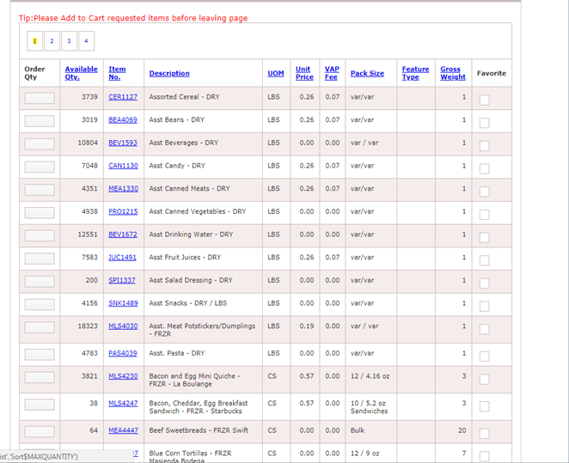
How to sort the Shopping List hyperlinks

Slide 16
Programs @ LARFB
SHOP, SMART & SAVE = THIS IS A PURCHASE PROGRAM - THE PRICES OF THE ITEMS ARE WHOLESALE BUT JUST UNDER A COSTCO OR SMART & FINAL PRICE. THIS IS NOT A FREE PROGRAM. THE AGENCY NEEDS TO PAY FOR ANYTHING ORDERED.
THE EMERGENCY FOOD ASSISTANCE PROGRAM (TEFAP) - GOVERNMENT COMMODITIES PROGRAM FOR QUALIFIED AGENCIES. AGENCY MUST DISTRIBUTE AT LEAST TWICE PER MONTH WITH ESTABLISHED DAY/TIME. REQUIREMENTS INCLUDE: CIVIL RIGHTS TRAINING FOR ALL VOLUNTEERS, POSTERS & INCOME GUIDELINES, TWO REPORTS MONTHLY.
DONATED - ITEMS WE HAVE DONATED ARE DISTRIBUTED TO PARTNER AGENCIES. ITEMS ARE ORDERED USING AGENCY EXPRESS.
Notes:
EXPLAIN THAT WHEN AN AGENCY SEES THE CREDIT LIMIT ON THEIR ACCOUNT IT DOES NOT MEAN THAT LARFB IS ALLOWING THEM TO ORDER $1,000 ON THEIR ACCOUNT WITHOUT HAVING TO PAY US. IT MEANS THAT THEY CAN ORDER UP TO $1,000 BUT NEED TO PAY US THE AMOUNT THEY ORDERED.

Slide 17
Pick up/Delivery Day
If would would like to schedule your day now.
Enter in the chat box, your agency name and day.
We will contact you later to discuss time.

Slide 18
Reporting
Monthly Reports due dates depends on program.
Not submitting your reports in time will cause your account to go on HOLD
Its is very important to submit your report as this will help us increase your agencies max factor

Slide 19
Communication
Most communication is done through email
Please make sure to provide us with updated contact information when personnel at agency changes
We also have a text program where we send updates directly to your cell phone
Complete the form to receive text message alerts by opting- in here https://forms.gle/CZy9iiUbhit3rTRX8

Slide 20
Q&A
Notes:
Feedback from Team:
Excel + Google Sheets
Questions & Answers
Agencies can unmute themselves to provide questions and comments.

Slide 21

The Emergency Food Assistance Program (TEFAP)
21

Slide 22
What will be covered?
1) What is TEFAP?
2) TEFAP Agreement
3) Policies
4) Civil Rights Training
5) Signs/Posters
6) Sign-In Sheets & Income Guidelines
7) TEFAP Reports
8) Files
22

Slide 23
What is TEFAP?
The Emergency Food Assistance Program is a federally funded food program which distributes USDA commodities to nonprofit and government agencies. These agencies in turn distribute commodities to qualified individuals/families free of charge.
23

Slide 24
TEFAP Agreement
Participating TEFAP agencies must have a current TEFAP agreement on file with the Los Angeles Regional Food Bank. The agreement states the TEFAP policies that must be kept in order to maintain participation in the program.
24

Slide 25
Policies
Recipients should never be asked to donate money or time in exchange for TEFAP commodities. Donations of any type can not be requested i.e. for bags or transportation costs.
The only requirement for a recipient to receive TEFAP commodities is to self-certify using the income guidelines and to sign the TEFAP sign-in sheet. Agencies may not ask recipients for proof of income.
Agencies that ask recipients to complete an application or intake interview in order to receive food must advise recipients it is not a required in order to receive TEFAP commodities only.
Agencies can not conduct political or religious activities in conjunction with the food distribution.
Agencies can not redistribute commodities to other locations or entity.
Agencies must distribute according to published days/times listed on their TEFAP agreement.
Agencies must be open to the general public.
Agencies must serve all clients regardless of service area the first time. (And every time the client returns.)
25

Slide 26
Civil Rights Training
It is mandatory to complete the Civil Rights training Annually.
All individuals that supervise and handle recipient information need to be trained
Individuals trained need to sign and submit via email:
TEFAPcivilrights@lafoodbank.org
26

Slide 27

Signs
27

Slide 28
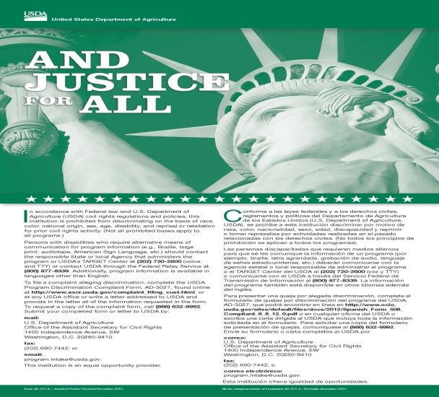
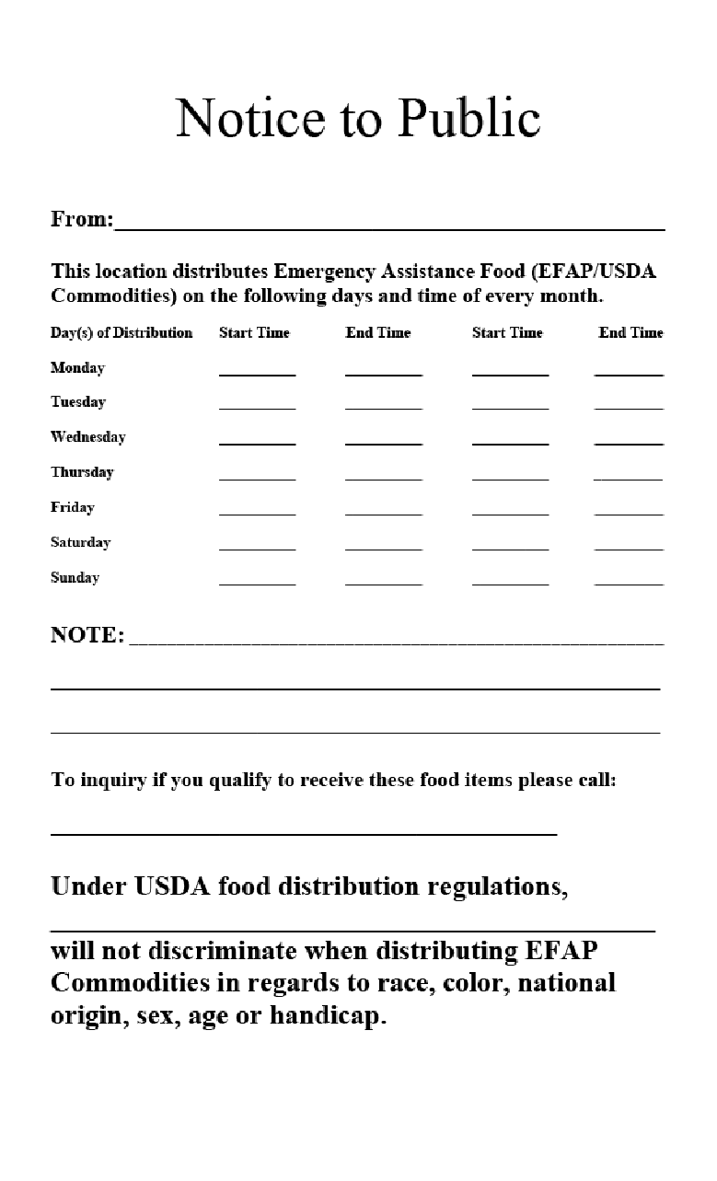

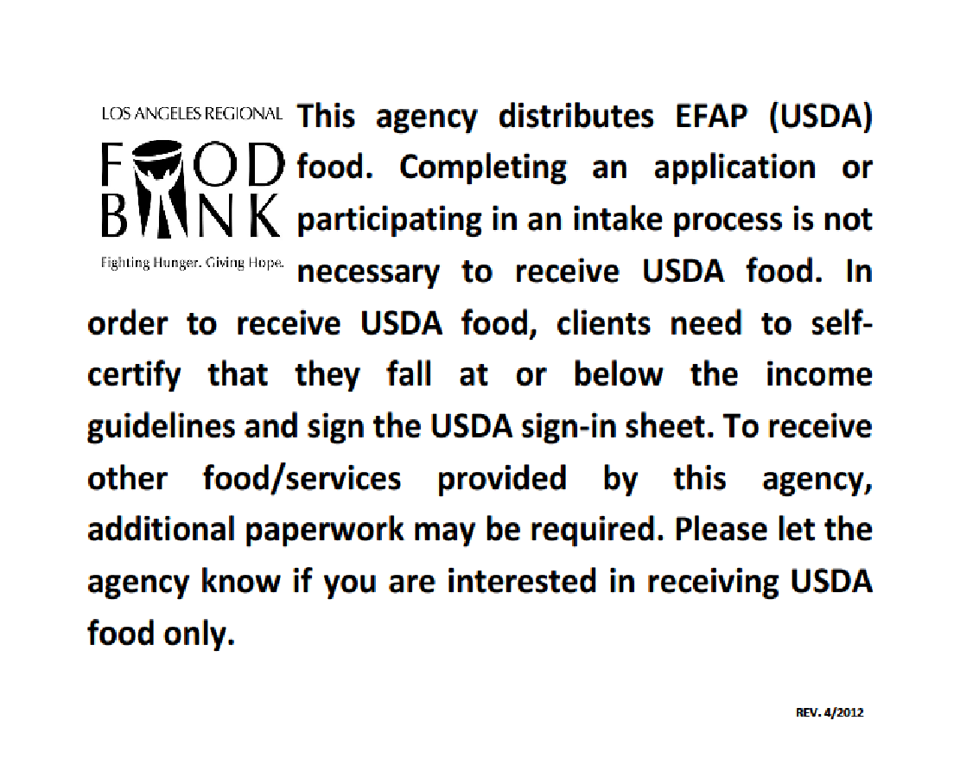
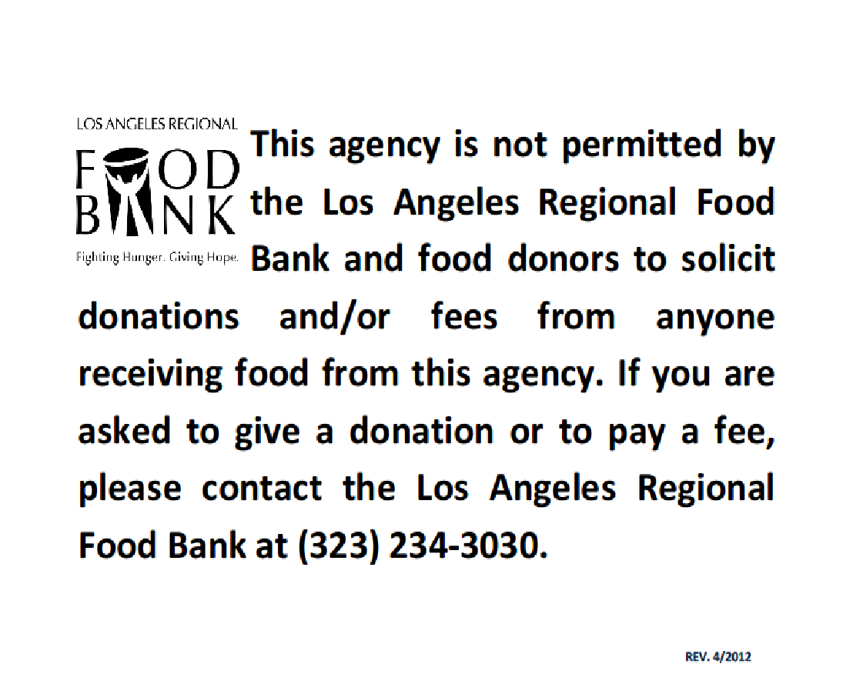
Posted During Distributions
28

Slide 29
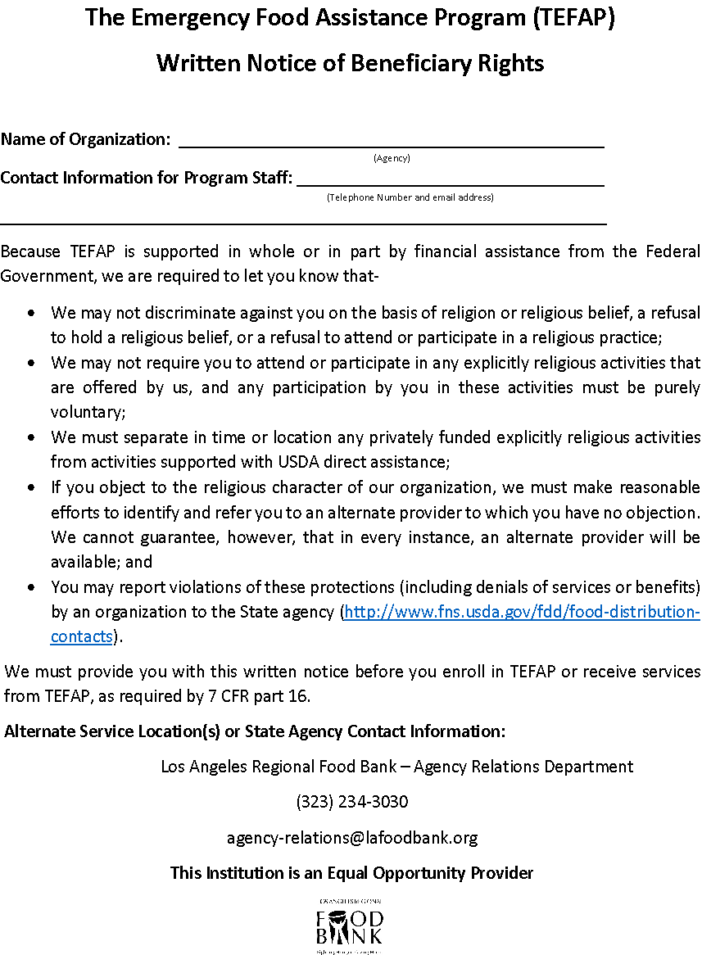
Posted During Distributions (continued)
29

Slide 30

Sign-in Sheets & Income Guidelines
30

Slide 31
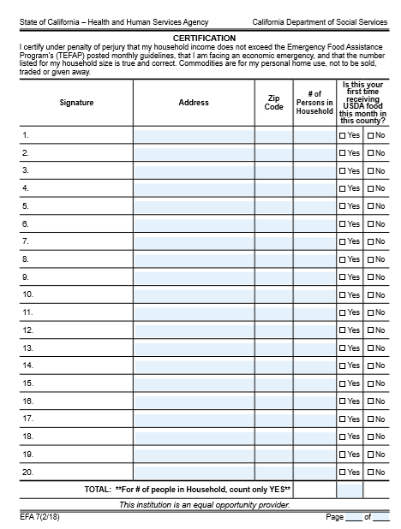
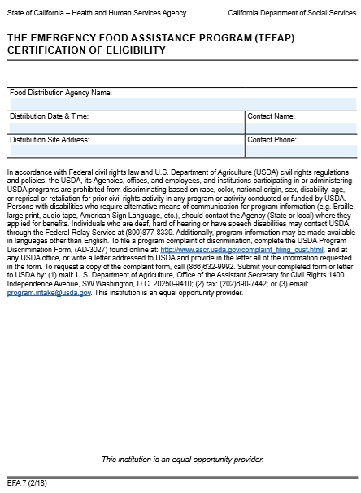
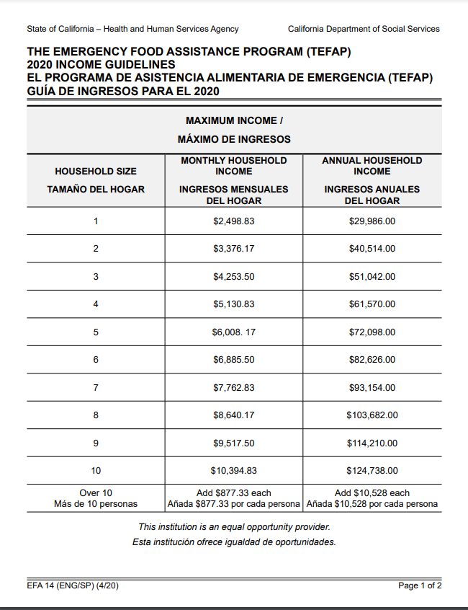
Income Guidelines &
Sign-In Sheet
31

Slide 32
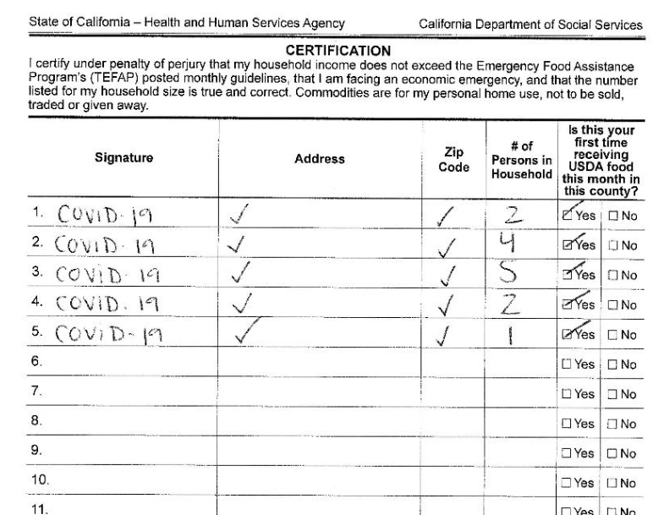
During pandemic you may sign in for your clients, No need for Address or Zip code.
32

Slide 33
Sign-In Sheet Policies
Income Guidelines must be displayed next to sign-in sheets, so that clients can self-certify.
Please make sure you are using updated income guidelines. The lower right side the form should read “Revised 4/20”.
A new sign-in sheet must be used for each day that TEFAP commodities are distributed.
Please make sure you are using updated sign in sheets. The lower left hand side, the form should read “2/18”
The heading on the second page of the sign-in sheet must be completely filled out before the distribution begins.
33

Slide 34


Monthly Reports
34

Slide 35
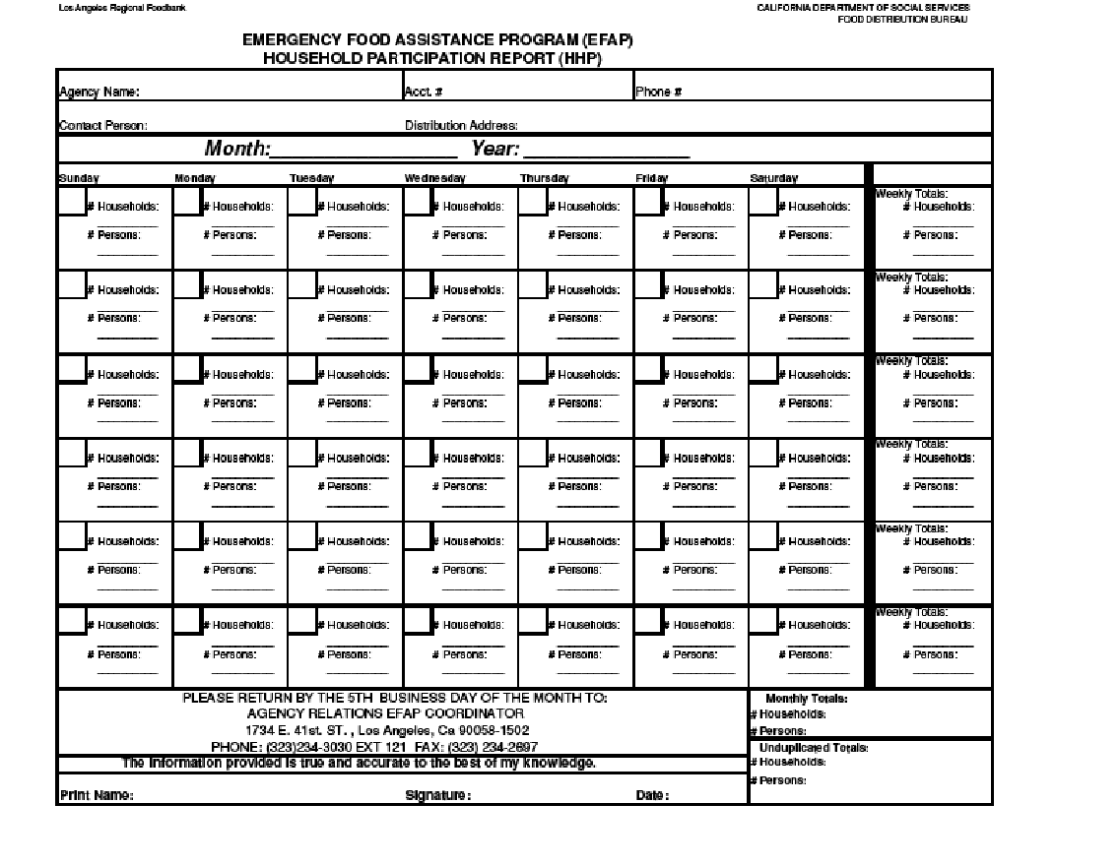
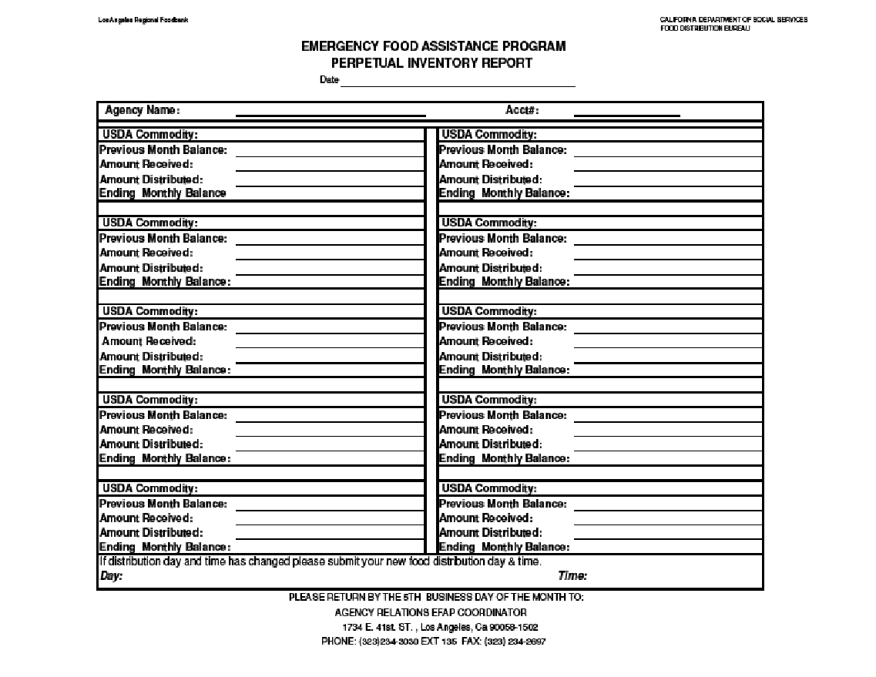
TEFAP Monthly Reports
Reports are due the 5th business day of the month.
The best way to send your report is via email
mcarreon@lafoodbank.org
Or text individual page to 323.517.7316
35

Slide 36
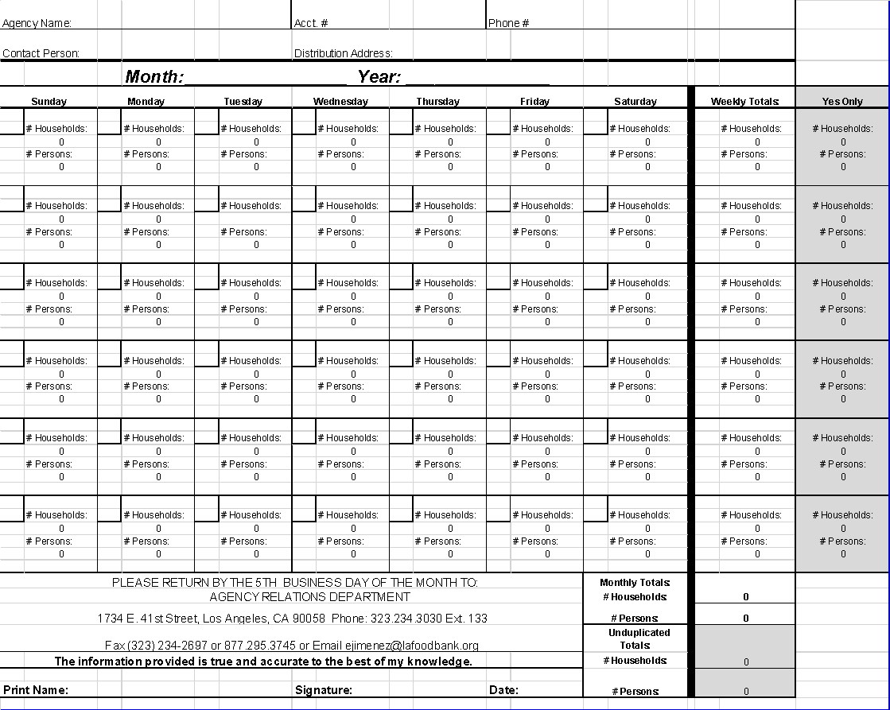
Excel Version of TEFAP Report https://www.lafoodbank.org/agency-resources/agency-forms/TEFAP-formsreports/
36

Slide 37
HHP Report – Unduplicated Totals
Importance of Unduplicated Totals - These are the only numbers that are reported to the State of California.
The households and persons are unduplicated if they answer “yes” to the question in the last column on the sign-in sheet. That is why it is important to have volunteers that can translate if needed.
Before submitting your report, review the figures to ensure they make sense. For example, unduplicated totals can not be more than your monthly totals.
You are responsible for the mathematical calculations on your monthly reports. Please double check.
37

Slide 38
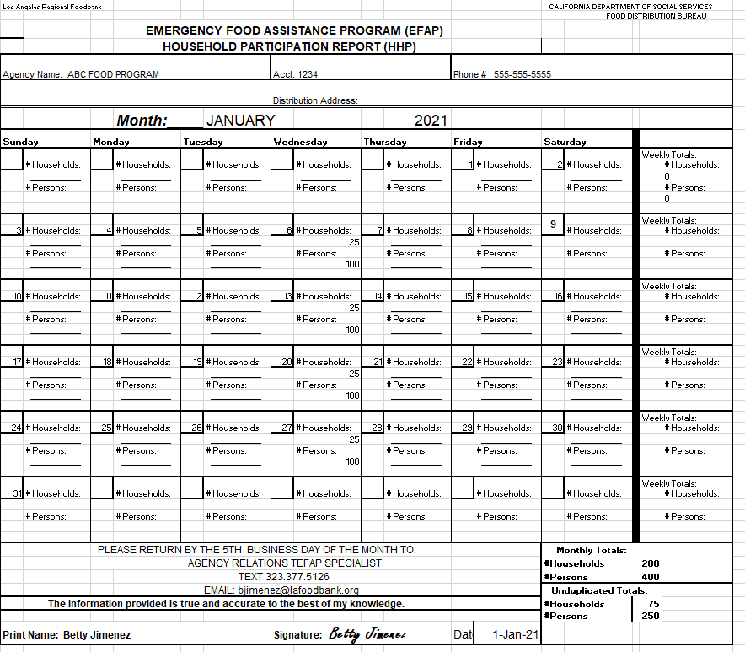
38

Slide 39
TEFAP Training
Two people from each TEFAP participating agency must be trained in TEFAP policies and reports.
Virtual TEFAP training is available at the Food Bank on a regular basis. Registration is required.
39

Slide 40



TEFAP Files
The following documents should be accessible and kept at the distribution site for 4 years:
    Monthly Reports
    Completed Civil Rights Forms
    Invoices
    Sign-in Sheets
    Temperature Logs.
40

Slide 41

Questions, please contact TEFAP Coordinator:
Milenia Carreon
mcarreon@lafoodbank.org
(323) 234-3030 Ext: 121
Text: (323) 517.7316
Created with input from:
State of California, Dept. of Social Services
41

