Slide 1
Finding the Perfect Grant Opportunity

Slide 2
Overview of Today’s Session
Research Strategies
Navigating Foundation Websites
The Foundation Directory Online
Reading 990 Forms
Keeping Track of Your Research

Slide 3
What is Grant Research?
The purpose of grant research is to find like-minded organizations that want to support your mission.
Let’s break this down.
Like-minded: This means funders that are aligned with your mission and priorities.
Support for your mission: You’re looking for funders that will provide financial support for your programs in the form of a grant.

Slide 4
Why Research?
To spend your limited resources wisely
To make your grant applications as strong as possible

Slide 5
Research Strategies: Where to Start
Look at similar organizations’ websites and annual reports to see who funds them.
Sign up for free RFP alerts from the Foundation Center (see handouts for how to do this!)
Use Google and try a variety of search phrases
“grant awards for _____”, “foundations that support ____”, “find grant money for _____”, etc.

Slide 6
Navigating a Foundation’s Website
No two websites are alike, but most websites will include:
Funding priorities
Grant guidelines: what your application will need to include
Application cycle and any deadlines
Don’t forget to check the FAQs page
Be aware that 90% of Foundations do not have websites

Slide 7
Foundation Directory Online
The Foundation Directory Online (FDO) is an online database of grants and grantmakers, along with other resources, provided by a nonprofit called the Foundation Center.
FDO is an incredibly useful tool for finding new funders, and it’s relatively easy to use.
While FDO is expensive to purchase, you can access it for free at many public libraries! A list of nearby libraries with FDO is included in the workshop handouts.

Slide 8
How to Conduct a Simple Search in FDO
When you conduct a search, you’re searching a database of more than 140,000 funders!
The basic search bar in FDO looks a lot like Google:

Slide 9
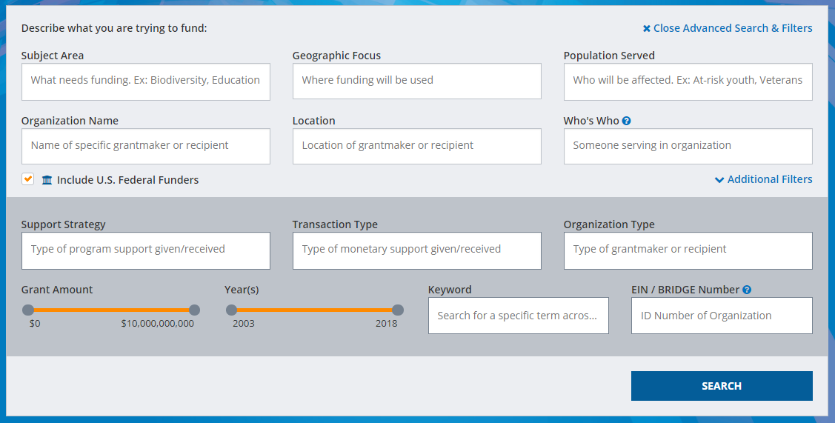
Advanced Search and Filters in FDO

Slide 10
Your FDO Search Results

Slide 11
FDO Funder Profiles

Slide 12
Reading Form 990s
Form 990s contain a lot of useful information, including:
Contact information
Board members
Giving to other organizations
Grant amounts – look for average, largest, and smallest
Giving patterns from year to year

Slide 13
Where to Find 990s
Foundation Directory Online
GuideStar
Foundation’s website
Google search

Slide 14
Research Steps: Part 1
A grantmaker has caught your eye, and you’re ready to learn more about them. You can:
Check to see if they have a website with a quick Google search
Use their website or a tool like FDO to find out:
Do they accept unsolicited proposals or do they require an invitation to apply?
Are their focus areas aligned with your program?
Do they have any restrictions? (location, etc.)
Do they list any deadlines for applying?

Slide 15
Research Steps: Part 2
Good news: You’ve read up on a
grantmaker and they still seem
like a great fit for your organization.
How can you do some deeper research, before you spend time on a grant application?
Investigate the foundation’s 990 forms
Find out whether they’ve been in the news
Check their board and staff lists and see if you have a contact who can make an introduction

Slide 16
Contacting Grantmakers
If you’re on the fence about whether to apply, it can be helpful to speak with someone at the foundation.
Don’t be afraid to call a foundation – just make sure to do your research first.
Briefly describe your program and ask whether it sounds like a good fit.
Don’t make an ask yet! Expect to go through their normal application process.
If they encourage you to apply, be aware that this is not a guarantee for funding.
Some foundations prefer not to be contacted. If this is the case, be sure to adhere to their policies.

Slide 17
Scenario 1
An associate tells you that XYZ Family Foundation gives large grants to several organizations similar to yours.
HOWEVER, the guidelines on the Foundation’s website state that giving is restricted to Orange County.
What would you do?

Slide 18
Outcomes for Scenario 1
Option 1: Check the Foundation’s 990s to see if they really only give in Orange County.
Option 2: Contact the Foundation directly to ask about giving in Los Angeles County.
Option 3: Based on your findings, either apply or move on.

Slide 19
Scenario 2
XYZ Foundation appears to be a perfect match that gives in your area.
BUT, you look at their 990s and see that the bulk of their funding goes to the same organizations every year.
What would you do?

Slide 20
Outcomes for Scenario 2
Option 1: Apply anyway.
Option 2: Contact the Foundation to ask if they recommend that you
apply.
Option 3: Look up the board
or staff to find a connection.
Option 4: Move on.

Slide 21
Scenario 3
XYZ Foundation looks like a perfect fit for your organization.
BUT, you learn that they don’t accept unsolicited proposals.
What would you do?

Slide 22
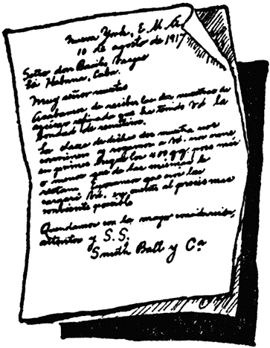
Outcomes for Scenario 3
Option 1: Look at their 990s. If their giving is diverse, you might have a chance with an introduction.
Call or send a letter of
introduction.
Option 2: Move on.
Option 3: Set a reminder for yourself to check the Foundation’s website every 6-12 months, to see if they begin accepting applications in the future.

Slide 23
Keeping Track of Your Research
Save the important information (giving categories, grant range, deadlines, contacts) and organize it in a spreadsheet.
Once you’ve decided a foundation is a good fit and you plan to apply, add it to your grants calendar.
Keep track of when and if contact has been made, including all phone calls, emails, etc.

Slide 24
How to Keep Track of Your Research

Slide 25
Closing Thoughts
Take a moment to write down some next steps for yourself. What will you do with the information you learned today?

Slide 26
What’s on Your to Do List?

Slide 27
Contact Information
Denise Ireland, Grants Manager
Email: direland@lafoodbank.org
Phone: 323-234-3030, Ext. 165
linkedin.com/in/denise-ireland/

