Slide 1
THE EMERGENCY FOOD
ASSISTANCE PROGRAM (TEFAP) TRAINING
Los Angeles Regional Food Bank
Presented by: Van Martini
TEFAP Consultant
California Department of Social Services

Slide 2
What is TEFAP?
Sacramento
Washington DC
Flow of food throughout the United States
Notes:
The Emergency Food Assistance Program
Federal program provided by the USDA
Commodities
Purchased by the USDA in Washington D.C
Transported to CALIFORNIA

Slide 3
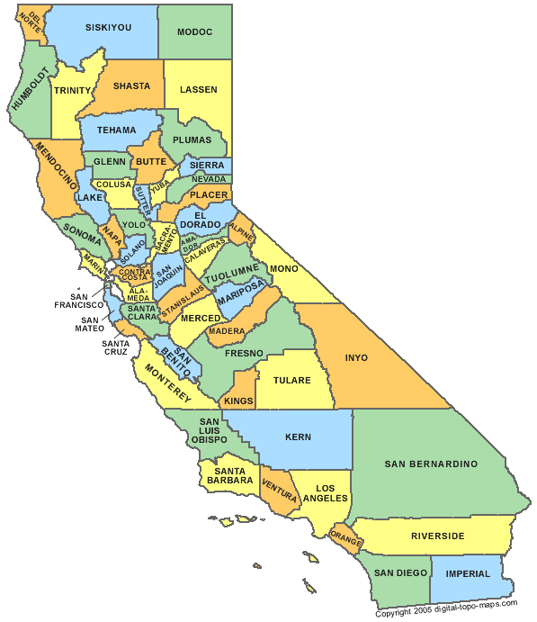
California Department of Social Services (CDSS)
Oversees at State level
50 Food Banks/58 Counties
Supplement nutrition
Notes:
CDSS oversees the program within California
50 food banks that provide the TEFAP program to 58 counties
REMINDER TEFAP is a supplemental food program

Slide 4

EFAP Requirements
EFAP POLICY AND PROCEDURE MANUAL
Notes:
The TEFAP program follows USDA regulations
The State of California also has an TEFAP procedure manual (updated 2/2021)
This presentation explains the necessary guidelines to comply with the regulations

Slide 5

Agreements-Local Food Bank
Notes:
California partners with Food Banks
Distribute throughout California
Food Banks have agreements with the State
Those food banks then in turn have agreements with their sub sites like pantries
Sub sites must have a Current TEFAP site agreement on file with THE FOOD BANK
A site agreement may not be necessary
manage the distribution (managed by the Food Bank itself)

Slide 6

Posters
Notes:
Required visible signage and forms during distributions (Rev. 9/2019)

Slide 7
Sign-in Sheets & Income Guidelines
Notes:
Income Guidelines EFA-14 (Rev. /24) & Sign-in Sheet – EFA-7 (Rev. 7/21)

Slide 8
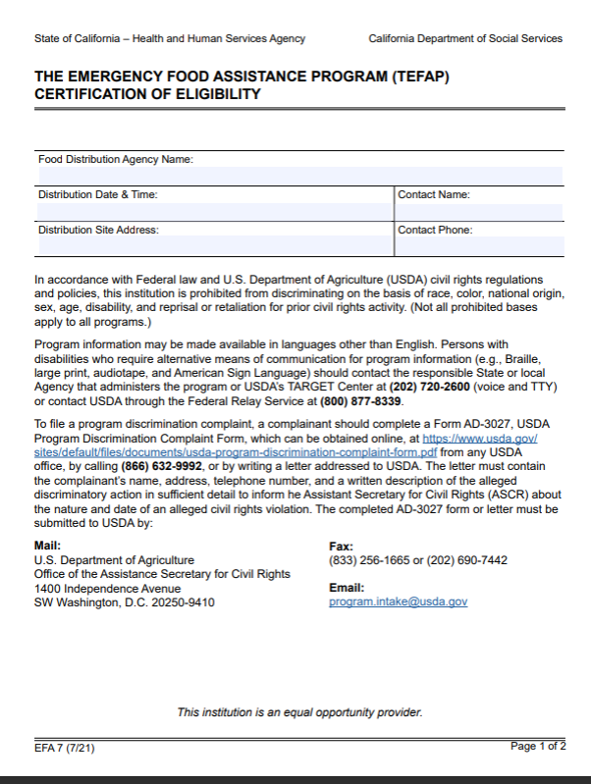
EFA-7 Form
(7/21)
Notes:
The EFA-7 form
Use current version of form (7/21)
FILL in the header with site info
YES/NO question must be filled out –
Yes means this person has not picked up prior to this visit
No means this person has picked up at another location THAT MONTH
For non duplicative household reporting purposes only count the boxes with yes
During the first distribution of every month all households and persons are unduplicated

Slide 9
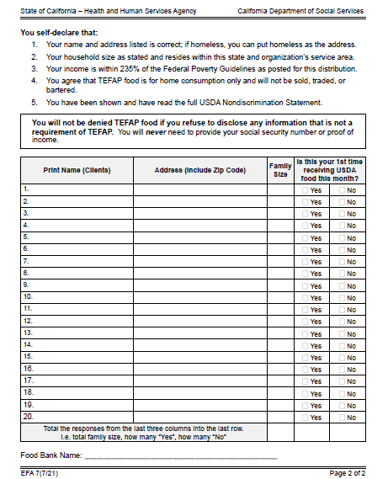
EFA-7 Form
(7/21)
EFA 7
Form (7/21)
Notes:
The EFA-7 Form, the And Justice for All poster and both the English and Spanish Income Guidelines should all be posted in sight of where the recipient signs up. Should be on a tri-fold for you.

Slide 10
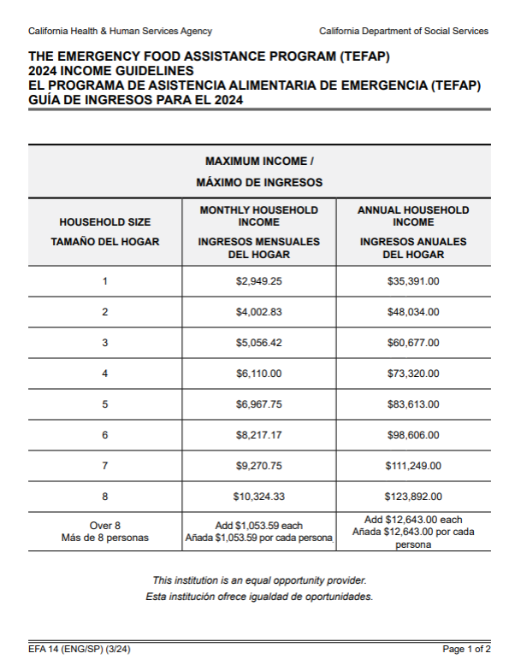
Income Guidelines
(3/24)
INCOME GUIDELINE(3/24)
Notes:
Current 3/24

Slide 11
Program Eligibility/Income Guidelines
Income within the current guidelines
Monthly or Annual Income
Only required to self-certify - May not be asked for proof of income, no SS# and etc.
2024 Forms in English and Spanish
Notes:
To qualify for EFAP program :
Recipients meet income guidelines displayed by sign in sheets
Based on monthly or annual income
MAY NOT BE ASKED FOR PROOF OF INCOME OR SSN
Only “self certify” by signing the EFA-7 form,

Slide 12
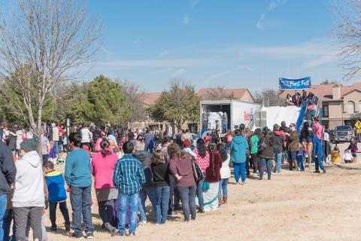
Additional Reminders About EFA -7
“X” marks the spot
Unhoused individuals must be offered TEFAP food
Notes:
If the person cannot sign, they may place an “X” and the volunteer may sign for them such as “Mary Jones for X” and then include address, zip, # in household and circle Y/N
EFAP food must be offered to the homeless; if they choose to give it back it may then be put with the regular donations and given out

Slide 13

Residency
Should reside in area
If no proof, food may not be denied if they are willing to sign EFA-7
If out of the service area, serve and advise of their site in their area
Notes:
Persons should reside in the area.
May ask for proof of residence HOWEVER, should still serve them if willing to sign the EFA-7.
Can re-direct them to contact Food Bank for closer sites

Slide 14

Alternate Person Pick Up
(section 6.5)
Notes:
Recipients may allow alternates to pick up

Slide 15
1
2
Must bring “Alternate Pick- up form” or signed note from recipient
Alternate can pick up for recipient
3
The site must attach form to EFA-7
Notes:
Alternate may to pick up for an eligible recipient.
One alternate can pick up for xxx persons
An original alternate pick up form is required annually
The alternate must bring an “ALTERNATE PICK UP” form
The pick- up form must be attached to the EFA-7

Slide 16
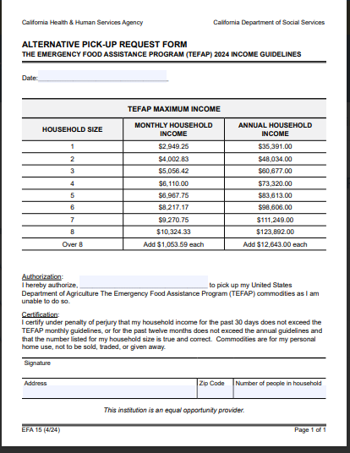
Alternate Pick-Up Form
(4/24)
Notes:
The recipient should fill in this form current version which is 4/2024.
Include the date. Put the person’s name authorized to pick up
The eligible recipient must sign the form, the address, zip code, and number in the household must be filled in
THIS FORM IS ALSO AVAILABLE IN SPANISH

Slide 17

Congregate Feeding Agency
Must serve predominantly people in need
Non-eligible persons can be served with eligible people if sharing common preparation

Slide 18
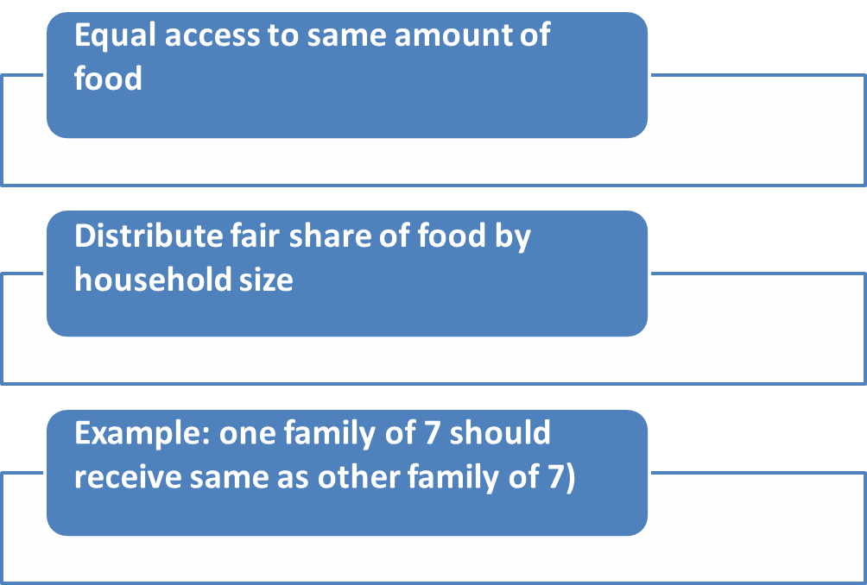
Frequency and Equity
Notes:
Participants should have equal access throughout the county, such as he/she can go to another site, if necessary.

Slide 19

Open to the Public
Must be open to the public
Prior permission for closed sites
Notes:
The site must be open to everyone from the public unless the Food Bank has previously received permission from the State to operate as a closed site.

Slide 20

Receipt and Distribution Procedure
Local food donations may be distributed with USDA commodities or in conjunction with other programs
Notes:
If the site requires an application for the donated foods, TEFAP MUST be offered first by only self certification
The donated food may then be offered after

Slide 21


End of Distribution/Donations
Must distribute during advertised dates and times
A person must stay to inform recipients of other options if the distribution runs out of food
No type of payment
MONETARY donations CANNOT be
solicited
Notes:
Must distributed during advertised dates and time and if run out must stay, no type of payment or donation requested.

Slide 22



Unrelated Activities religious, political, social
NOT during a distribution
Information not placed in EFAP containers
NOT a condition to receive commodities
No disruption or delay
Notes:
Essentially it must be clear that the religious activity is not a condition to receive EFAP foods
Cannot put flyers in the boxes or delay distribution for such things as a prayer service
Crosses, Bibles, signs, symbols are perfectly fine
Cannot require prayer or listening to political speeches to receive food
May pray before or after distribution or away from the line
May not disrupt or delay distribution

Slide 23
Additional Required forms and signage for Distribution Sites
Written Notice of Beneficiary Rights
This new form is coming soon

Slide 24

Storage

Slide 25
Storage Requirements
Health & Safety (§ 10)
Sanitary and free from infestation
Safeguard against theft, spoilage and loss
Proper temperatures
Separate and Identifiable as USDA
Off floor and away from walls
Locked and secure
Repackaging of food NOT allowed
Food Loss - contact CDSS immediately
Notes:
Storage must:
Be cleaned regularly
Use pro-active pest control measures
Stored at appropriate temps
Separate and Identified as USDA
Kept ideally 4-6’’ off the floor and 3’ from the wall
Storage of food should be locked
Repackaging of product not allowed

Slide 26
Shipment and Receipt of USDA Foods
(FNS 709-5 Rev 4)
Delivery Appointment
  not less than 72 hours prior
  If late or without appointment, should try to accept if able or reschedule for later
Destination changes
  At least 45 days in advance of the start of the delivery period
  Inspecting the Shipment
    Seal
    Quantity
    Temperature
    Condition of USDA Foods
    Bill of Ladings (BOLs)
Notes:
*Yuba Sutter does not get direct shipments – anything to note for them for inspecting shipment? Check if amount is correct especially, miscounts can happen with split loads
Once the shipment has been inspected and received, the ERA must send the BOL, by email to bol@calfoods.org, within 24 hours of delivery to the intermediary to be receipted
Documentation must include:
• Sales Order Number
• An account of over short or damaged product at the time of receipt
• The quantity received in good condition

Slide 27

Inventory
No excessive inventory
No more than 6 months
FIFO method
Check the best if used by date
Notes:
Use FIFO - first in and first out method but regularly check the Best If Used By Date.

Slide 28
TEFAP Reimbursement Process
Expenses related to TEFAP administration
All program costs in the claims for reimbursement even if they exceed their tentative reimbursement
Submit 1 EFA 4 for each program a month
Claiming Timelines:
Oct 1 through Dec 31 - 1st quarter claim due January 31
Jan 1 through Mar 31 – 2nd quarter claim due April 30
Apr 1 through June 30 – 3rd quarter claim due July 31
Jul 1 through Sept 30 – 4th quarter claim due October 31
Notes:
Providers must maintain CDSS required financial records documenting all TEFAP related administrative expenses.
Financial documentation (invoices) will be reviewed during compliance monitoring visits and upon requests

Slide 29
Allowable TEFAP Expenses (Section 16.5)
Intrastate transportation, storage, handling, distribution, repackaging, and processing
Salaries of persons directly administering program-related expenses;
Fringe benefits and travel expenses
Rent and utilities
Accounting, auditing, and other administrative services;
Computer services
Costs related to training
Costs associated with determination of eligibility, verification, and documentation
Costs associated with providing information to persons receiving USDA commodities regarding proper storage and preparation
Costs for publication of times and locations of distributions
Meals provided to volunteers, i.e., non-salaried staff, for services rendered during the distribution of USDA commodities. Meal cost must be reasonable and adequately documented with volunteer’s name, hours worked, receipts, invoices, or other evidence of the cost of providing meals, and the volunteer’s signature for each meal received.
Notes:
Both direct and indirect costs attributable to TEFAP as outlined in Federal regulations (7 CFR §251.8)

Slide 30
Acceptable Supporting Documents
A description of the allocation methodology used to calculate the expenses
A copy of the ERAs accounting ledger pertinent to TEFAP costs
An appropriate summary of expenses for the submitted quarter; or
A printout from an automated software program that summarizes TEFAP expenses
Purchase/expense request prior approval for item over $5000.00
Notes:
Contact your Consultant for the Purchase/expense request

Slide 31
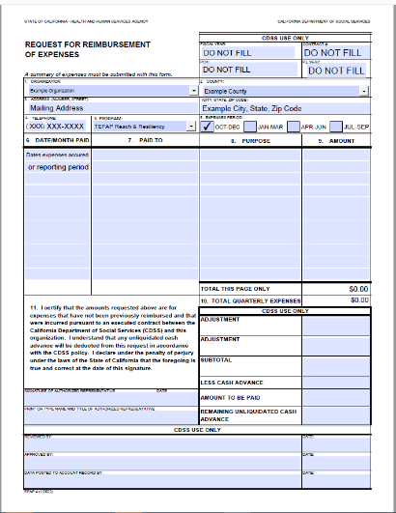
EFAP 4 Forms
(1/24)
EFAP 4 Forms
(1/2022)
Notes:
Fillable EFA 4 form (1/2022)
Fill out all sections 1-11 to include signatures and date

Slide 32
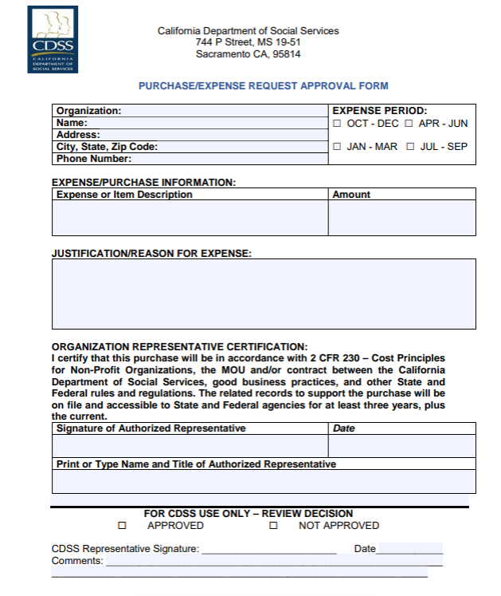
Purchase Request Approval Form
Notes:
Fillable EFA 4 form (3/2021)
Fill out all sections 1-11 to include signatures and date

Slide 33

Records and Reports (Section 14)
Accurate and complete records documenting for 3 years plus the current year
Inventory and Household Participation reports in CSFP TEFAP Inventory Portal (CTIP)
Separate CTIP Training can be scheduled
Notes:
Accurate and complete records documenting all TEFAP related administrative expenses
Inventory and Household Participation reports in CSFP TEFAP Inventory Portal (CTIP) due the last day of the month following the reporting month

Slide 34

Questions?

