Slide 1
Neighbor Intake
Jimmy Torres
Notes:
The Dream Team has rebranded to the Leadership Support Committee. Originally named to symbolize the Food Bank's ambitious goals, the Dream Team was dedicated to organizing, designing, and developing the curriculum for Leadership Team meetings to foster the leadership skills of the Food Bank's leaders. The concept was originally developed by Jeff, Weldon, and Alicia. Brainstormed how to better approach change management. The team has grown and evolved over the years.
Despite the positive intent behind the name, we decided to rebrand it to the Leadership Support Committee to better align with the naming convention of other Food Bank committees and to more clearly associate it with the Leadership Team.
If you want to join the committee and contribute to Leadership Team resources and training events, please speak with your manager about participating. Participation is open to any Leadership Team member, which includes all employees who are an analyst, lead, or higher. We highly encourage your involvement, as it’s a valuable opportunity to enhance your leadership skills.

Slide 2
Agenda
What is Neighbor Intake
Program Overview
Key Metrics
Onboarding
Q and A

Slide 3
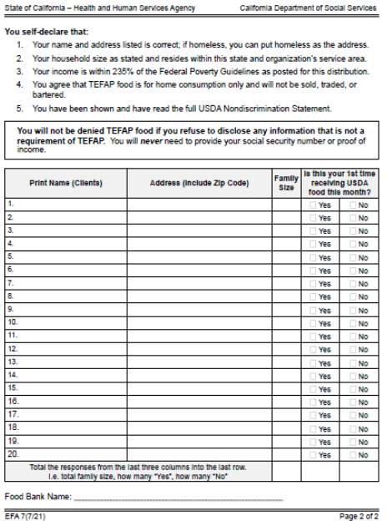
What is Neighbor Intake
Digital client tracking system provided by LARFB
No more sign-in sheets*
Free for Agencies that on-board
Household report is now digitized

Slide 4
What is Neighbor Intake
Comes with technology to help implement program
Laptops
Tablets
Scanners
Laminators

Slide 5
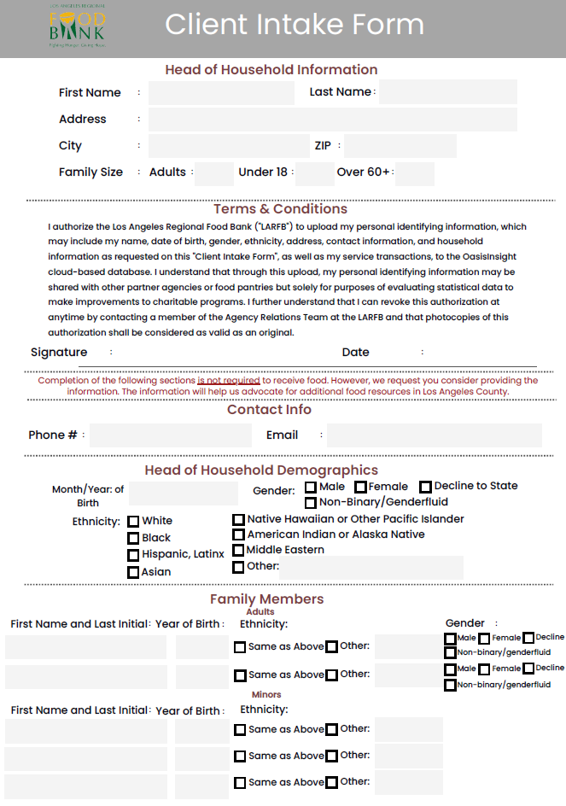
Program Overview
Everything starts with the Client Intake form
Information is kept private and secure
Form is optional and not mandatory for food
Other languages will soon be available

Slide 6
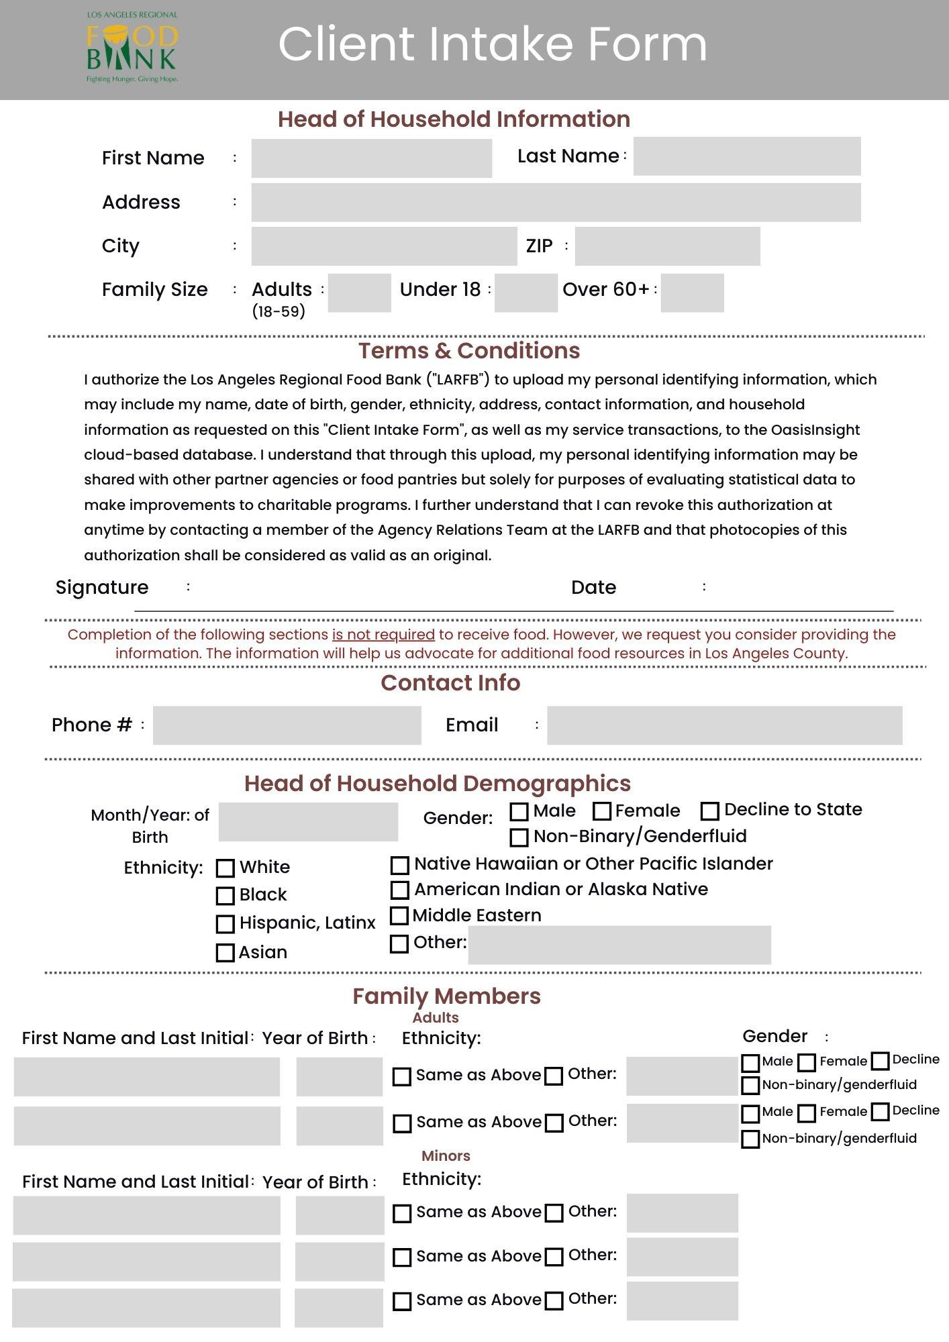

Slide 8
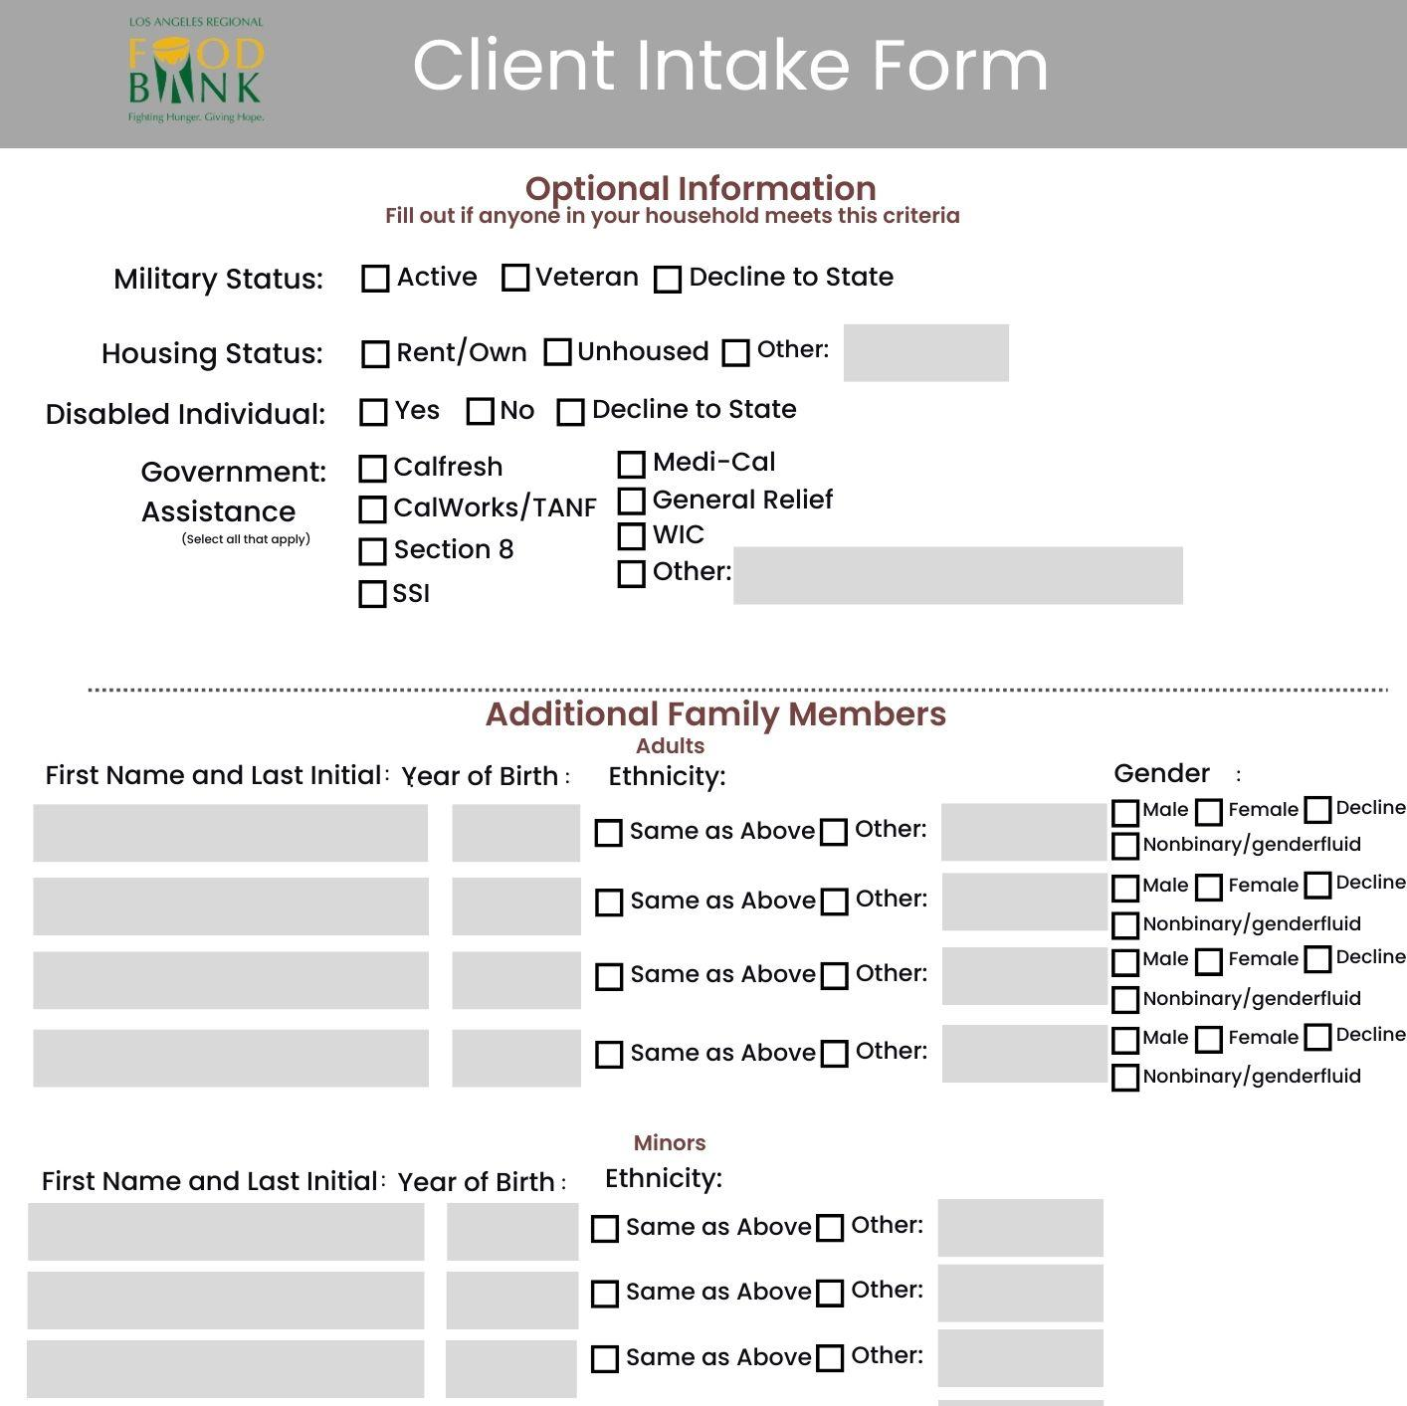

Slide 9
Program Overview
Client ID cards will be created from Intake Form

Slide 10
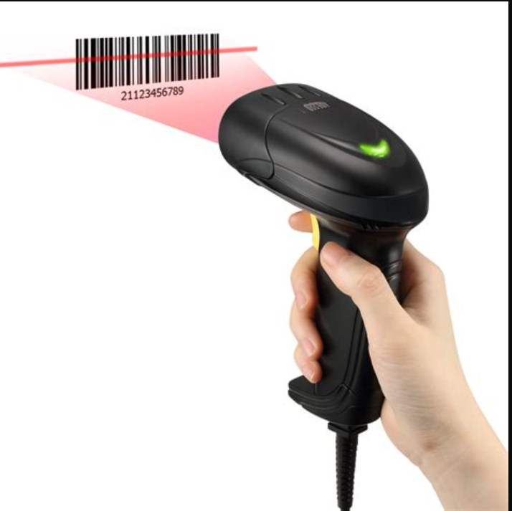
Program Overview
Clients will have cards scanned at your food distribution

Slide 11
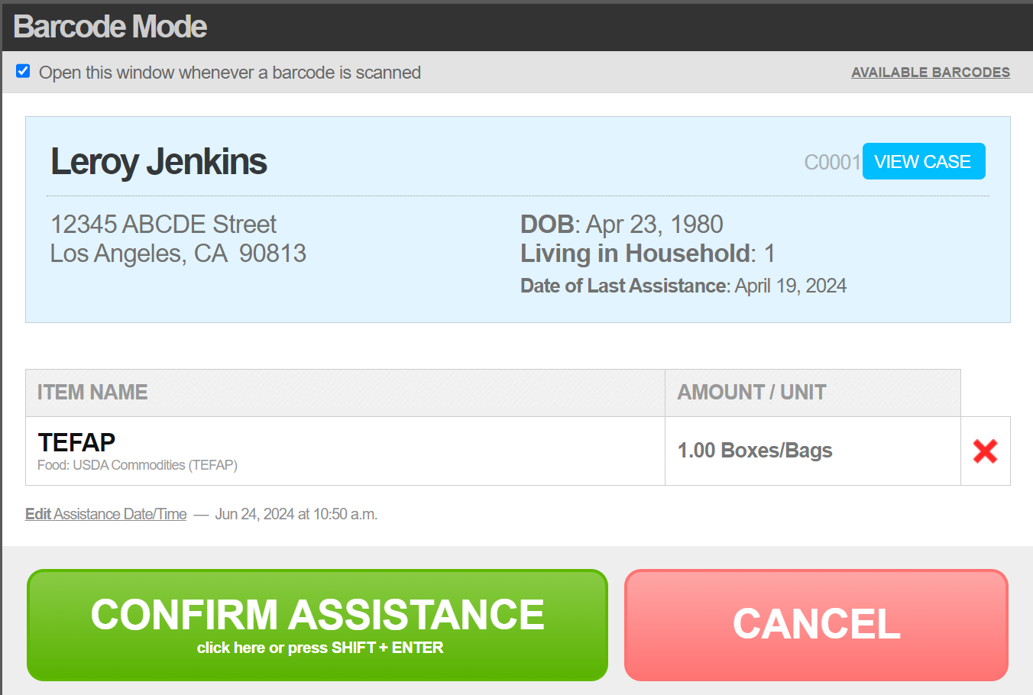
Program Overview
As you can the system will give you relevant client information

Slide 12
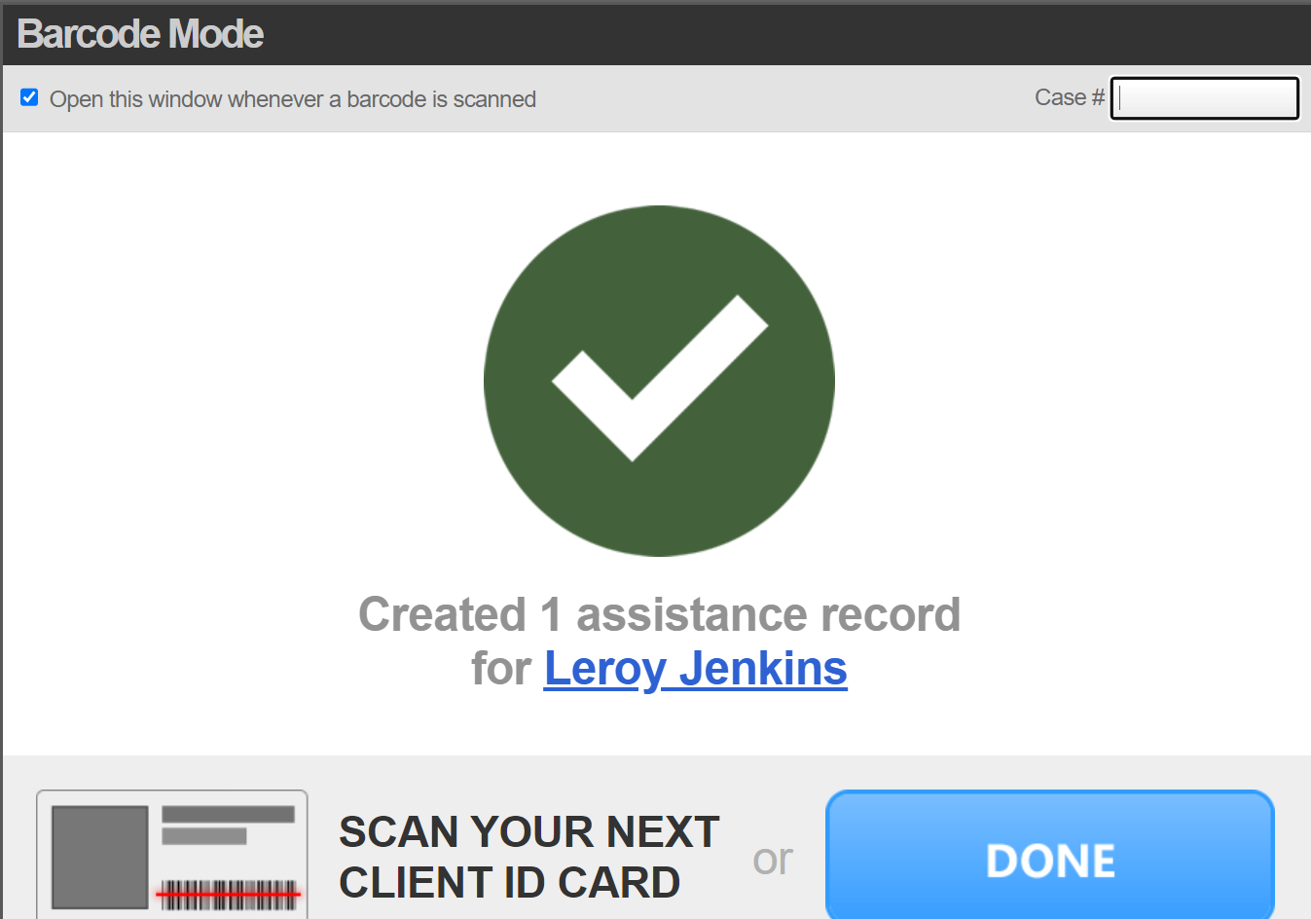
Program Overview
System will log the assistance
All household count and duplicate count is done automatically

Slide 13
Live Demo
Notes:
The Dream Team has rebranded to the Leadership Support Committee. Originally named to symbolize the Food Bank's ambitious goals, the Dream Team was dedicated to organizing, designing, and developing the curriculum for Leadership Team meetings to foster the leadership skills of the Food Bank's leaders. The concept was originally developed by Jeff, Weldon, and Alicia. Brainstormed how to better approach change management. The team has grown and evolved over the years.
Despite the positive intent behind the name, we decided to rebrand it to the Leadership Support Committee to better align with the naming convention of other Food Bank committees and to more clearly associate it with the Leadership Team.
If you want to join the committee and contribute to Leadership Team resources and training events, please speak with your manager about participating. Participation is open to any Leadership Team member, which includes all employees who are an analyst, lead, or higher. We highly encourage your involvement, as it’s a valuable opportunity to enhance your leadership skills.

Slide 14
Launch Day

Slide 15
Key Metrics
12 Agencies Currently Using Neighbor Intake

Slide 16
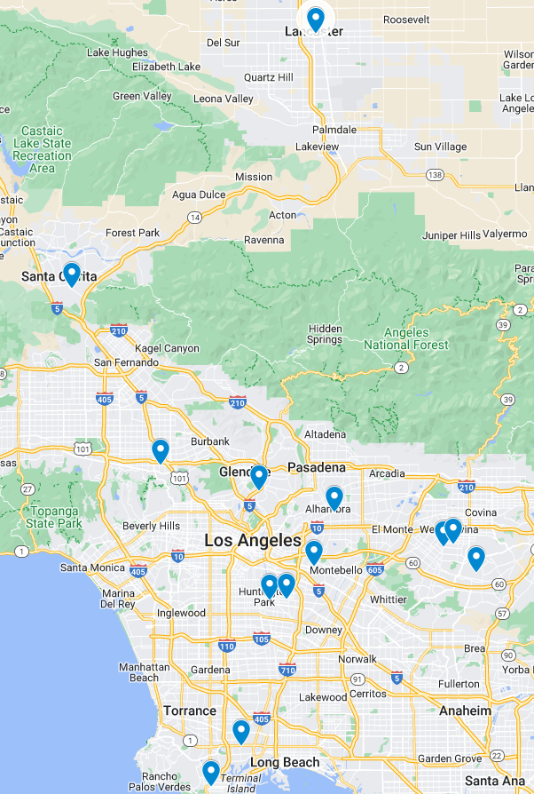

Slide 17
Key Metrics
Over 13000 Neighbors on the system

Slide 18
Key Metrics
Age Breakdown
Minors: 1482
Adults: 3587
Seniors: 2161

Slide 19
Key Metrics

Slide 20
Onboarding Process
Receive Required Documents
Receive Training
And
Equipment
Distribute
Client Intake
Form
Go Live
Follow Up

Slide 21
Q and A
Notes:
The Dream Team has rebranded to the Leadership Support Committee. Originally named to symbolize the Food Bank's ambitious goals, the Dream Team was dedicated to organizing, designing, and developing the curriculum for Leadership Team meetings to foster the leadership skills of the Food Bank's leaders. The concept was originally developed by Jeff, Weldon, and Alicia. Brainstormed how to better approach change management. The team has grown and evolved over the years.
Despite the positive intent behind the name, we decided to rebrand it to the Leadership Support Committee to better align with the naming convention of other Food Bank committees and to more clearly associate it with the Leadership Team.
If you want to join the committee and contribute to Leadership Team resources and training events, please speak with your manager about participating. Participation is open to any Leadership Team member, which includes all employees who are an analyst, lead, or higher. We highly encourage your involvement, as it’s a valuable opportunity to enhance your leadership skills.

Slide 22
Contact Info
Jimmy Torres
213-523-8246
jitorres@lafoodbank.org
neighborintake@lafoodbank.org

