Slide 1
Extra Helpings

Slide 2
AGENDA
Overview of Extra Helpings Program
Fun Facts
Extra Helpings Program - Requirements & Expectations
New Agreement
Best Practices
Food Transportation and Temperature Logs
Q & A
Store Partnership Interest Form
Extra Helpings Donation Receipts
Reporting
Quality Control Form
Forms of Communications
SB 1383 and Reporting
Q & A

Slide 3
PROGRAM OVERVIEW
Extra Helpings was originally established as a service to facilitate donations from restaurants and hotels but now focuses mainly on Retail Donors.
Retail Store donations are routed directly to an agency.
Donors are matched to nearby agencies to ensure that donations are distributed as quickly as possible.
Items available through the Extra Helpings program can include frozen, refrigerated foods, baked goods, produce, eggs, meat, dairy products, and occasionally non-food items.
Pantry Agencies that participate in this program are required to distribute at least once per week prior to applying to the program.

Slide 4
FUN FACTS
Let’s talk numbers
2023 Totals
28,366,373
2024
13,713,559 pounds
3% higher than last year
Top Donors
Costco
Target
Amazon

Slide 5
PROGRAM EXPECTATIONS
All perishable food being transported must be covered with an insulated blanket unless a refrigerated truck is being used (You may receive one on agency approval and availability).
Temperatures should be taken at store and then once again at your agency.
Donations must be weighed by category and recorded on the Extra Helpings Donation Receipt. Donation Receipts can be pickied up at COI
Must submit poundage in Mealconnect of all donations picked up within 24 to 48 hrs
Pantry Agency must distribute at least once a week
Pantry Reports are due by the 5th business day of each month
Submit Receipts to the FB upon request

Slide 6
NEW AGREEMENT
In September we will be sending out an updated Extra Helpings Agreement for all our active and inactive agencies.
Lined items that have been updated:
Distribution Schedule (weekly distribution)
Temperature guidelines
Records on site for both Monitor Visits and Audits
MealConnect Entries within 24 -48 hrs
Provide records upon request

Slide 7
BEST PRACTICES
Should be in good health when conducting a pickup
Wear a protective face covering (if required)
Use hand sanitizer or wash hands prior to entering the store and after
Make sure your agency representatives are meeting with drivers to ensure there are no issues between donor and agency
Be patient and kind to the receivers, always say thank you. Keep in mind this is an extra task asked of them
Agency should meet with store manager on a quarterly basis
Issues should be handled in a timely matter
Take pictures and videos of any bad donations
Only one representative should be responsible for entering receipts (Recommended to have one backup representative in the absence of the primary)

Slide 8
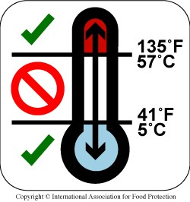
TEMPERATURE
SAFETY
Tools - Thermometer, Insulated Blanket or Refrigerated Truck
Recommended Temperatures During Transportation & Storage
Refrigerated food - 41 degrees F or below
Frozen Foods - 0 degrees F or below
Fresh Produce - 41 degrees F or below
Dry Goods - 70 - 90 degrees F
Temperature Logs
One log per Refrigerator/Freezer
Log data on receiving and distribution days
Temperature below should be taken at store and when you arrive at the facility

Slide 9
QUESTIONS

Slide 10
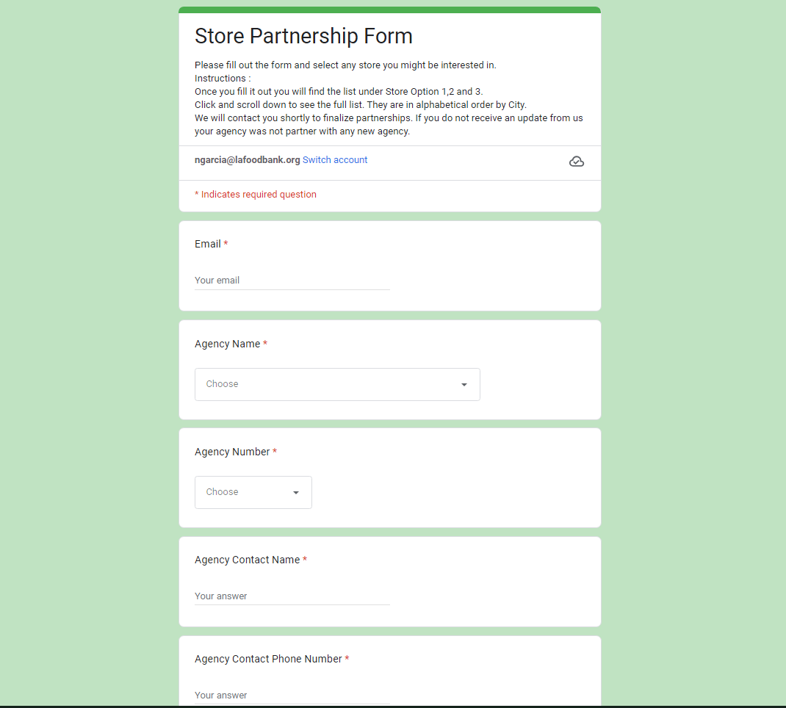
STORE PARTNERSHIP
FORM
An email will be sent out to all of our EH Agencies.
Store Partnership Interest Form
Select your Agency
Select the Store you are interested in.
Stores are assigned to agencies that are within a 7 miles radius
Stores are available on a first come first serve basis
Must be current/up to date with reporting (MC and PR)
Storage Capacity
Agencies without partners are given priority

Slide 11
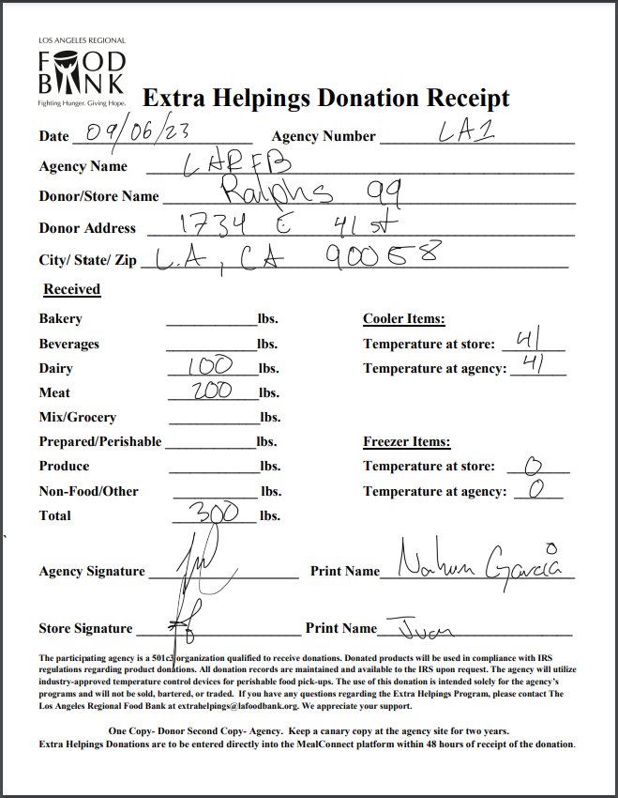
DONATION RECEIPTS
Must keep two years of donation receipts onsite (current and past year)
Paper copies, Digital copies, or both
Carbon Copy receipts are available for pick up at both warehouse with Inventory Control
Donation Receipts will be checked on Monitor Reports and/or Food Bank Audits
Digital receipts are available for download on our website:
Link - https://www.lafoodbank.org/agency-resources/forms/agency-direct/

Slide 12
REPORTING
MealConnect Reporting
Daily
Donations are expected to be entered daily
To avoid duplicates or multiple entries
Weekly
If donations are entered weekly we need each receipt to be different
This will help us during audit and avoid missing donations
Weekly cutoff days are Sunday
Difference between Donation Receipts and Pantry Reports
Donation Receipts
Are used to keep track of donated items received (Donation Receipts)
Poundage should be recorded in MealConnect (MC)
Pantry’s Only
Pantry Reports keep track of the number of people the agency serves each month
Reports are due by the 5th business day of the month
Link - https://forms.gle/VmD6Sr21SbtGzn5j6

Slide 13
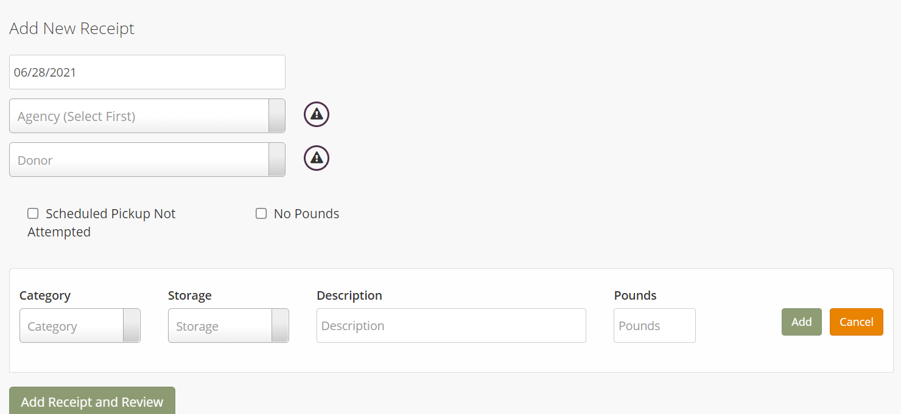
DESKTOP VIEW
—Training Video—
https://youtu.be/lm98lLZ4P9c

Slide 14
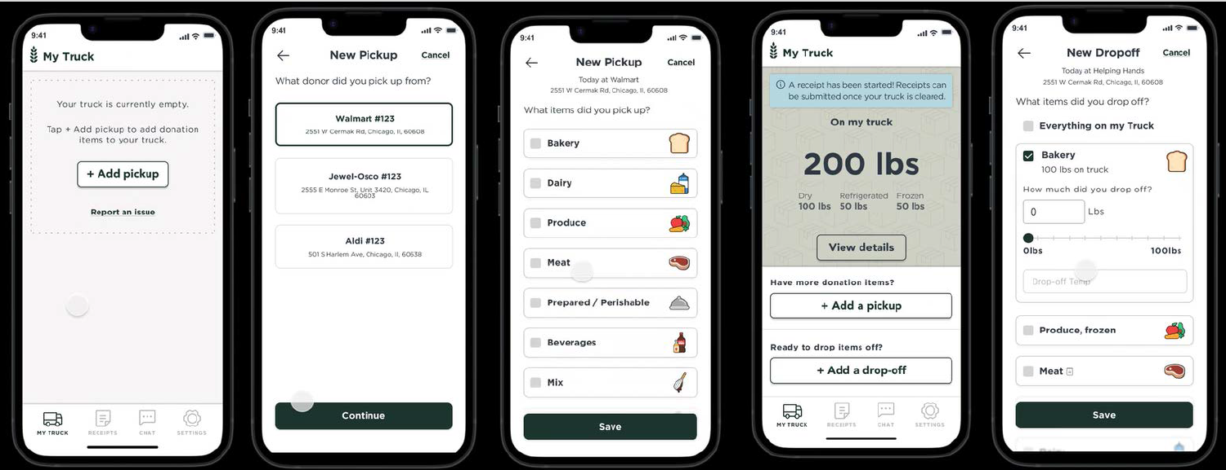
MOBILE APP VIEW
MealConnect App Receipting

Slide 15
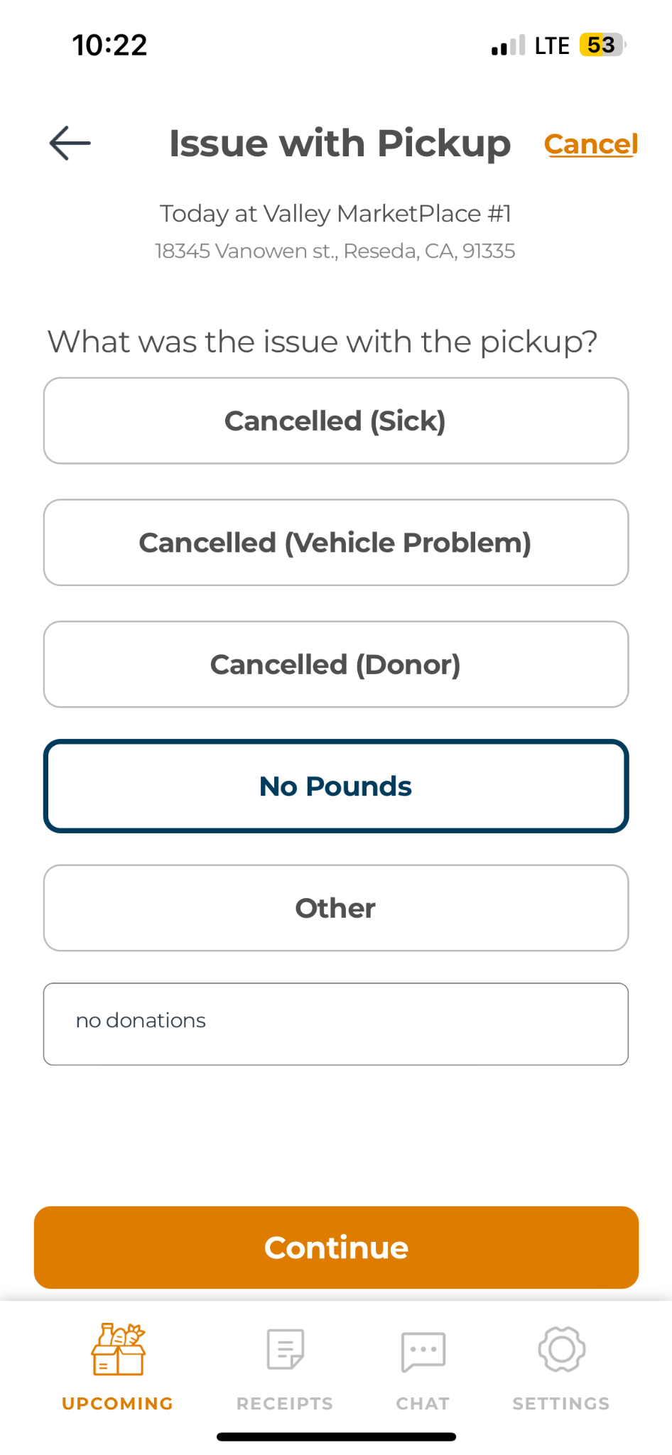
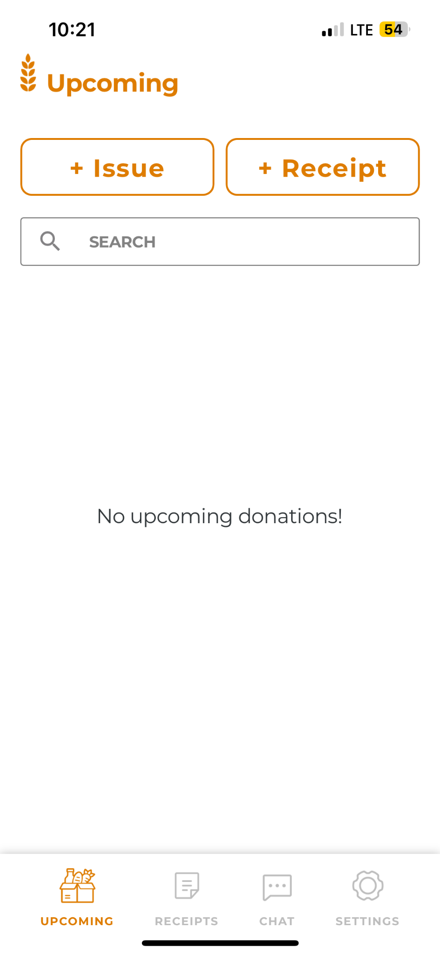
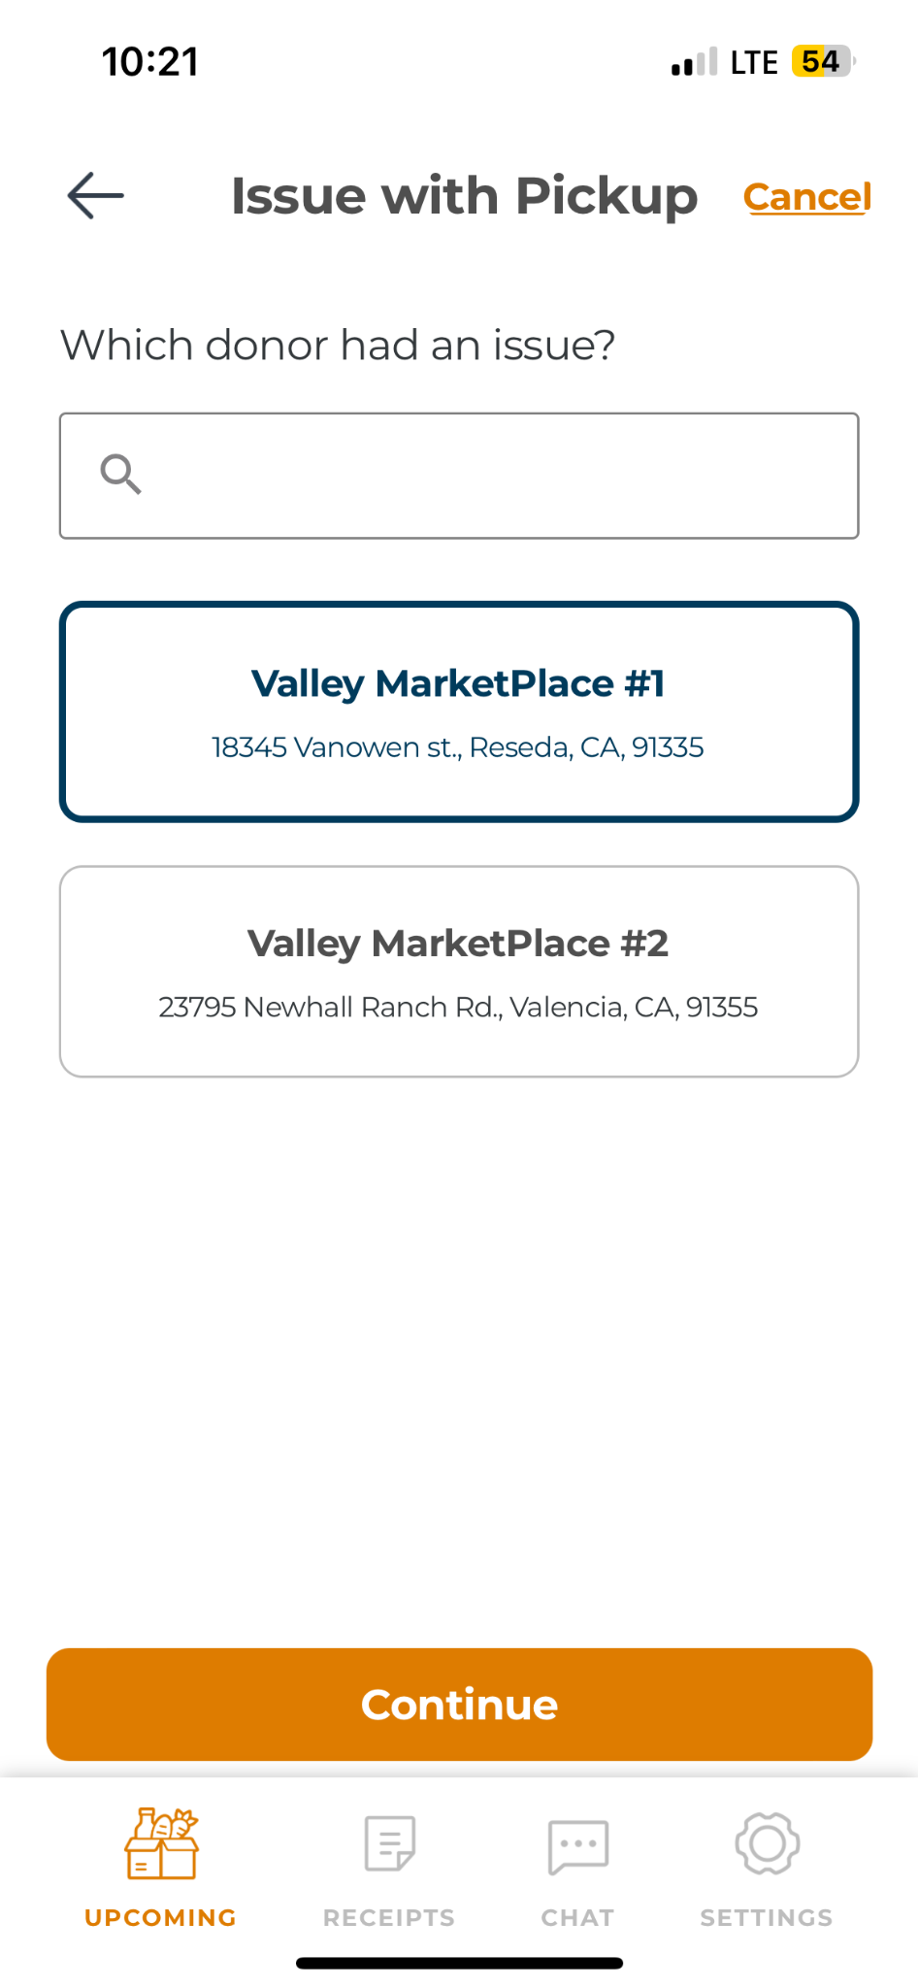
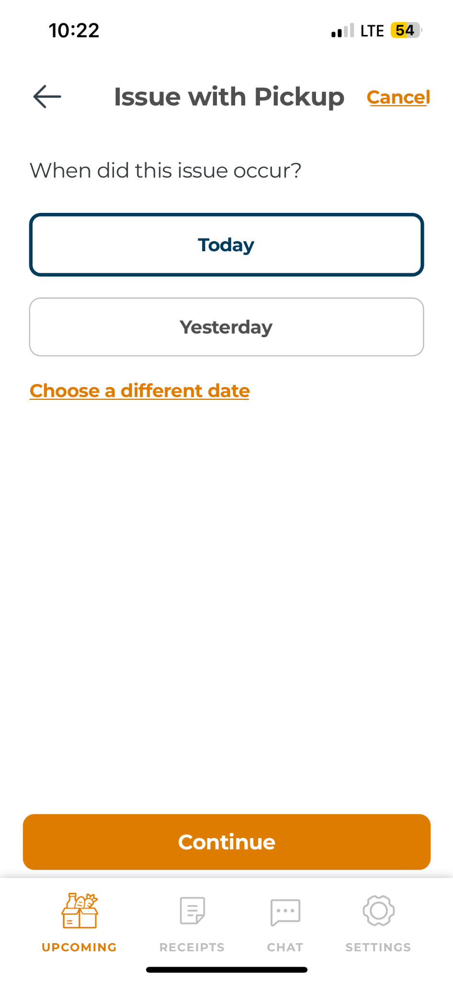
NO DONATIONS
(MOBILE APP)

Slide 16
QUALITY CONTROL
FORM
We introduced a Google Form a few months ago to give agencies the opportunity to report bad donations or any incidents at their partnered store.
It’s easy for you to report anything with the proper supporting information.
Look at donations moving forwards. (return to the store)
Quality Control Report
Pictures
Videos
Documents
Link to the Google Form Below
https://forms.gle/1hVzgMDBuxAEMKZB8

Slide 17
SB 1383
Duplicates
Entering the Data more than once.
Multiple Entries
Entering different data on the same day.
Late Entries
To ensure timely closure of each month, all entries must be submitted on schedule.
Data Entry Warnings
Agencies will receive a warning for the errors above.
SB 1383
Reporting to the City you are located in and how to properly report donations.
SB 1383
Establishes reporting requirements for retail stores, restaurants, and food recovery agencies. LARFB reports your MealConnect entries to the city entities monthly. If you are contacted by your home city, regarding your capacity please meet with them. Please let them know that you have been instructed not to duplicate your EH reports. You should refer them to LARFB for your MealConnect reports. If you receive other donations directly from a donor (not EH), you are required to report that poundage directly to your home city. If you receive donations from other food rescue organizations, please report your donations directly to the food rescue organizations.

Slide 18
QUESTIONS AND Q&A

Slide 19
CONTACT US
We are not able to respond to you on MealConnect if you send us a message on that platform.
(323) 234-3030
extrahelpings@lafoodbank.org
1734 E 41st St,
Los Angeles, CA 90058

Slide 20
Program Requirements
Original signed EH Application – must be signed by the Director/Pastor or highest ranking person of the organization
Original signed EH Agreement – must be signed by the Director/Pastor or highest ranking person of the organization
Original signed Liability Release form – must be signed by the Director/Pastor or highest ranking person of the organization
A copy of agency IRS 501(c)3 (Determination Letter)
Show good standing on the California Attorney General Registry Verification
A copy of your agency’s “entity status” letter from the California Franchise Tax Board Entity Status Letter,
Show good standing on the California Secretary of State website
A copy of your California Articles of Incorporation endorsed with the California State Seal. Your organization needs to be incorporated to serve the ill, needy or infants.

Slide 21
Q&A

Slide 22
Chat Feature
Feeding America is introducing a new feature to your MealConnect Account
Mealconnect app was updated
What if we could talk to store representatives without calling
This feature can be accessed through your App
This chat will be monitored by the Extra Helpings Team
Feeding America will make the feature live in the next coming months.
Donors will be able to see donations reported immediately after being entered

Slide 23
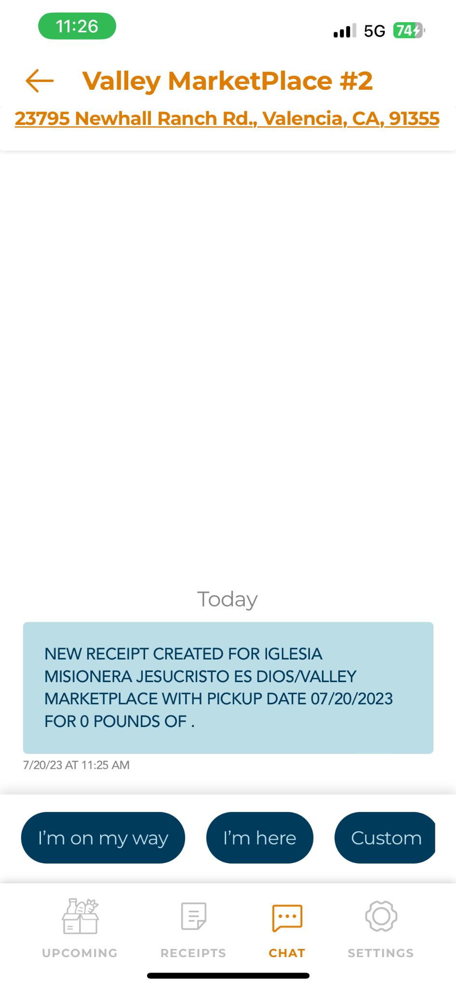
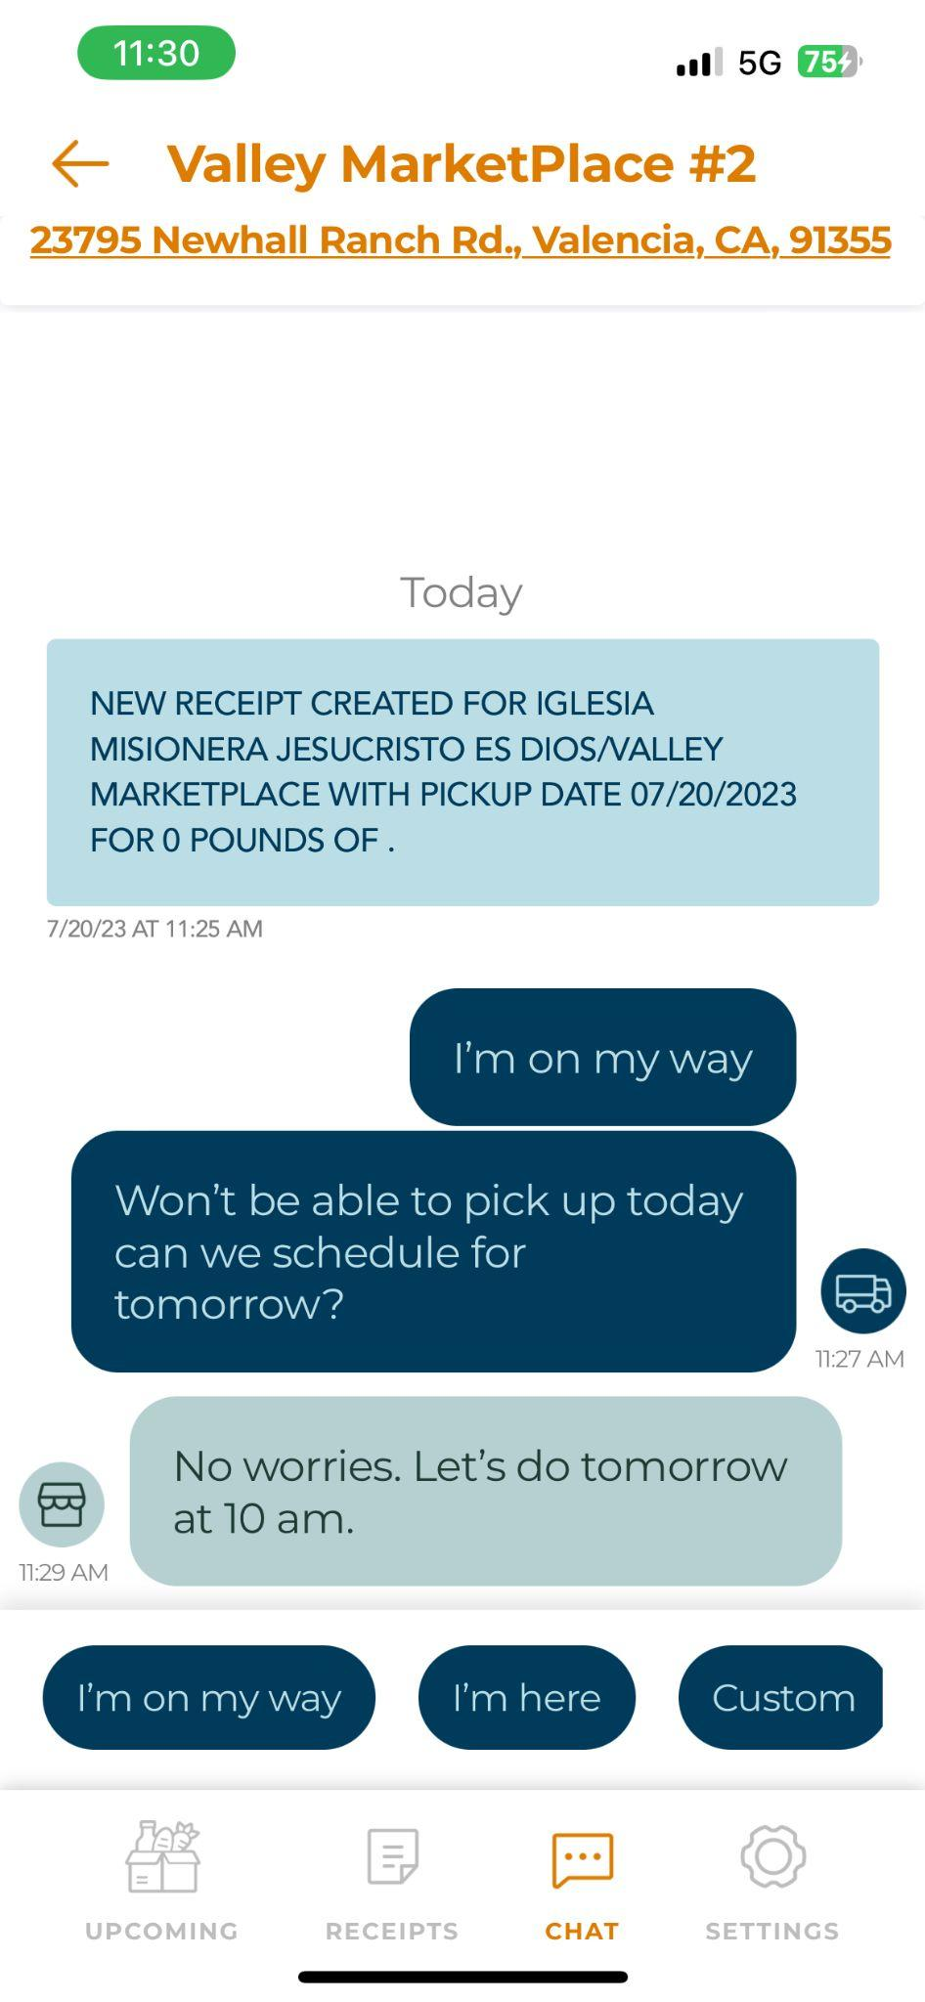
Chat Feature
Video Link
Video Link (No Audio)
MealConnect Guide
Step by Step Guide - PDF
What it looks like
Let’s go live

Slide 24
Program Requirements
A copy of your current General Liability Insurance Certificate– must cover your distribution location and name the Los Angeles Regional Food Bank as an additional insured (minimum coverage $300,000 per occurrence)
A list of the current Board of Directors or Church’s Organization Chart
ServSafe California Food Handler certificate, please visit the website www.servsafe.com (Onsites) or www.cafoodhandlers.com (Pantries)
(LARFB provides a discount only for CA food handlers)
A pamphlet or summary of services provided by your organization. Churches may submit weekly bulletins.
A copy of a voided check from the organization, imprinted with the current address of the organization

