Slide 1
Elevate Your Nonprofit’s Digital Impact: Strategies for Social Media and Content Marketing

Slide 2
Introductions
Olivia Cervantes
Marketing Content Manager, LARFB
Victoria Lasavath
Marketing and Communications Manager, LARFB

Slide 3
Overview
Today, we will cover:
Getting started (and becoming an expert) on social media.
What, where and why post on social media.
The role of social media in modern marketing.
Content marketing synchronization
Questions and answers.

Slide 4
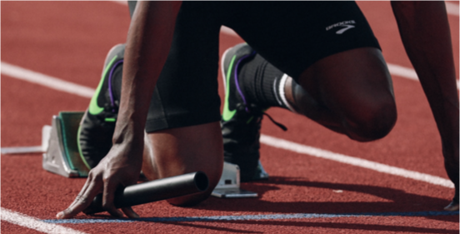
Getting Started With Social Media

Slide 5
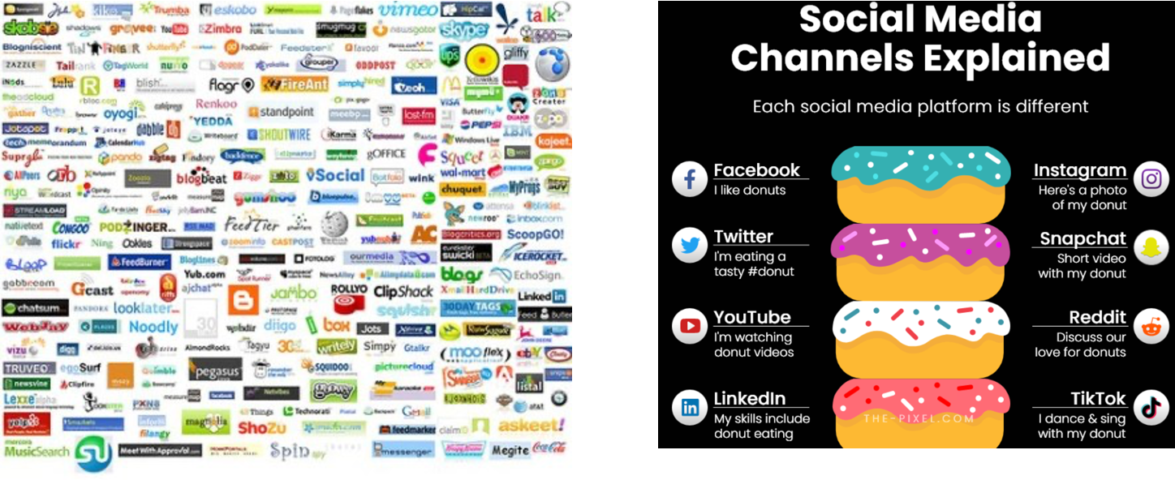
Which Platforms Make the Most Sense For You?
Notes:
VL

Slide 6
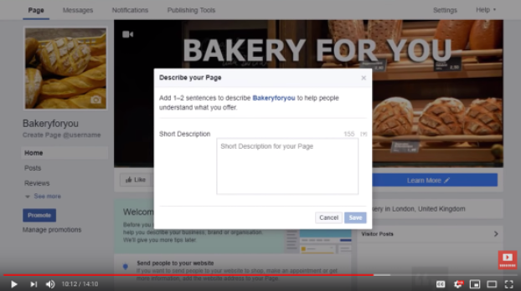
Create Your Accounts
How to start a Facebook Business Page
  https://youtu.be/Zl87ugrZSfo
How to make sure you Google Business Profile is Ready
  https://www.youtube.com/watch?v=81nhmYRTYZM
How to start an Instagram Brand Account
  https://www.youtube.com/watch?v=gJh1QvV9fVE
How to start a Twitter Account
  https://www.businessinsider.com/how-to-setup-a-twitter-account
How to start a YouTube Channel
  https://www.youtube.com/watch?v=6o7qODwjEz8
Notes:
VL

Slide 7
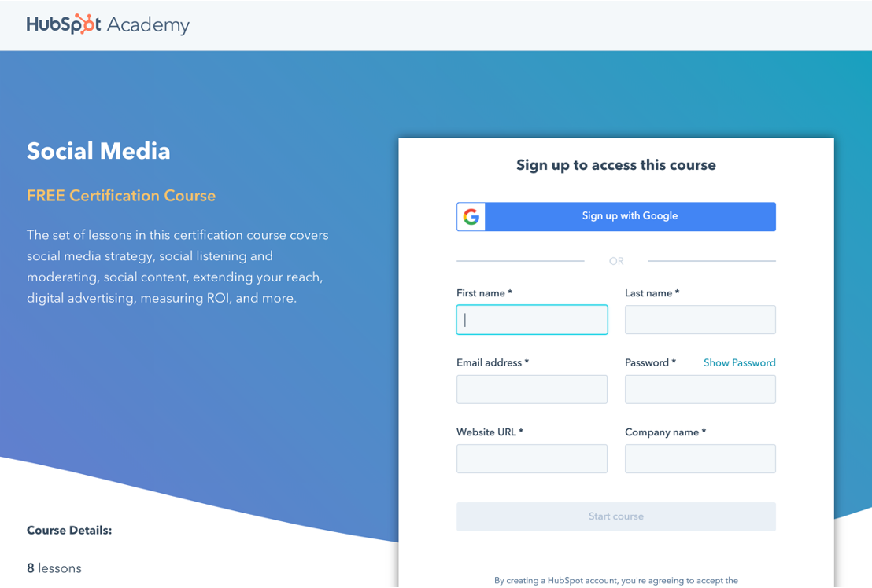
Become a Social Media Expert
Notes:
VL

Slide 8
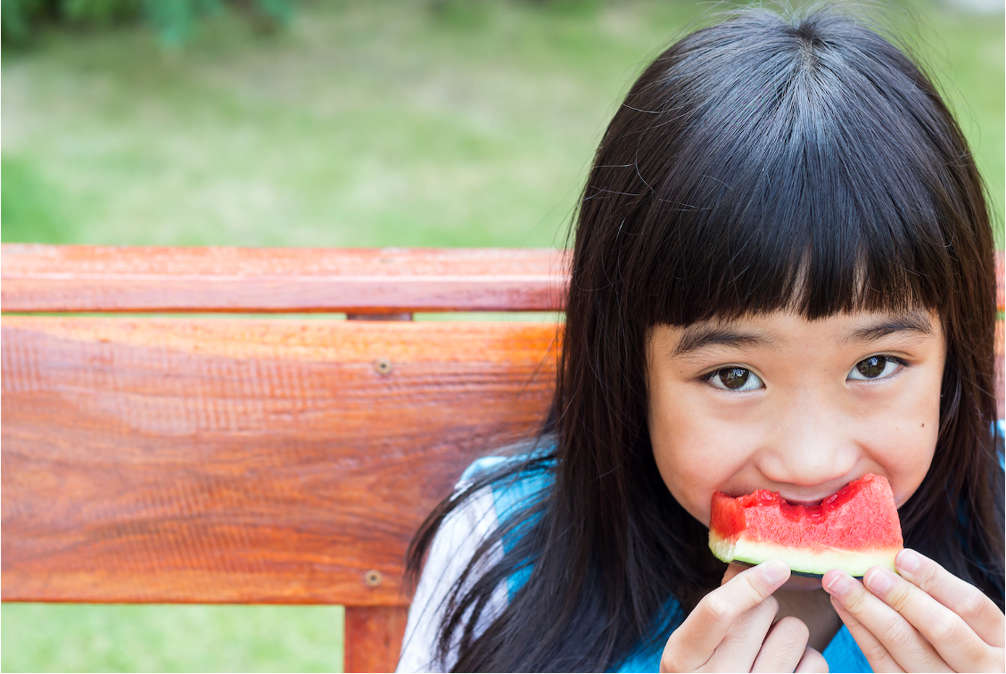
THE WHAT, WHERE, WHEN & WHY OF SOCIAL MEDIA POSTS

Slide 9
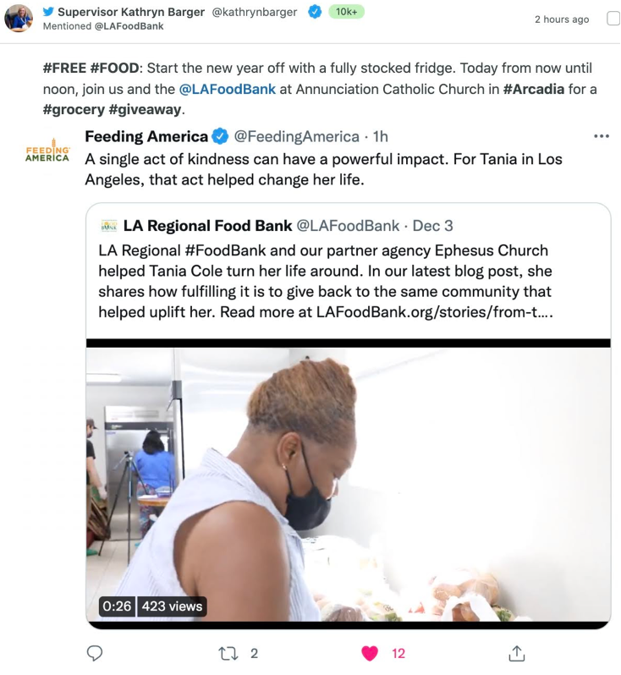
What
Social Media should be just that; social.
Posts should demonstrate that you know and care about your audience
POST TYPES
User Generated Content (UGC)
This is any content—text, videos, images, reviews, etc.—created by people, rather than brands. We will often share UGC on our own social media accounts, mainly Instagram.
These are opportunities to show appreciation and build credibility.
Notes:
OC

Slide 10
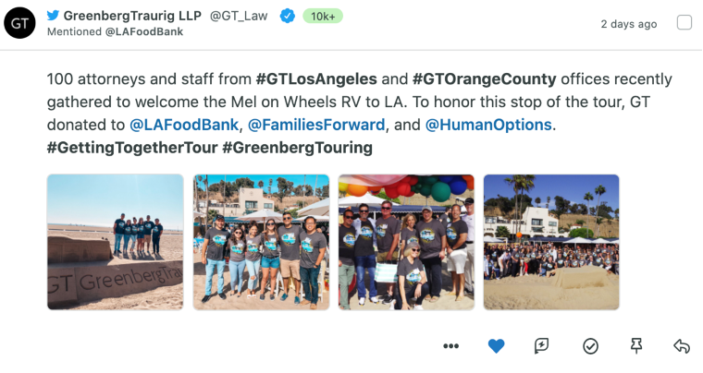
Another Way for UGC
Our mission is something pretty much no one can argue with; when people learn about the urgent need and our efficient work to alleviate hunger and prevent food waste, many of them can’t help but want to get involved. We should treat our audience as active participants in our mission, not passive recipients of our message.
By cultivating and maintaining relationships with influential members of our community, we improve our opportunities to increase awareness, credibility, audience size and, ultimately, conversions.
Create social media toolkits and messaging points for:
VIPs and Influencers for events.
Campaigns such as #GivingTuesday.
For volunteers and staff.
  Let’s face it! If your story isn’t interesting to you, it won’t be interesting to anyone else. Employee and volunteer advocacy will help you build your brand and credibility.
Notes:
OC

Slide 11

Partner Agency Content-Generated Examples
Notes:
OC

Slide 12
Partner Agency Content-Generated Examples
Notes:
OC

Slide 13
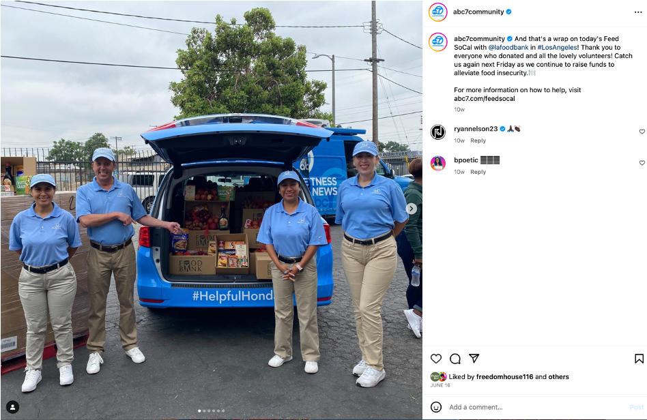
What
Curated Content: These are opportunities to show our expertise and that we are paying attention to topics that are of interest to our audience; these include articles and other content we share from reliable third parties.
Notes:
OC

Slide 14
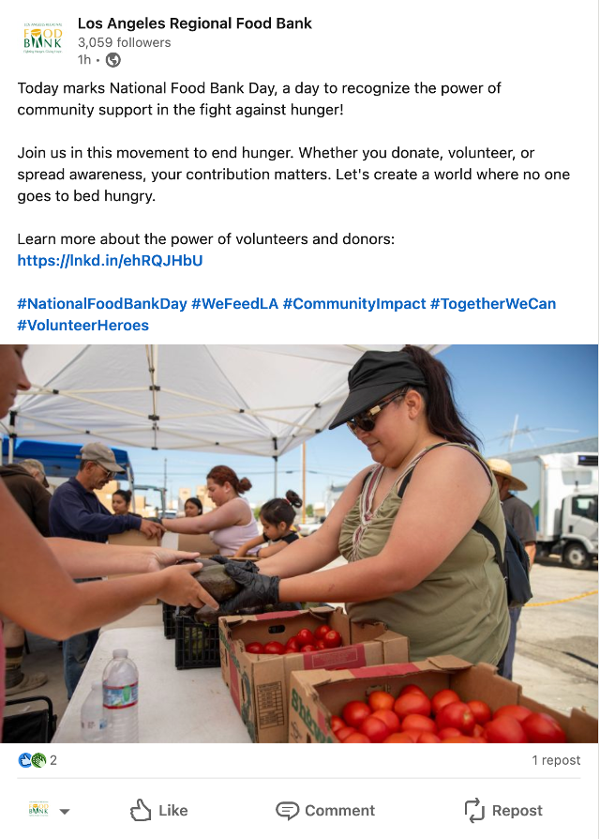
What
When in doubt, keep your posts as brief as possible.
Remember: there’s a good chance you’re dealing with scrollers and mobile users.
Treating your posts like novels creates more opportunities for readers to lose interest and likewise miss your CTA. So, using photos and videos is a good way to engage a distracted audience.
Original Content: Just like it sounds, this is content we’ve created and which we own.
Video: It’s best to upload video natively to social rather than sharing a link to YouTube.
Blog: Post a teaser, photo and link that make the reader want to learn more. This will drive traffic back to your site and improve chances of a conversion.
Photos: Grab attention and cut down on wordiness with photos!
Notes:
OC

Slide 15
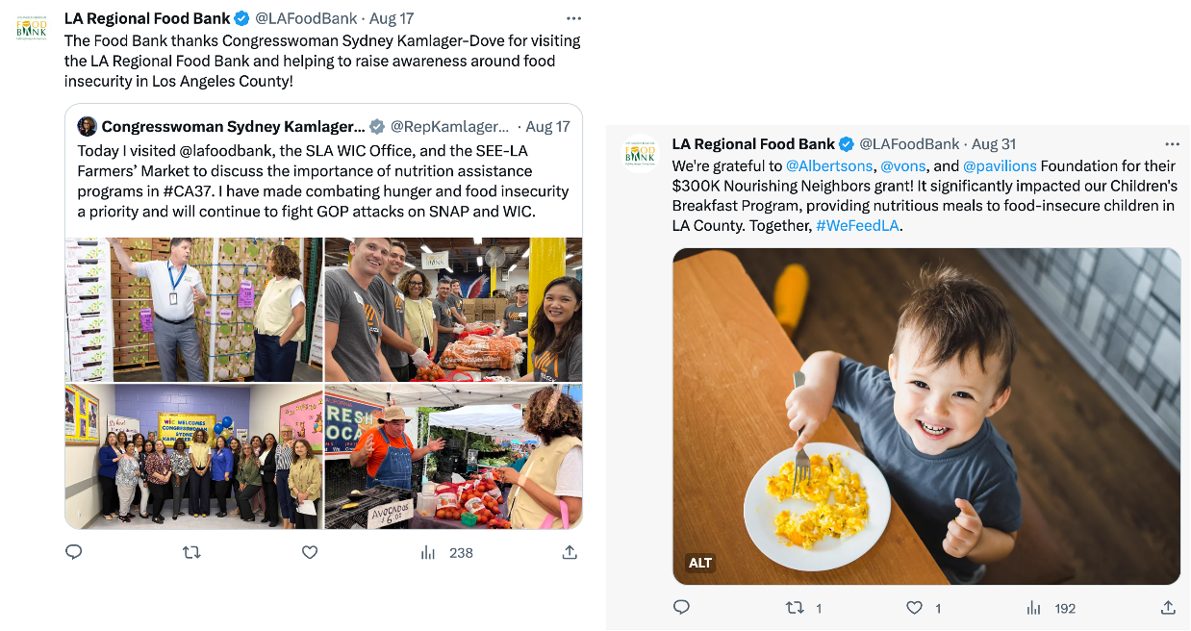
What
Micro Content: These are shorter posts which might include a stat and a CTA or a even just quick “thank you.” These help to keep audiences primed and engaged.

Slide 16
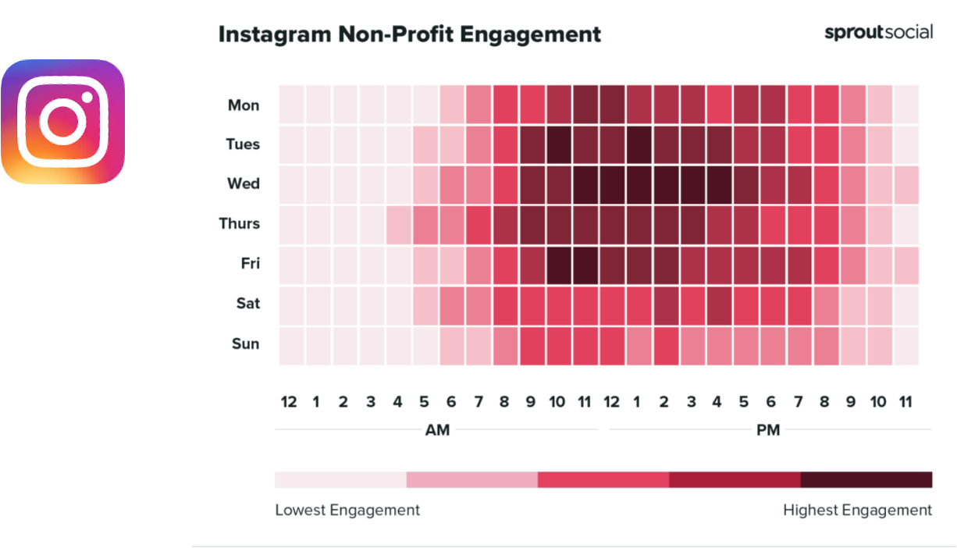
Instagram Post Timing
Notes:
VL
•Best times to post on Instagram for Nonprofit:
•Tuesdays at 10 a.m. and 1 p.m.
•Wednesdays from 11 a.m. to 5 p.m.
•Fridays from 10 a.m. to noon
•Best days to post on Instagram for Nonprofit: Wednesdays
•Worst days to post on Instagram for Nonprofit: Saturdays and Sundays

Slide 17
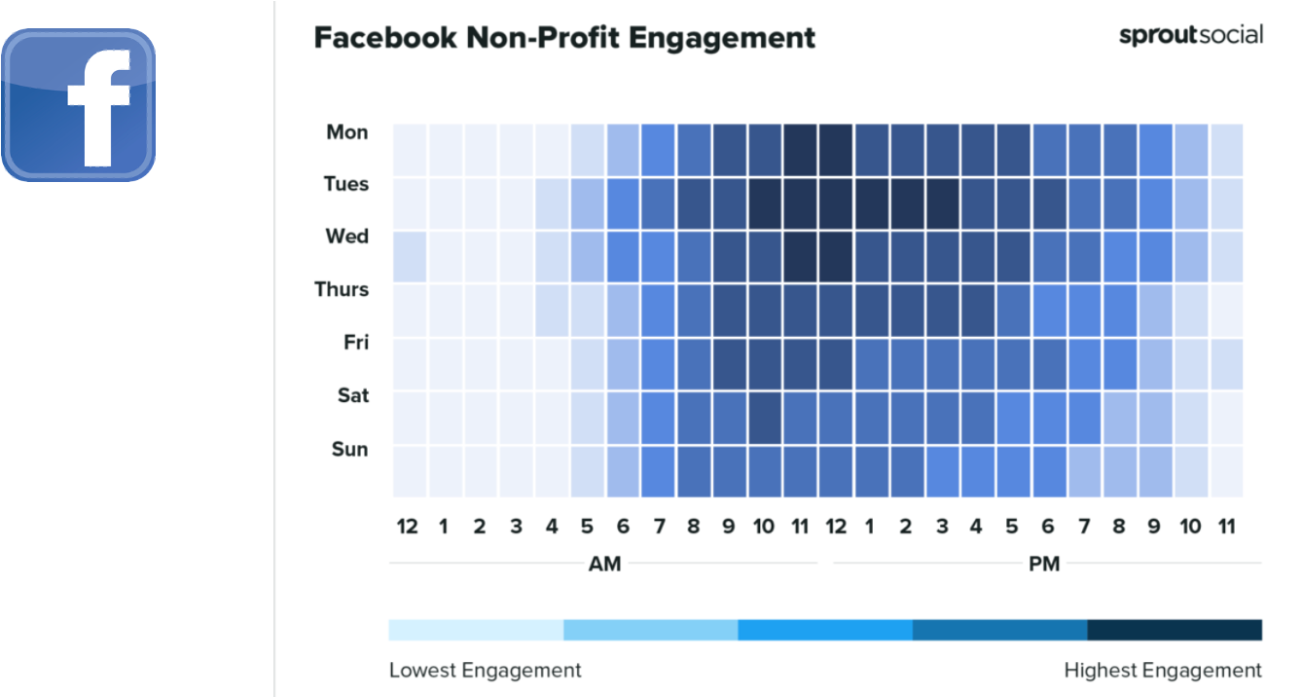
Facebook Post Timing
Notes:
•Best times to post on Facebook for Nonprofit:
•Mondays from 11 a.m. to 1 p.m.
•Tuesdays from 10 a.m. to 4 p.m.
•Wednesdays from 11 a.m. to 1 p.m.
•Best days to post on Facebook for Nonprofit: Mondays through Wednesdays, but especially on Tuesdays
•Worst days to post on Facebook for Nonprofit: Sundays

Slide 18
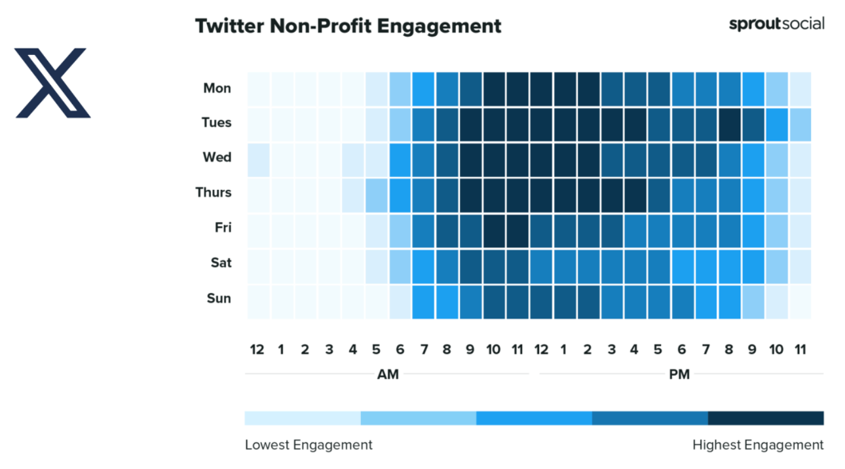
Twitter/X Post Timing
Notes:
VL
•Best times to post on Twitter for Nonprofit:
•Mondays from 10 a.m. to 3 p.m.
•Tuesdays from 9 a.m. to 5 p.m. and at 8 p.m.
•Wednesdays from 9 a.m. to 3 p.m.
•Thursdays from 9 a.m. to 5 p.m.
•Fridays from 10 a.m. to noon
•Best days to post on Twitter for Nonprofit: Tuesdays, Wednesdays, Thursdays
•Worst days to post on Twitter for Nonprofit: Saturdays
●

Slide 19
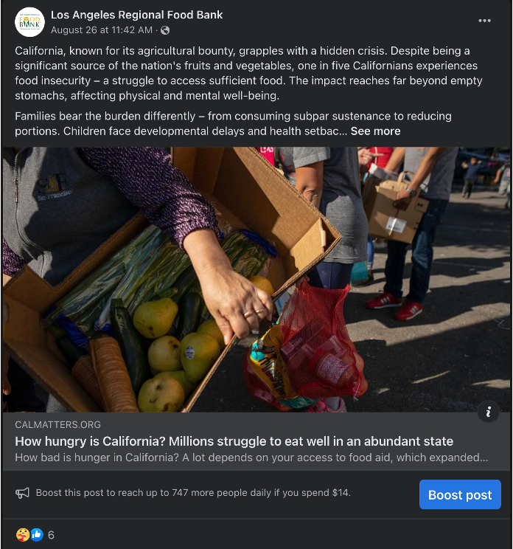
Why Post This?
Before posting, ask yourself:
Who am I trying to reach?
What do I want them to do or learn?
Am I demonstrating value?
How will I know if I have been successful?
Would I share this if I didn’t work at this organization, or in this space?
Successful posts:
Are Relevant
Spark Emotion
Are Trustworthy
Demonstrate Empathy
Authoritative/Educational
Authentic
Share worthy/Interesting
Notes:
VL

Slide 20
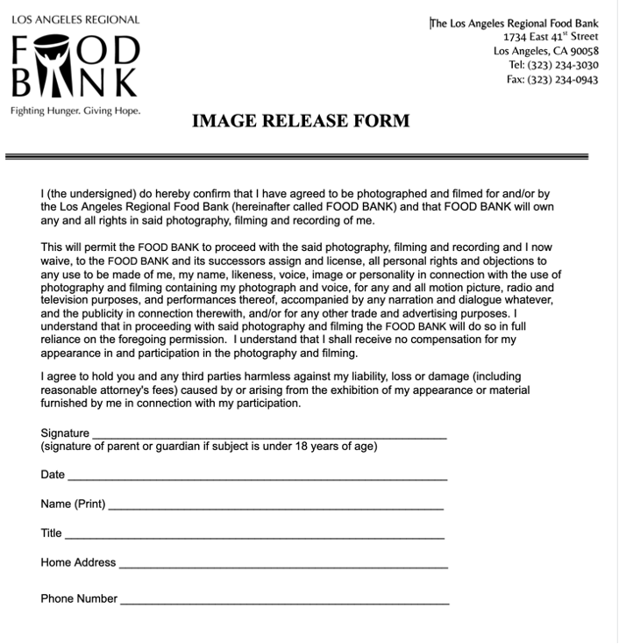
Privacy
Respecting the privacy of clients
Image releases
Getting consent
Try to avoid license plates or remember to block if using
Notes:
VL
●
Kindly approach clients with respect and care and thank them for visiting and describe the importance of storytelling and asking if they would be willing to help. Try to remember they are in a vulnerable position seeking help and we want to always make them feel as comfortable as is while respecting their wishes and privacy.

Slide 21
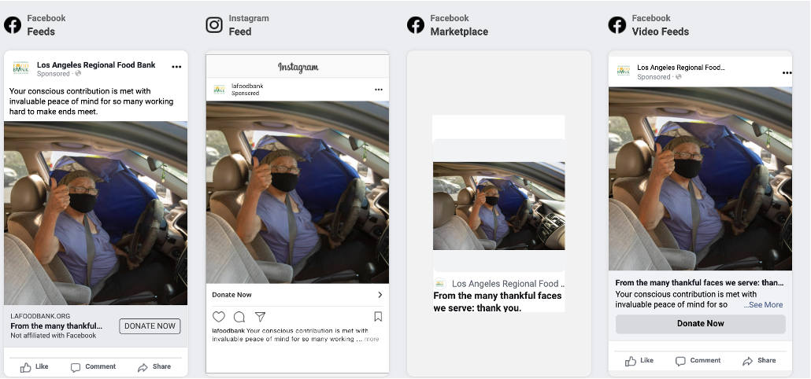
Keeping Up With Social Media
QR Codes: the rise and familiarity of using these is something to consider and to think about if it fits your demographic
User experience moved from more mobile to more desktop and now, it is shifting to more mobile – something to think about as you are creating content
Algorithms
Relevance
Recency
Resonance (how engaging)
Authenticity is key
Boosted/sponsored ads help gain visibility (platforms will offer promotions)
Notes:
●
●Algorithms differ from platform to platform and content should be tailored as needed.
●
●The pandemic reminded us how to evolve our social media practices and strategies as things are always changing.
●
●https://www.searchenginejournal.com/how-social-media-algorithms-work/380642/#close

Slide 22
Engagement
What is social media engagement?
How to increase engagement?
Notes:
VL
●Asking around the room: what types of posts are your favorite from the last year or what has the most engagement?
●
●https://blog.hootsuite.com/social-media-engagement/#What_is_social_media_engagement
●Engagement:
●Shares or retweets
●Comments
●Likes
●Followers and audience growth
●Click-throughs
●Mentions (either tagged or untagged)
●Using branded hashtags
●
●How to increase?
●
●Analyze your engagement
●Select your strategy
●Know your audience
●Create and share valuable content (get creative i.e. asking questions, contests, polls, spotlighting clients, etc.)
●Stay topical
●Keep conversation flowing: practice reactive and proactive engagement
●Show your human sign
●Keep response rates speedy
●

Slide 23
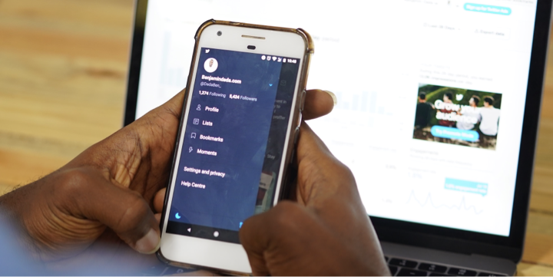
Social Media’s Role in Marketing Strategy

Slide 24
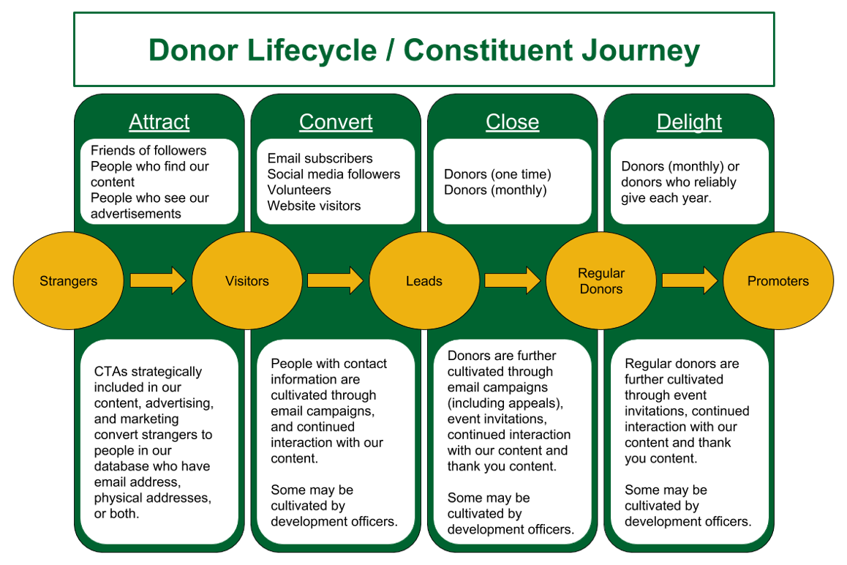
Notes:
OC

Slide 25
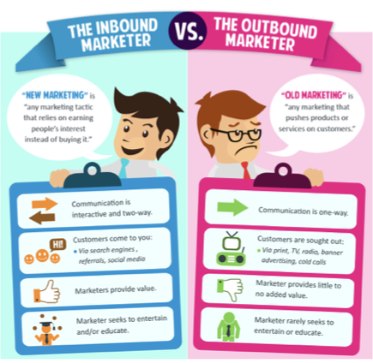
Inbound Marketing
Notes:
OC

Slide 26
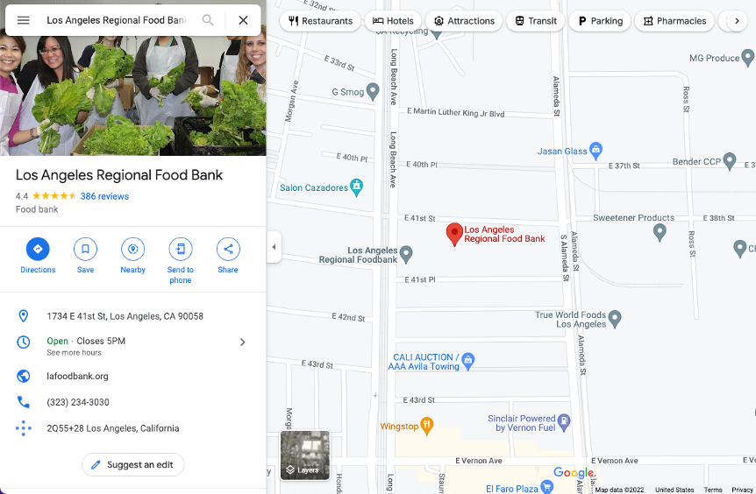
How Can People Find Me?
Create or update your Google My Business Profile.
Keep the profile up-to-date.
Notes:
VL
Creating your Google My Business is as simple as heading to Google Maps (link on how-to: https://support.google.com/business/answer/2911778?hl=en&co=GENIE.Platform%3DDesktop)
●
●It’s important to keep the profile up to date with distribution times, hours of operation. We want to avoid people getting misleading information.

Slide 27
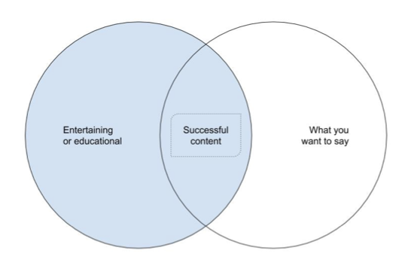
Content Marketing

Slide 28
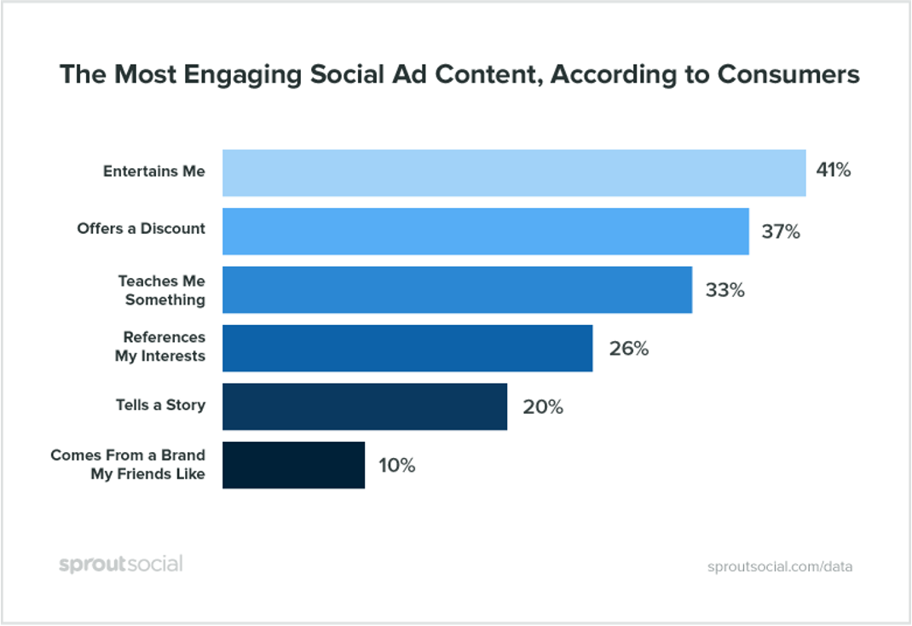
Content Marketing

Slide 29

Content Marketing
Creating Content
Social Media - Facebook, Instagram, X, YouTube
Blog Posts
Videos

Slide 30
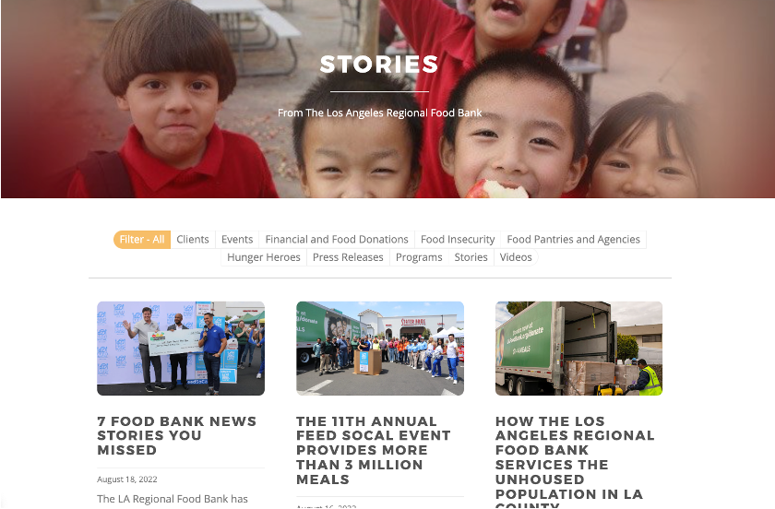
Why Create Content?
Why Create Content?
Tell someone’s story
Impact
Exposure
Boost support for your
organization and/or cause.
Search engine optimization
Notes:
By writing how someone was struggling but thanks to your agency they were able to get by, someone else will feel inspired. Perhaps those that are intimidated to ask for help for the first time.

Slide 31
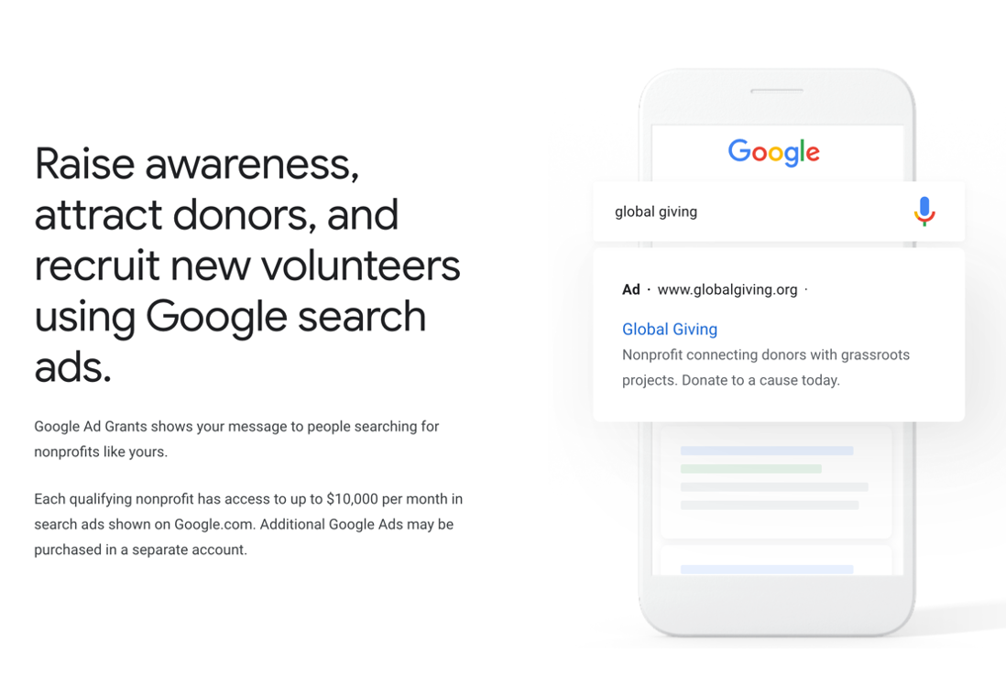
Google Grants
Connect Content to Google Grants
Up to $10K a month in free ads
Free YouTube tutorial: https://youtu.be/ZilFhTquOBo?si=pG7nDPQk911DUIEA
https://www.google.com/grants/
Notes:
VL

Slide 32
Social Media Marketing
Social media can be used to syndicate content.
Organic Social Media Marketing.
  Video
  Photos
  Blog posts
Paid Social Media Marketing
  Boosted posts
  Social media advertising
Influencer Marketing
Much of this content can also help you with e-newsletters.
Notes:
VL

Slide 33
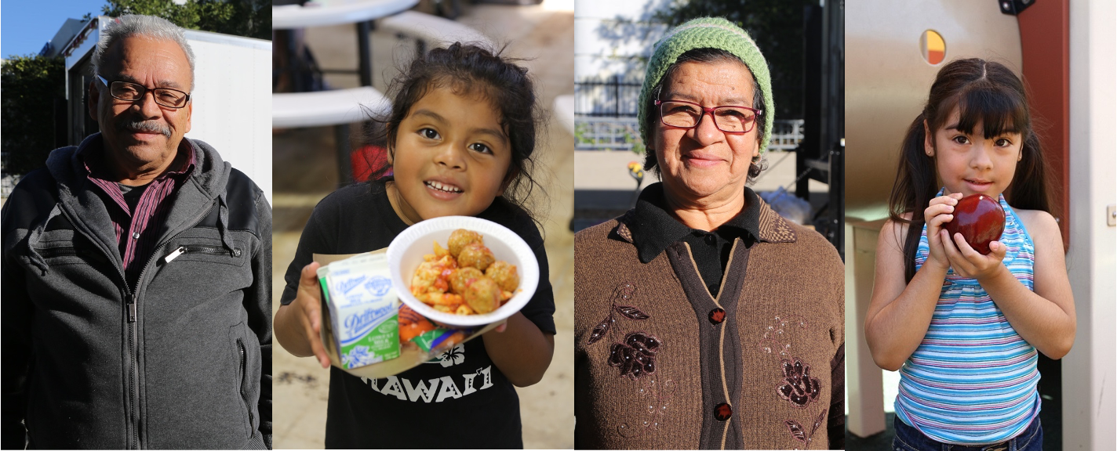
Q & A

