Slide 1
Human-Centered Design 101
An Introduction

Slide 2
Agenda
Introductions
Icebreaker - ‘Guess what was my first job?’
What is Human-Centered Design?
Why human-centered design is important to the Food Bank?
Activity - ‘How can we …?’
Next Steps - Tools, Resources
Q&A

Slide 3
Ice breaker
Guess what was my first job?
Draw a picture of your first job
Post-it , or scratch paper
Marker or dark pen
Volunteer
Share your name
Current job title/organization
A bit about the picture you drew

Slide 4
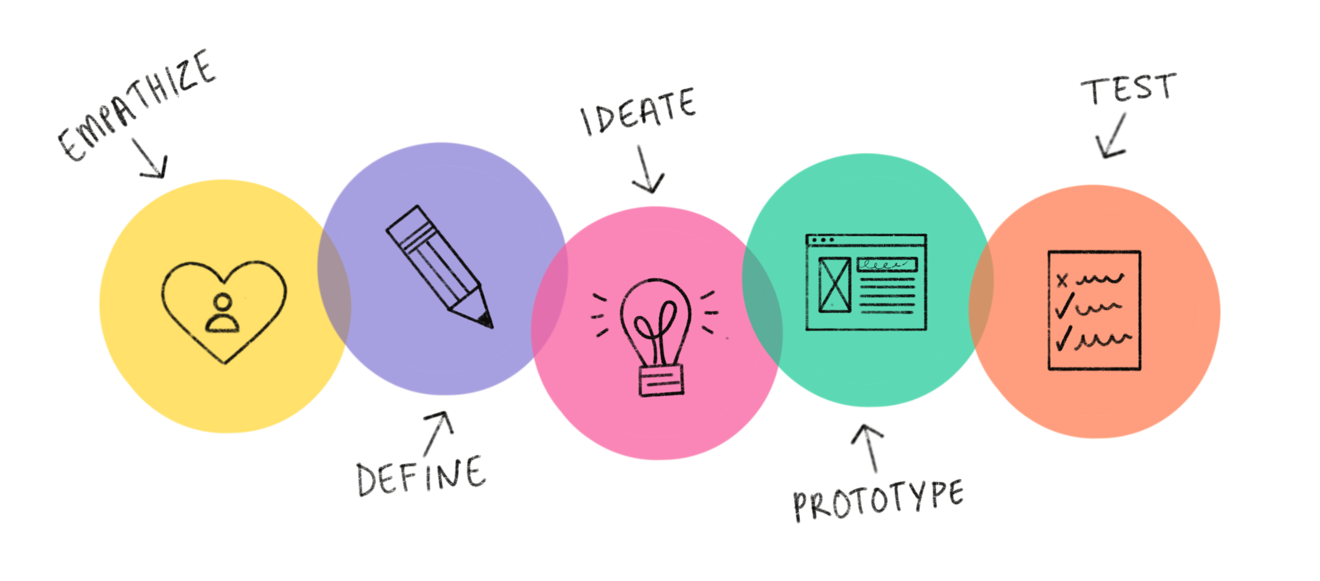
What is Human-Centered Design?
Human-centered design (HCD) is an approach to problem-solving that concentrates on the needs, preferences, and experiences of the end-users or customers. It is a design framework that focuses on understanding the perspectives of the people who will ultimately use or be affected by a product, service, or system.
Notes:
Some of the key steps of design thinking are: to empathize, define the goal, ideate, develop a prototype, and test the prototype and all this happens before we come to a final decision.
Example coffee shop- new flavor

Slide 5
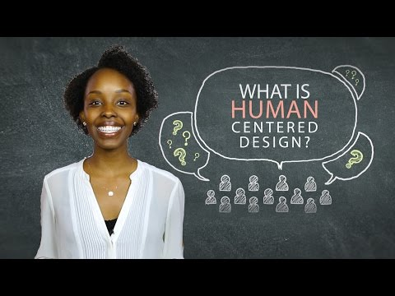
What is Human-Centered Design?
Notes:
Video: What is HCD? From a global development organization’s perspective but aligns with the work our agencies do (community focused).
https://www.youtube.com/watch?v=0bxtEqM2TQU

Slide 6
Why human-centered design is important to the Food Bank?
Notes:
Core values : Inclusion, Diversity, Equity, & Accessibility (IDEA): HCD helps the Food Bank embrace this principle by foster a culture that minimizes bias and is inclusive of everyone’s ideas.
Improved Communication: Encourages more critical conversations, advocating for collaboration rather than immediate solutions.
Better Solutions: By including more feedback from our stakeholders, the outcomes will be better allowing the Food Bank to effectively serve both the community and our staff.

Slide 7
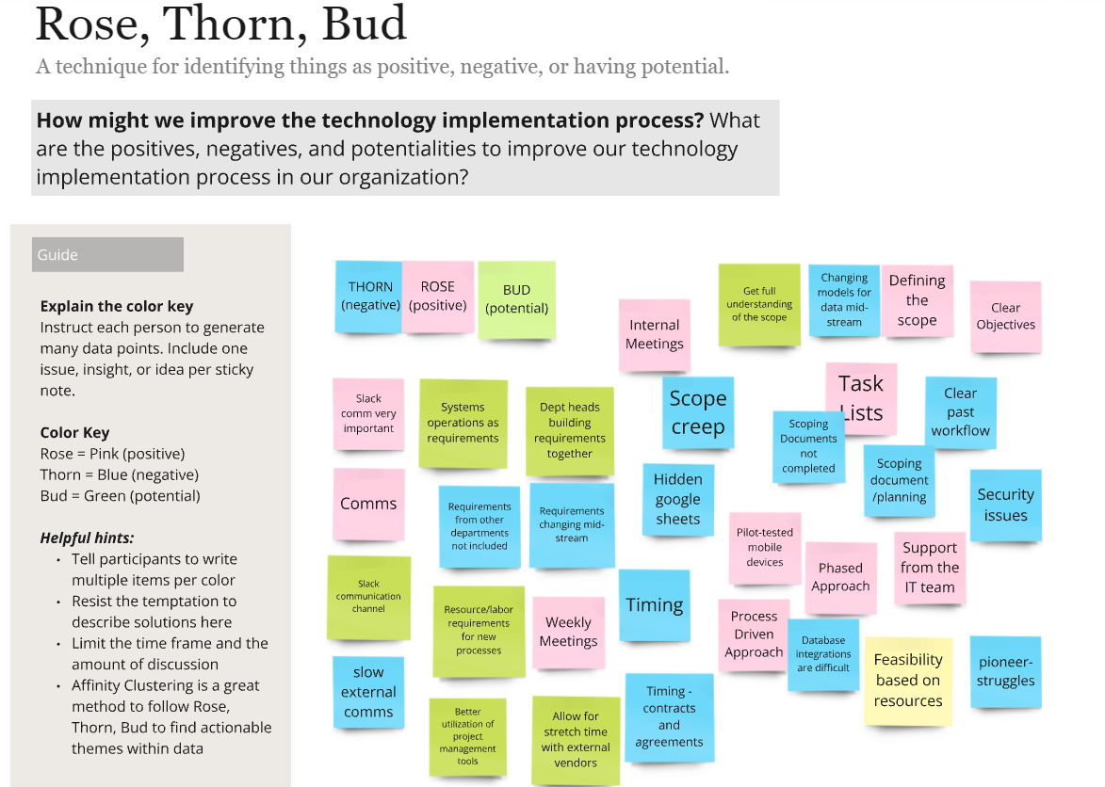
How does the Food Bank use HCD?
Rose, Thorn, Bud
Notes:
Use HCD to ensure we are reaching our stakeholders as quickly and effectively as possible. Use iterative approach to continue improve our solutions.
Learning how to approach a problem with creative solutions that are effective. Gather the perspectives of your stakeholders before making a decision on a initial thought or assumption.
Systems Governance Committee - HCD exercises with stakeholders who had projects completed in the past year were invited to help craft the mission statement and provide feedback on projects they would like to tackle in the upcoming year.
Collect feedback with Rose, Thorn, Bud

Slide 8
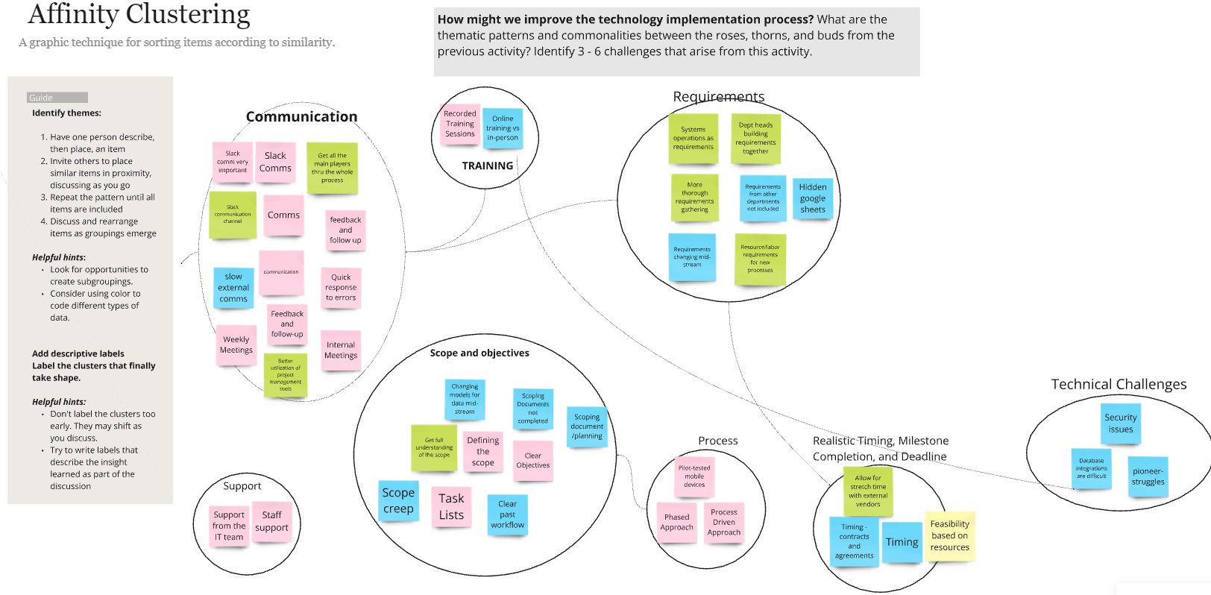
Affinity Clustering
Notes:
Group feedback based common themes

Slide 9
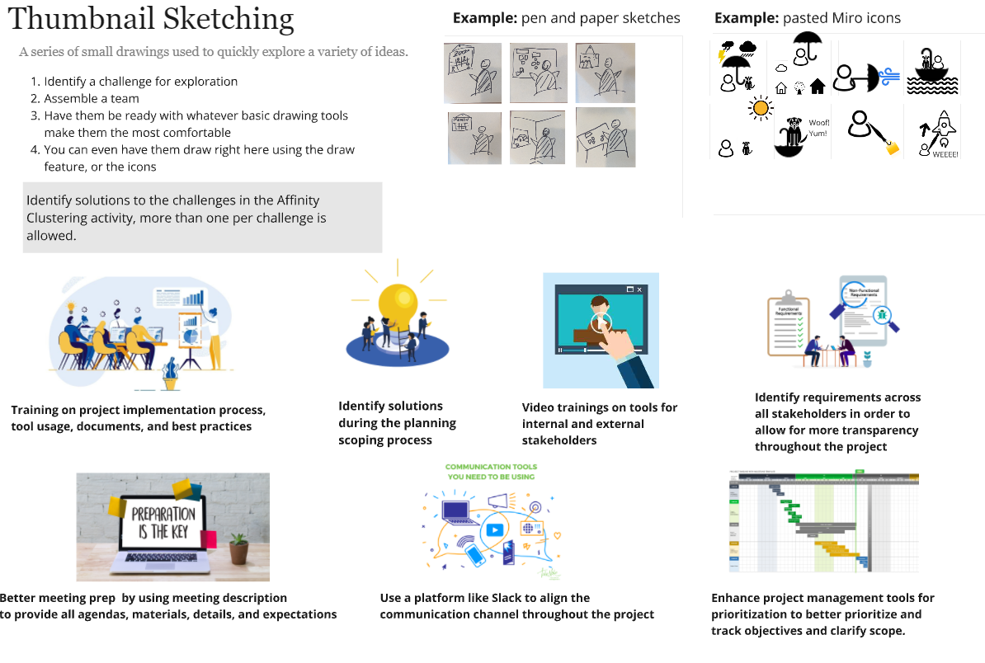
Thumbnail Sketching
Notes:
Create a statement identifying “How might we… address, improve upon, or resolve that?” and visualize it with a thumbnail

Slide 10
Difficulty Matrix
Notes:
Chart those statements on a matrix based on their relative difficulty, impact, and time requirements.

Slide 11
I.D.E.A Champions: All Staff Event
I Like…
I Wish…
Notes:
The Food Bank used a similar activity called I Like/I Wish during our IDEA Champions: All Staff Event.
What you do you like about working at the Food Bank?
What do you wish was at or available at the Food Bank?

Slide 12
Banana Box
Notes:
The Banana Box is our monthly newsletter. A result of a human-centered design feedback survey and now includes information ranging from nutrition advice to learning & development suggestions.

Slide 13
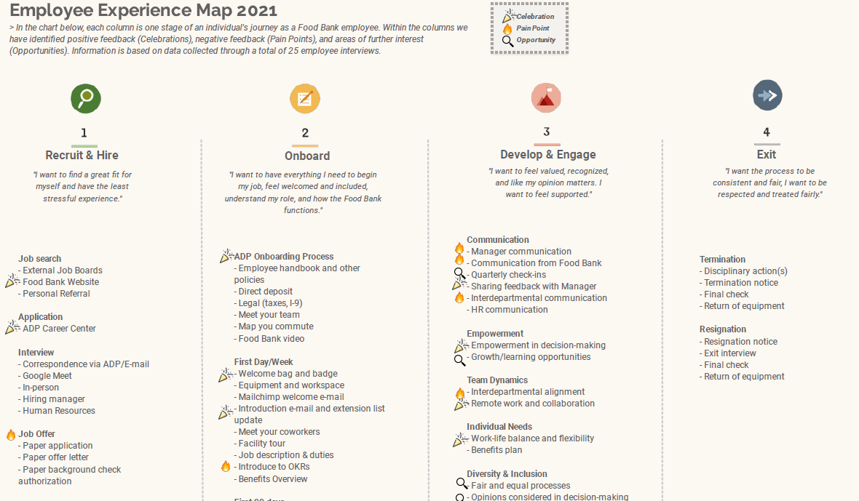
Employee Journey Map

Slide 14
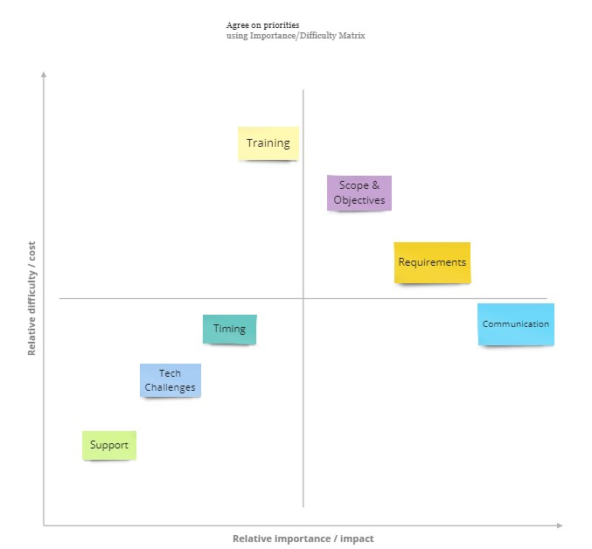
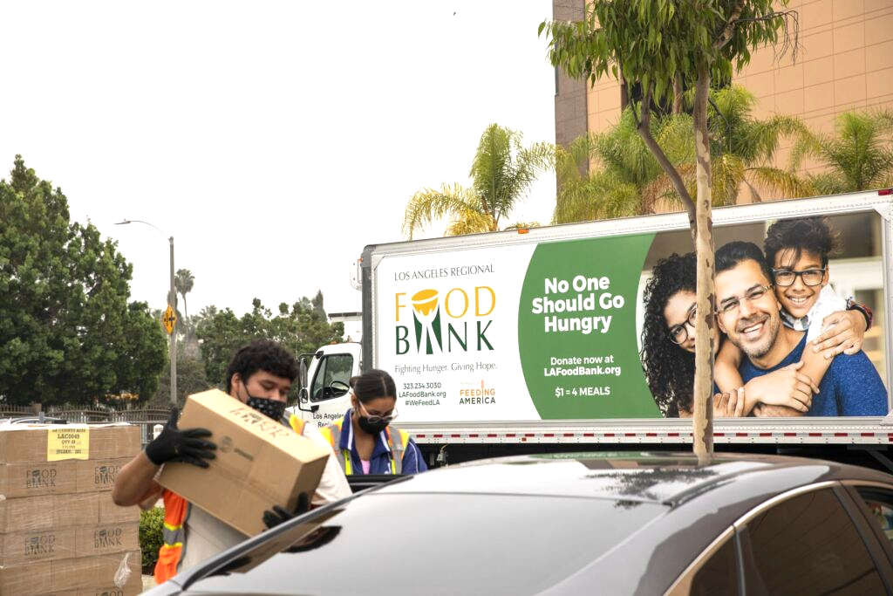
Data and processes
Building a home delivery solution during the pandemic
Process Improvements -Tech Cycles & Projects

Slide 15
What we’ve learned from our experience
Tip #1 - Use it for what it is, a tool
Tip #2 - Don't get stuck in the “ideation” phase
Tip #3 - Be ready for the ideas that come out of your session(s)
Notes:
Tip #1 - Use it for what it is, a tool
It’s a tool
HCD and the various methods involved are tools in your toolbelt.
Don’t expect it to magically solve all of your problems
Tip #2 - Don't get stuck in the “ideation” phase
Don’t endlessly brainstorm and continue bouncing the same ideas without identifying a solution
Although coming up with the ideas can be the most fun part of the process, remember that there are other steps in the process that are just as important to ensure an impactful result.
Tip #3 - Be ready for the ideas that come out of your session(s)
Solutions you design together with your stakeholders may not be what you anticipated
Some of the ideas that come out of this might not be what you expected. That’s okay!
Remember, you’re making solutions for others so listen to what is important to THEM.

Slide 16
What we’ve learned from our experience
Tip #4 - Emphasize your end-goal
Tip #5 - Have a solid plan for next steps
Tip #6 - It will take time
Notes:
Tip #4 - Emphasize your end-goal
Understand and communicate what everyone is intending to get out of the session. Maintains a focus for the group
Have a clear understanding of what you want to get out of a HCD session. More importantly, clearly communicate that vision to everyone involved often.
Tip #5 - Have a solid plan for next steps
Be prepared for next steps to continue the momentum of your solution
Part of the HCD process includes prototyping and piloting your ideas. Make sure you know who the key players will be in this step and what everyone’s role is. This step is key to bringing your ideas to life so spend time planning and executing it well.
Tip #6 - It will take time
Creating and implementing a solution will take time
If you’d like to implement HCD practices organization-wide, changing the way you work is also part of the process.
Just like implementing any new process or practice, it will take time. Identify your “change champions” and make sure you have the proper buy-in from leaders

Slide 17
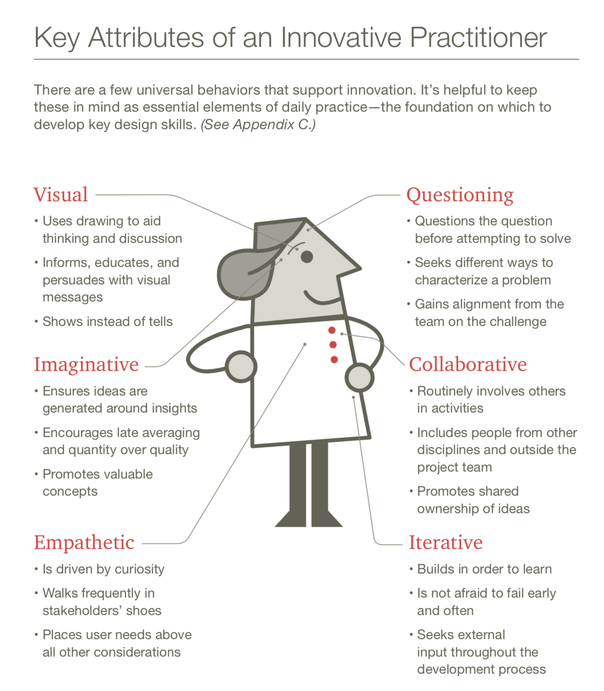
What are the key attributes of a design practitioner?

Slide 18
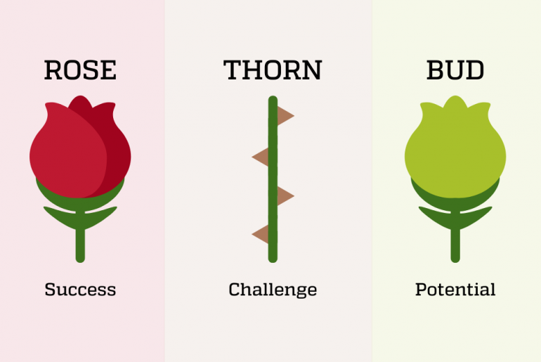
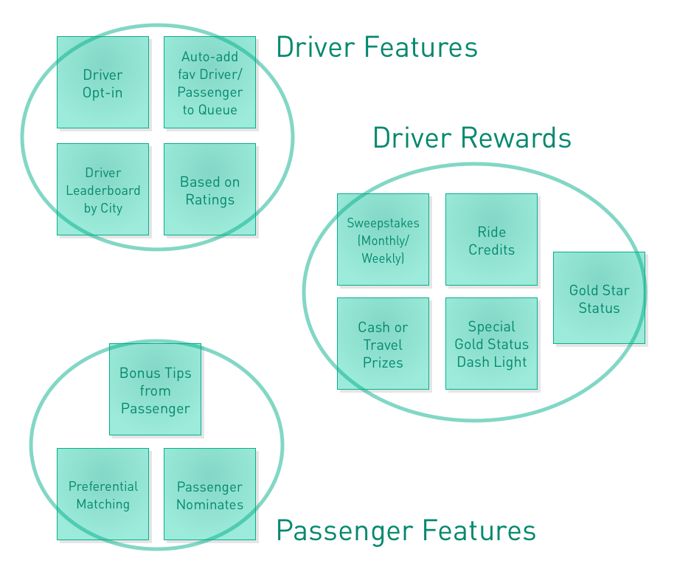
Today’s Activity
How might the Los Angeles Regional Food Bank better support your organization?
Rose, Thorn, Bud Affinity Clustering

Slide 19
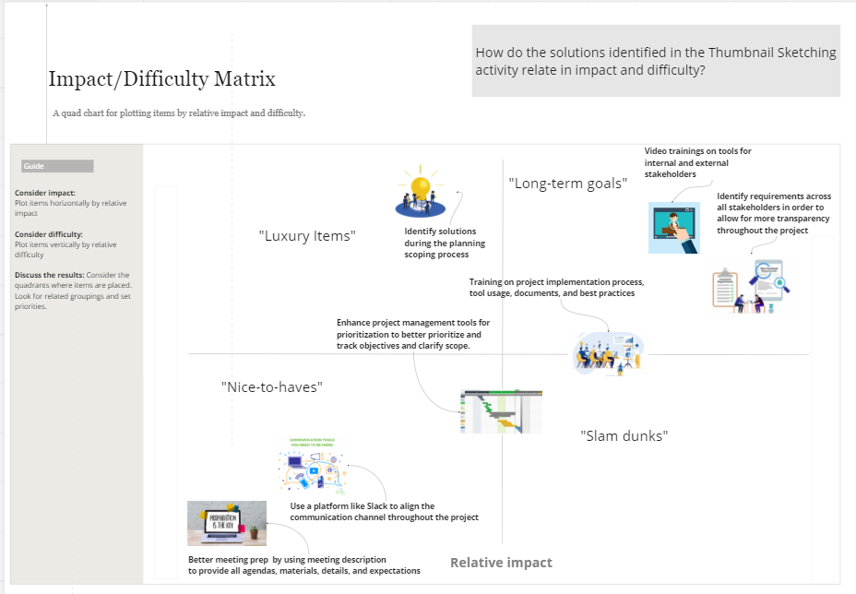
What about next steps?
Thumbnail Sketching Difficulty Matrix
Notes:
Miro Board example - LINK

Slide 20
Remote and Hybrid Tools
Virtual Collaboration Tools
Collaborative Document Creation
Google Workspace
Docs
Slides
Sheets
Digital Whiteboards
Miro Online Whiteboard
Mural Collaborative Whiteboard
Google Jamboard
Notes:
In addition to pen and paper, there are digital white boards and other digital tools hybrid meetings

Slide 21
Resources
IDEO
IDEO-U
IDEO.org
Stanford d.school
LUMA Institute
Design Thinking for the Greater Good by Jeanne Liedtka
Final Thoughts Q&A

Slide 22
Q & A

Slide 23
THANK YOU!

