Slide 1
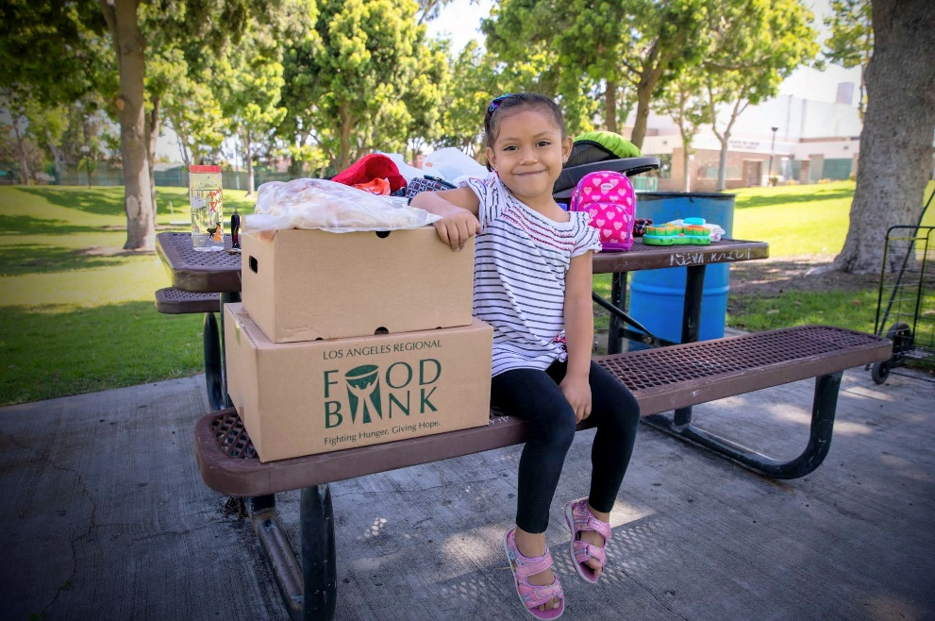
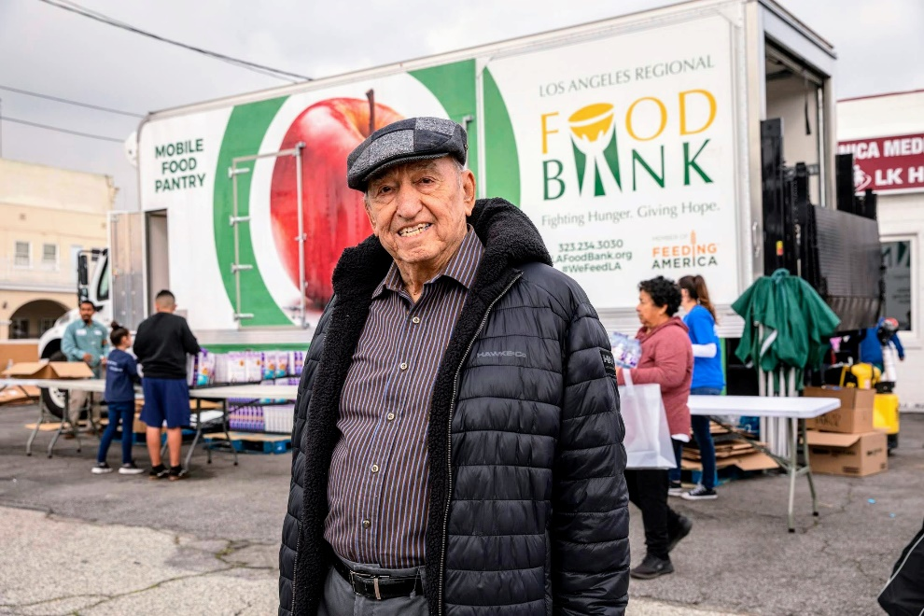
SERVING LOS ANGELES COUNTY SINCE 1973

Slide 2
FOOD BANK MISSION
To mobilize resources to fight hunger in our community.
Source and acquire nutritious food and other products and distribute it to people experiencing nutrition insecurity through our partner agency network and directly through programs;
Energize the community to get involved and support hunger relief;
Conduct hunger and nutrition education and awareness campaigns and advocate for public policies that benefit the people we serve.

Slide 3
Demystifying the Grant Process
Best practices and tips for writing successful grant proposals.

Slide 4
ANYONE CAN WRITE A GRANT

Slide 5
Tell A Story
HISTORY
MISSION
NEED
IMPACT

Slide 6
Tell A Story
HISTORY
MISSION
NEED
IMPACT
(WHO?)
(WHAT?)
(WHY?)
(What can be gained?)

Slide 7
IMPACT
Communities Served
Partners
Volunteers
Individuals Served
Board
Employees
Supporters

Slide 8
NEED
Root Causes
Challenges
Solutions

Slide 9
Grant Terminology
LOI (Letter of Inquiry or Letter of Intent): A brief letter outlining an organization’s funding request. Some grantmakers require an LOI as a first step before they will accept a full grant proposal.
RFP (Request for Proposals): A funder may release an RFP to solicit grant applications to address a specific issue. Philanthropy News Digest is a good source for RFPs.

Slide 10
Grant Terminology
Common Grant Types Note: This terminology is also used to describe all types of donations – not just grants.
General Operating/Unrestricted: Unrestricted/Operating grants fund the ongoing expenses of the organization.
Programmatic: In contrast with general operating grants, program grants support specific programs. A program grant is considered Restricted, meaning the funder has designated it for a specific purpose.
Capacity Building: These help organizations expand an existing program or launch a new one. Capacity grants may fund the purchase of equipment, the hiring of new personnel, building renovations or other concrete steps that expand services.
Research: Typically found in academia and research-oriented nonprofits.
In-kind: Provide non-monetary help, such as equipment, property, or other tangible donations.

Slide 11
Steps in Applying for Grant Funding
Identify a need. This is a problem in the community – not in your organization.
Develop a plan for addressing that need, including goals, activities, resources involved (such as personnel and equipment) and costs.
Research and identify grantmakers that are aligned with your organization.
Funder relationships are key.
Write and submit a grant proposal or LOI, depending on instructions.
If funded, immediately thank the grantmaker.
Execute the grant activities.
Submit a mid-year progress report and a final report Always follow the funder’s guidelines. After reporting, repeat beginning with step four.

Slide 12
What Goes into a Grant Proposal?
The exact sections of a grant proposal vary by funder. Be sure to follow their instructions. Common grant proposal sections are:
1. Cover Letter
2. Introduction & Organization Description
3. Statement of Need
4. Program Description, Goals and Key
5. Personnel
6. Evaluation
7. Sustainability Plan
8. Conclusion
9. Budget and Attachments

Slide 13
Cover Letter
Cover Letter: this provides a big-picture view of your grant proposal. Be sure to include:
The request amount
The purpose of the request
A brief snapshot of the need
Tip: Write the cover letter last after writing the proposal.
This will make it easier to summarize.

Slide 14
Introduction
Introduction: The first paragraph of a grant proposal offers a brief summary of the request.
The first sentence of the proposal should include:
Your organization name
The request amount
The purpose of the request
Example: The XYZ organization respectfully requests a $100,000 grant from The Foundation Name for the Senior Nutrition Program, which provides nutritious meals to food insecure seniors in Los Angeles County.

Slide 15
Organization Description
Organization Description: This section provides a high-level overview of your organization, including:
Mission statement
Brief history, including year founded
Primary activities, programs and services
Target population served, including geographic area

Slide 16
Statement Needed
Statement of Need: This is the problem statement. Describe the need with a sense of urgency.
Include quantifiable data, such as statistics, to help describe and justify the need.
Explain why this is important. What are the repercussions of this problem?
Remember: The need is a problem in the community – not in your organization.

Slide 17
Including Data in a Need Statement
Compare these two examples. Which is more powerful and convincing?
“Hunger is widespread in our community.”
“Hunger is widespread in our community: one in five people in Los Angeles County are food insecure.”

Slide 18
Program Description and Goals
Program Description: This section describes the program in detail. What are the specific activities you will undertake to address the need you identified?
Program Goals: Must be measurable. Funders look for SMART goals:
Specific: Well-defined, clear, and unambiguous
Measurable: Quantifiable
Achievable: Does your organization have the resources needed to achieve this goal?
Realistic: Within reach – a reasonable goal for the time period.
Timely: With a clearly defined timeline, including a start and end date.

Slide 19
SMART Goals
SMART Goals
Compare these two examples:
“With your generous support, we will reduce hunger.”
“With your generous support, in calendar year 2022 the Food Bank will distribute 110 million pounds of food to individuals and families facing hunger in Los Angeles County.”

Slide 20
Evaluation, Key Personnel & Sustainability
Evaluation: How will you measure the program’s success? The answer needs to be specific and quantifiable. Reference the SMART goals. Describe what information you will collect and how you will collect it.
Key Personnel: Provide short bios highlighting the experience of organization leaders and/or the staff who will be implementing the program.
Sustainability: How will you sustain the program beyond this grant funding? Show that you have other donors and a plan to sustain funding.

Slide 21
Conclusion and Attachments
The Conclusion restates the request.
Convey a sense of urgency.
Restate the ask amount
If the funder has donated previously, this is a good place to thank them for their past support.
Attachments: These are additional supplemental documents submitted with your proposal.
The requirements vary by funder.
Common attachments include:
IRS Determination Letter/ 501 (c)(3) Letter
Organization Budget
Board of Directors List
Audited Financial Statements

Slide 22
Budget
The funder may have a specific budget form. Always follow the guidelines and use the required format.
Budgets may show income and expenses for the entire program, or simply how the grant will be spent.
Typically a budget is limited to one page.
The budget must be consistent with the proposal.

Slide 23
Grant Writing Tips
Use data
Specificity is essential
Be concise
Avoid jargon
Testimonials
Research
Learn to say a lot in a few words
Be familiar with the funder

Slide 24
STAY PREPARED
Make a template
Take a grant writing course
Recommended Reading:
“Winning Grants,” by Mim Carlson and Tori O’Neal-McElrath

Slide 25
Steps to Finding Funding
Types of Grants: Foundation, Corporate, Government
Research Corporate Social Responsibility Departments and Foundations
Build relationships
Submit a Letter of Inquiry

Slide 26
Grant Resources
Foundation Directory Online by Candid
https://www.grants.gov
https://california.grantwatch.com/cat/24/nutrition-grants.html

Slide 27
Questions?

Slide 28
Thank You!

