Slide 1
Anti-Hunger Advocacy 101:
Legislative Engagement Strategies for Agency Partners

Slide 2
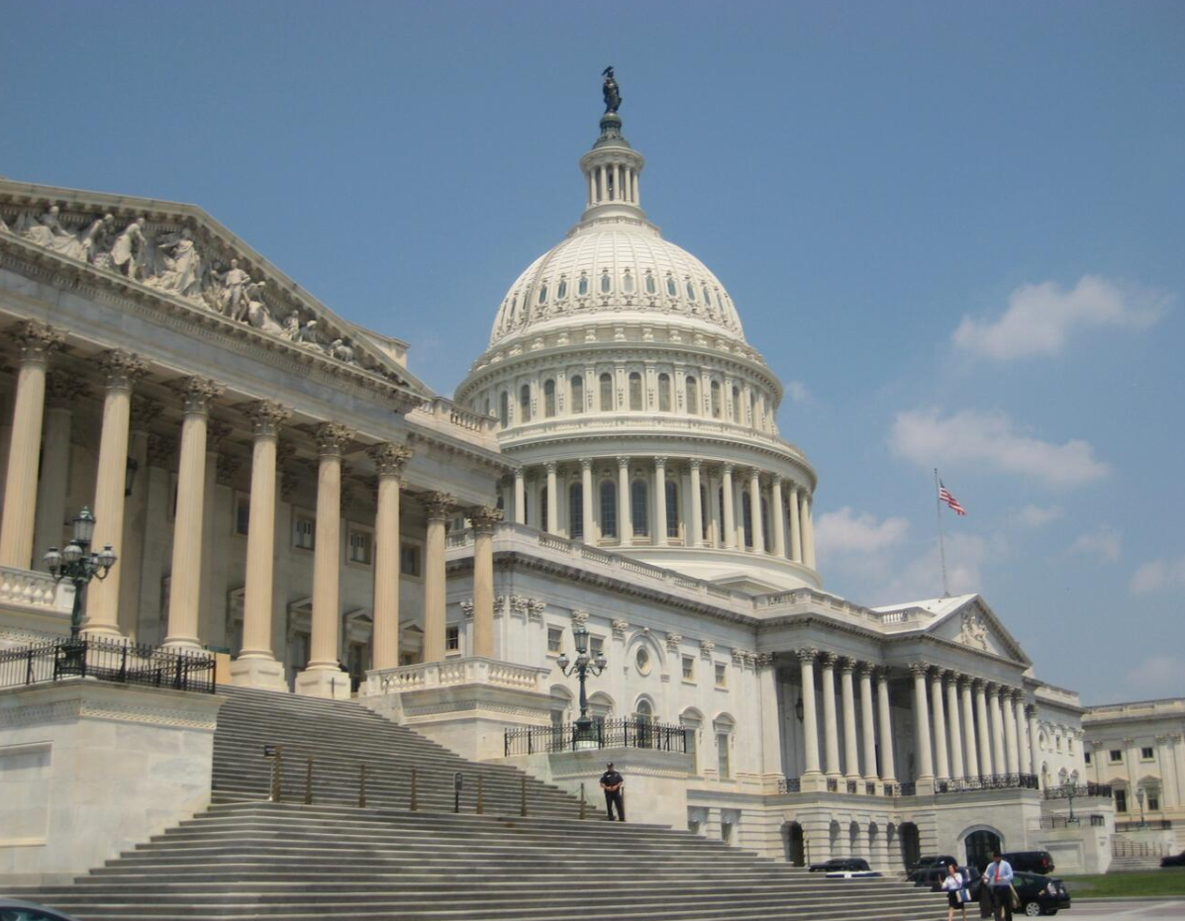
Anti-Hunger Advocacy 101:
Legislative Engagement Strategies for
Agency Partners
Today’s Presenters
Chris Carter
Senior Policy & Research Manager
Los Angeles Regional Food Bank
Claudia Castaneda
Government Affairs/Policy Associate
Los Angeles Regional Food Bank

Slide 3
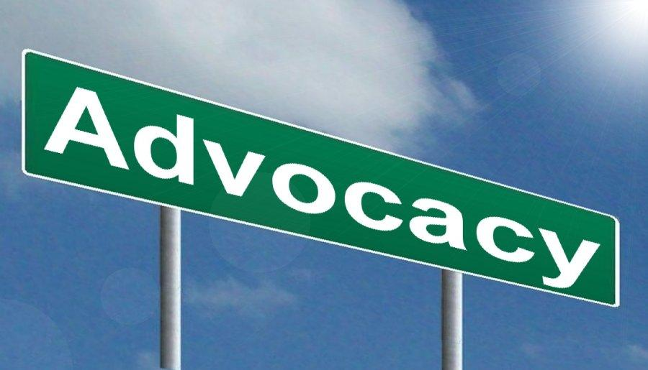
What is advocacy?
Advocacy
Advocacy and lobbying tend to be used interchangeably.
Advocacy is much broader than legislative lobbying.
Advocacy is more focused on raising awareness and influencing public opinion rather than directly influencing legislation or policy.
Raising awareness about an issue: environmental protection, animal welfare, affordable housing, healthcare access, food insecurity.
Greenpeace, Habitat for Humanity, Humane Society, Feeding America
Advocacy involves engaging in information campaigns to educate the public and influence public opinion:
  Social media campaigns, TV commercials, PSAs, hosting community meetings, seminars to educate the public, producing informational materials, producing research reports, writing Op-Eds, creating and getting signatures for public petitions, organizing demonstrations, etc.

Slide 4
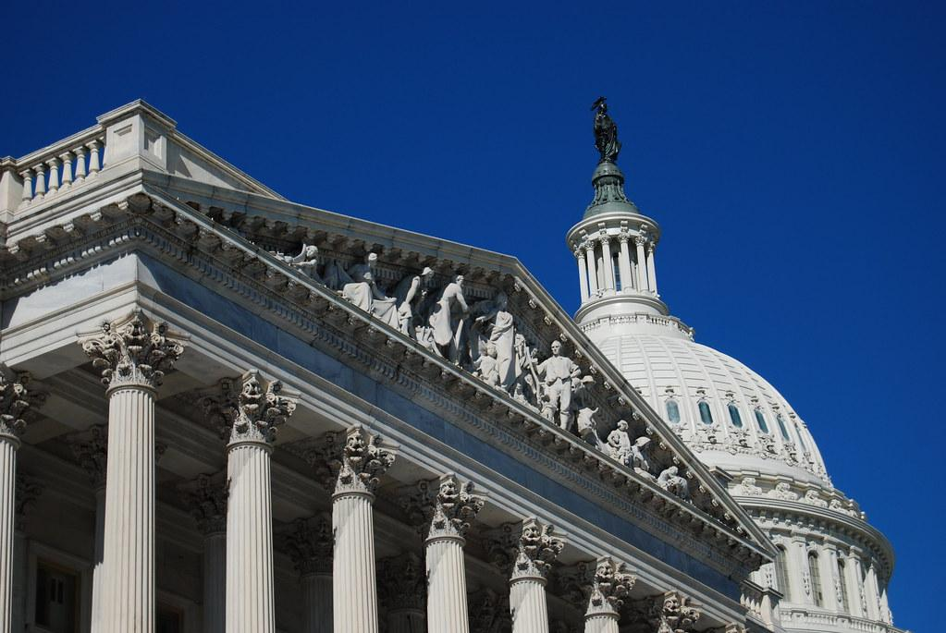
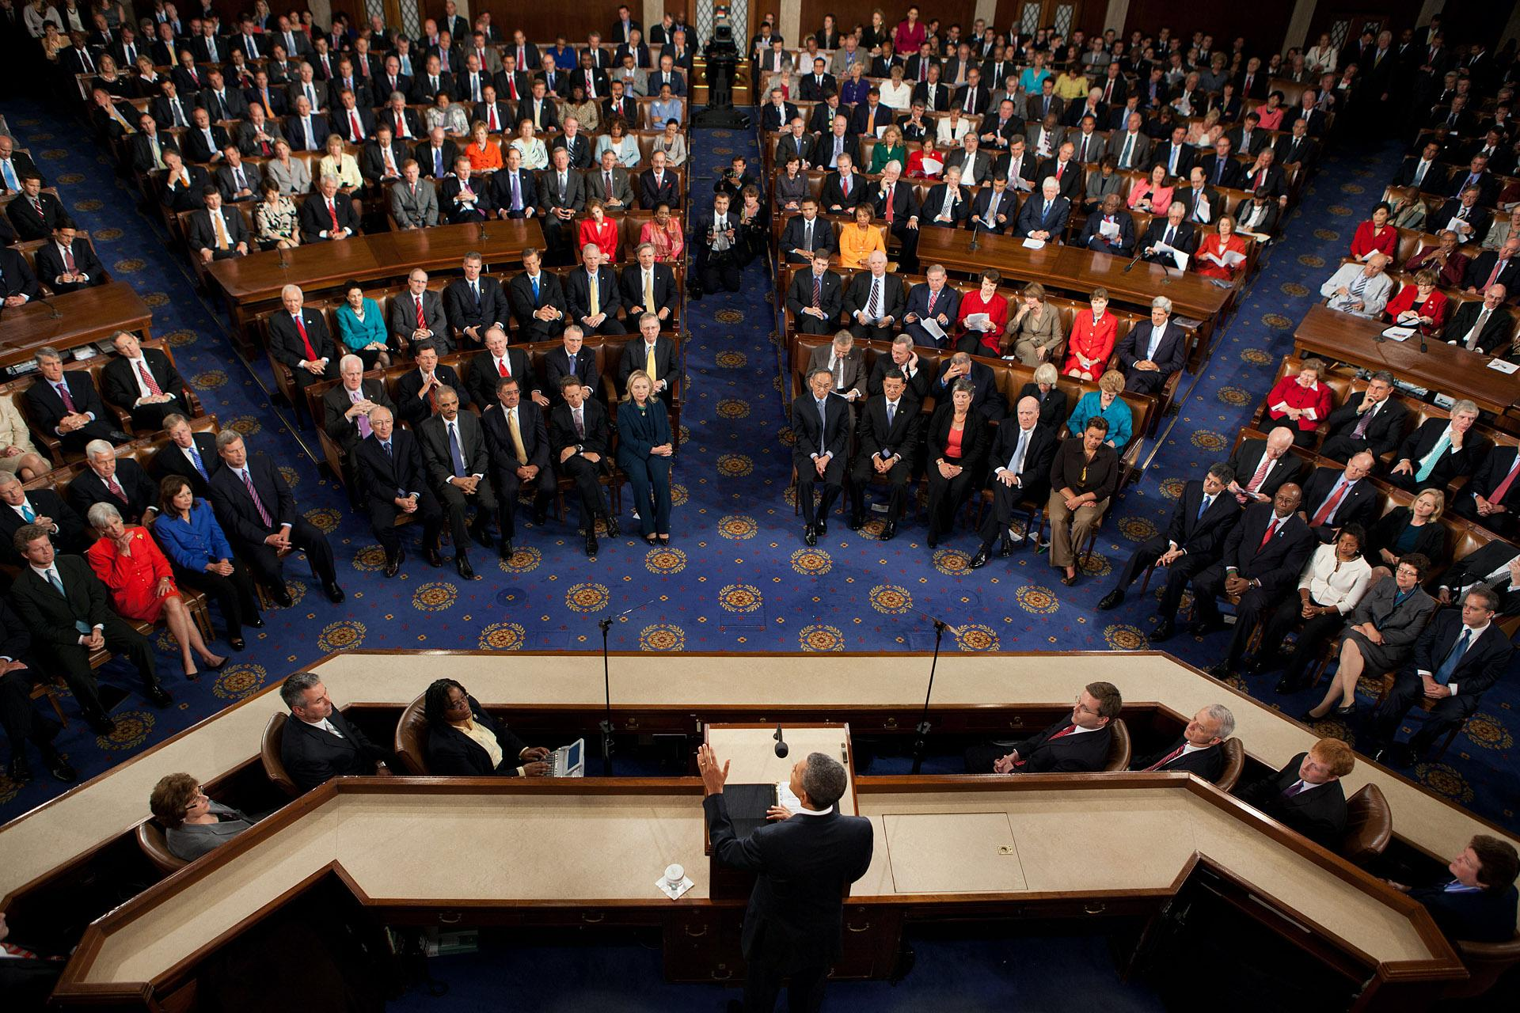
What is lobbying?
Lobbying
Lobbying is a subset of advocacy.
Lobbying is attempting to influence legislation at the federal, state, or local levels through direct or grassroot communications.
Direct lobbying is any attempt to influence new or existing legislation by communicating with a member of a legislative body or other government representative who has a say in the legislation.
Grassroots lobbying is asking other organizations or members of the public to influence legislation through communication with a legislators. For example, a member alert asking partners/the public to contact a legislator to support/oppose legislation using online portals/sign on letters.

Slide 5
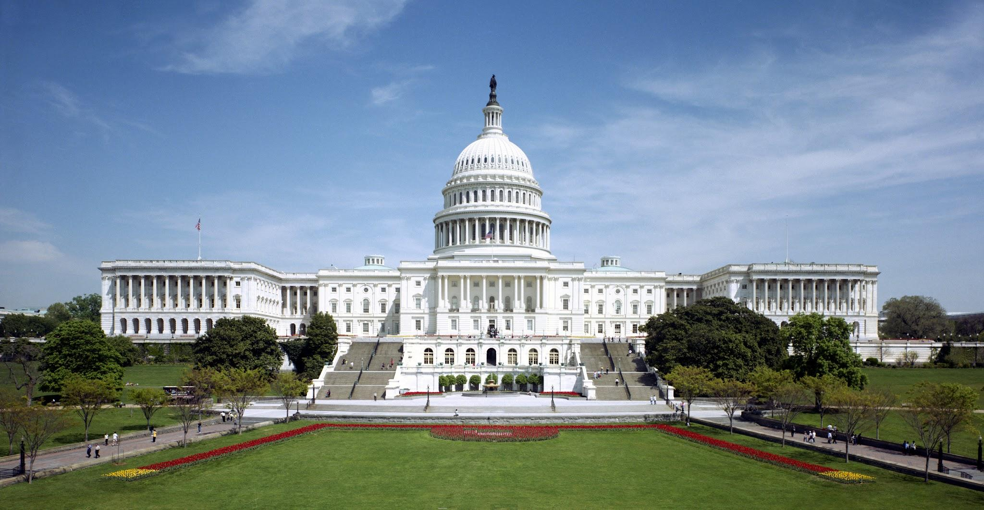
Nonprofit lobbying:
Nonprofit Lobbying:
It is permissible for nonprofits so long as it is not a “substantial part” of the organization’s total activities.
It’s regulated by the IRS: “Substantial Test” not to exceed 5 - 15% of total organizational activities.
Nonprofits are forbidden from engaging in certain types of activities:
  Cannot engage in any activities that are support of or in opposition to a candidate for public office.
  Cannot endorse candidates for public office.
  Cannot make contributions to a political campaign or public statements in favor of/opposition to any candidate.
  Cannot endorse or oppose any candidates for public office, or use charitable assets for partisan campaign activities.

Slide 6
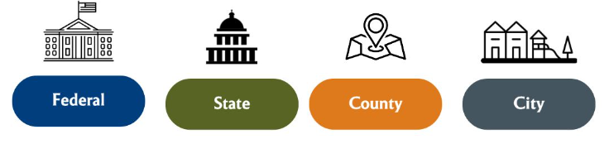
Engaging in Advocacy:
Levels of Government

Slide 7
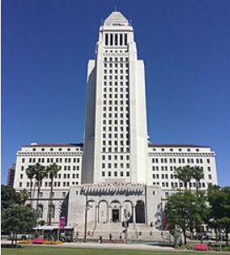
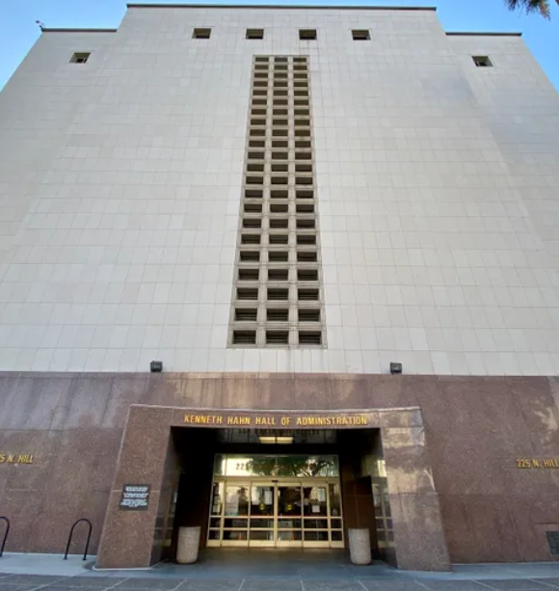
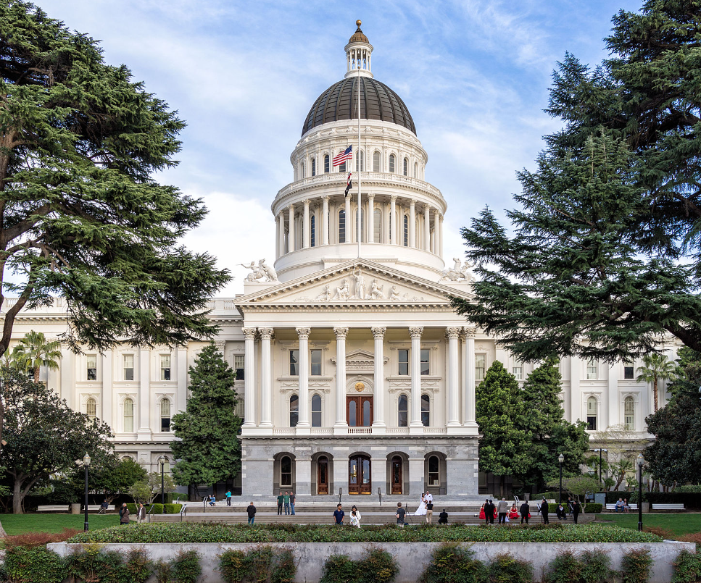
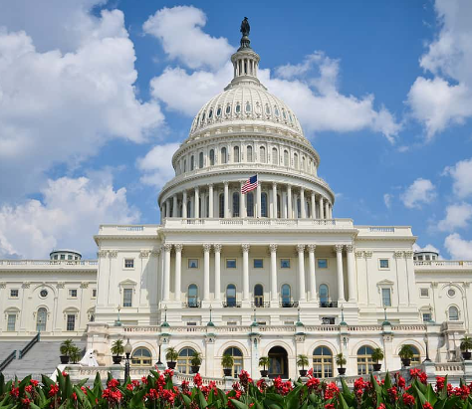
Engaging in Advocacy:
Mayor Karen Bass &
15 City Council Members
88 Cities in LA County
Los Angeles County
Board of Supervisors Representing 5 Districts
Governor of California
State Assembly & Senate
President
U.S. House of Representatives
U.S. Senate

Slide 8
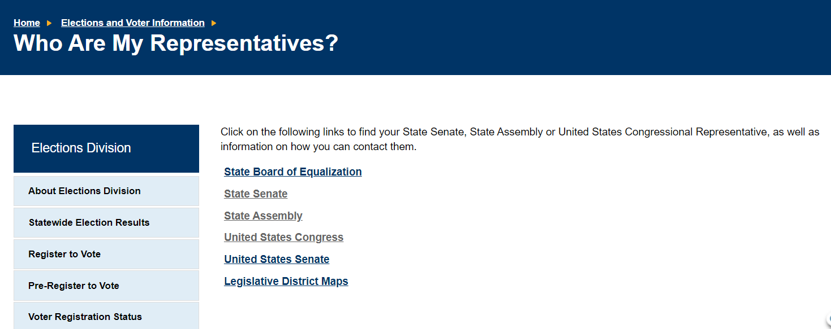
Who are my legislators?
Visit the California Secretary of State website: https://www.sos.ca.gov/

Slide 9
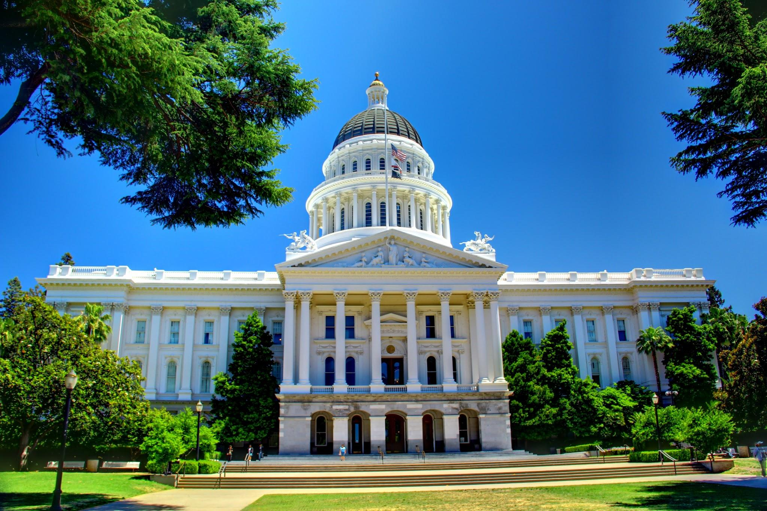
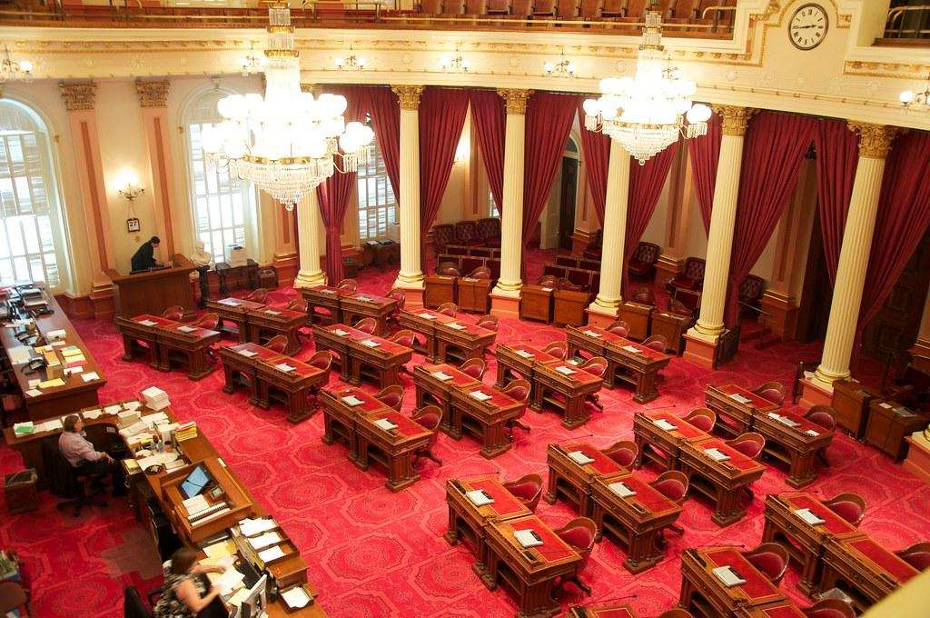
California State Legislative Updates:

Slide 10

State Legislative Updates:
SUN Bucks
SUN Bucks Summer EBT Program
Recent federal legislation established a permanent summer EBT program that will benefit nearly 5 million children in California.
SUN Bucks is an example of a lobbying/advocacy legislative success.
Rep. Susan Davis introduced the ‘Stop Child Summer Hunger Act’ in 2014.
It’s the first major permanent federal nutrition entitlement program in decades since Food Stamps in 1960s and WIC in 1970s.
The SUN Bucks program will provide $120 per eligible child to buy groceries when school is out during the summer.
Children who qualify for free or reduced-price school meals, or who receive CalFresh, CalWORKs, or Medi-Cal, are automatically enrolled.
Share the SUN Bucks toolkit: cafoodbanks.org/sun-bucks

Slide 11
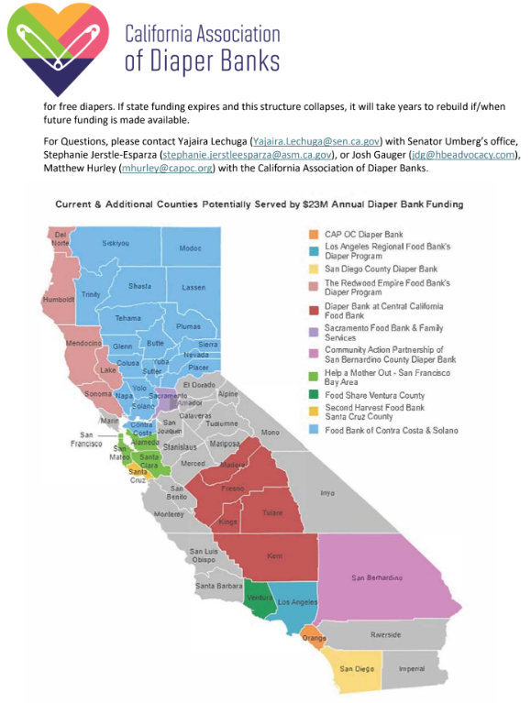
State Legislative Updates:
Diaper Bank Program
Diaper Bank Program Funded in 2024-2025 State Budget & Coverage Expanded
Established in 2019, the state’s diaper banks have distributed 160 million diapers to over 1 million families with 1.6 million infants.
Los Angeles Regional Food Bank has distributed over 23 million diapers through 125 agency partners in communities throughout LA County.
The state legislature passed $30 million in one-time funding over three years in the 2021-22 budget that expired in June 2024.
Thanks to the California Association of Diaper Banks and advocacy/lobbying from a range of stakeholders and partners, the Governor and legislature included $9 million in funding to keep the state's Diaper Bank Program operating in the 2024-2025 fiscal year.
Three new food banks were added to the program (Ventura, Santa Cruz, Contra Costa & Solano) that now covers 39 counties and 83% of California residents.

Slide 12
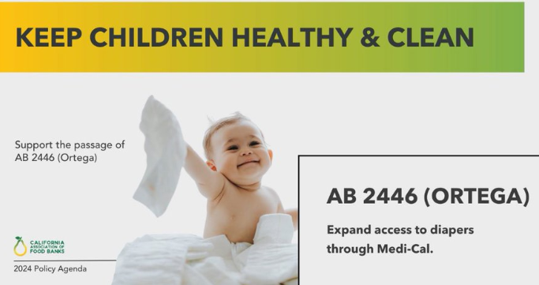
State Legislative Updates:
AB 2446 Ortega – Medi-Cal Coverage for Diapers
AB 2446 Ortega – Medi-Cal Coverage for Diapers
This bill would ensure that medically necessary diapers are provided through Medi-Cal as mandated by the federal Early and Periodic Screening, Diagnostic and Treatment (EPSDT) program.
Current California law is overly restrictive and doesn’t align with federal law. It leaves children under 5 unable to access diapers when medically necessary.
The bill would help to expand access to diapers for low-income families by allowing children age 5 and under to qualify for prescription diapers minimizing the risk of painful conditions like Urinary Tract Infections (UTIs) and diaper dermatitis which have serious health consequences for children.

Slide 13
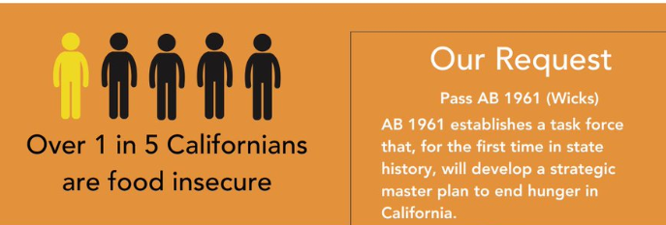
State Legislative Updates:
AB 1961 Wicks - Master Plan to End Hunger in California
AB 1961 Wicks – Master Plan to End Hunger in California
The bill would establish a state taskforce that will create a strategic master plan to end hunger in California.
The taskforce would be responsible for identifying barriers for food retailers reaching food desert regions.
By identifying and mapping regions of need, the council would subsequently work to increase enrollment in federal nutrition programs.
The taskforce will comprise of government agencies, anti-hunger nonprofits, food retailers, the agricultural sector, and academic institutions
The goal of AB 1961 will be to provide a strategic plan to the California legislature by January 2026 with comprehensive solutions to address food insecurity in California.

Slide 14
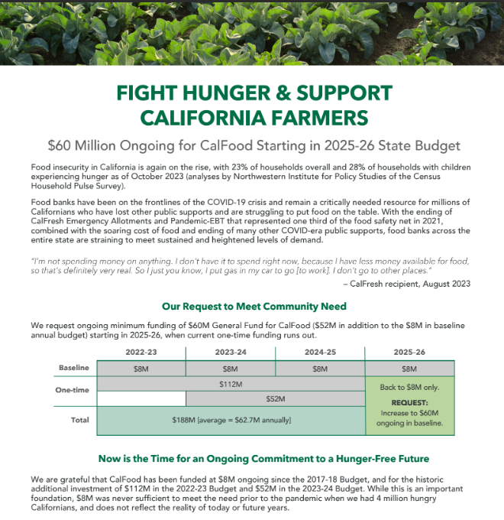
State Legislative Updates:
CalFood Program State Budget Request: $60 Million Ongoing for CalFood Starting in 2025-26
CalFood is another legislative success due to advocacy and lobbying by the state’s food banks.
The CalFood Program enables food banks to purchase and distribute California grown and manufactured foods.
Food banks can purchase expensive food items including milk, eggs, and frozen protein items as well as fresh produce.
The program was funded at $8 million pre-pandemic, then boosted by $164 million in multi-year funding during the pandemic.
CalFood returns to the $8 million baseline funding next year, and our network will advocate/lobby for that to be increased to an annual $60 million baseline ongoing.

Slide 15
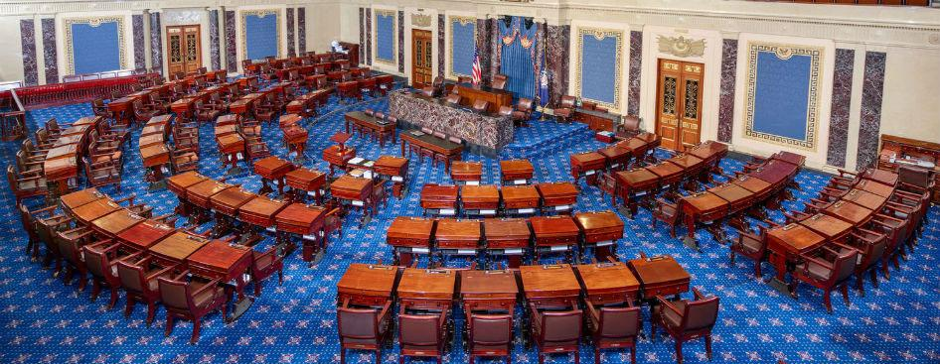
Federal Legislative Updates

Slide 16
Federal Legislative Updates:
Timeline
August Congressional Recess
House: Thursday, July 25 – Friday, Sept. 6
Senate: Monday, Aug. 5 – Friday, Sept. 6
Farm Bill
Current Farm Bill expires: Monday, Sept. 30
Federal fiscal year 2025 begins: Tuesday, Oct. 1

Slide 17
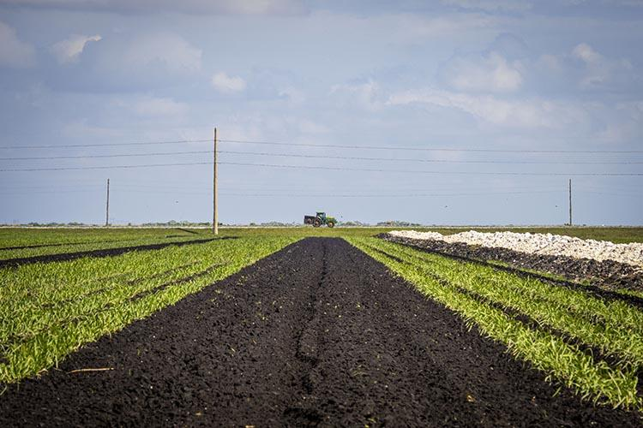
Federal Legislative Updates:
Farm Bill
What is the Farm Bill?
-Comprehensive piece of legislation that authorizes most federal food & agriculture programs across the country
-Including SNAP/CalFresh
-Reauthorized every 5 years, expired Sept. 30, 2023
-CR passed November 2023, extended until Sept. 30, 2024
TEFAP is a cornerstone of the charitable food sector food supply but current funding for TEFAP is drastically insufficient to meet growing needs.
-30% of our food distribution purchasing budget.
SNAP provides timely and targeted support to help people put food on the table during difficult times (Protecting this program is crucial for the next farm bill).

Slide 18
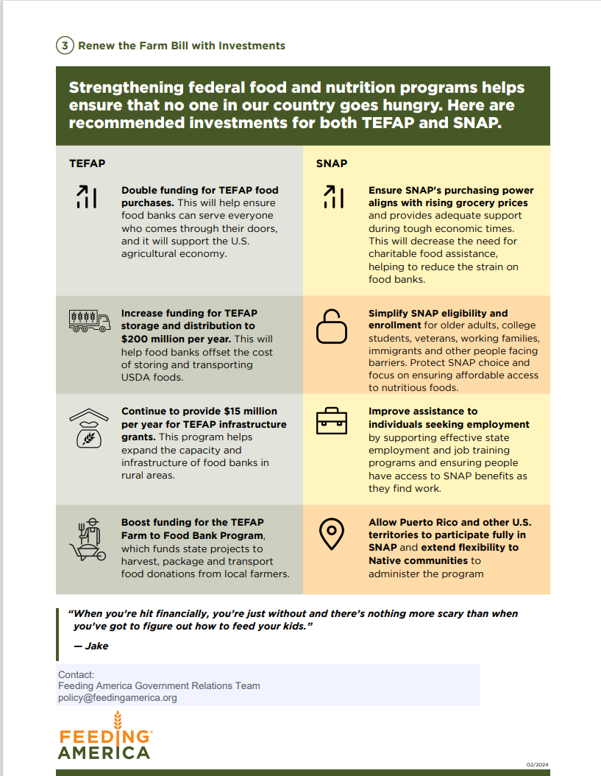
Federal Legislative Updates:
H.R. 6203 Farmers Feeding America
Farmers Feeding America Act (H.R. 6203/S. 2713)
H.R. 6203 Farmers Feeding America Act would double funding for TEFAP food purchase and reauthorize and increase funding for storage and distribution. The bill also provides flexibility to help the USDA better serve specific geographically isolated states and procure fresh produce.
$900 Million Food Purchasing
$200 Million Store & Distribution
$15 Million Infrastructure

Slide 19
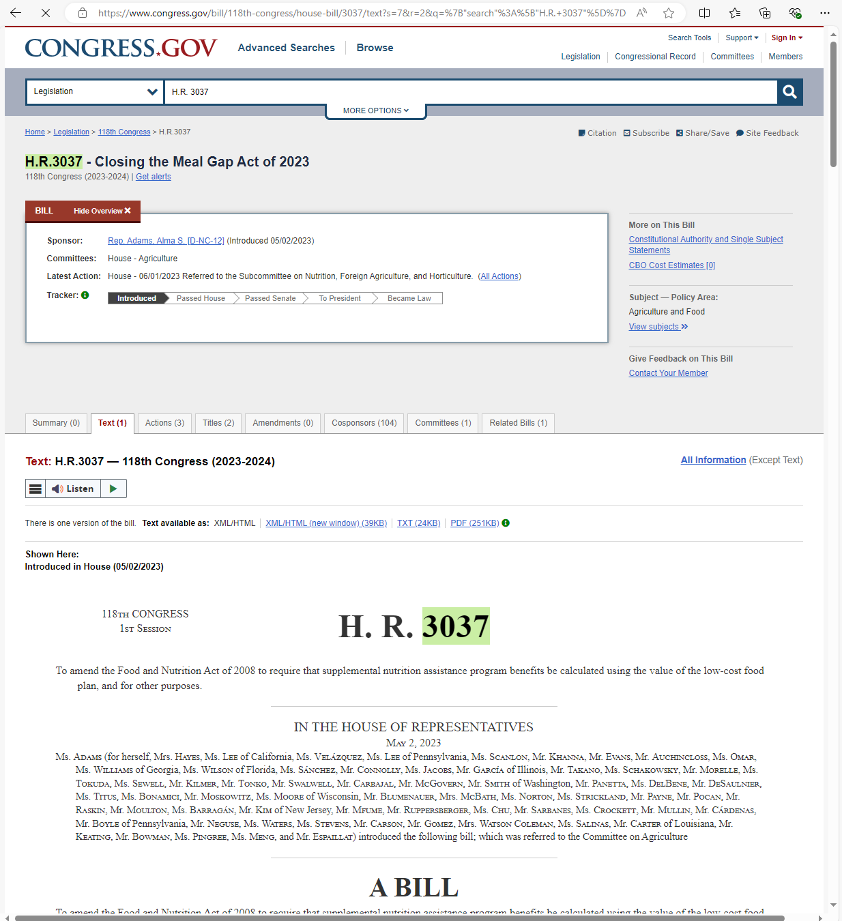
Federal Legislative Updates:
H.R. 3037 Closing the Meal Gap Act
Closing the Meal Gap Act (H.R. 3037/S. 1336)
H.R. 3037 Closing the Meal Gap Act would boost SNAP benefit levels for all participants, using the Low-Cost Food Plan. This would protect the U.S. Department of Agriculture’s ability to respond to changes in family diets and nutritional guidance changes through future Thrifty Food Plan updates.

Slide 20
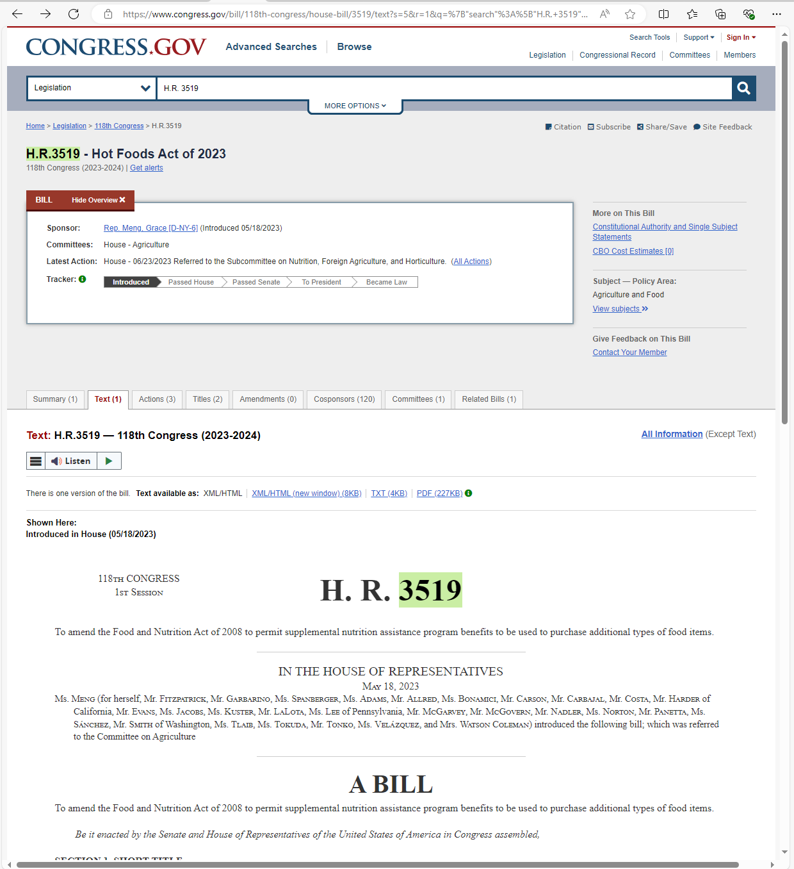
Federal Legislative Updates:
H.R. 3519 Hot Foods Act
Hot Foods Act (H.R. 3519)
H.R. 3519 Hot Foods Act would permanently end the prohibition on the use of SNAP benefits to purchase hot, prepared foods from SNAP food retailers. This bill would oppose restricting SNAP choice for participants and support incentives to increase food access for all.

Slide 21
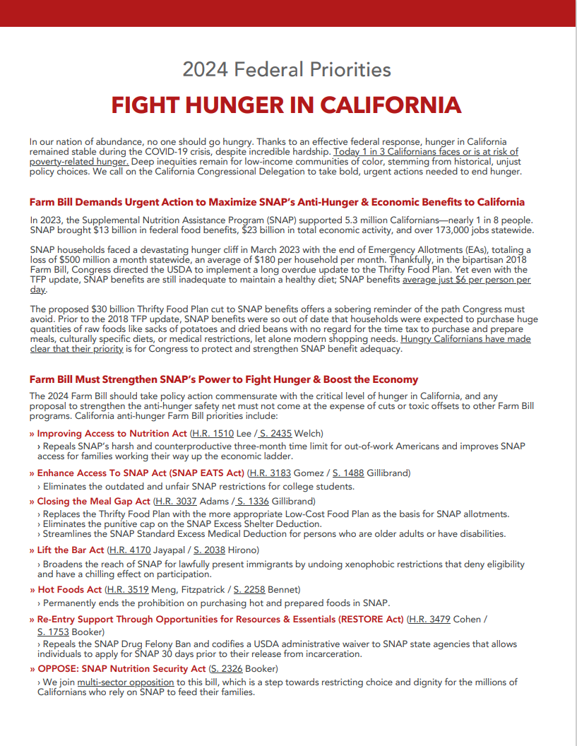
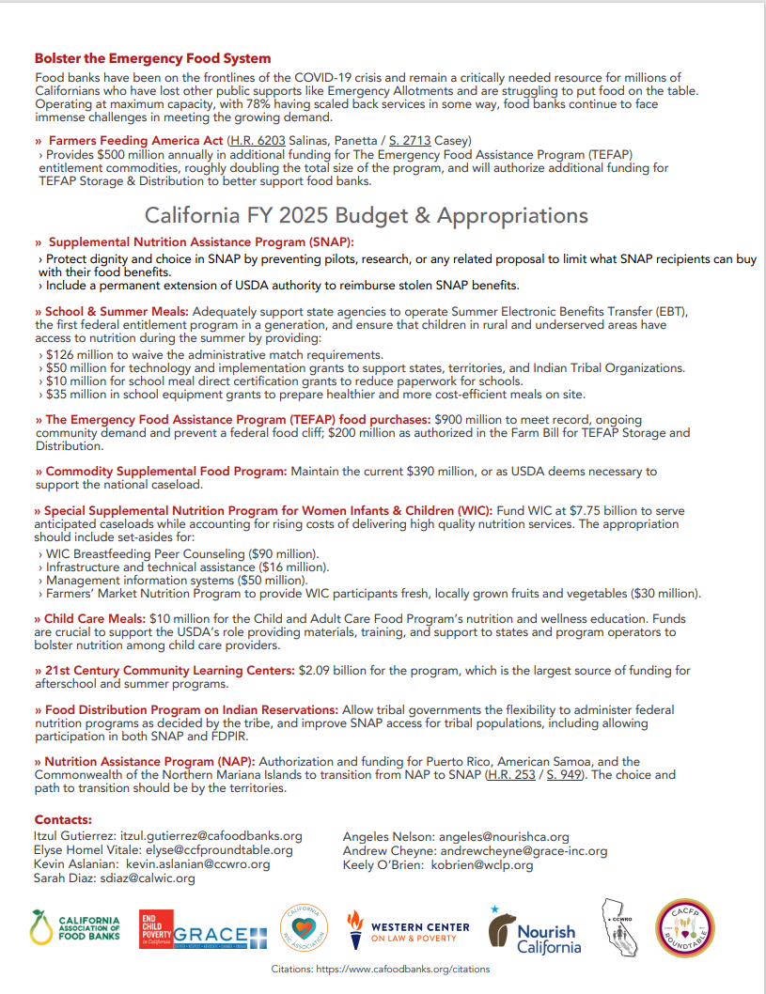
Federal Legislative Updates:

Slide 22

How to Engage in Legislative Advocacy:
Key ways to engage your legislators:
Sign-on Letters/Calls of Support
Creating a legislative factsheet for your agency
Hosting legislative briefing meetings with elected officials & policy staff
Hosting a site visit with an elected official

Slide 23
What are sign on letters?
Sign-on Letter
A letter used to demonstrate broad support for, or opposition to, an issue, bill or action.
An organizational sign on letter would be drafted using the input of anti-hunger coalition leaders to share with members of Congress or state legislators to declare their stance on an issue and urge their support/opposition.

Slide 24
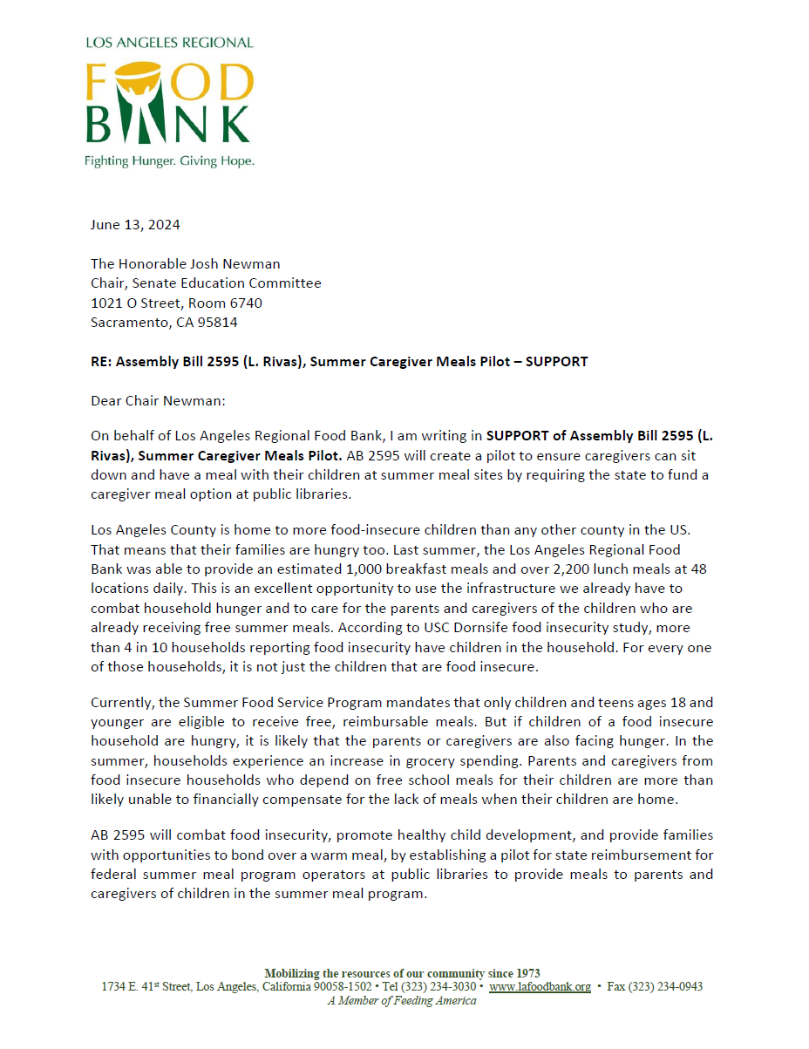
Sign-on Letters Drafting Process
Present historical/background information on the issue or bill.
State your organization or coalition’s position on the issue (support/oppose).
Share how this issue impacts the (budget, operations, service capacities) of your organization.
Address the letter to the legislator or committee who is reviewing the bill or budget proposal.
Sign the letter and share with legislative staff in the offices of legislators in your district. If this is a coalition letter (multiple organizations) make sure to add their names to the letter as supporting organizations.

Slide 25
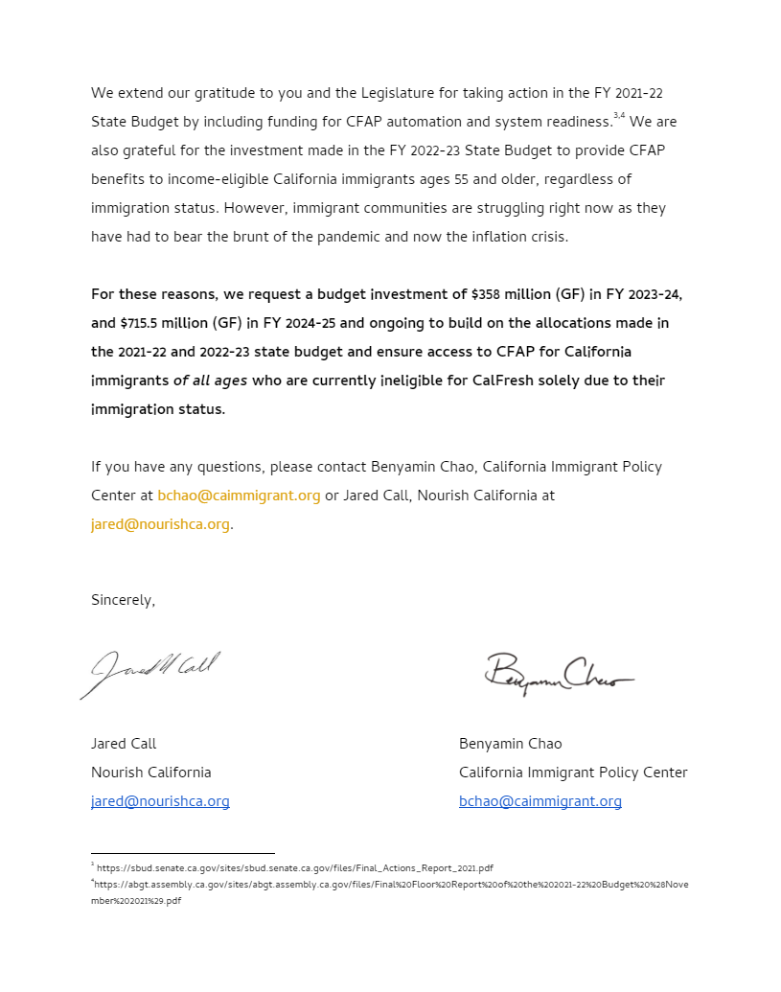
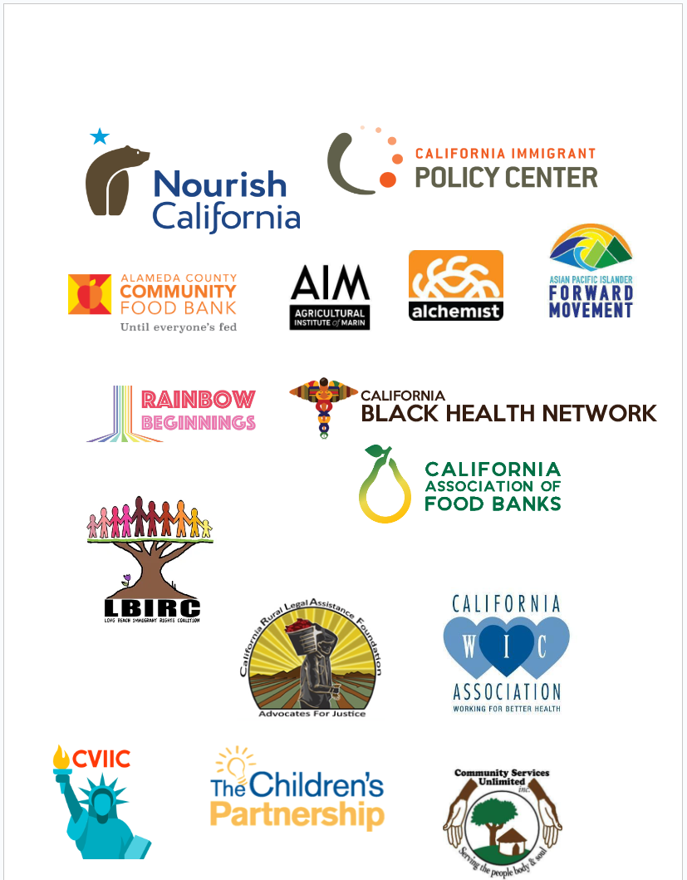
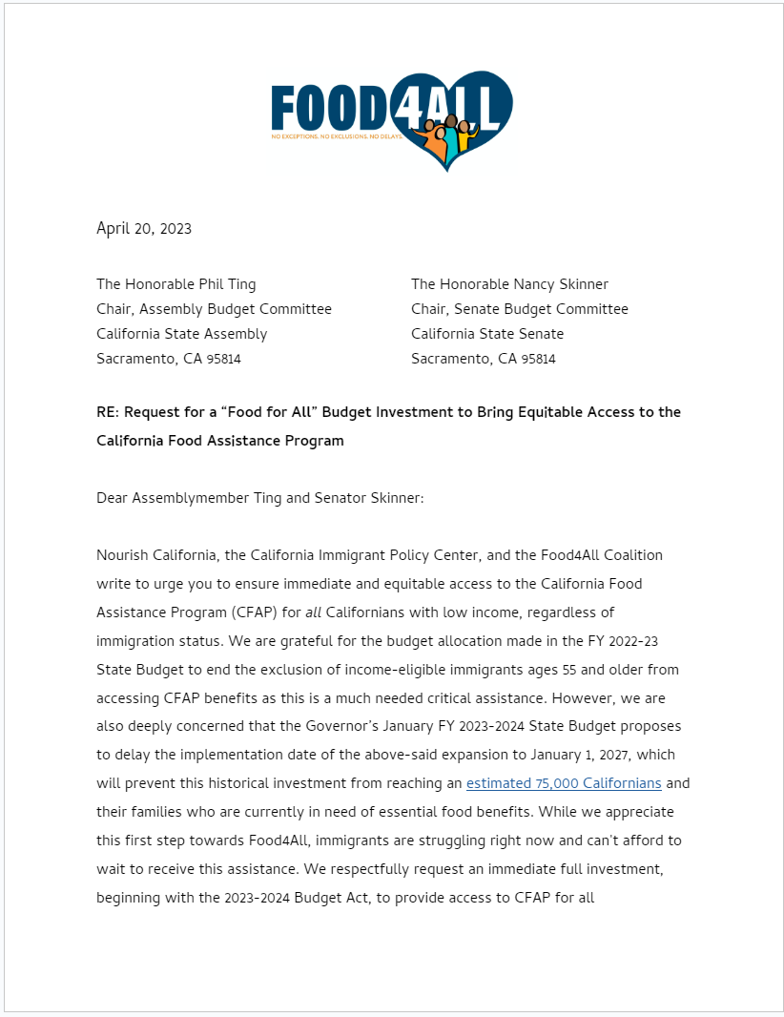
How to Write a Sign-on Letter:
Sign the letter and share with legislative staff in the offices of legislators in your district. If this is a coalition letter (multiple organizations) make sure to add their names to the letter as supporting organizations.

Slide 26
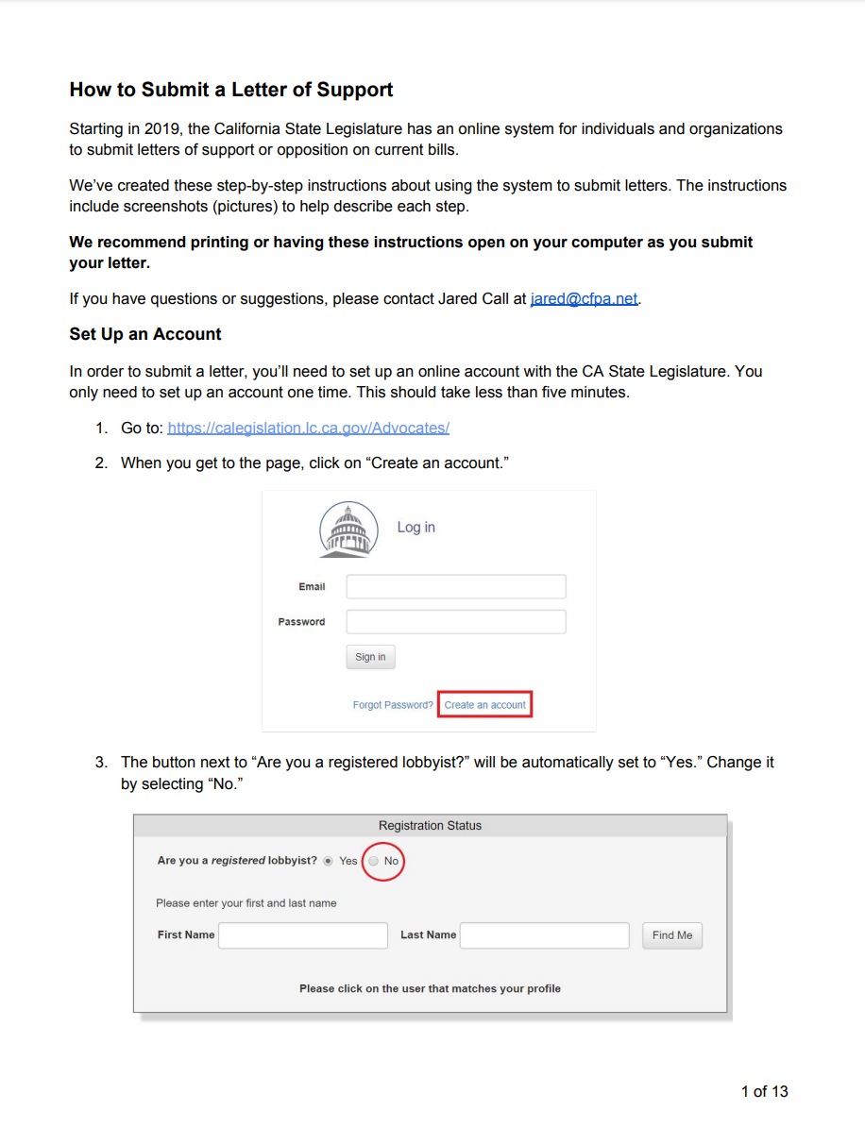
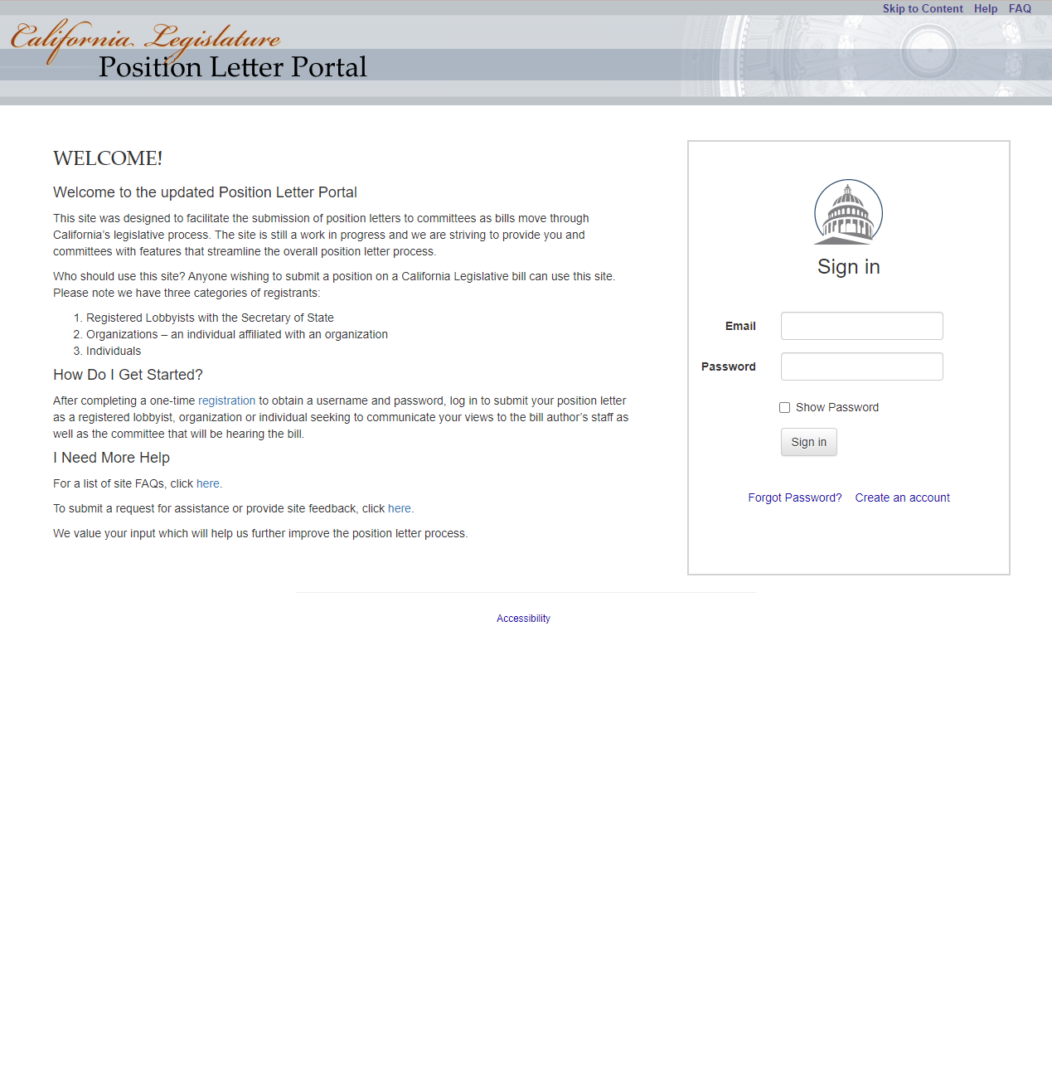
How to Submit a Sign-on Letter:
If the letter addresses a California state specific issue or the bill was introduced by a CA state legislator, then upload your official pdf letter to the California Legislature Position Letter Portal (Calegis Portal).
https://calegislation.lc.ca.gov/Advocates/
Follow up with an email to the staffer handling the bill/issue in the respective legislator’s office.

Slide 27
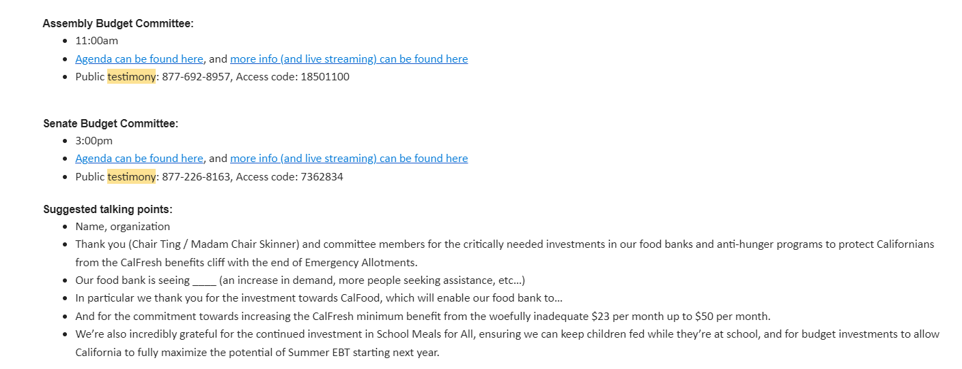
Providing Public Comment/Testimony:
Call in requests occur when a committee convening opens the floor for public comment.
At this time advocates are able to provide public comment in support of a bill/issue area in person or over the phone.
Coalition leaders will normally provide a script that advocates can follow to provide their comment on behalf of the network or their organization.
Providing public comment helps to bolster support behind important bills that affect our anti-hunger network partners and the communities that depend on our services.

Slide 28
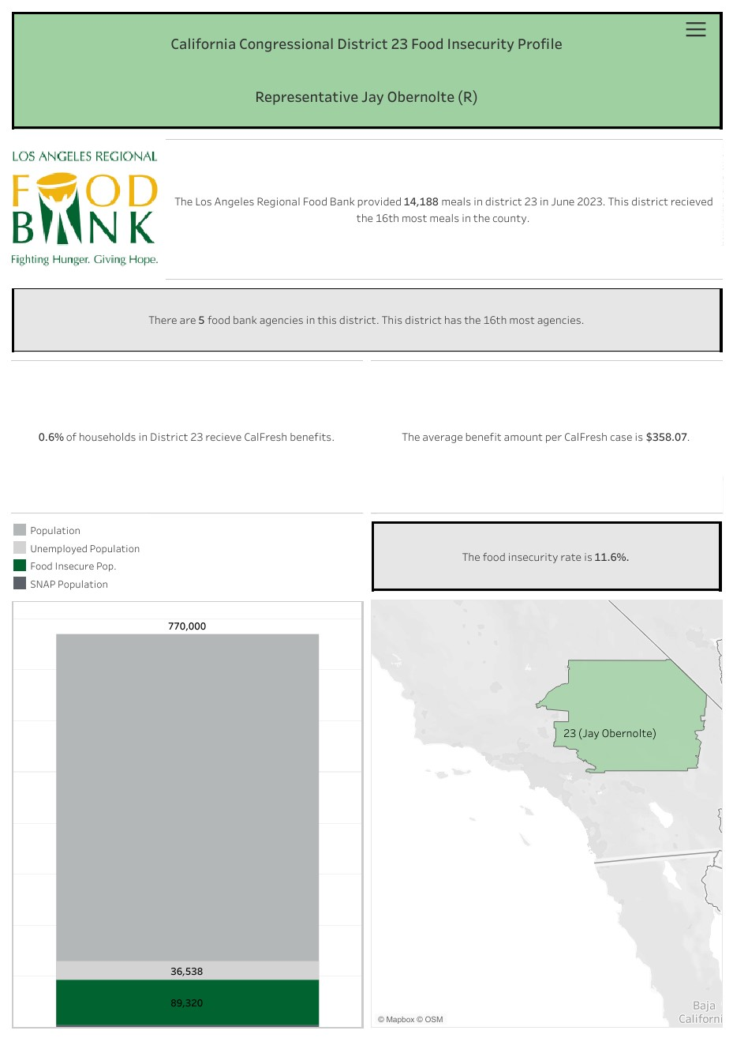
Creating a Legislative Factsheet for Your Agency:
Components of a Factsheet
Include Los Angeles County food insecurity data
Include your agency's food distribution data:
  Number of pounds distributed
  Number of meals distributed
  Number of individuals served
Include the cities, neighborhoods and communities you serve (and if possible, stats for each community)
Include the range of programs you operate: After School Meals, Congregate Meals, Food Pantry Services, Mass Distribution Sites, Meal delivery, Senior Meals, etc.
Include client photos, short bios, quotes and testimonials

Slide 29
Creating a Legislative Factsheet for Your Agency:
Include Food Insecurity & Poverty Data in Los Angeles County:
A staggering 30% of county residents are grappling with food insecurity, marking a substantial six percentage-point increase from 2022, when the rate stood at 24%, according to USC Dornsife.
More than 1 in 4 people in Los Angeles County struggle with nutrition insecurity.
USA Food Prices Rose by 25 Percent From 2019 to 2023.
Consumers spend 11.3% of their disposable income on food - a 30-year high.
A study finds that Californians spend the most on groceries in America.
A $25 item in 2019 would likely cost more than $30.75 in 2024 – an estimated 22.8% increase.
US food prices specifically have gone up 25% from 2019 to 2023.

Slide 30
Creating a Legislative Factsheet for Your Agency:
Include Food Insecurity & Poverty Data in Los Angeles County (continued):
According to the 2024 Quality of Life Index, prepared by UCLA’s Luskin School of Public Affairs:
▪ Of the people living in LA County, 24% say they fear going hungry due to food affordability.
▪ When asked if food prices have impacted their lives, 94% say it has made a major or minor impact.
▪ Nearly 4 in 10 renters have worried about losing their homes and becoming homeless.

Slide 31
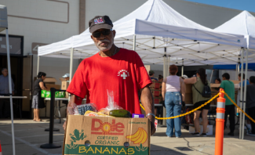

Creating a Legislative Factsheet for Your Agency:
Include Client Stories
“I get food stamps, $189, and that probably lasts probably about two weeks with the food stamps that I have,” Connie said. “I’ll get like the meat, and I’ll get the stuff that I don’t get here, so this will take the place of whatever I can’t get.” Connie, Santa Clarita
In a recent visit to the Antelope Valley, the Food Bank met Samuel Williams at a food distribution at Iglesia El Lirio de los Valles in Lancaster. Like many, Williams fell on hard times. As a veteran, Williams receives his social security check and retirement. However, that wasn’t enough to pay for his home and other necessities, causing him to lose that home. Williams had been living in motels. He receives retirement every month, but when he applied for CalFresh, he was awarded a minimum of $23 monthly. In a time when food prices have skyrocketed, $23 a month isn’t enough to even cover the basics.
“This is a life-saving event for me,” Williams said. I’m just doing my part to make myself available to whatever you have to offer. Last month, it was such sustenance that I appreciated it, and it carried me through the month.” Samuel, Lancaster
Without a job, anybody, including Connie, would struggle. Without an income, she has to find a way to feed herself and her young daughter and cover any other costs. Although her daughter receives CalFresh benefits, the $189 per month that she receives is simply not enough to feed them both for the full month. Which is why she turns to the Santa Clarita Valley Food Pantry for assistance.
www.lafoodbank.org/stories

Slide 32

Hosting Legislative Briefing Meetings:
Schedule an appointment with your legislator
Send an email to the scheduling staff, or complete the online meeting request form.
Introduce your organization and the purpose for your meeting request.
Include your available dates & times.
If you do not hear back within a reasonable time, do not get discouraged. Staffers receive a lot of meeting requests, they may not always respond right away.
Circle back with a follow up email citing your original meeting request.

Slide 33

Hosting Legislative Briefing Meetings:
Conduct Preliminary Research:
Get to know your legislator.
Check out your legislator’s website for biographical information, committee assignments, and recent press releases.
Look up their voting record on anti-hunger legislation.
New to your organization? Make sure you know his/her history with your organization.
Follow your legislator on social media.

Slide 34
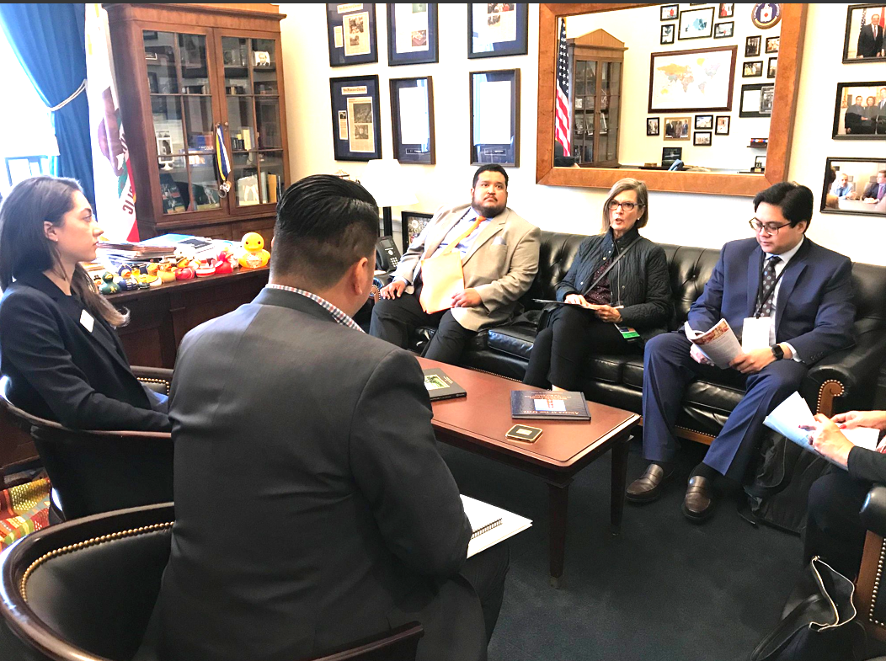
Hosting Legislative Briefing Meetings:
What should I bring to the meeting?
Create your own “leave behind” folder.
Include your agency’s legislative factsheet.
Include bill factsheets on legislation that you are asking the elected official to support.
Bring your organization's recent newsletters & annual report

Slide 35
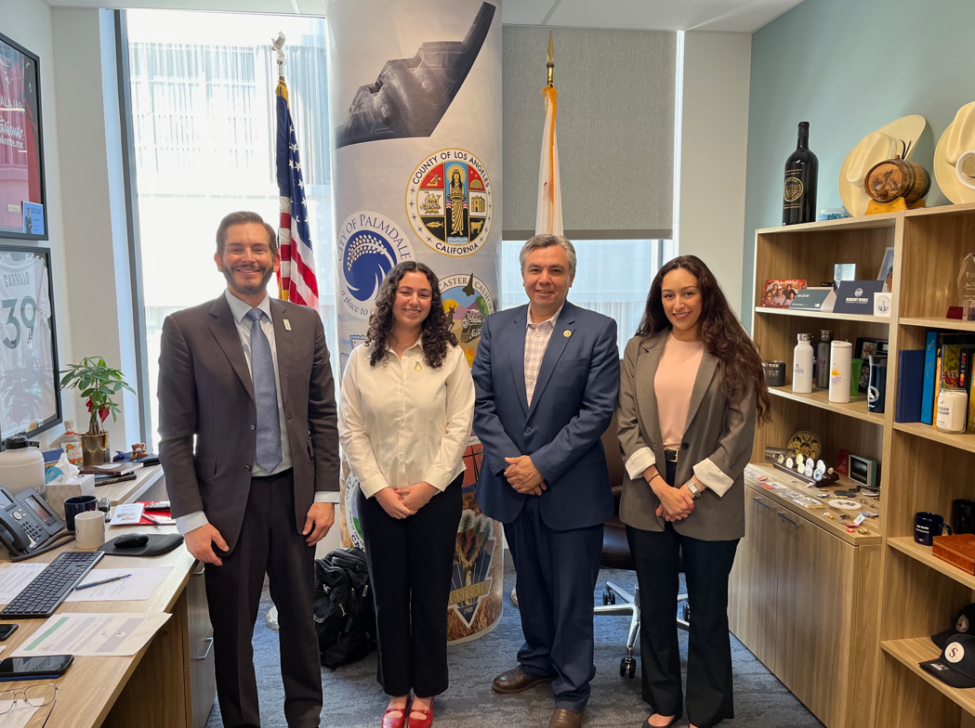
Hosting Legislative Briefing Meetings:
All Politics IS Local - Points to emphasize in your meeting
Share food distribution data: number of pounds/ meals, number of households/individuals served.
Give local examples/ share client stories about the impact your programs have in alleviating hunger in your community.
Share your legislative factsheets, and ask your legislator to co-sponsor legislation, vote for or against legislation.
Ask your legislator to agree to a site visit when they are home.
Take a group photo with the elected official and post it on your organization’s social media platforms.

Slide 36

Hosting Legislative Briefing Meetings:
After the meeting/ follow up:
Send a thank you email/letter to the legislator and staff who attended the meeting.
Follow up with any materials or information that was promised during the meeting.
Send the list of bills you requested the legislator to support.
Invite the legislator to visit your agency or a distribution site.

Slide 37
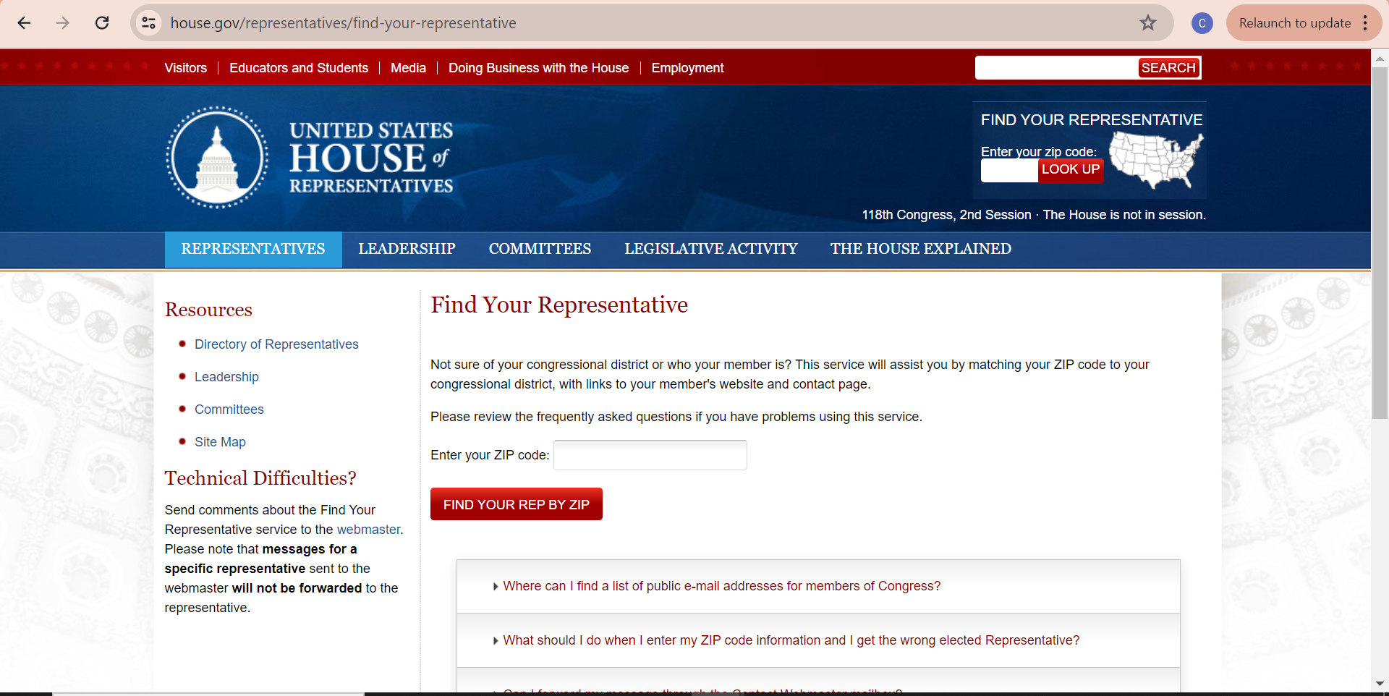
How to Host a Legislative Site Visit:
Use the legislator lookup tool at:
https://www.house.gov/representatives/find-your-representative (Federal)
https://www.ca.gov/service/?item=look-up-my-representatives (State)
Enter your area zip code and the lookup tool will generate results for the legislators that oversee your food pantry/distribution site.

Slide 38
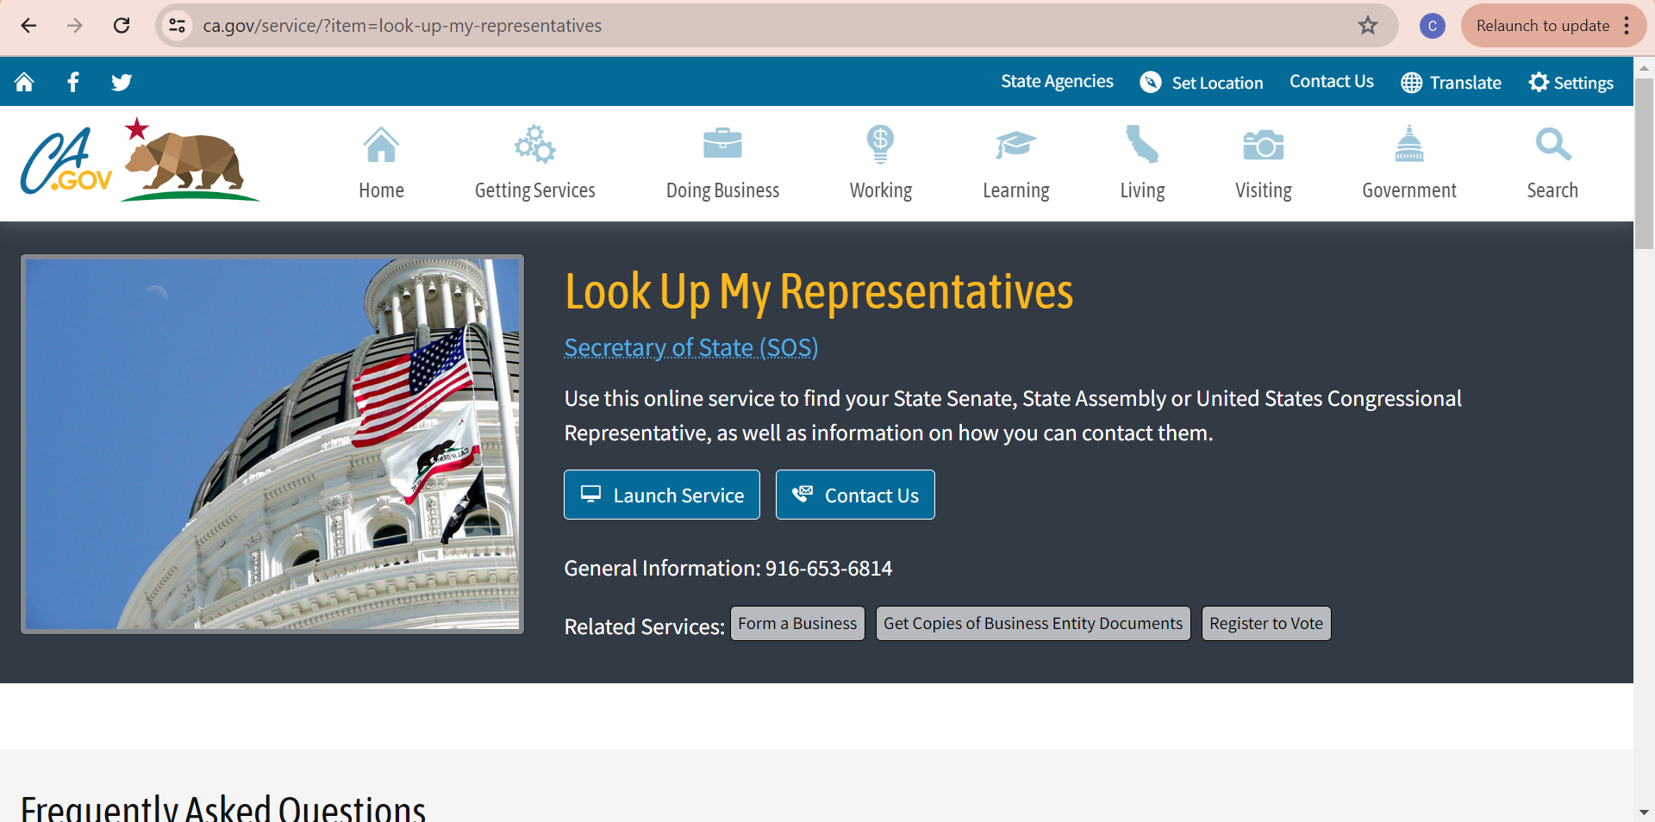
How to Host a Legislative Site Visit:
The federal lookup tool will show you who your local Member of Congress is based on your area code.
The state lookup tool will connect you with your State Legislator(s) Assemblymember(s) & Senator(s).
Some food pantries may have more than one representative who overlaps their city or service region.

Slide 39
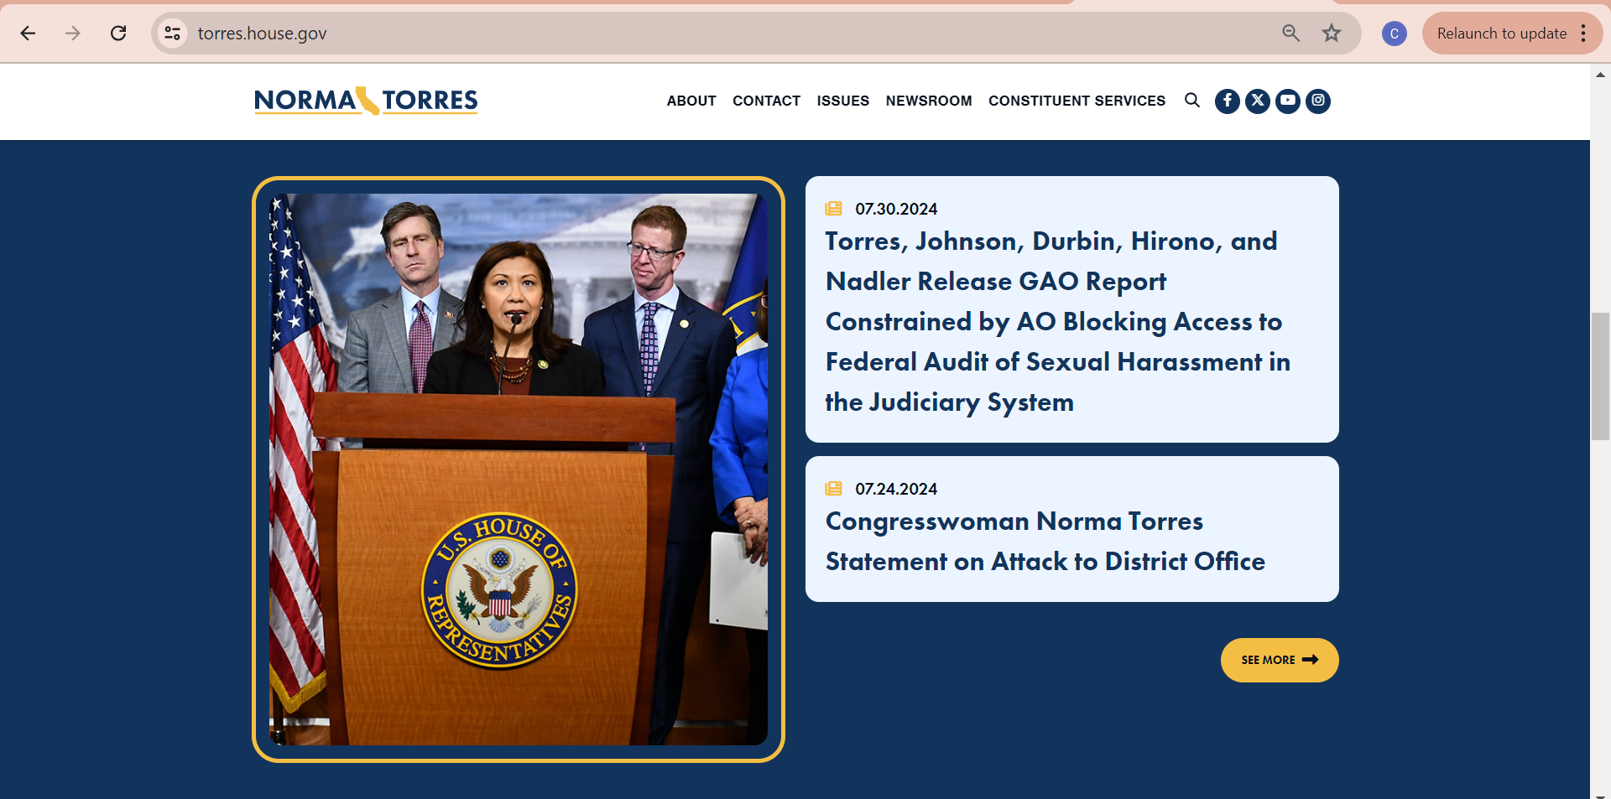
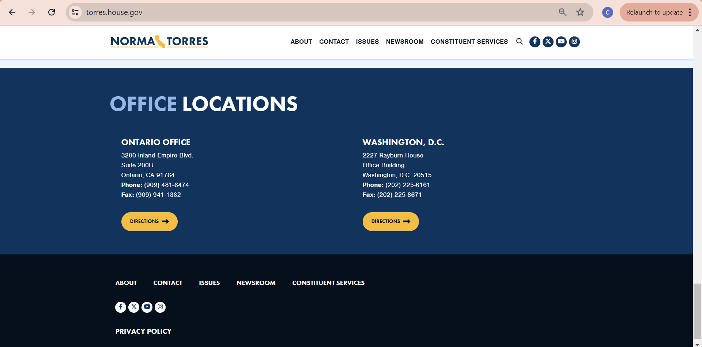
How to Host a Legislative Site Visit:
Visit your legislator’s official (.gov) homepage. Here you will find their official biography, notable achievements, and policymaking priorities.
To schedule your legislative visit find their district office information (normally at the bottom of their homepage).
Call their District office and request the contact information for their district scheduler (email).
Draft your initial outreach email with an invitation for a site tour.

Slide 40
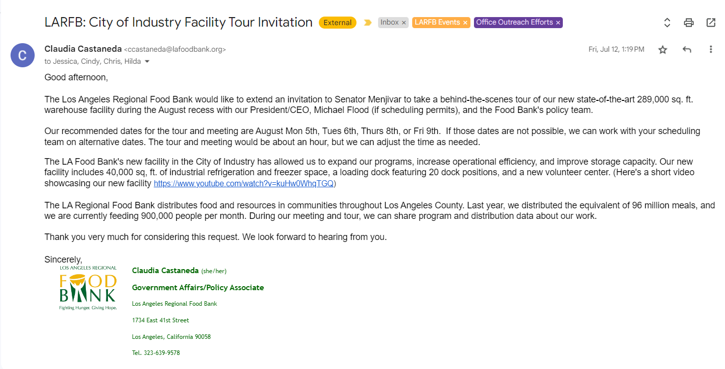
How to Host a Legislative Site Visit:
Draft initial outreach email with an invitation for a site tour.
Prepare day-of (factsheets & itinerary for internal staff, informational pamphlets about the food pantry and its distributions to share).
RSVP parking for elected officials & media/press if applicable.
Provide takeaway materials for legislators and their staff.
Conduct follow up outreach (email/phone) to thank them for their visit and support.
Remember to include the purpose of the visit, date(s)/time, point of contact, a map with instructions for parking, list of attendees and if this will include a speech/speaking engagement

Slide 41
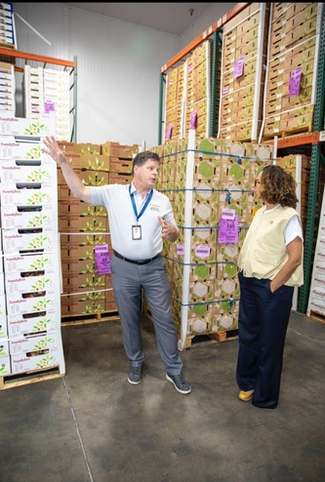
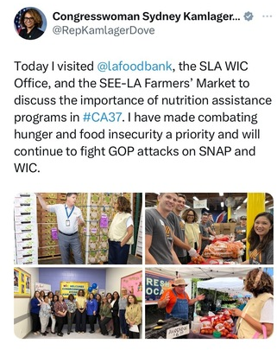
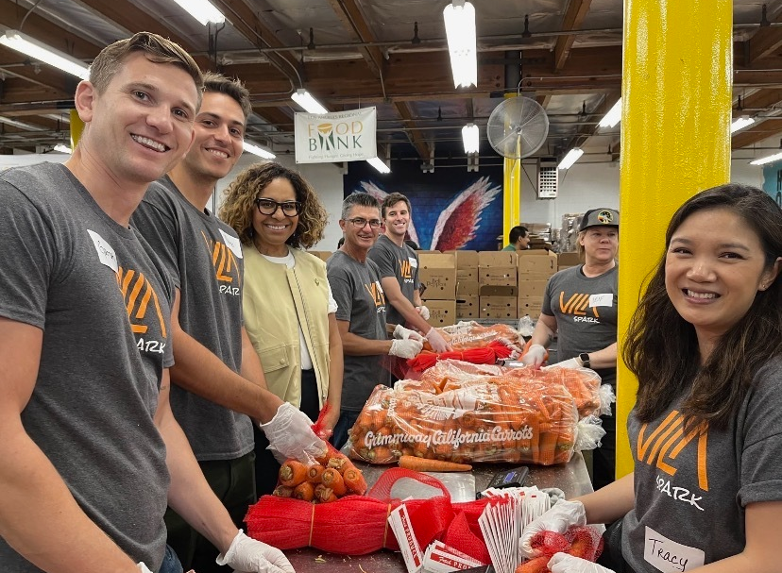
How to Host a Legislative Site Visit:

Slide 42

LA Regional Food Bank – Support/Tools for Agencies
Policy Updates through Agency Relations Communications:
  Food insecurity data
  Policy updates - state and federal legislation
  Legislative briefings and factsheets
  Policy action requests
  Sign-on Letters
State and Federal Legislation Tracker with CAFB:
  cafoodbanks.org/hunger-legislation-tracker

Slide 43
Questions?

Slide 44
Contact the LARFB Policy Team:
We are here to help you become stronger anti-hunger advocates for your communities!
If you are interested in scheduling a meeting or site visit with you legislator please contact:
Chris Carter
ccarter@lafoodbank.org
Claudia Castaneda
ccastaneda@lafoodbank.org

