Slide 1
Extra Helpings
Retail Store Donation Program
Safety Food Handling & Procedures

Slide 2

Extra Helpings
Sonia Rodriguez – SR Retail Coordinator Ext. 158 sorodriguez@lafoodbank.org
Nahum Garcia – Retail Coordinator Ext. 214 ngarcia@lafoodbank.org
Juan Esquivel – Agency Relations Coordinator Ext. 207 jesquivel@lafoodbank.org
Mark Flagel – Volunteer Retail Coordinator

Slide 3
How Extra Helpings Works
Agencies submit an Extra Helpings agreement and/or application. Once approved the agency becomes part of the program. However, that doesn't automatically guarantee the agency a retail store.
EH agencies must be distributing food at least once a week. Most retail donors request 3 to 7 days a week donation pick-ups.
Retail stores are assigned upon availability. A store near you might already be assigned to another agency. We try to assign retail stores with a partner within an 8 mile radius.

Slide 4
Donations must be weigh by category and recorded on the Extra Helpings Donation Receipt.
Temperatures should be taken at store and then once again at your agency. (we will show demonstration)
All perishable food being transported must be covered with an insulated blanket. (let us know if your agency needs one)
Must submit an Extra Helpings Monthly Report by the 5th business day of each month with total pounds picked up from each store.
Reports that are late 3 months in a row will cause your agency to loose a store.

Slide 5

Best Practices
Make sure your agency representatives are meeting with drivers to ensure there are no issues between donor and agency.
Be patient and kind to the receivers, always say thank you. Keep in mind this is an extra task asked of them.
Agency should be meeting with store manager on a quarterly basis.
Any issues should be handled in a timely matter.

Slide 6
Extra Helpings Donation Receipts
Donation Receipts are carbon copy and can be picked up at both Food Bank locations. The white copy is for the retail donor. The yellow copy is for your record keeping purposes.
If the receiver absolutely refuses to take a copy you must still fill out the receipt and keep for your reference.

Slide 7

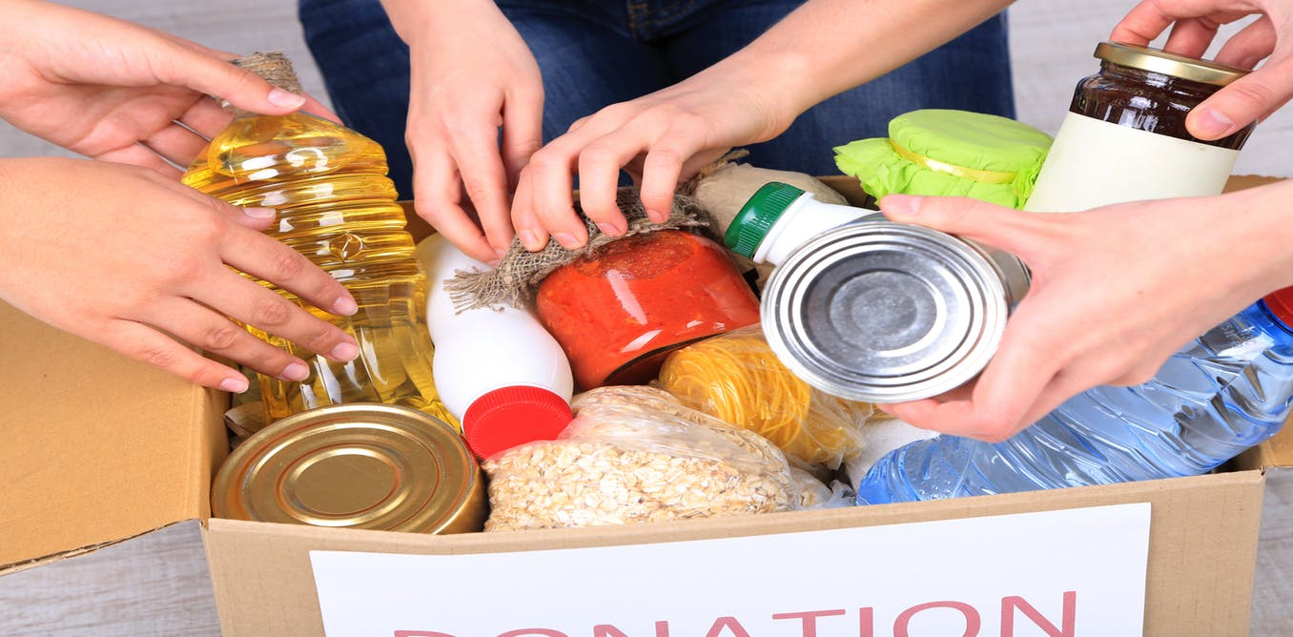
Food Sorting
When your agency picks up at the food bank, food is already sort out by our volunteers and staff. However, when picking up directly from the donor your agency needs to sort all donations by category to ensure it is still consumable.
If at any time an agency feels that the donated product is unsafe the product should be thrown out.
Please refer to the Feeding America Store Donation Agency Training Manual handout.

Slide 8
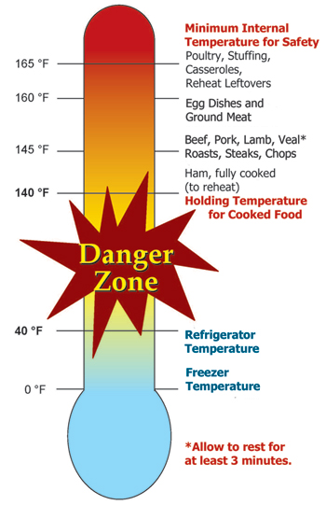
Taking Temperatures
Temperatures should be taken at store and then again at your distribution site.
0°F for Meat, Fish, and Shellfish (Raw Food, Ice cream)
41°F for Dairy Products, Prepared Salads, Fruits, Greens, and Desserts.
Room temperature for shelf stable products.
Note: On distribution days perishable items should be kept at suggested manufactured temperatures until they are distributed.

Slide 9
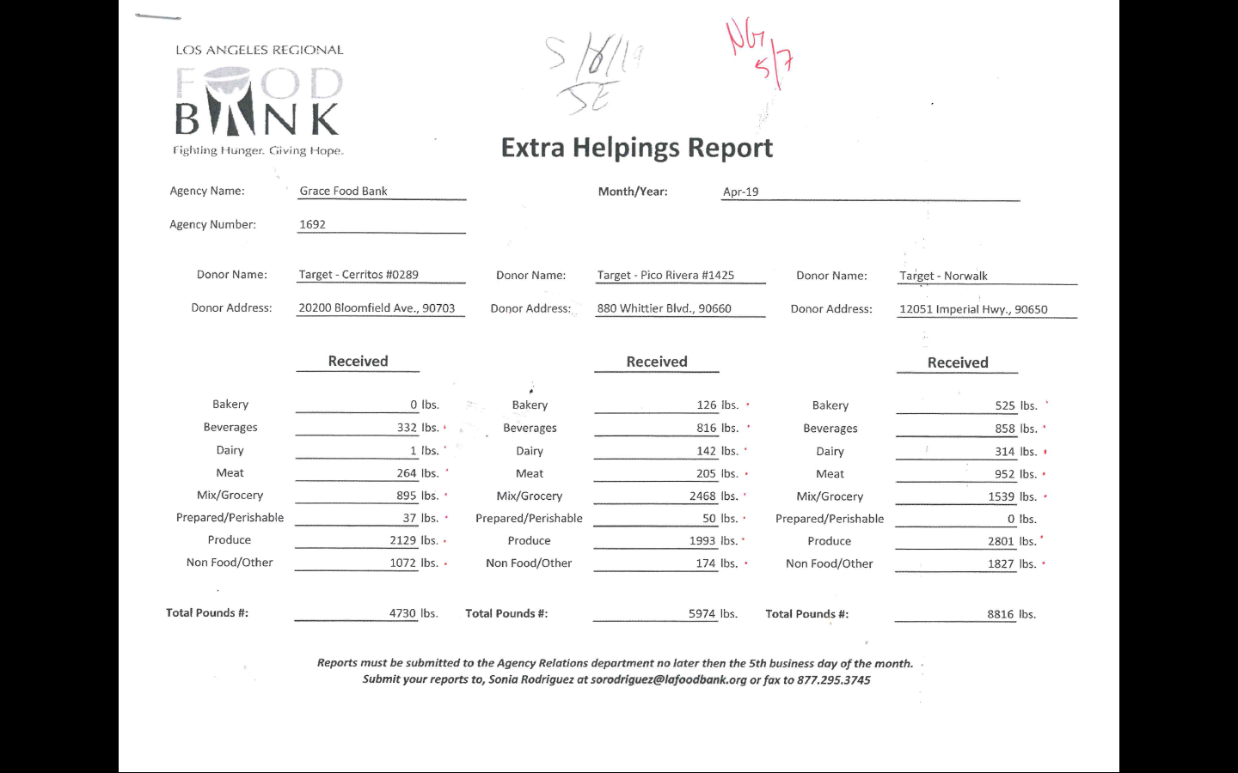
Extra Helping Monthly Report
The monthly report reflects total pounds by category by store.
This form is in PDF and Excel format.
We have a step by step guide on how to complete the report.
Due every 5th business day of the month.

Slide 10

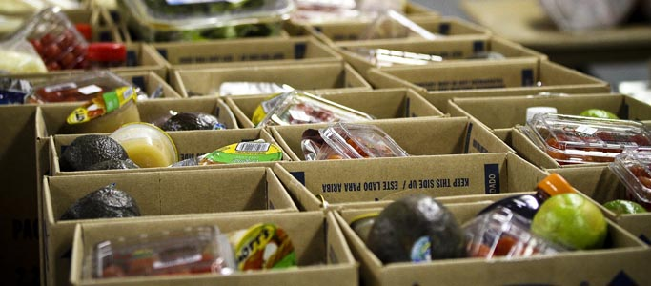
- How long before my Agency is assigned a donor?
It is based on the agency and the amount of stores in your area.
New stores and stores having to be reassigning.
- When do I get a scale, thermometer and insolated blanket?
When assigned your first store.
- What kind of Donations should I Expect?
Donations by store vary and are based on each donor’s guidelines and store size.
- What if I can’t pick up this week?
Please inform the store if you can’t make it on your assigned day. They may be able accommodate a pick up of the donation to another day.
- What if I can’t pick up anymore?
If you can’t pick up anymore inform the Food Bank, we will schedule another agency to pickup.
Not informing the Food Bank will affect your eligibility moving forward.

Slide 11
Additional Questions, Comments & Suggestions

