Slide 1
Extra Helpings Program
(Retail Store Donation Program)

Slide 2
Topics to be Covered
What is Extra Helpings?
What are the benefits of Extra Helpings?
Retail Store Donor Perspective
Procedures
Reporting (Challenges & Opportunities)
New Retail Donors
Questions and Answers

Slide 3
What is Extra Helpings?
The Extra Helpings program is the Los Angeles Regional Food Bank’s prepared and perishable Food Rescue Program. This program routes food from grocery stores, caterers, bakeries, and other food service establishments directly to agencies that feed the needy in Los Angeles County.
In 2015, the Food Bank reported 10.3 million pounds of food through EH. In 2016, the Food Bank reported 12.2 million pounds of food through EH. It is a 18.5% increase. In 2017, our goal is 16 million pounds.
There are 214 agencies participating in EH. Of the 214 agencies, 47 of the agencies are EH only agencies. There over 350 unduplicated grocery stores in the program.

Slide 4
Benefits of Extra Helpings
Agencies receive additional food at no cost.
Agencies receives food from local sources. Less time driving, less cost spent on gas and maintenance. Reduced carbon footprint.
Agencies can distribute perishable items right away; possibly same day.
Agencies can respond to donor requests in timely manner.
Stores donate to local organization for goodwill in the community. (Great idea to have an elevator speech ready at all times.)speech and offer the store personnel a visit to your site.)

Slide 5
Retail Store Donor Perspective

Slide 6
EH Pick Up Procedures
The agency driver should have agency identification with them at all pick- ups i.e. LARFB agency card are issued to each agency.
The agency driver is a representative of the Food Bank through the Extra Helpings program and should conduct himself accordingly in all aspects: verbal, appearance, and in conduct at all times. Anything else is unacceptable.
The driver needs to understand that the receiver is in charge of the loading dock. If they need anything they need to ask the receiver for help instead of taking it upon themselves i.e. using any equipment, restroom, or telephone.
If the receiver is unavailable they should ask for the assistant store manager or the store manager.
When the driver arrives, he/she must check in with the receiver. The receiver needs to check which dock can be used, if any. The driver may need to use a loading ramp instead.
If the receiver is not available and loading dock is closed, the driver should park in the back by the loading dock and enter the store through the front entrance. He should talk with the assistant store manager or store manager regarding next steps. (You should not take donations through the front of the store due to hazards and liabilities.)
Some stores/receivers will ask the driver to collect the donation from the departments. Others will ask the driver to wait at loading dock and they will collect the donations for the driver.
After the donation is collected, the receiver needs to verify and record the products being taken.
The driver needs to complete the Extra Helpings Donation Receipt and ask the receiver to initial or sign the receipt; see attached. The original (white page) is left with the receiver.
The driver will keep a copy of the donation receipt (yellow page) and needs to give the yellow copy to the agency for reporting purposes .
The donations that are perishable need to be covered with an insulated blanket while transporting the product to the agency.
If there is ever a problem during the store pick up, it is best that your driver does not confront the issue alone. We ask that your driver contact the agency and/or the Agency Relations department ASAP for assistance.

Slide 7
EH Receipts

Slide 8
Reporting
MealConnect a website created to help member food banks manage enabled agency donation volume from a single online platform dashboard, creating greater efficiencies and improving data integrity.
Opportunities: MealConnect can be accessed from any smartphone, tablet, or computer.
Challenges: Submitting on time. Once a report has been submitted we only have a 24 hour period to make any changes.
NOTE AT THIS TIME WE RECEIVE 70% OF THE EH REPORTS BEFORE THE CUT OFF DAY.

Slide 9
EH Reports

Slide 10
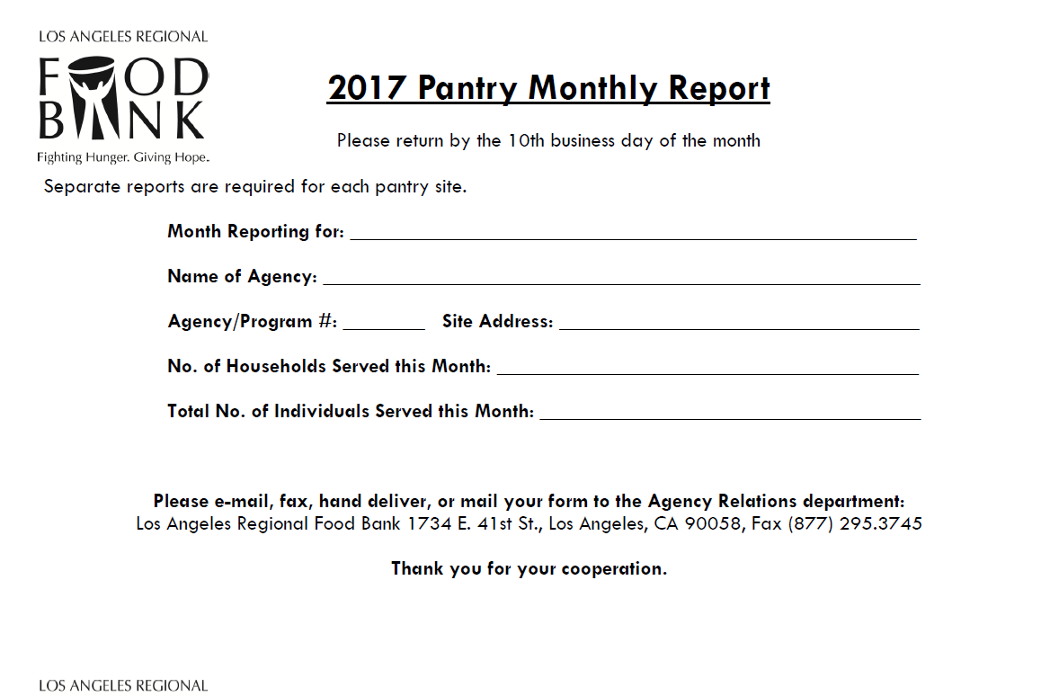
Pantry Monthly Report
(only used by non-EFAP agencies)

Slide 11
New Retail Donors
Smart & Final
Starbucks
Costco
99 Only Stores

Slide 12
Questions, Answers,
Comments & Suggestions

